Slide 1
Module 4 Unsupervised Learning
Raghu Prasad K S
9845547471

Slide 2
Self Organizing Feature Map
A Self-Organizing Feature Map (SOFM), also known as a Self-Organizing Map (SOM) or Kohonen Map, is a type of unsupervised artificial neural network used for dimensionality reduction and clustering.
Its primary function is to transform a high-dimensional input dataset into a low-dimensional, discretized representation—typically a two-dimensional (2D) grid—while preserving the topological structure of the data. This means that data points that are close together in the high-dimensional input space will be mapped to nearby neurons (nodes) on the 2D map

Slide 3
Self Organizing Feature Map
🗺️ How the SOM Works
The SOM consists of two layers: an input layer (representing the features of the data) and an output layer (the 2D grid of neurons, or the "feature map").⁴ Unlike standard neural networks that use backpropagation, the SOM uses competitive learning.
The training process involves three core steps, repeated over many iterations:

Slide 4
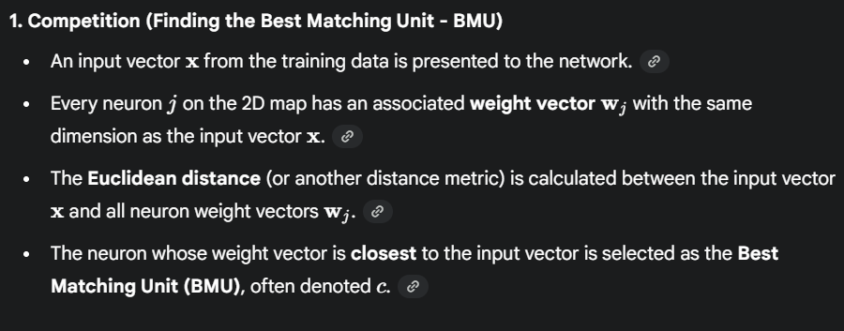
Self Organizing Feature Map

Slide 5
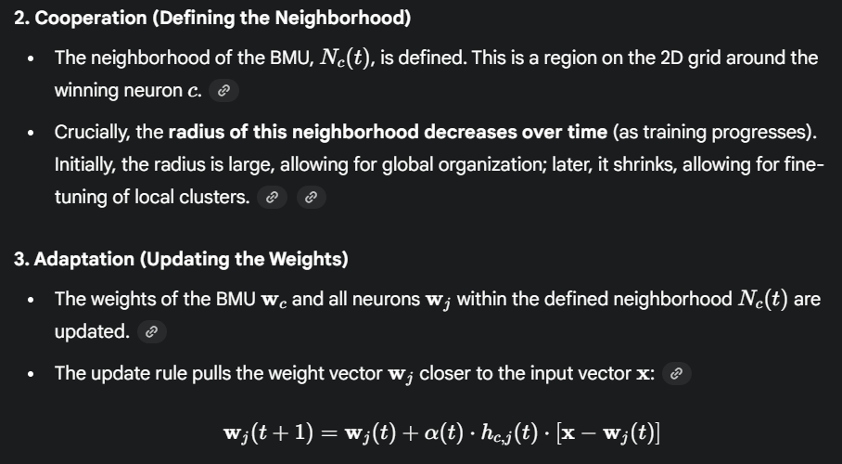
Self Organizing Feature Map

Slide 6
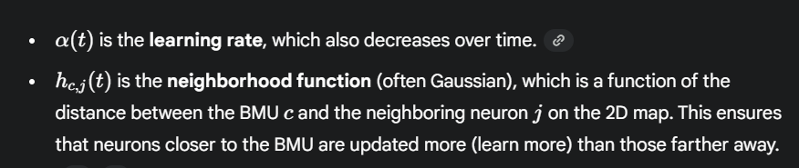
Self Organizing Feature Map

Slide 7
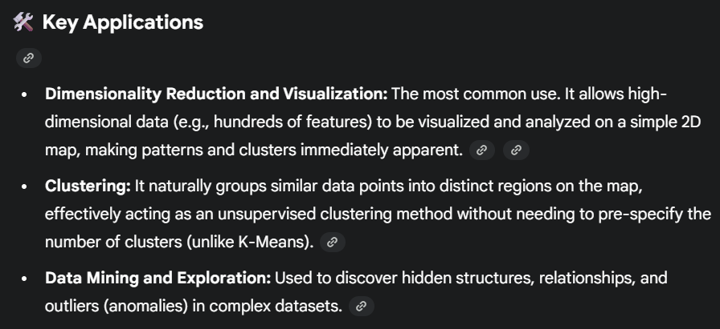
Self Organizing Feature Map

Slide 8
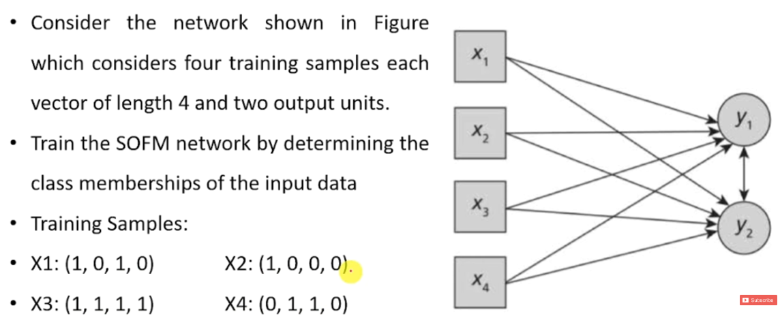
Self Organizing Feature Map-Solved Example

Slide 9
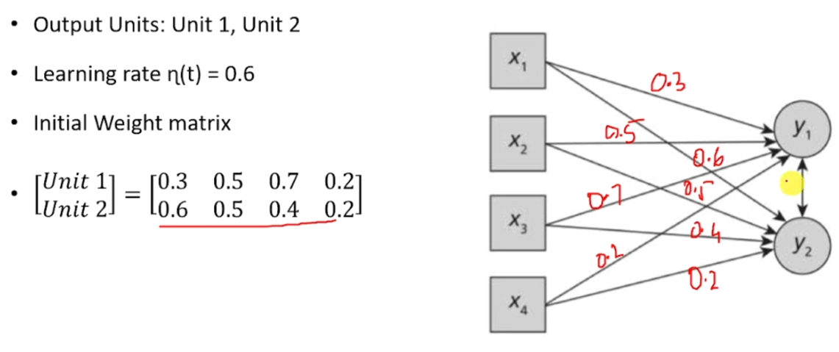
Self Organizing Feature Map-Solved Example

Slide 10
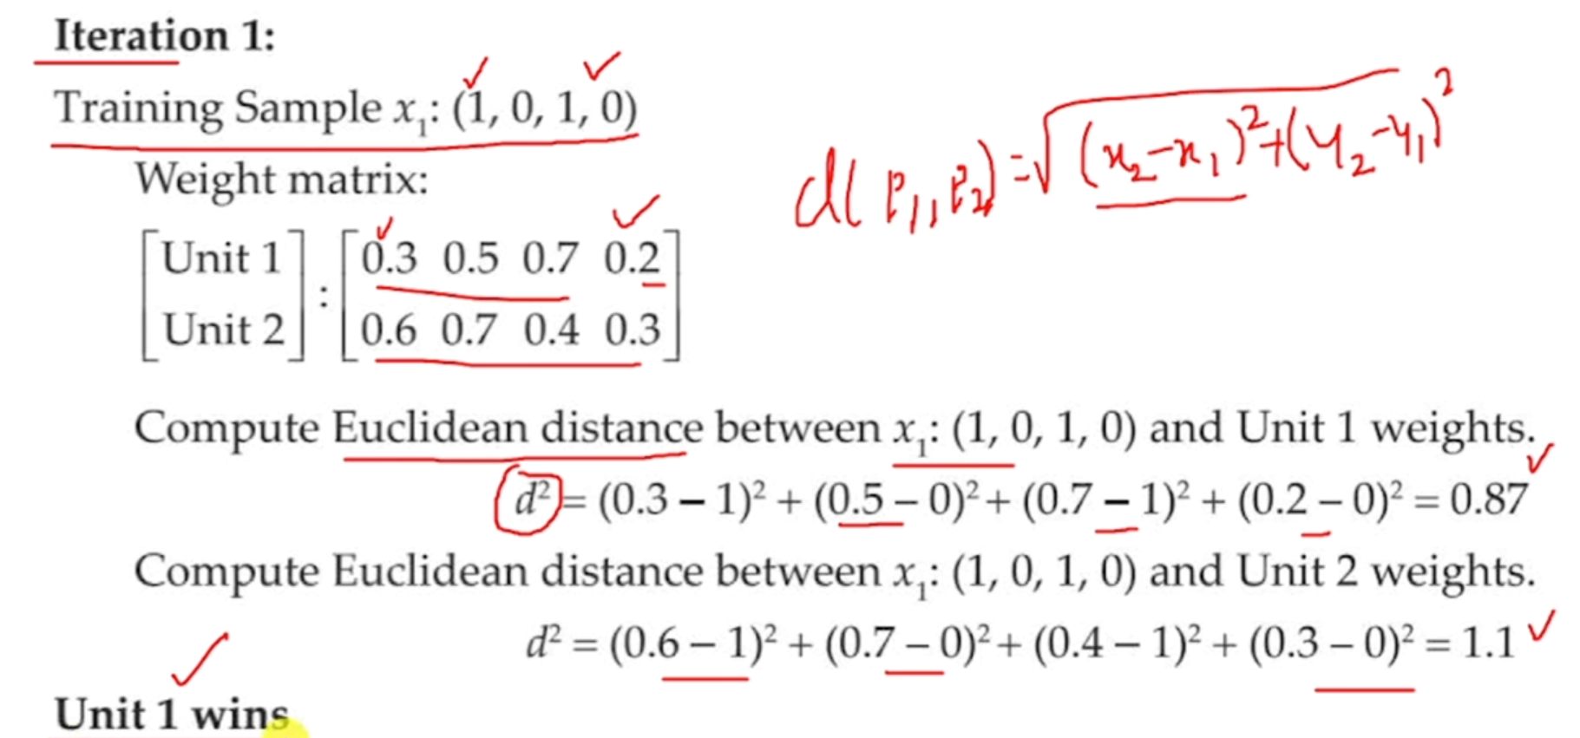
Self Organizing Feature Map-Solved Example

Slide 11
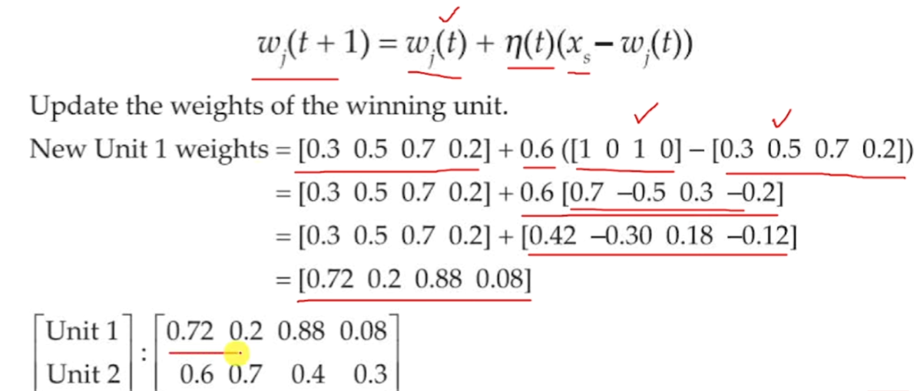
Self Organizing Feature Map-Solved Example

Slide 12
Self Organizing Feature Map-Solved Example

Slide 13
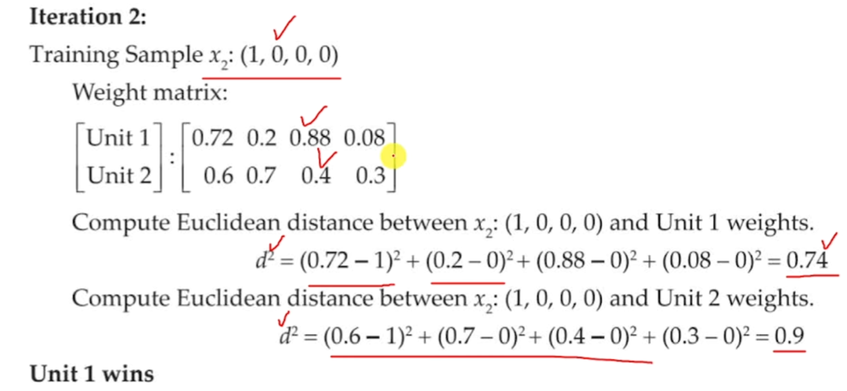
Self Organizing Feature Map-Solved Example

Slide 14
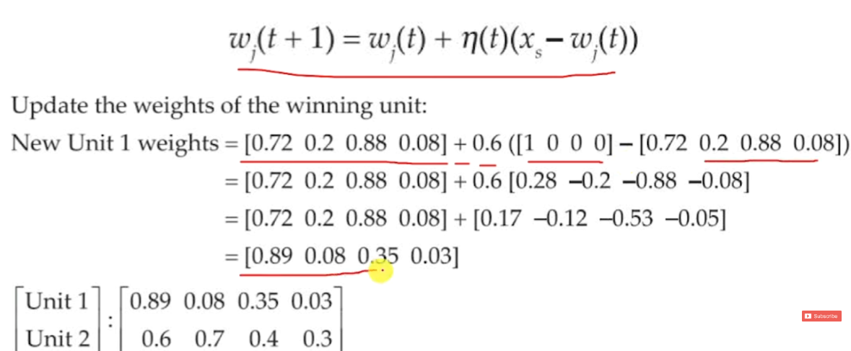
Self Organizing Feature Map-Solved Example

Slide 15
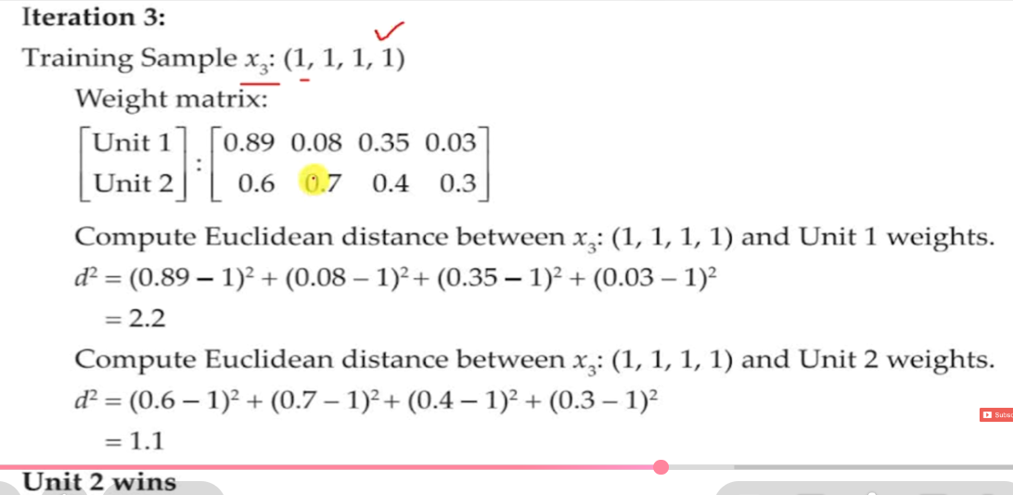
Self Organizing Feature Map-Solved Example

Slide 16
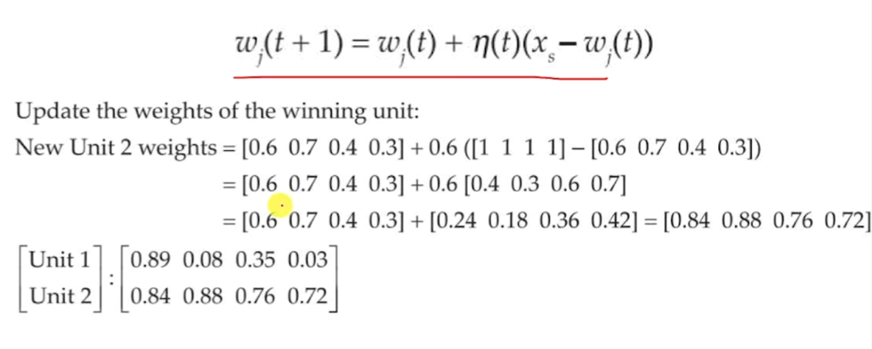
Self Organizing Feature Map-Solved Example

Slide 17
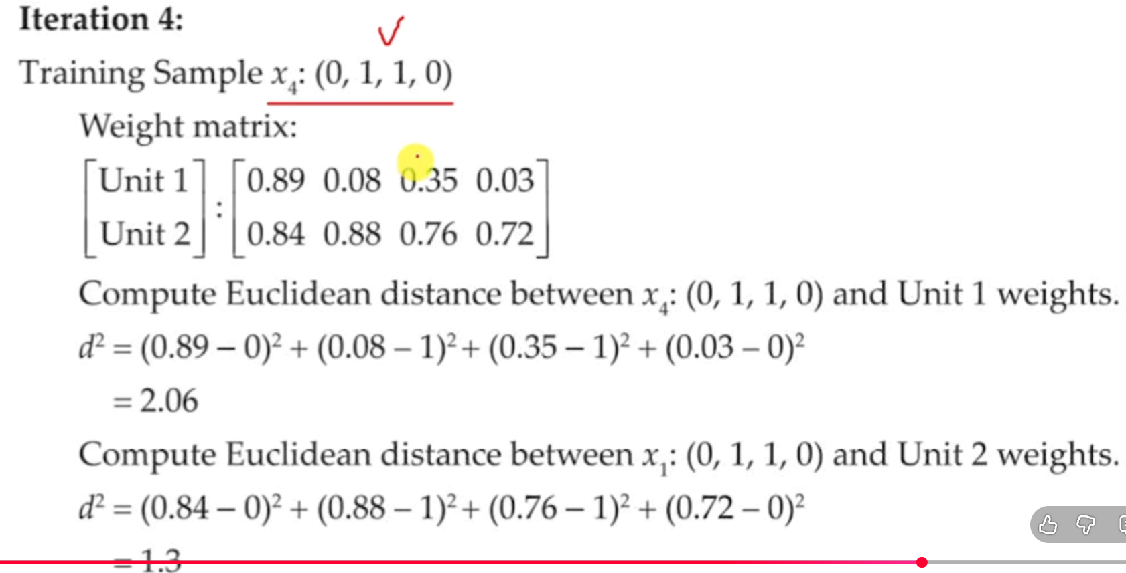
Self Organizing Feature Map-Solved Example

Slide 18
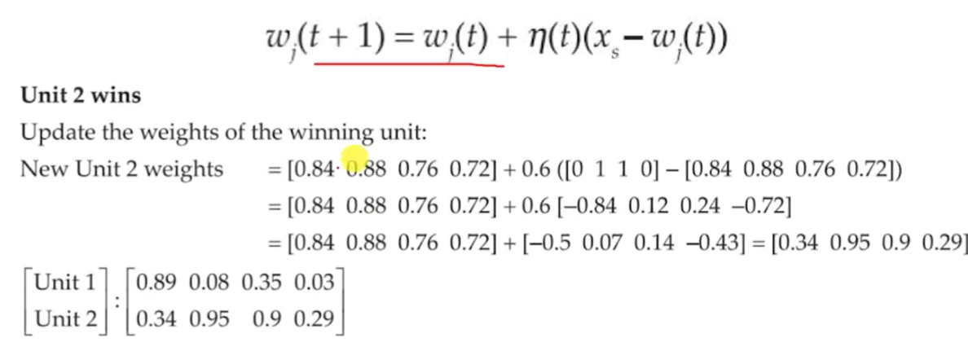
Self Organizing Feature Map-Solved Example

Slide 19
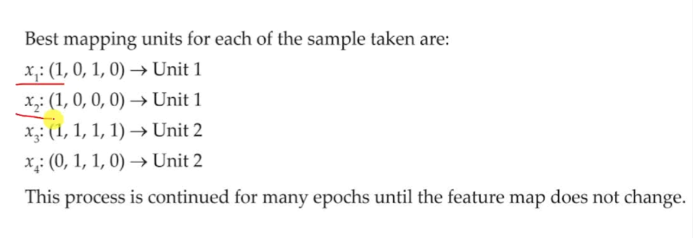
Self Organizing Feature Map-Solved Example

Slide 20
Reference
Self Organizing Feature Map Kohonen Maps Solved Example
https://youtu.be/_IRcxgG0FL4?si=_TdiKgC-NVnCESya
https://youtu.be/InVvyioWDlw?si=aTI80HPG35d2A26S

