Slide 1
Module 3 Ensemble Learning Kmeans Clustering
Raghu Prasad K S
9845547471

Slide 2
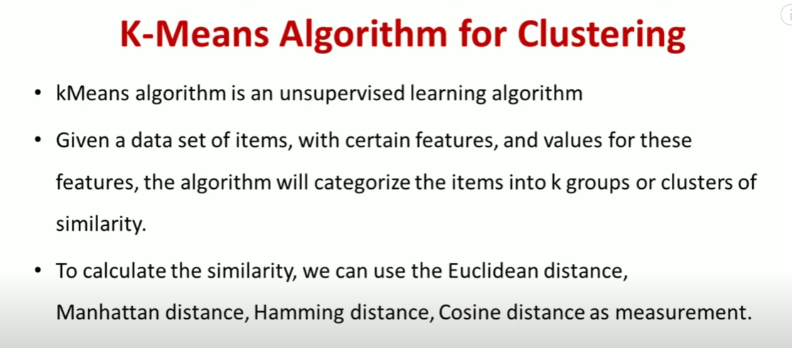
K-Means Clustering

Slide 3
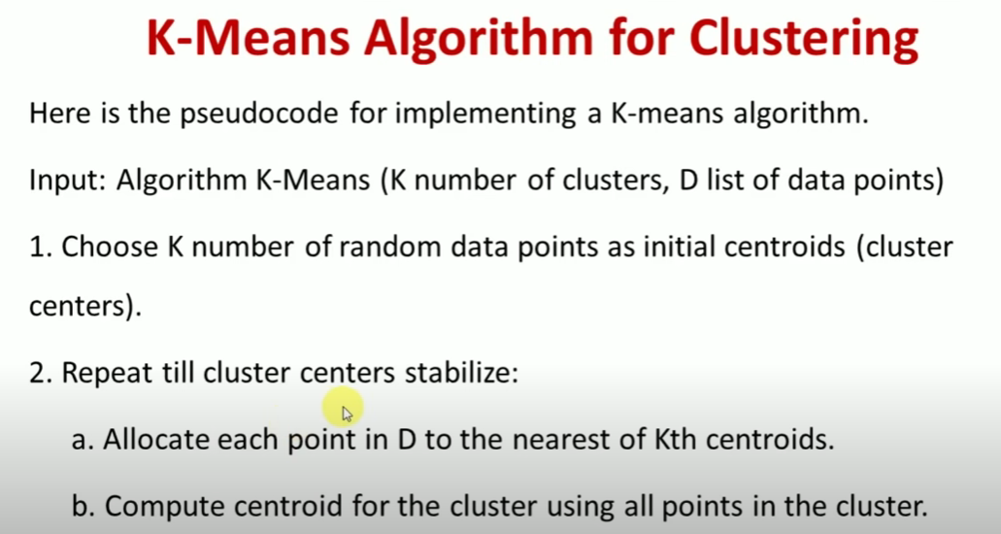
K-Means Clustering

Slide 4
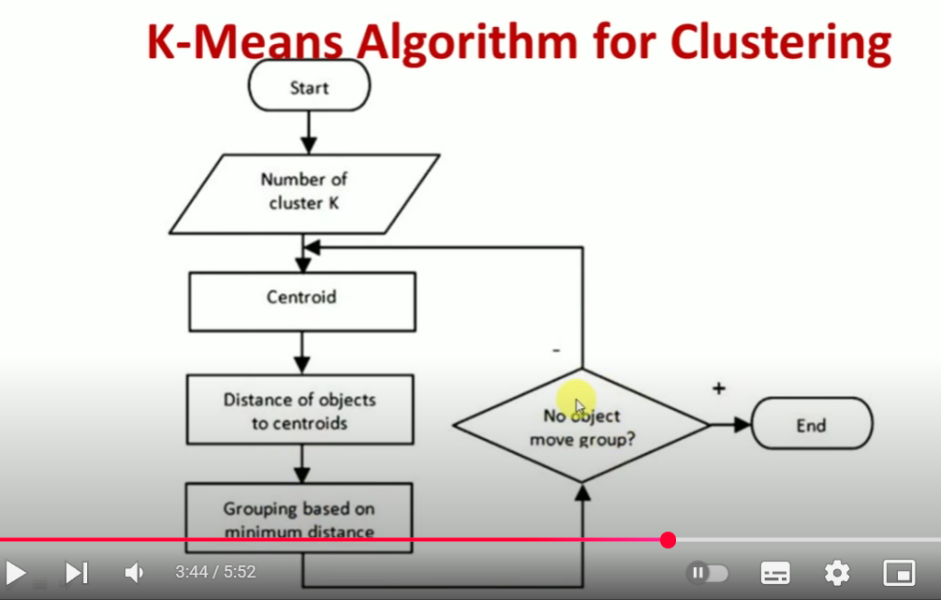
K-Means Clustering

Slide 5
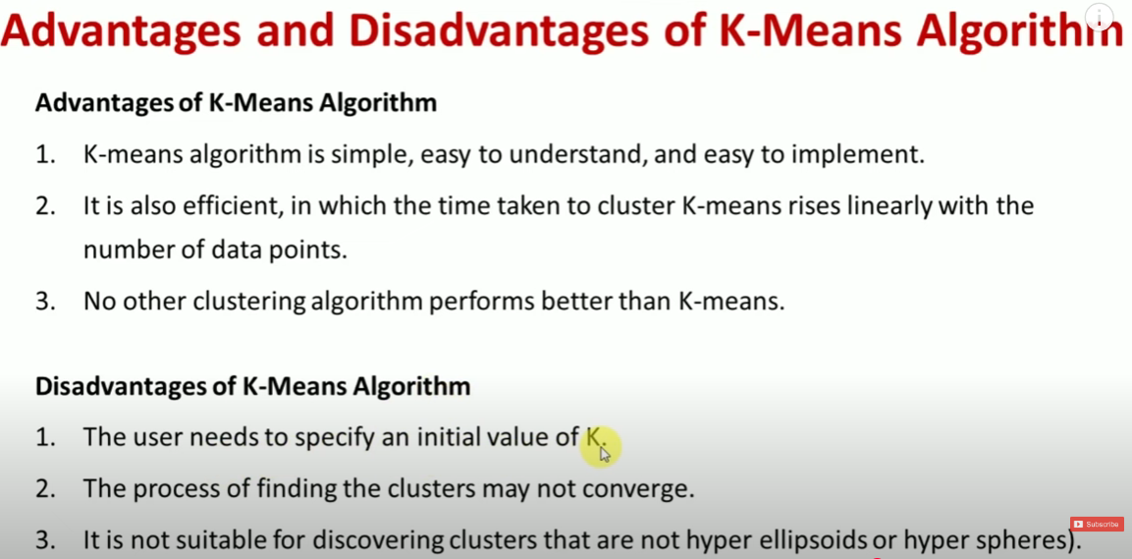
K-Means Clustering

Slide 6
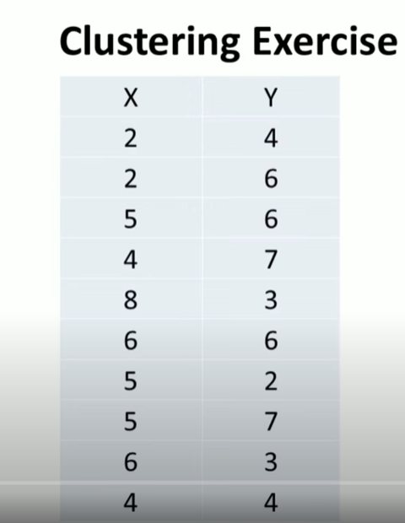
K-Means Clustering-Solved Problems

Slide 7
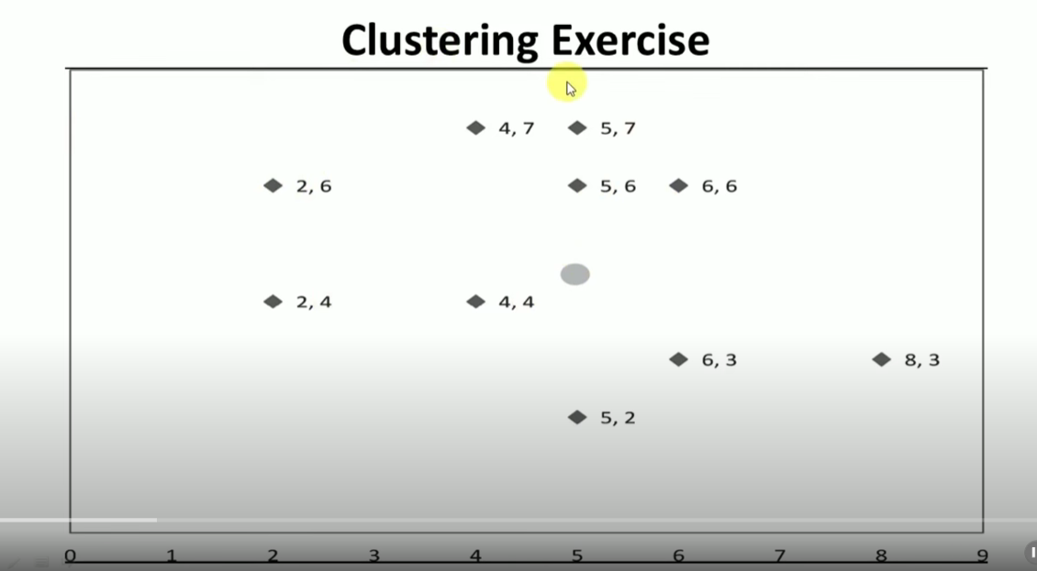
K-Means Clustering-Solved Problems

Slide 8
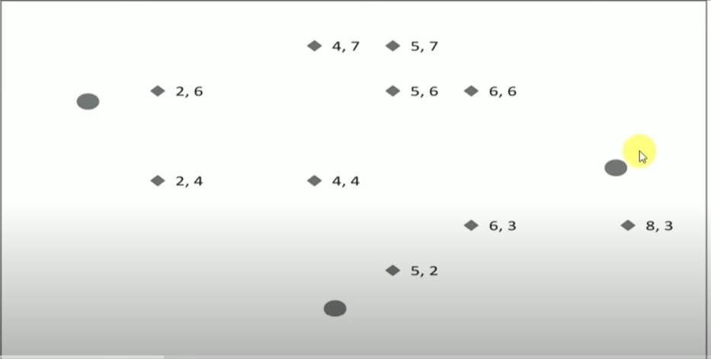
K-Means Clustering-Solved Problems

Slide 9
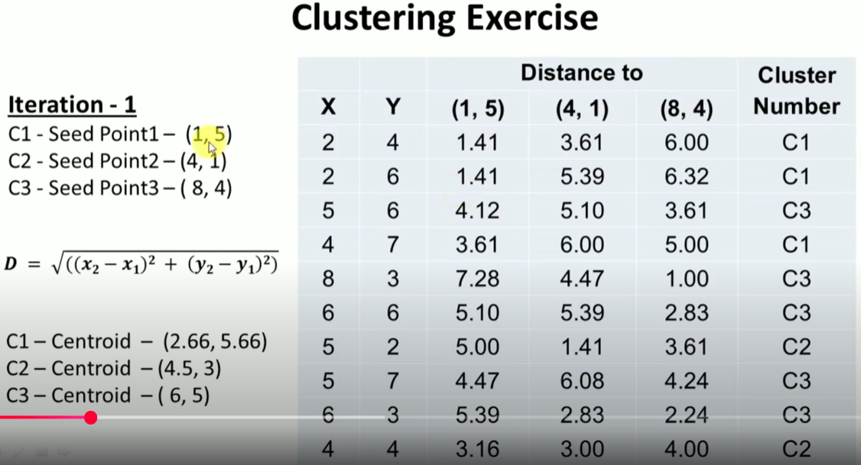
K-Means Clustering-Solved Problems

Slide 10
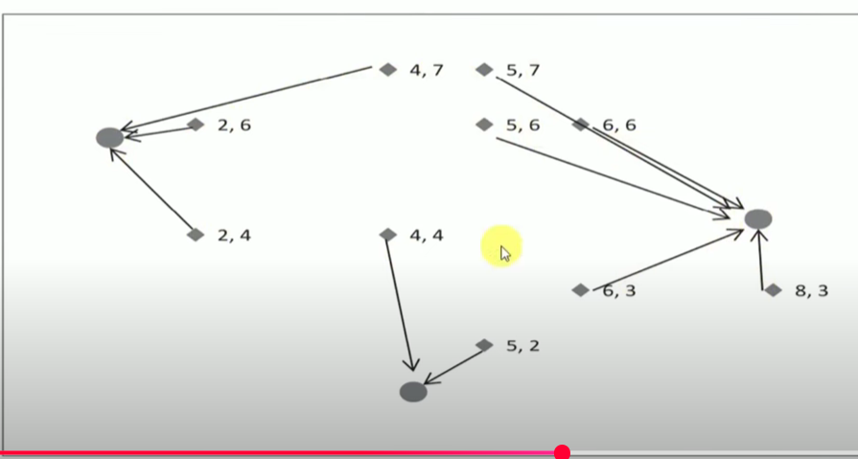
K-Means Clustering-Solved Problems

Slide 11
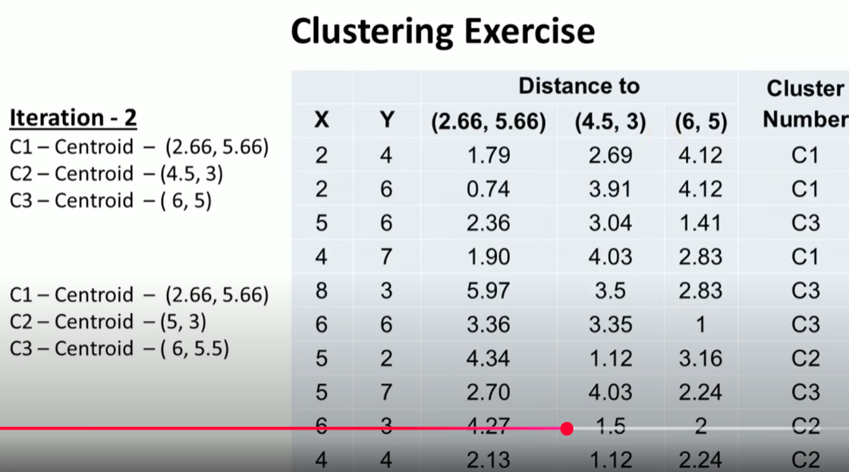
K-Means Clustering-Solved Problems

Slide 12
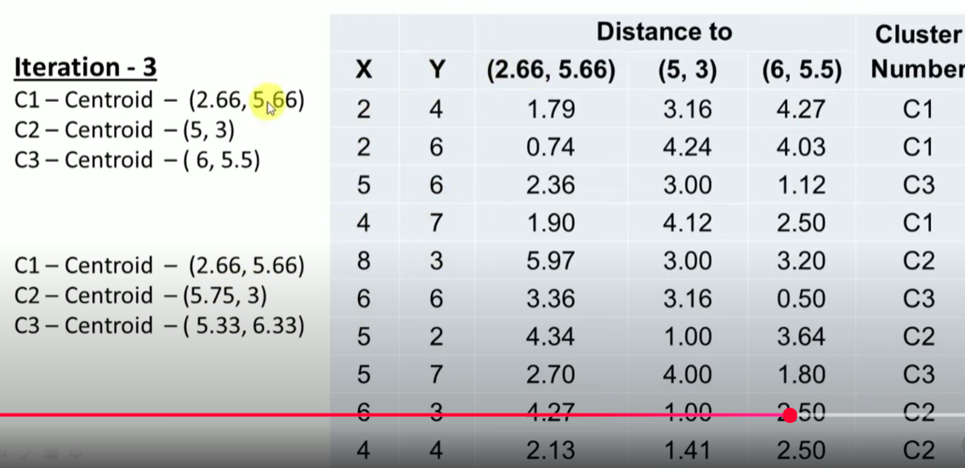
K-Means Clustering-Solved Problems

Slide 13
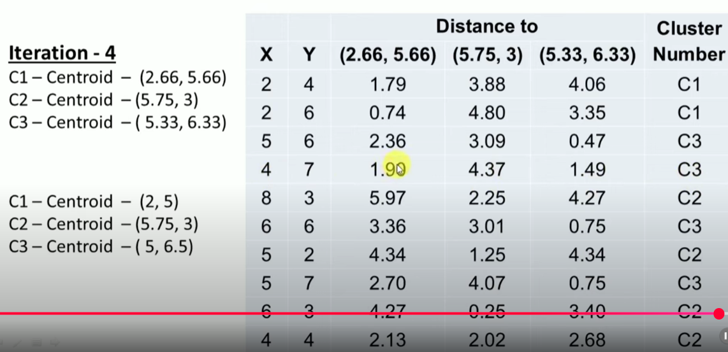
K-Means Clustering-Solved Problems

Slide 14
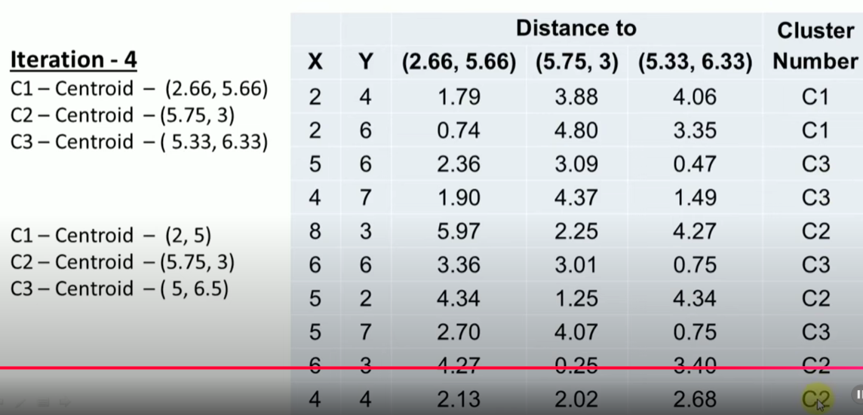
K-Means Clustering-Solved Problems

Slide 15
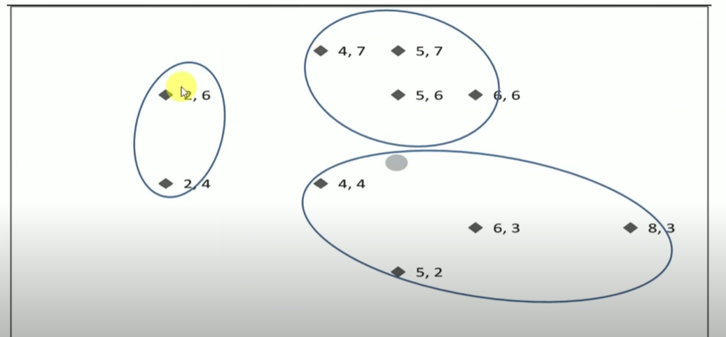
K-Means Clustering-Solved Problems

Slide 16
Reference
Introduction
https://www.youtube.com/watch?v=3tLdD-4-wnI
Solved Problem
https://www.youtube.com/watch?v=FllcPjvztTI
Programs
https://www.geeksforgeeks.org/machine-learning/k-means-clustering-introduction/

