Slide 1
Module 3 Ensemble Learning Bagging Random Forest
Raghu Prasad K S
9845547471

Slide 2
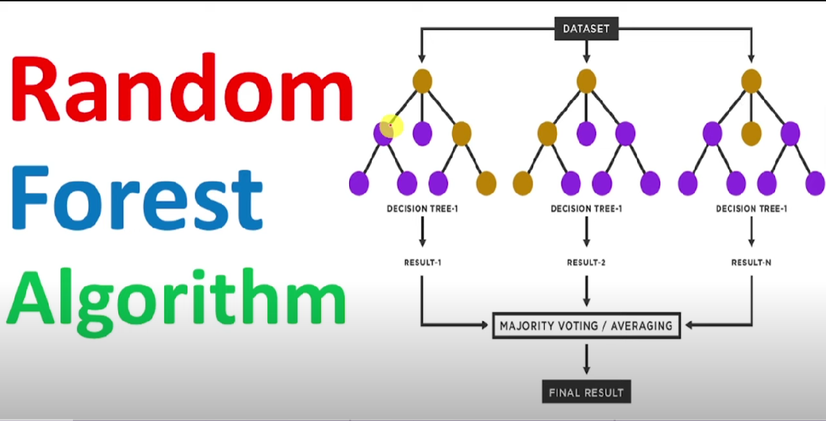
Random Forest

Slide 3
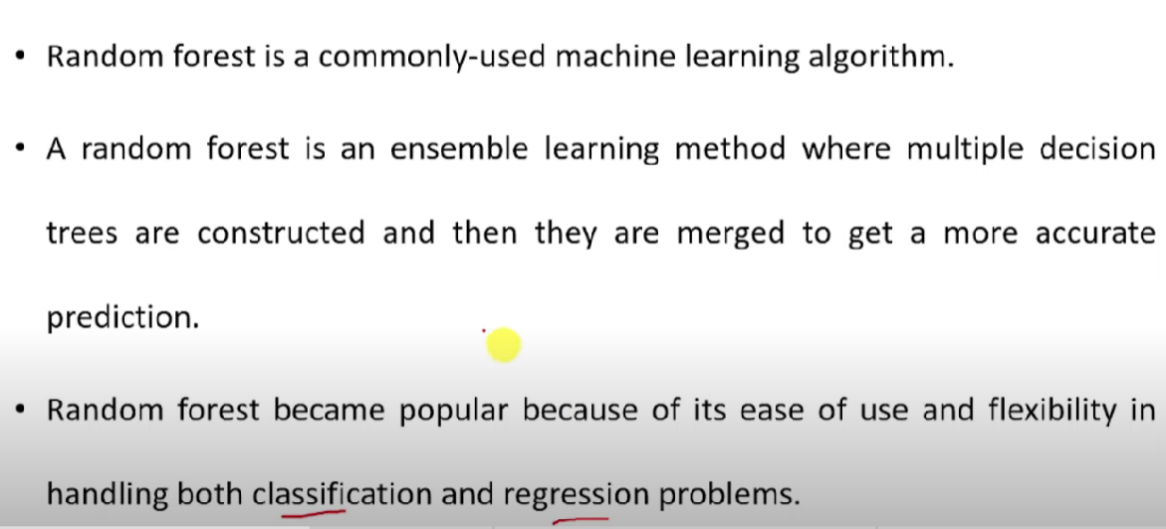
Random Forest

Slide 4
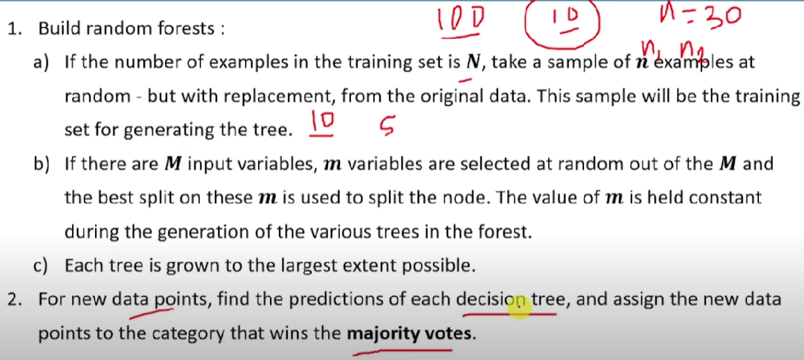
Random Forest

Slide 5
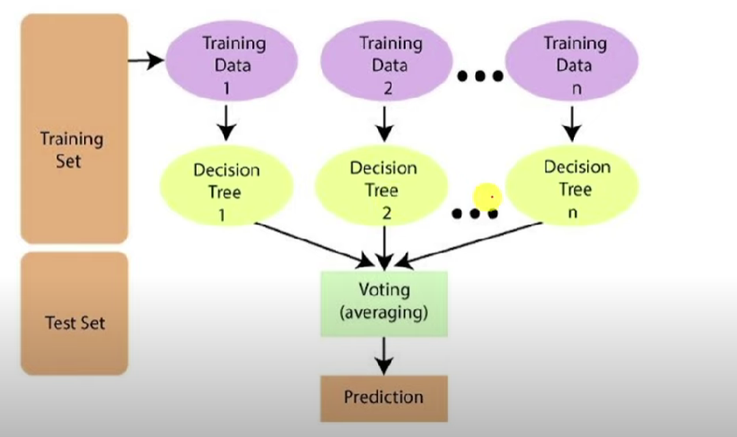
Random Forest-Algorithm steps

Slide 6
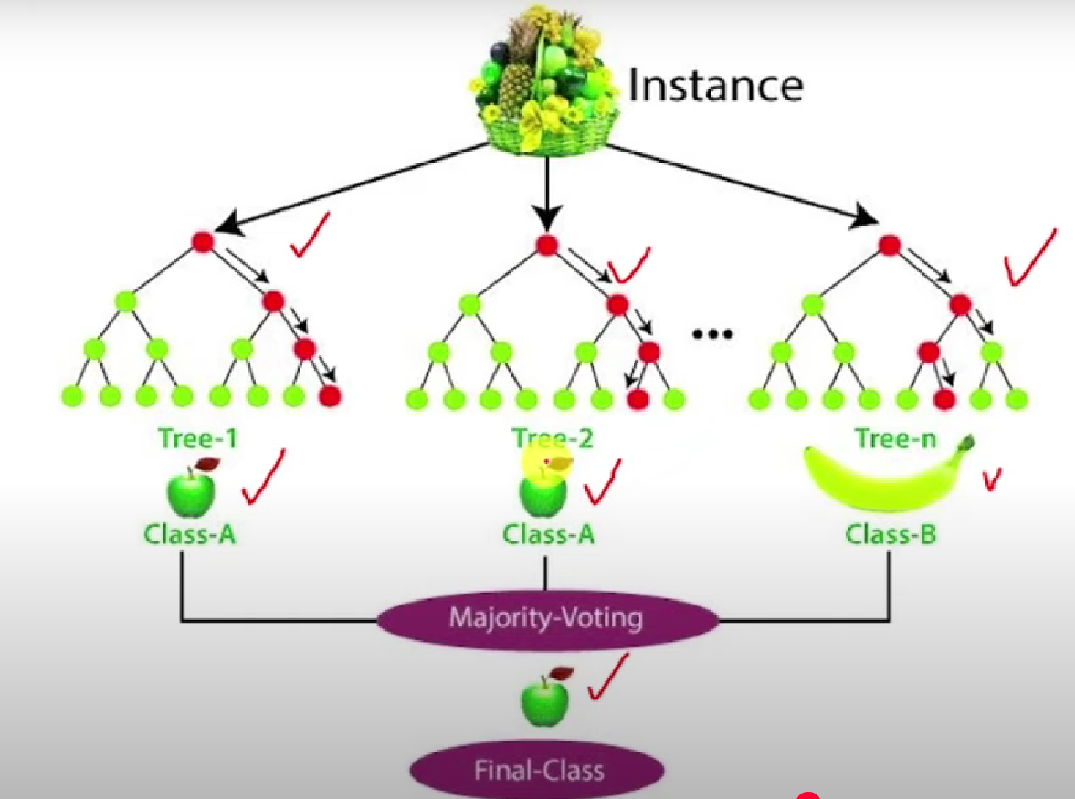
Random Forest-Algorithm steps

Slide 7
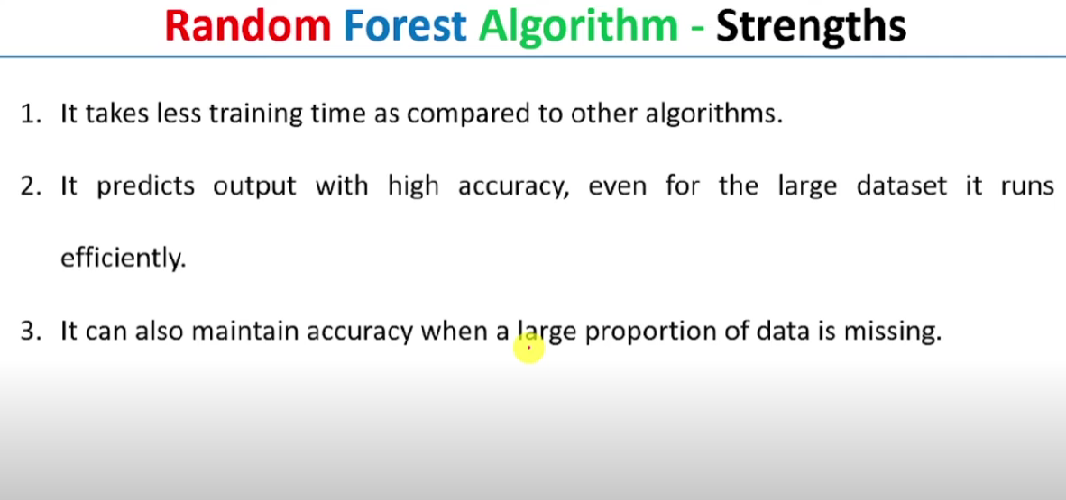
Random Forest-Algorithm steps

Slide 8
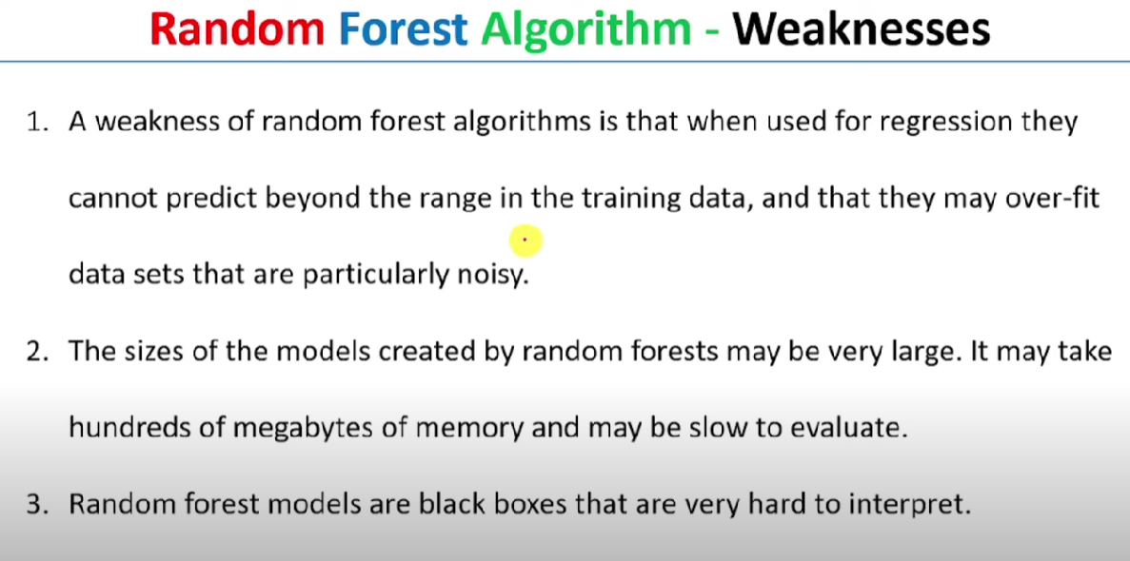
Random Forest-Algorithm steps

Slide 9
Reference
Introduction
https://www.youtube.com/watch?v=kPq328mJNE0
Programs
https://www.geeksforgeeks.org/machine-learning/random-forest-algorithm-in-machine-learning/

