Slide 1
Module 1 Concept Learning
Raghu Prasad K S
9845547471

Slide 2
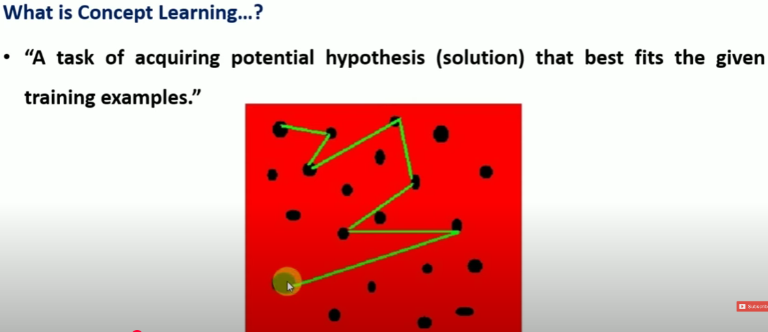
Concept Learning

Slide 3
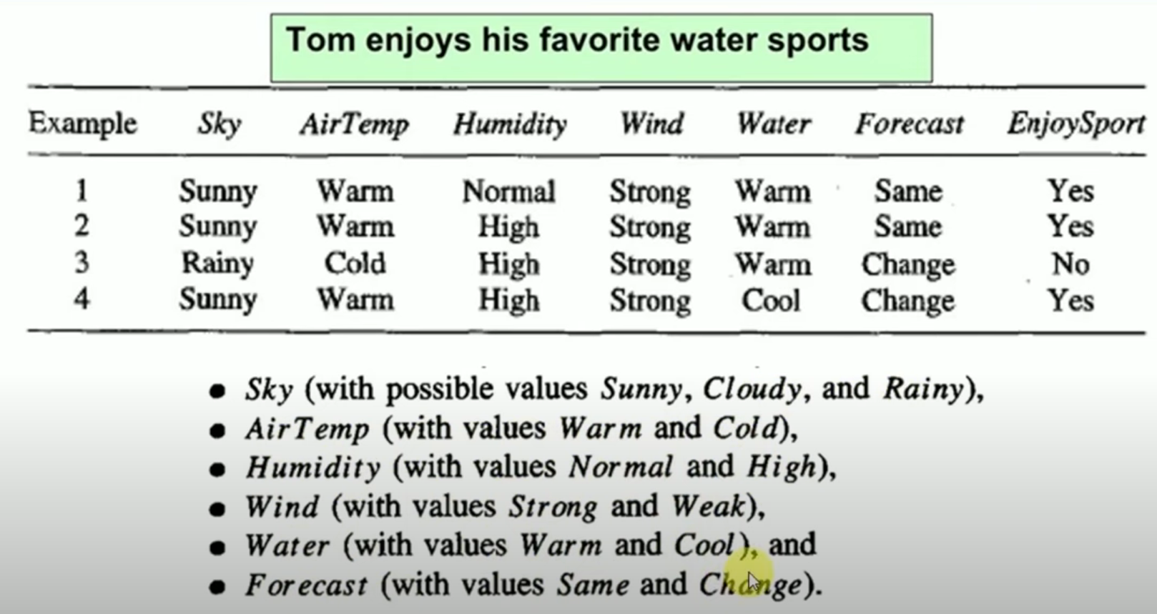
Concept Learning

Slide 4
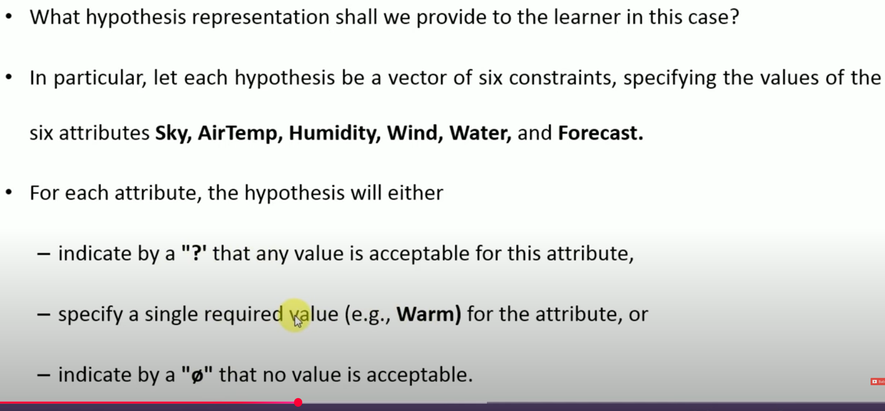
Concept Learning

Slide 5
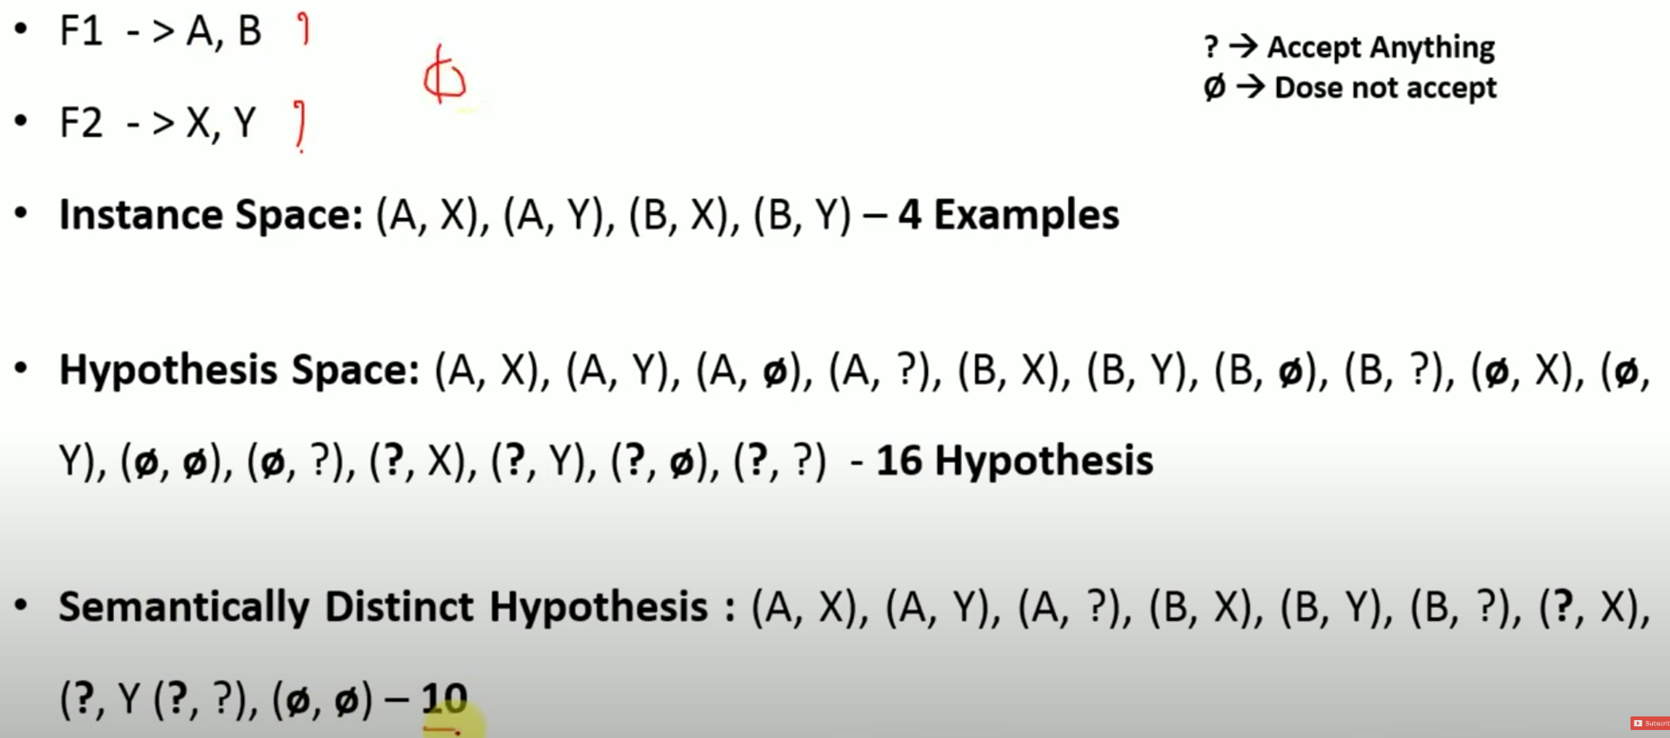
Concept Learning

Slide 6
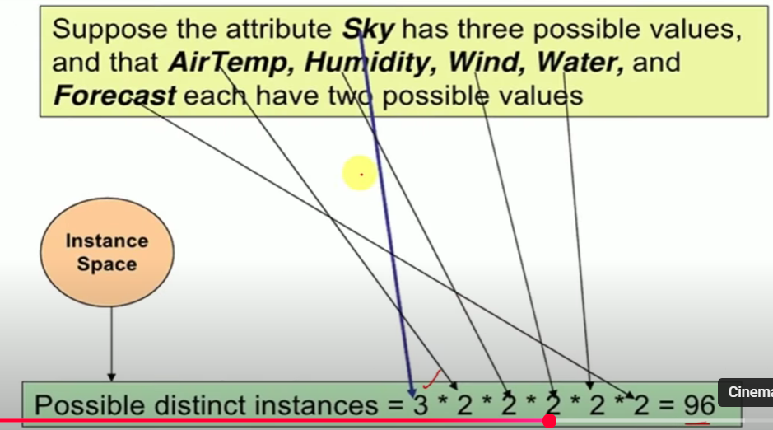
Concept Learning

Slide 7
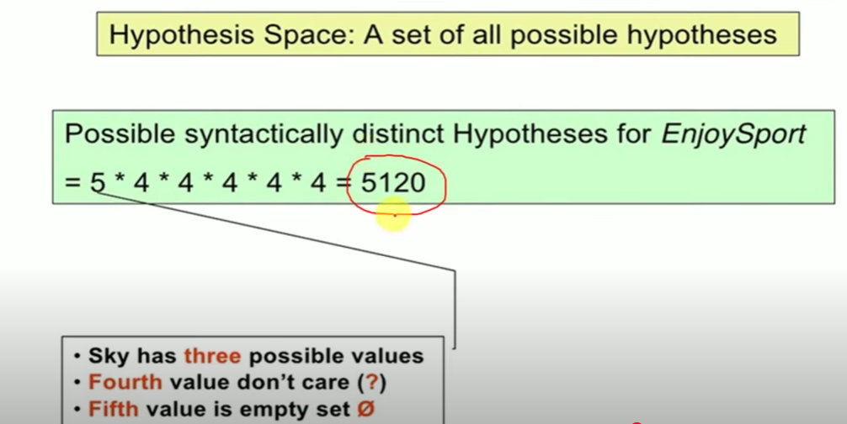
Concept Learning

Slide 8
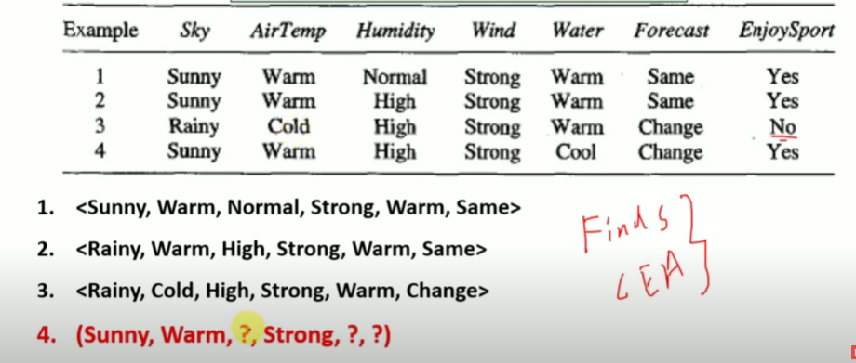
Concept Learning

Slide 9
Reference
Introduction
https://www.youtube.com/watch?v=z5AKsT3apWI

