Slide 1
MLOps
Raghu Prasad
9845547471
www.kaushalya.tech
CEO

Slide 2
Introduction
Raghu Prasad – BE, MS
Total of 29 years of experience
7 years as a lecturer in an Engineering College
22 Years into IT
Worked with companies like CISCO,CSC,ICICI,First Apex – NTT Data
Currently into Corporate training and consultancy
Worked with corporates and public sector
Service Offerings – In person/On-line/Corporate/Academic Institutes
Consultancy – Consultant to vendor of Atal Tinkering Lab/ECIL-ECIT, Incarnus – Healthcare Service Provider
Technologies – Java,Python,Web technologies,Java Script technologies (MEAN stack),IOT,Test Automation,Machine Learning,Artificial Intelligence,ERP,.NET,Cloud Computing,Devops,MLOps
Customers – ILinkDigital,Operative,Flatworld,IQVIA,Sony,Philips,L & T,NextGen,Incarnus,Aspire system,
NewHorizonCollege Of Engineering,NIE Mysore,Acharya College Of Engineering,SIT-Tumakuru,BGS-IT,Sindhi College,Malnad Enginering College,S B College of Management, REVA University,Nagarjuna Engineering College,Dayanand Sagar University,NIT-Imphal

Slide 3
Topics
Introduction to AI,ML and Deep Learning
Life Cycle of Machine Learning Project
DevOps
MLOps
MLFlow
MLFlow Demo

Slide 4
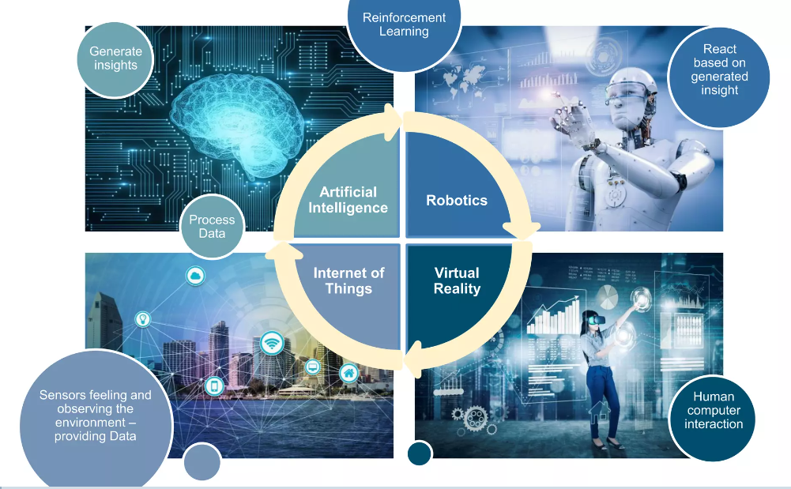

Slide 5
What is Artificial Intelligence ?
In computer science, artificial intelligence (AI), sometimes called machine intelligence, is intelligence demonstrated by machines, in contrast to the natural intelligence displayed by humans. Colloquially, the term "artificial intelligence" is often used to describe machines (or computers) that mimic "cognitive" functions that humans associate with the human mind, such as "learning" and "problem solving"

Slide 6
What is Cognitive Computing ?
Cognitive -
Relating to or involving the processes of thinking and reasoning
Cognitive computing (CC) describes technology platforms that, broadly speaking, are based on the scientific disciplines of artificial intelligence and signal processing. These platforms encompass machine learning, reasoning, natural language processing, speech recognition and vision (object recognition), human–computer interaction, dialog and narrative generation, among other technologies

Slide 7
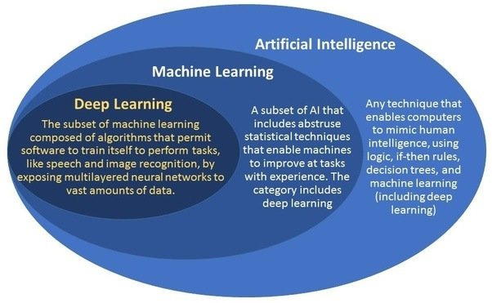
What is AI/ML/DL ?

Slide 8
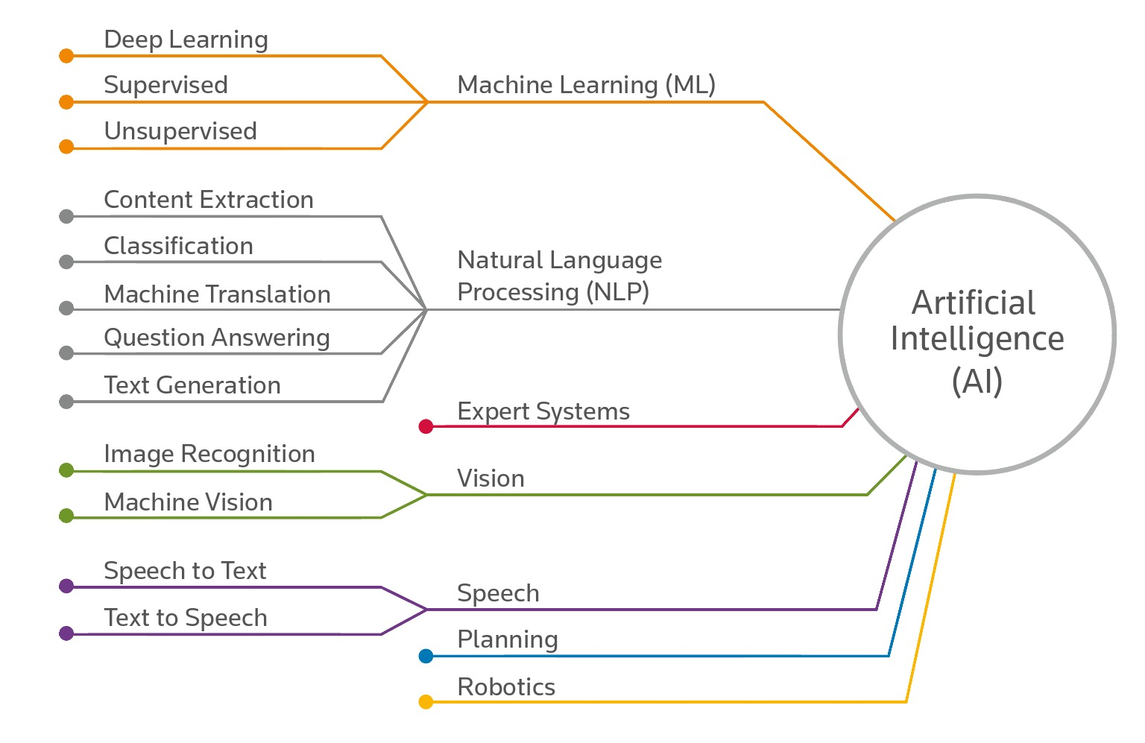
What is Artificial Intelligence ?

Slide 9
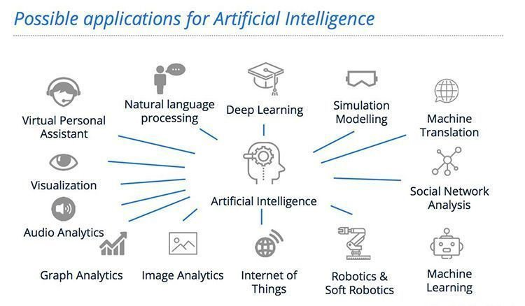
AI – History

Slide 10
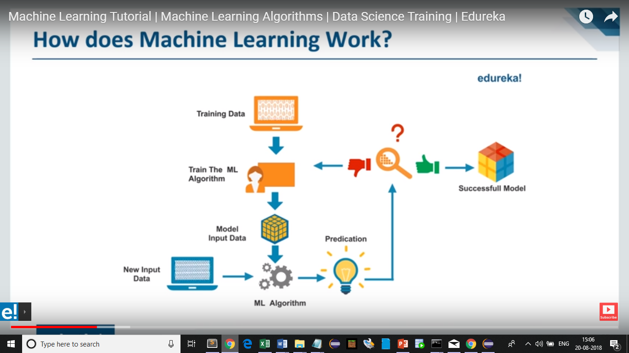
How does machine learning works ?

Slide 11
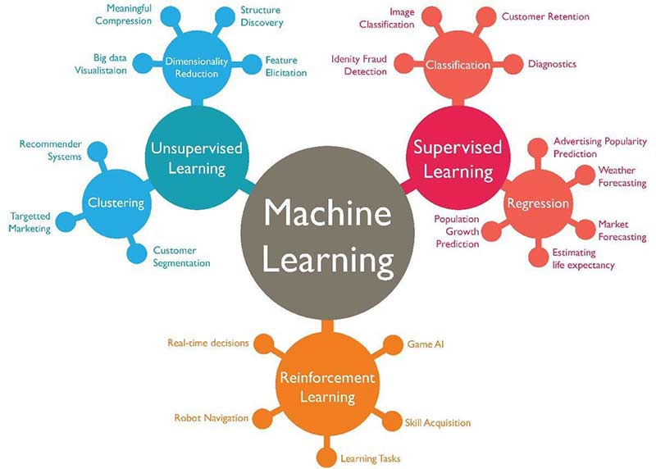
Types of machine learning

Slide 12
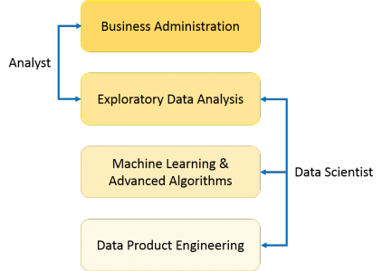
Machine Learning in Data Science
What is data science
Data Science is a blend of various tools, algorithms, and machine learning principles with the goal to discover hidden patterns from the raw data, make sense of the data, predicting the future and take business decisions.

Slide 13
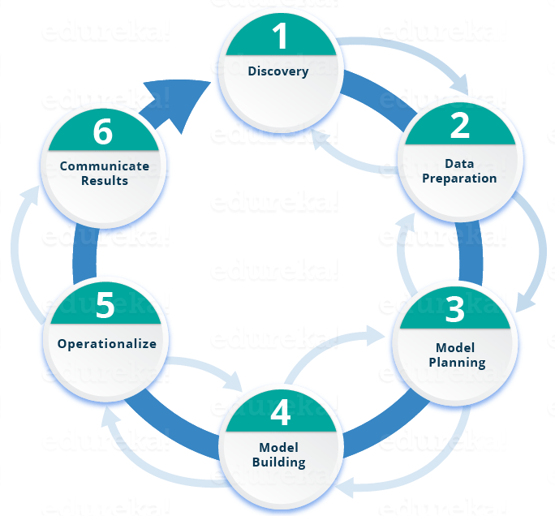
Life Cycle of ML Project

Slide 14
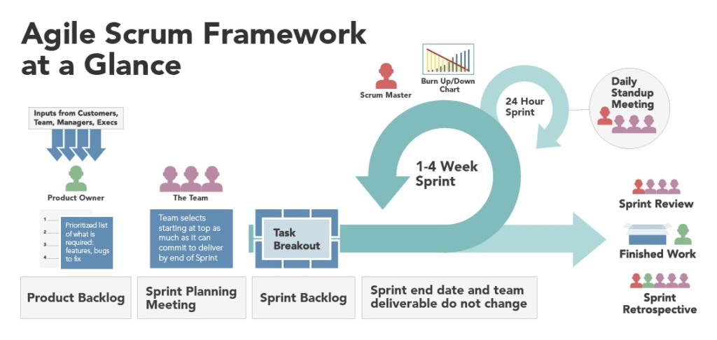
Agile Scrum Framework for development

Slide 15
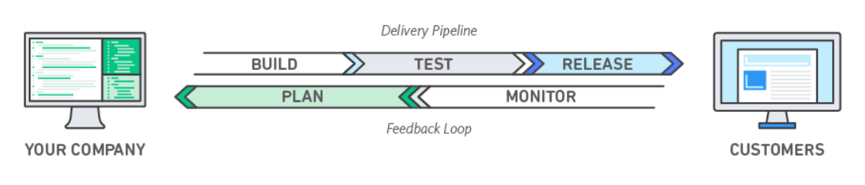
DevOps
DevOps is the combination of cultural philosophies, practices, and tools that increases an organization’s ability to deliver applications and services at high velocity: evolving and improving products at a faster pace than organizations using traditional software development and infrastructure management processes.

Slide 16
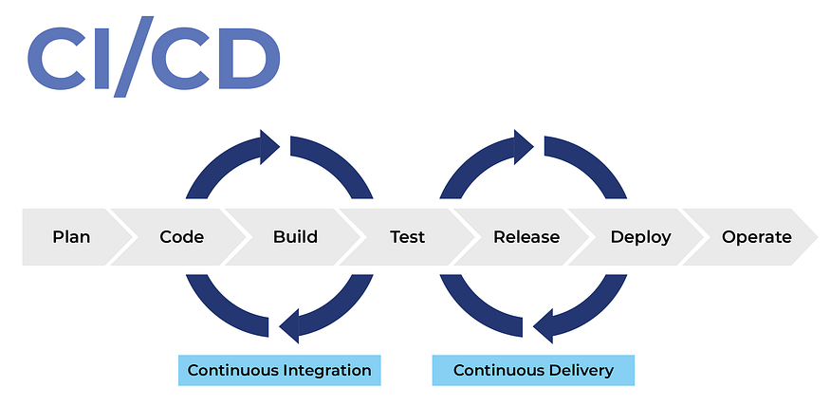
DevOps - CICD

Slide 17
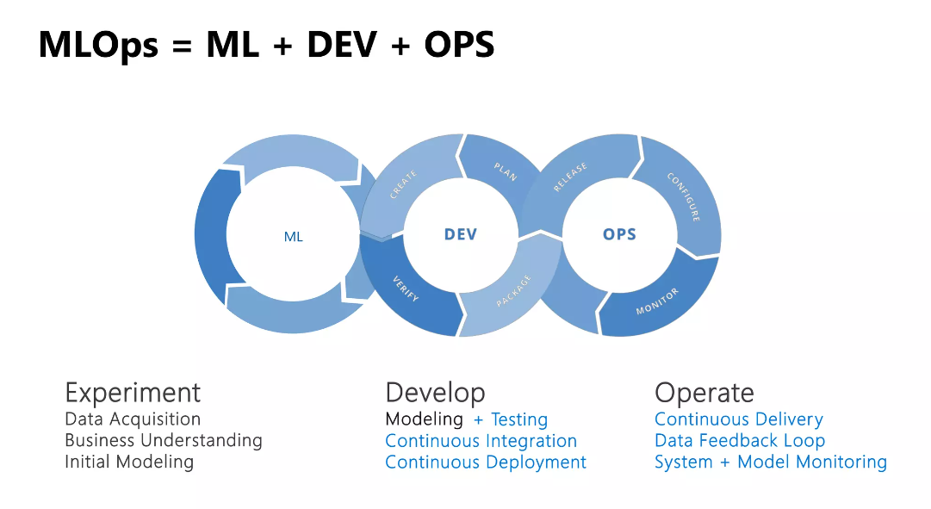
MLOps

Slide 18
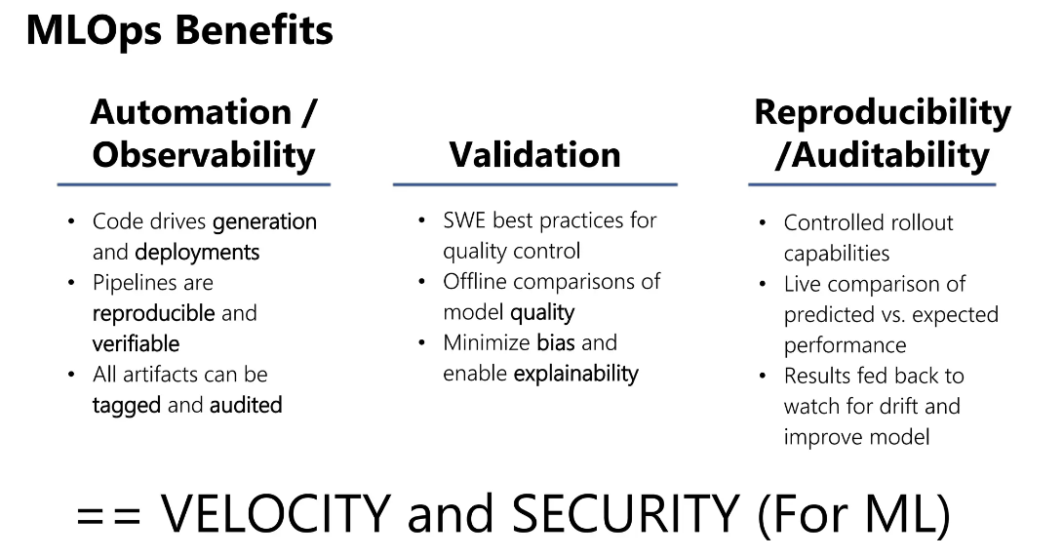
MLOps

Slide 19
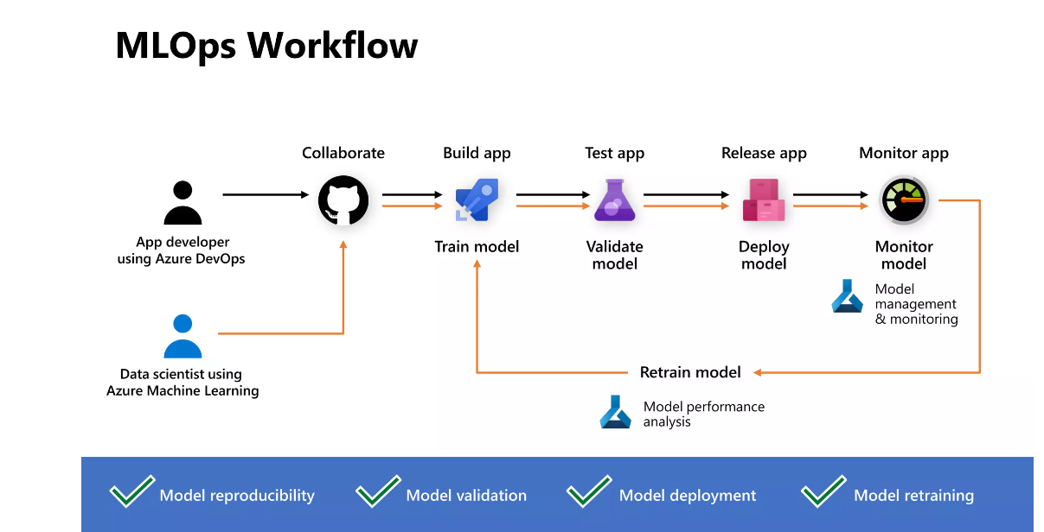
MLOps in AzureCloud

Slide 20
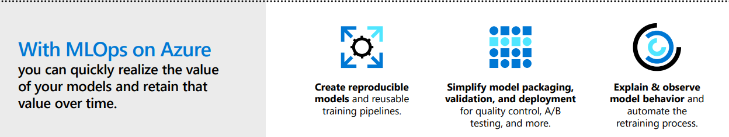
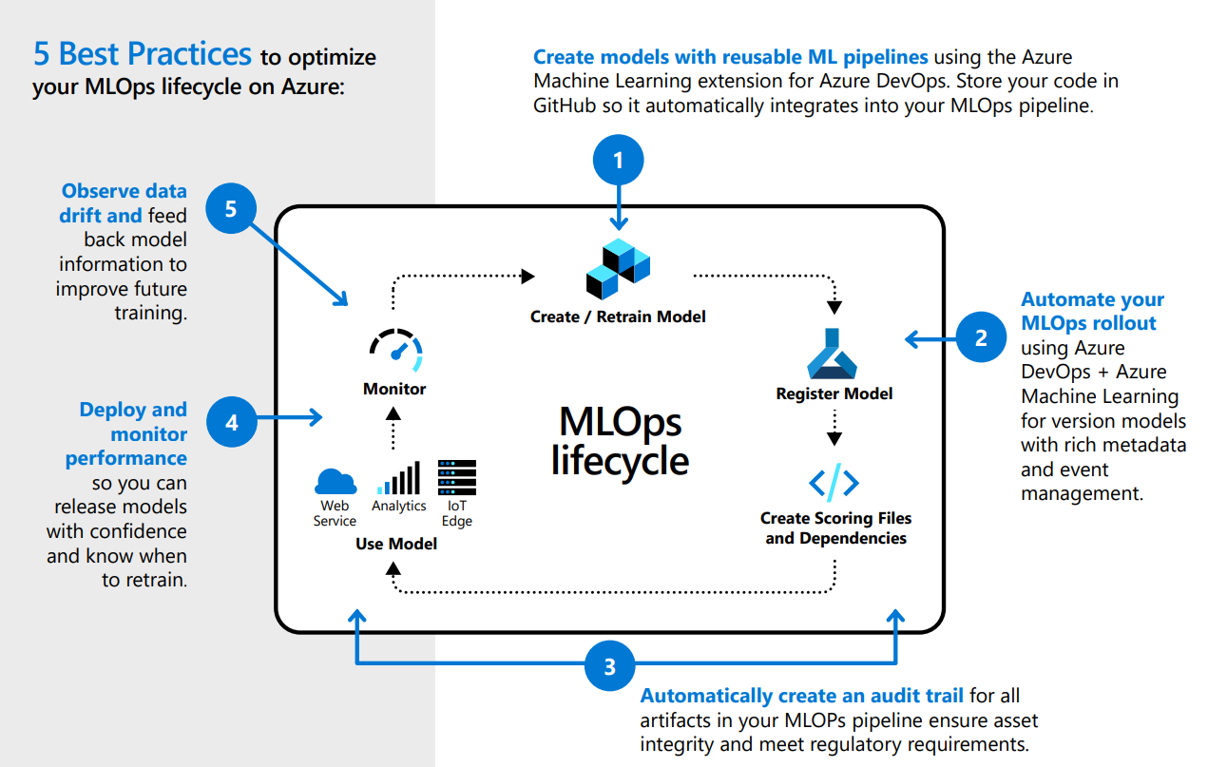
MLOps in AzureCloud

Slide 21
Learning path
Git,Github,Github Action
MLFlow
Docker,Kubernetes
Azure Cloud from Mlops perspective
Flask/React

Slide 22
MLFlow
MLflow is an open source platform to manage the ML lifecycle, including experimentation, reproducibility, deployment, and a central model registry.
MLflow currently offers several key components:
MLFlow Tracking
MLFlow Projects
MLFlow Model
MLFlow Registry

Slide 23
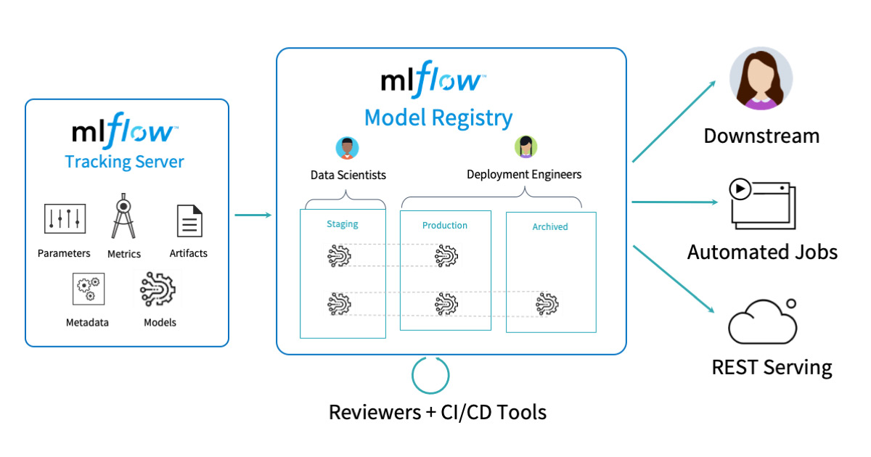
MLFlow

Slide 24
Thank You
Raghu Prasad
9845547471
www.kaushalya.tech

