Slide 1
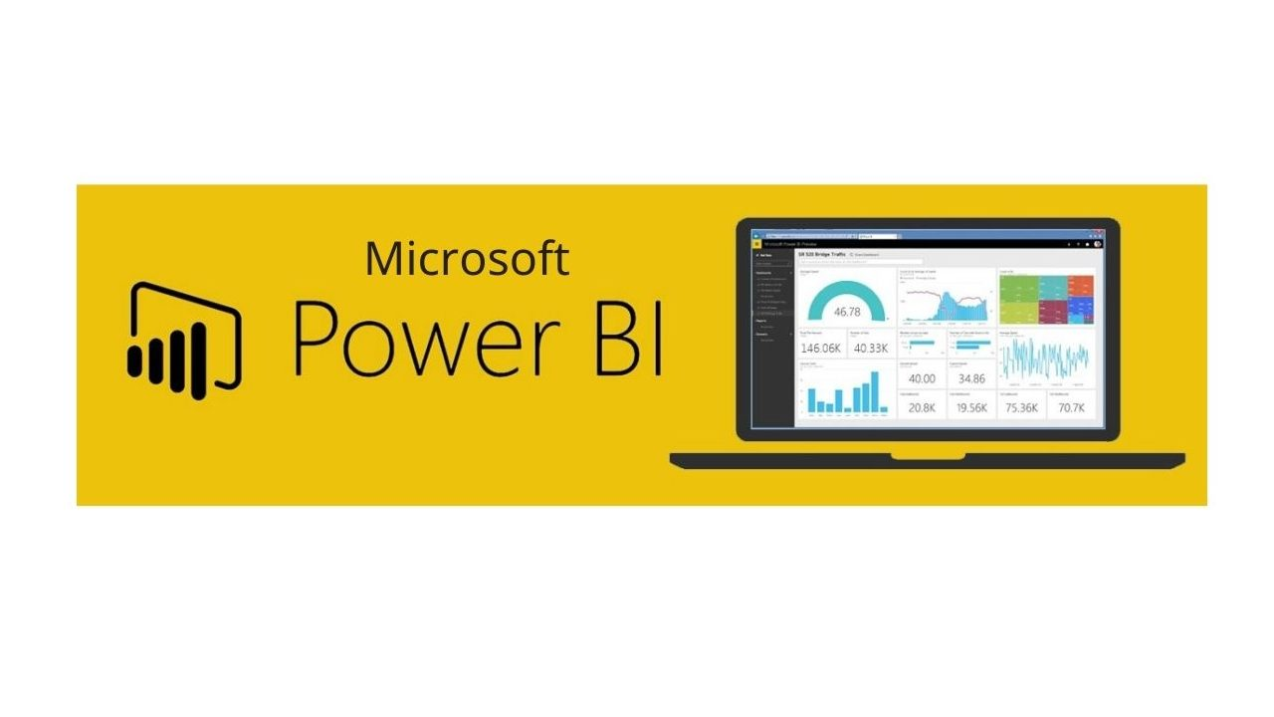
Introduction to Power BI
Raghu Prasad K S
CEO
www.Kaushalya.tech
9845547471

Slide 2
Agenda
Introduction to Power BI
Power BI Components
Data Modelling
Gartner Magic Quadrant
Build data models and visualizations
Introduction to DAX
Power BI Services
Getting Started with Power BI

Slide 3
Introduction
Raghu Prasad – BE, MS
Total of 30 years of experience
7 years as a lecturer in an Engineering College
23 Years into IT
Worked with companies like CISCO,CSC,ICICI,First Apex – NTT Data
Currently into Corporate training and consultancy
Worked with corporates and public sector
Service Offerings – In person/On-line/Corporate/Academic Institutes
Consultancy – Consultant to vendor of Atal Tinkering Lab/ECIL-ECIT, Incarnus – Healthcare Service Provider, Automation Spectrum Pty Ltd,Australia,Tech Varaha,Bengaluru
Technologies – Java,Python,Web technologies,Java Script technologies (MEAN/MERN stack),IOT,Test Automation,Machine Learning,Artificial Intelligence and block chain,Tableau,Power BI,Cloud Computing
Corporate Customers – IQVIA,ITC Infotech,Philips,L & T,NextGen,Incarnus,Aspire system,Netwoven,SkillUpRight
Academic Customers – New Horizon College of Engineering,BGS-IT,Sindhi College,Malnad Enginering College,S B College of Management, REVA University,Nagarjuna Engineering College,Dayanand Sagar University,Acharya Institute of Technology,NIE Mysore,NIT-Imphal, AMC College, Kristu Jayanti College,SIT,SVIT etc

Slide 4
What is Power BI
Power BI is a business intelligence (BI) and data visualization tool developed by Microsoft.
It enables users to connect to multiple data sources, transform data, create interactive reports, and share insights across organizations.
Power BI is widely used for data analysis, reporting, and decision-making.
Power BI is a collection of software services, apps, and connectors that work together to turn your unrelated sources of data into coherent, visually immersive, and interactive insights. Your data might be an Excel spreadsheet, or a collection of cloud-based and on-premises hybrid data warehouses. Power BI lets you easily connect to your data sources, visualize and discover what's important, and share that with anyone or everyone you want.

Slide 5
Key Components of Power BI
Key Components of Power BI
Power BI consists of several components that work together:
1. Power BI Desktop (Windows Application)
A free application for creating reports and dashboards.
Users can connect to multiple data sources, clean and transform data, and create interactive visualizations.
2. Power BI Service (Cloud-Based)
A cloud-based SaaS platform for publishing, sharing, and collaborating on reports and dashboards.
Provides features like scheduled data refresh, AI-powered insights, and security controls.
3. Power BI Mobile (iOS, Android, Windows)
A mobile application to view and interact with reports and dashboards on the go.
4. Power BI Gateway
A tool for connecting on-premises data sources (like SQL Server, Excel) to Power BI Service.
Ensures secure and automatic data refresh.
5. Power BI Embedded
A service for integrating Power BI reports and dashboards into web applications.

Slide 6
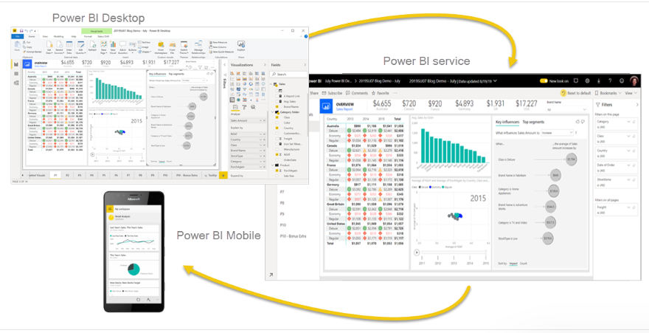
Key Components of Power BI

Slide 7
Power BI Roles
Power BI for business users
Power BI Desktop for report creators
Power BI Report Builder for enterprise report creators
Power BI for administrators
Power BI for developers
What is Power BI embedded analytics?
Create your own visuals in Power BI
What can developers do with the Power BI API?

Slide 8
Workflow in Power BI
One common workflow in Power BI begins by connecting to data sources in Power BI Desktop and building a report. You then publish that report from Power BI Desktop to the Power BI service, and share it so business users in the Power BI service and on mobile devices can view and interact with the report.
This workflow is common, and shows how the three main Power BI elements complement one another.

Slide 9
Microsoft Fabrics
Microsoft Fabric is an offering that combines data + services in a unified environment, making it easier to perform analysis and analytics on various sets of data. Power BI is an example of one of the services that's integrated with Microsoft Fabric, and your organization's OneLake data store is an example of the data that can be used, analyzed, or visualized. Large organizations find Microsoft Fabric particularly useful, since it can corral and then bring greater value to large stores of data, then using services (like Power BI) to bring such data to business life.
Administration of Power BI is now handled by Microsoft Fabric, but your favorite tools like the Power BI service and Power BI Desktop still operate like they always have - as a service that can turn your data, whether in OneLake or in Excel, into powerful business intelligence insights.

Slide 10
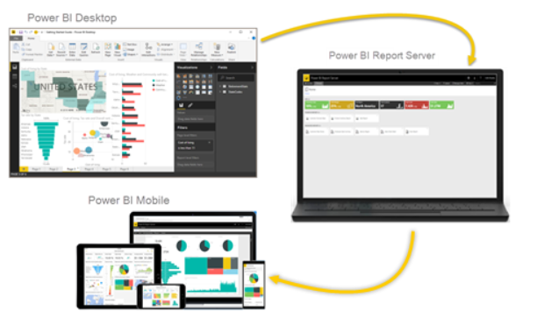
On-Premise Reporting with Report Server
What if you need to keep your reports on premises, say, behind a firewall? Read on.
You can create, deploy, and manage Power BI reports in Power BI Desktop, and paginated reports in Report Builder, with the ready-to-use tools and services that Power BI Report Server provides.

Slide 11
Data Modeling
Importance of data modeling
Creating and managing relationships
Introduction to DAX (Data Analysis Expressions)
Building calculated columns and measures

Slide 12
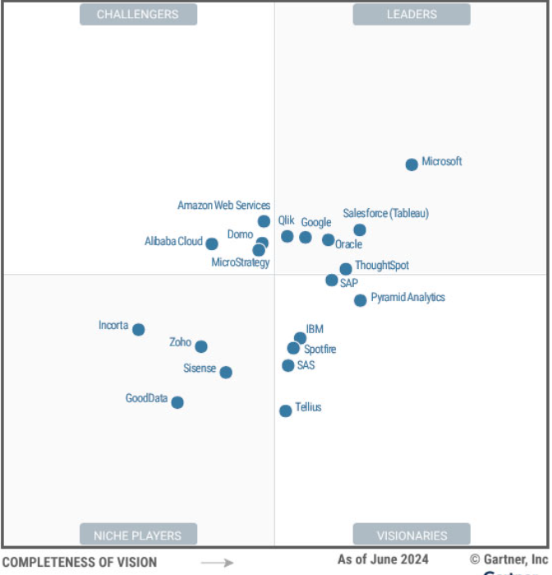
Gartner Magic Quadrant

Slide 13
Visualizations and Dashboards
Creating visualizations: bar charts, line graphs, pie charts
Customizing visuals (formatting, interactions, filters)
Adding slicers and bookmarks
Designing dashboards

Slide 14
Advanced DAX
Time intelligence functions (e.g., YTD, MTD calculations)
Using variables in DAX formulas
Advanced calculations and performance optimization

Slide 15
Power BI Service
Publishing reports to Power BI Service
Sharing dashboards and collaborating with teams
Scheduling data refreshes
Introduction to Power BI apps

Slide 16
Integration and Case Studies
Integrating Power BI with Excel, Teams, and other tools
Embedding Power BI reports in applications
Case study: Building a project from scratch
Q&A and wrap-up

Slide 17
Getting Started
Download and install Power BI Desktop
Hands-on session

Slide 18
Reference
https://www.cxtoday.com/customer-data-platform/gartner-magic-quadrant-for-analytics-and-business-intelligence-abi-platforms-2024/
https://www.microsoft.com/en-us/download/details.aspx?id=58494
https://learn.microsoft.com/en-us/power-bi/fundamentals/power-bi-overview

