Slide 1

Python-Installation and setup
Raghu Prasad Konandur

Slide 2
Integrated Development Environments (IDE’s)
Python code editors are designed for the developers to code and debug program easily. Using these Python IDEs, you can manage a large codebase and achieve quick deployment.
Popular IDE’s for python
Anaconda – Spyder
Jetbrain – Pycharm
IDLE – Built-in editor with Python software

Slide 3
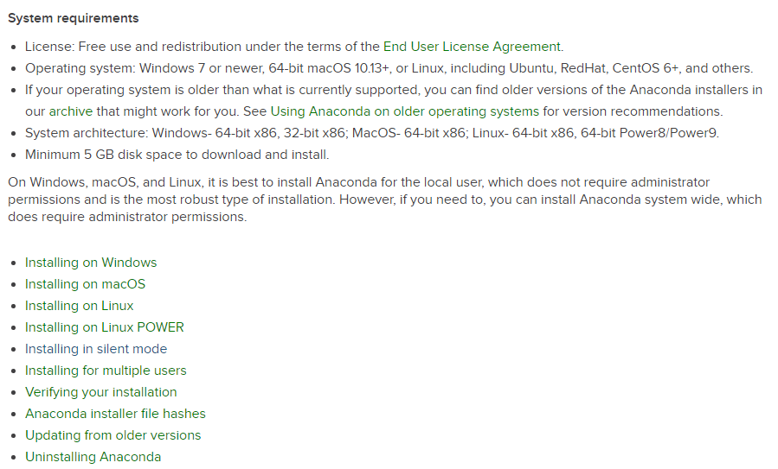
System Requirement for Anaconda

Slide 4
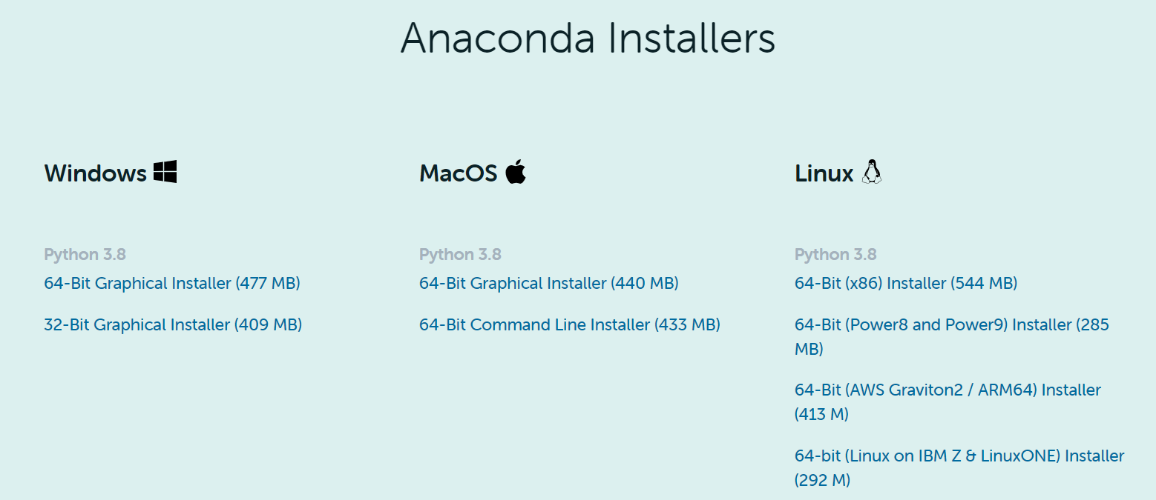
Download Anaconda python distribution
Visit - https://www.anaconda.com/products/individual
Download the installer based on your operating system and processor

Slide 5
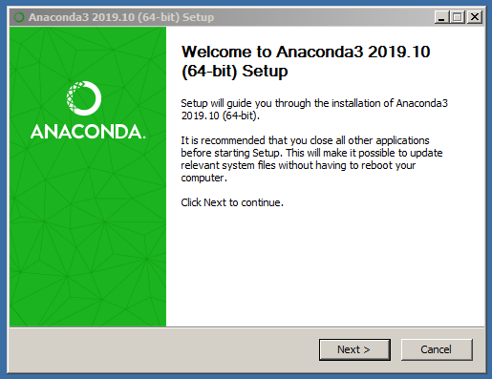
Installation
Click on the downloaded installer
Installation starts

Slide 6
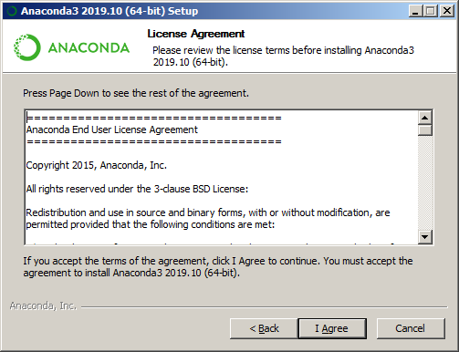
Installation Of Anaconda IDE

Slide 7
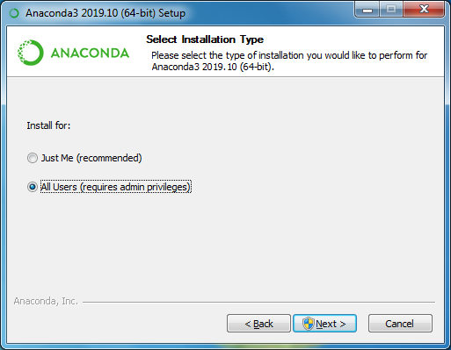
Installation Of Anaconda IDE

Slide 8
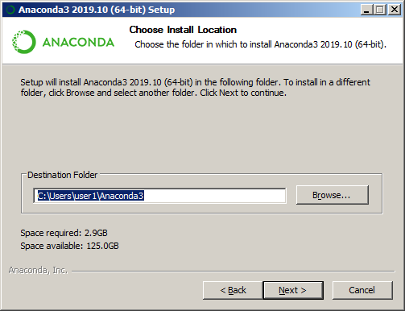
Installation Of Anaconda IDE

Slide 9
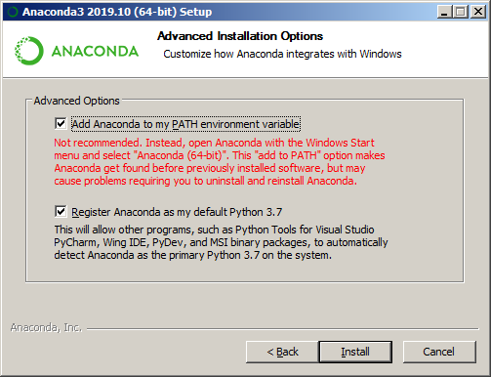
Installation Of Anaconda IDE

Slide 10
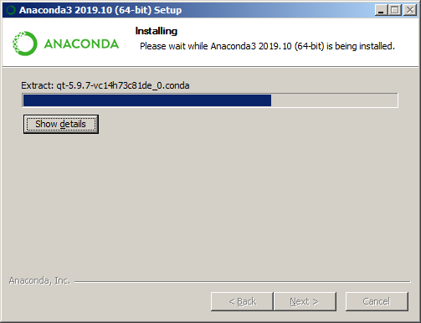
Installation Of Anaconda IDE

Slide 11
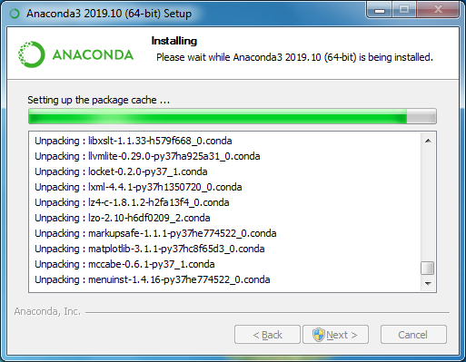
Installation Of Anaconda IDE

Slide 12
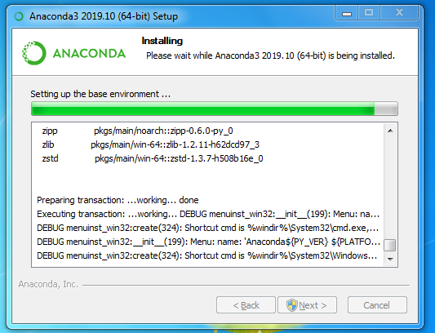
Installation Of Anaconda IDE

Slide 13
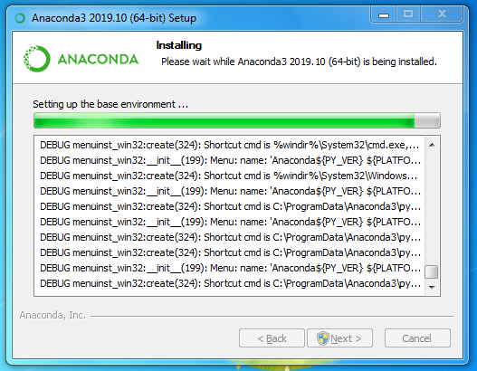
Installation Of Anaconda IDE

Slide 14
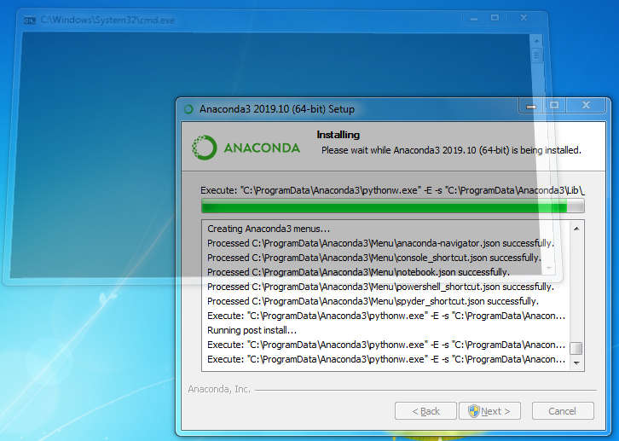
Installation Of Anaconda IDE

Slide 15
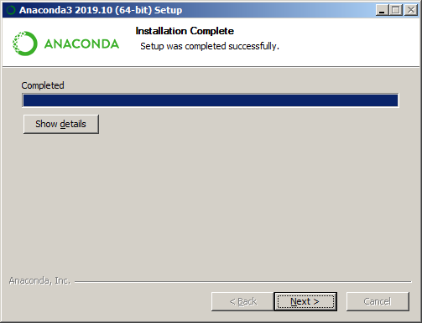
Installation Of Anaconda IDE

Slide 16
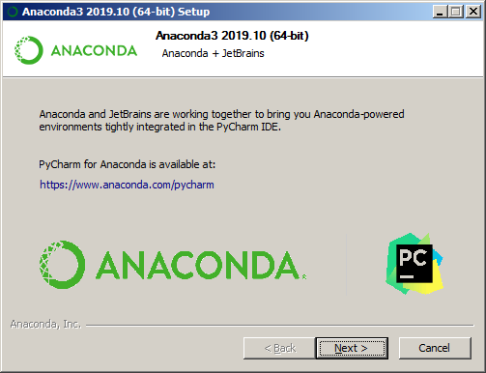
Installation Of Anaconda IDE

Slide 17
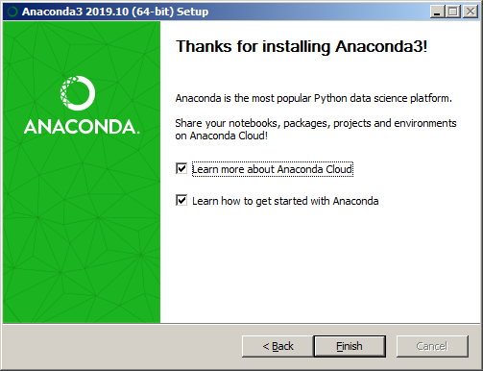
Installation Of Anaconda IDE

Slide 18
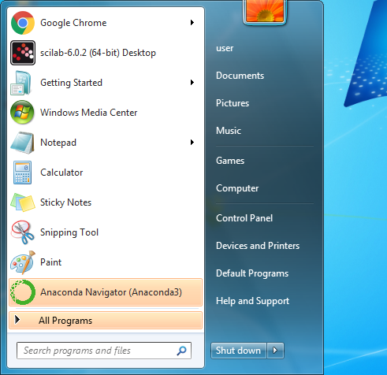
Installation Of Anaconda IDE – Program Menus

Slide 19
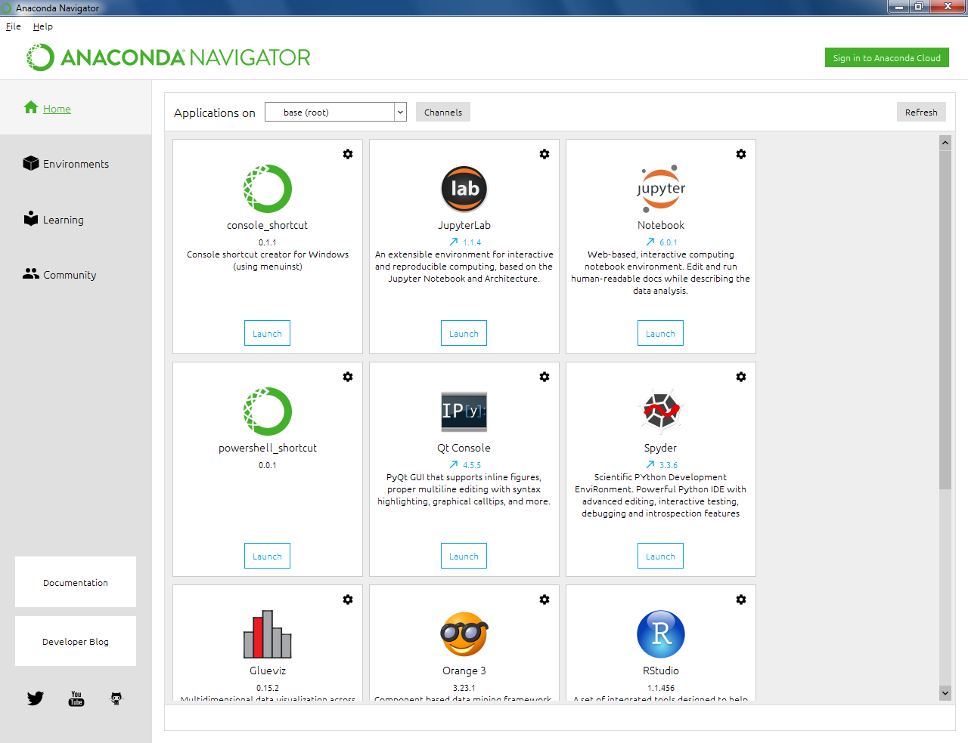
Installation Of Anaconda IDE – Spyder

Slide 20
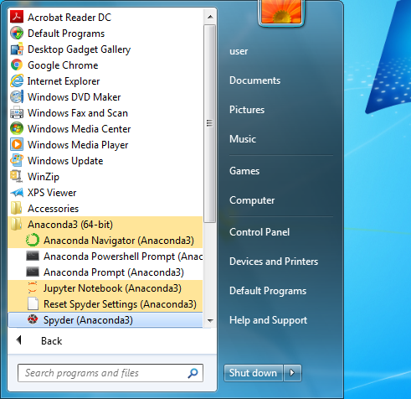
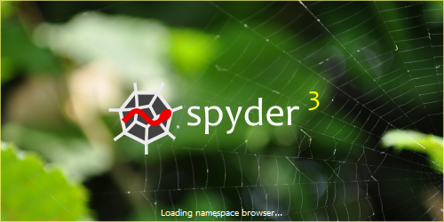

Installation Of Anaconda IDE – Launching Spyder

Slide 21
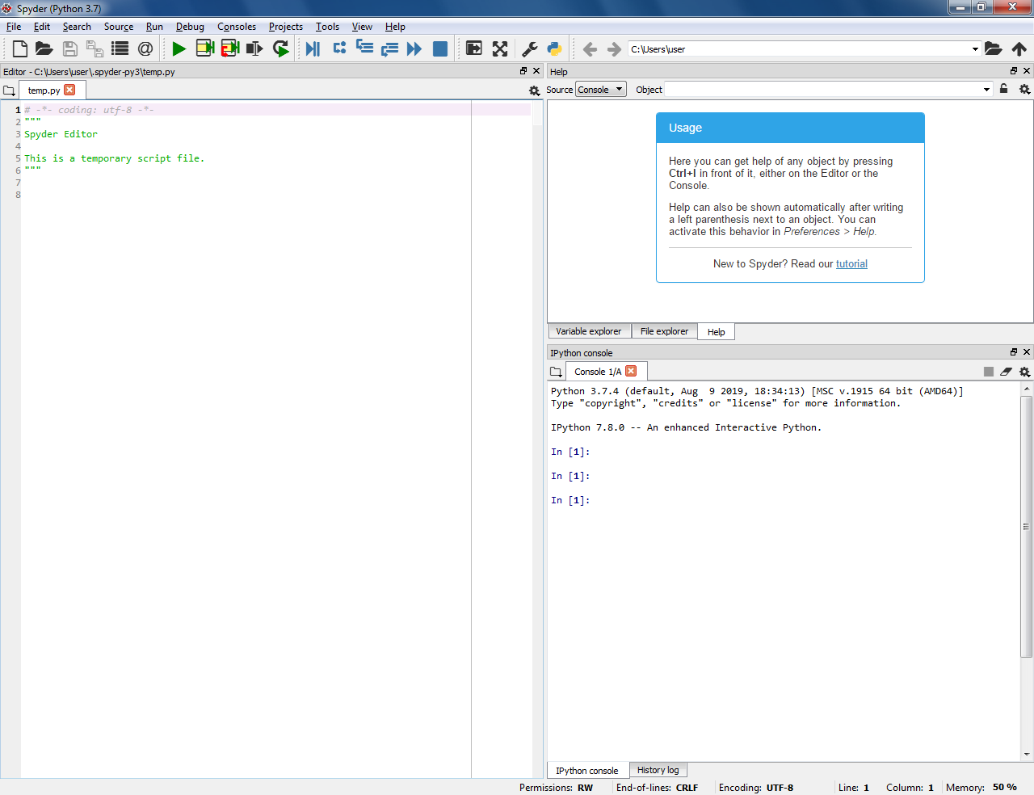
Installation Of Anaconda IDE – Spyder Console

Slide 22
Thank You

