Slide 1
Python Crash Course
Raghu Prasad Konandur
CEO
www.kaushalya.tech
9845547471

Slide 2
Introduction
Raghu Prasad K S – BE, MS, CEO of Kasuhalya Technologies
Total of 24 years of experience
7 years as a lecturer in an Engineering College
17 Years into IT
Worked with companies like CISCO,CSC,ICICI,First Apex – NTT Data
Currently into Corporate training and consultancy
Worked with corporates and public sector
Technologies – Java,Python,AI,ML,Web technologies,Java Script technologies (MEAN stack),IOT,Test Automation – Selenium,Jmeter
CSR Activities
Professional Yoga Trainer and motivational speaker

Slide 3
About Us
Kaushalya Technologies (www.kaushalya.tech) is an educational technology company started by IT Professionals and Academicians.
It has offices in Jakkur and Sahakara Nagara in Bengaluru
Kaushalya Technologies are into IT niche skills training, consultancy and educational application development
We conduct FDP, SDP, Internships for educational institutions.
We conduct Boot camp and niche IT skills training for corporates.

Slide 4
Our Major clients
Educational Institutions
Acharya Institute of Technology, REVA University,Dayanand Sagar University, Nagarjuna Engineering College, Bengaluru
BGSIT- Bellur, Malnad Engineering College-Hassan, NIE-Mysore, MYCEM, Mysore, NIT-Manipur
Sindhi College, SB College of Management, Bengaluru
IT Companies
L & T – Mysore,NextGen-Bengaluru,Philips-Bengaluru,Incarnus-Chennai,Aspire Systems-Chennai, Infidata Technologies – Bengaluru, Edulife- Bengaluru

Slide 5
Course Objectives
Introduce trainees to Python as a generic programming language
Introduce trainees to Object Oriented Programming and its usages
Code as you learn
Build ability to solve a problem by developing necessary algorithms
Bridge the gap between actual skills required for the industry and the current skills possessed by the trainees
Prepare trainees for hackathons and placements

Slide 6
Course Outcome
Trainees are expected to gain theoretical and practical exposure in basics of Python
Hands-on and minds-on Learning
Build a project at the end of the training
Learn soft skills aspects such as being a team player and critical thinking ability
Well prepared to participate in hackathon and campus
Well versed with software development life cycle

Slide 7
Training Methodology
It’s combination of theoretical and practical sessions. We will introduce to a concept and use hands-on session to further strengthen their understanding of the concept.
It’s a 30 hour course
Following assessment methodology would be performed
Pre-assessment test
Attendance and attentiveness in the class
Completion of hands-on session
Completion of assignments
Completion of project
Feedback
Post-assessment test
Softcopy of the course material would be handed over to each student at the end of the course.
Joint certificate by the college and Kaushalya would be issued to the trainees

Slide 8
Course Outline
Introduction to Python
Installation of Python and getting started with python
Introduction to IDE and Installation of Anaconda
Features of Python
Object Orientation
File Operations

Slide 9
Objectives
Learn Python
Understand the usages of Python
Understand the applications built on Python
Understand the domains
Hands-on coding

Slide 10
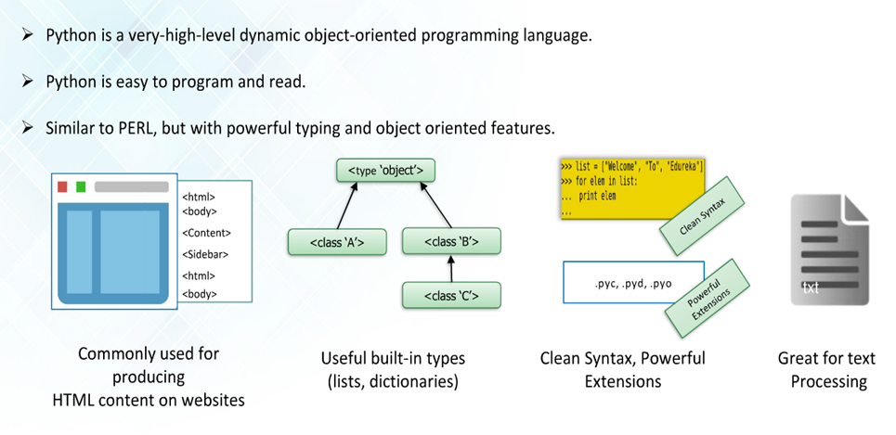
PYTHON
Notes:
py: This is normally the input source code that you've written.
.pyc: This is the compiled bytecode. If you import a module, python will build a *.pyc file that contains the bytecode to make importing it again later easier (and faster).
.pyo: This is a *.pyc file that was created while optimizations (-O) was on.
.pyd: This is basically a windows dll file. http://docs.python.org/faq/windows.html#is-a-pyd-file-the-same-as-a-dll

Slide 11
Python Implementations and Alternate
CPython (the de-facto reference Python implementation)
PyPy (a fast Python Implementation with JIT compiler)
IronPython (Python running on .NET)
Jython (Python running on JVM)
MicroPython (Python Running on Microcontrollers
Re-packaged CPython that include more libraries or are specialized for a particular application:
Anaconda Python (a full Python distribution for data management, analysis and visualization of large data sets)
pythonxy (Scientific-oriented Python Distribution based on Qt and Spyder)
winpython (WinPython is a portable scientific Python distribution for Windows)
Conceptive Python SDK (targets business, desktop and database applications)
Enthought Canopy (a commercial distribution for scientific computing)
PyIMSL Studio (a commercial distribution for numerical analysis – free for non-commercial use)
To host and run Python in the cloud:
PythonAnywhere (freemium hosted Python installation which allows to run Python in the browser.)
Notes:
https://wiki.python.org/moin/PythonImplementations

Slide 12
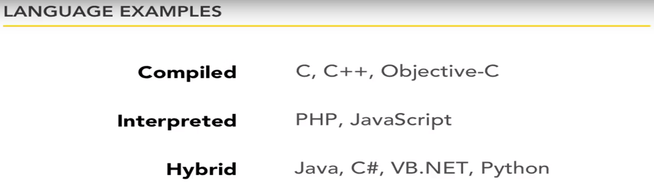
Compiled and Interpreted Languages

Slide 13
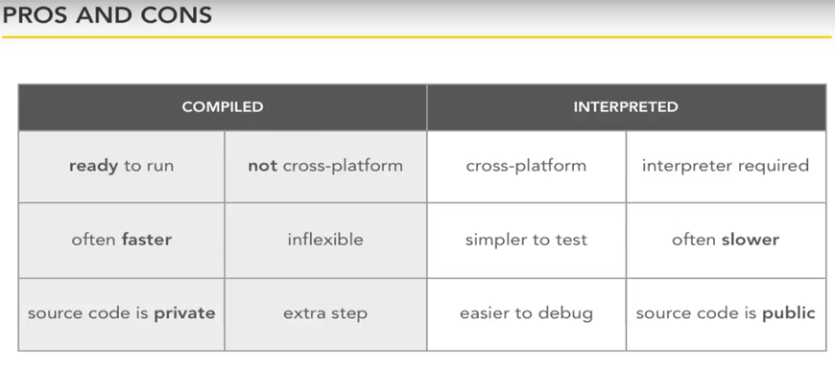
Compiled and Interpreted Languages

Slide 14
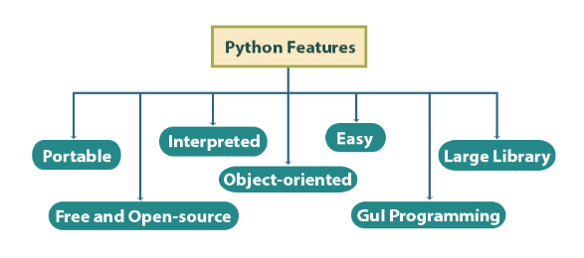
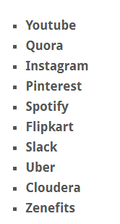
Why Python
Notes:
i. Easy
Python is very easy to learn and understand; using this Python tutorial, any beginner can understand the basics of Python.
ii. Interpreted
It is interpreted(executed) line by line. This makes it easy to test and debug.
iii. Object-Oriented
The Python programming language supports classes and objects. We discussed these above.
iv. Free and Open Source
The language and its source code are available to the public for free; there is no need to buy a costly license.
v. Portable
Since it is open-source, you can run Python on Windows, Mac, Linux or any other platform. Your programs will work without needing to the changed for every machine.
vi. GUI Programming
You can use it to develop a GUI (Graphical User Interface). One way to do this is through Tkinter.
vii. Large Library
Python provides you with a large standard library. You can use it to implement a variety of functions without needing to reinvent the wheel every time. Just pick the code you need and continue. This lets you focus on other important tasks.

Slide 15
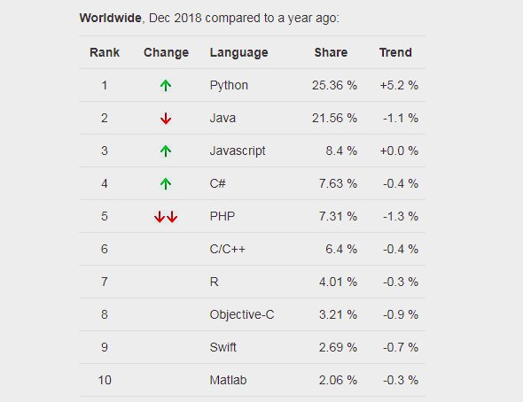
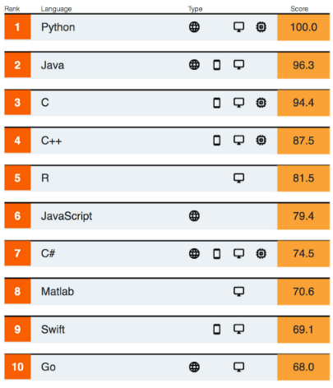
Top 5 Programming Languages
Notes:
Ref IEEE Spectrum

Slide 16
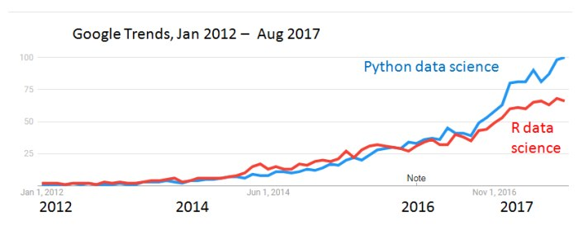
Google Trends in DataSciences
Notes:
https://www.datacareer.ch/blog/success-of-python-and-r-evidence-from-google-trends/

Slide 17
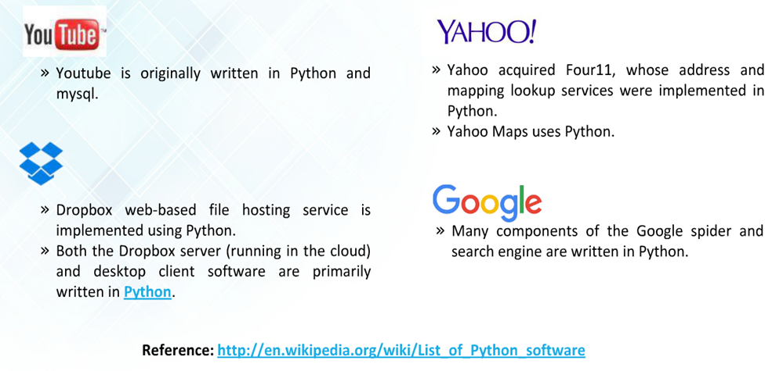
Users of Python
Notes:
https://en.wikipedia.org/wiki/List_of_Python_software

Slide 18
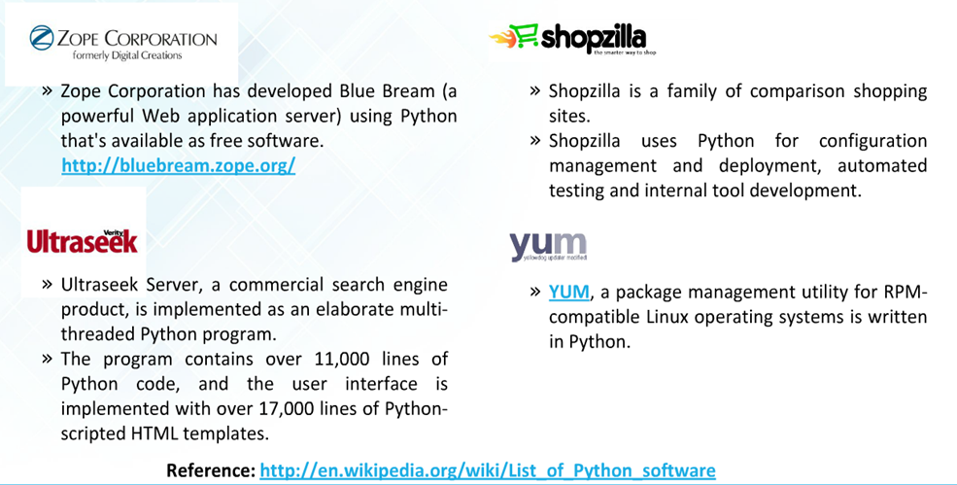
Users of Python
Notes:
https://wiki.python.org/moin/OrganizationsUsingPython

Slide 19
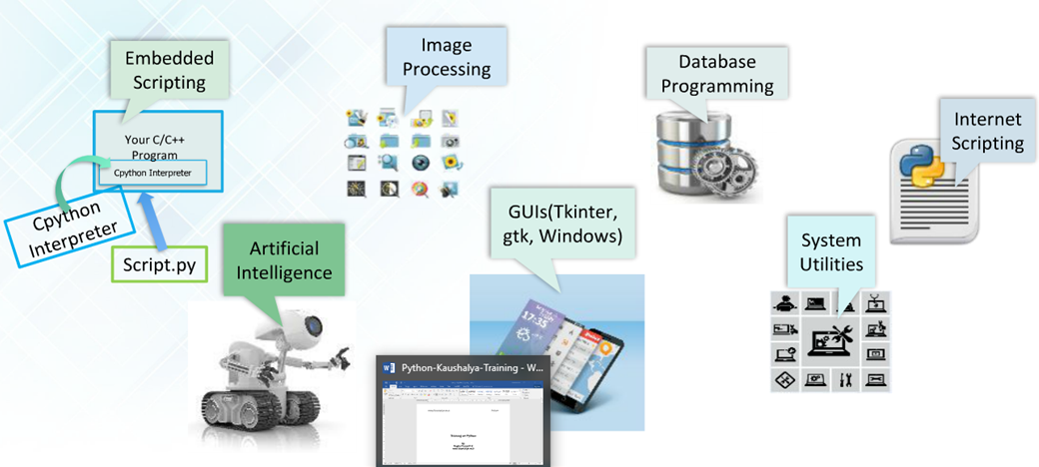
Traditional Uses of Python

Slide 20
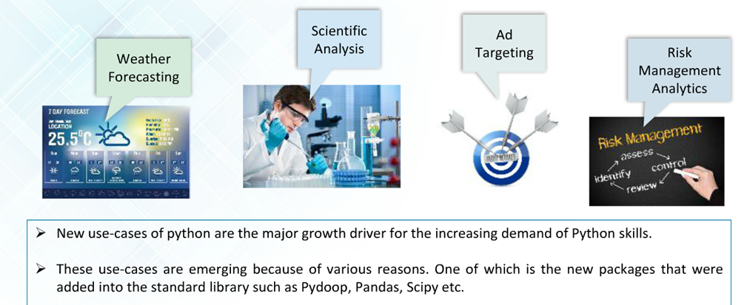
Uses of Python in Data Analytics

Slide 21
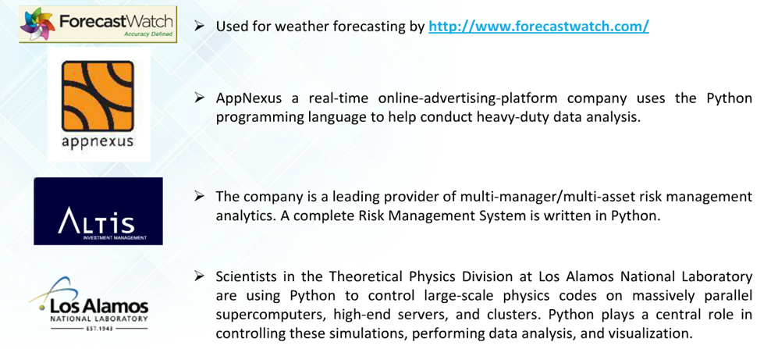
Python Users for Data Analytics

Slide 22
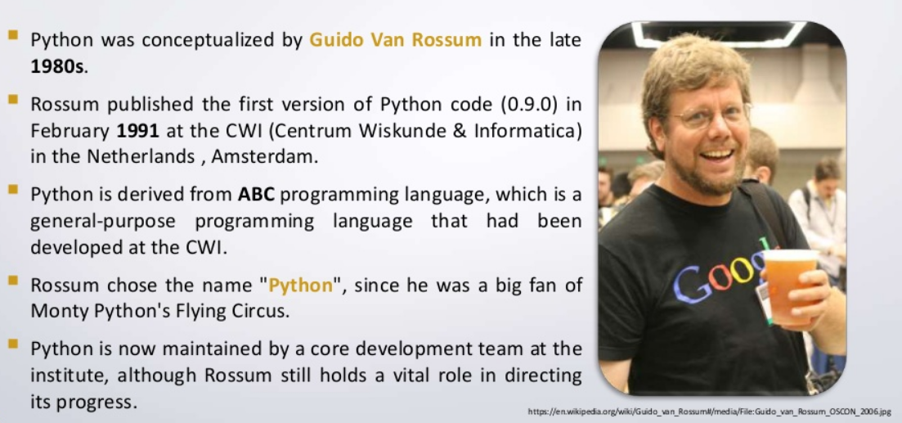
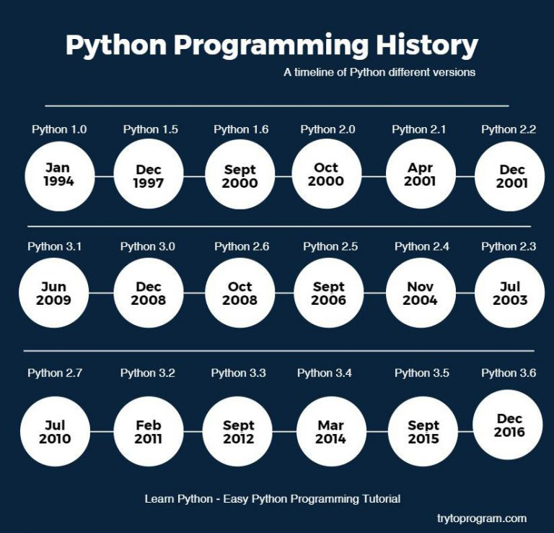
Python History

Slide 23
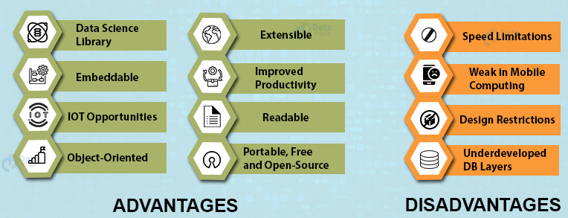
Pros and Cons of Python
Advantages of Python Over Other Languages
1. Less Coding
Almost all of the tasks done in Python requires less coding when the same task is done in other languages. Python also has great standard library support.
2. Affordable
Python is free therefore individuals, small companies or big organizations can leverage the free available resources to build applications.
3. Python is for Everyone
Python code can run on any machine whether it is Linux, Mac or Windows. Programmers need to learn different languages for different jobs but with Python, can perform professionally build web apps, perform data analysis and machine learning, automate things, do web scraping and also build games and powerful visualizations. It is an all-rounder programming language.
Notes:
Advantages of Python
Let’s see how Python dominates over other languages.
1. Extensive Libraries
Python downloads with an extensive library and it contain code for various purposes like regular expressions, documentation-generation, unit-testing, web browsers, threading, databases, CGI, email, image manipulation, and more. So, we don’t have to write the complete code for that manually.
2. Extensible
As we have seen earlier, Python can be extended to other languages. You can write some of your code in languages like C++ or C. This comes in handy, especially in projects.
3. Embeddable
Complimentary to extensibility, Python is embeddable as well. You can put your Python code in your source code of a different language, like C++. This lets us add scripting capabilities to our code in the other language.
4. Improved Productivity
The language’s simplicity and extensive libraries render programmers more productive than languages like Java and C++ do. Also, the fact that you need to write less and get more things done.
5. IOT Opportunities
Since Python forms the basis of new platforms like Raspberry Pi, it finds the future bright for the Internet Of Things. This is a way to connect the language with the real world.
6. Simple and Easy
When working with Java, you may have to create a class to print ‘Hello World’. But in Python, just a print statement will do. It is also quite easy to learn, understand, and code. This is why when people pick up Python, they have a hard time adjusting to other more verbose languages like Java.
7. Readable
Because it is not such a verbose language, reading Python is much like reading English. This is the reason why it is so easy to learn, understand, and code. It also does not need curly braces to define blocks, and indentation is mandatory. This further aids the readability of the code.
8. Object-Oriented
This language supports both the procedural and object-oriented programming paradigms. While functions help us with code reusability, classes and objects let us model the real world. A class allows the encapsulation of data and functions into one.
9. Free and Open-Source
Like we said earlier, Python is freely available. But not only can you download Python for free, but you can also download its source code, make changes to it, and even distribute it. It downloads with an extensive collection of libraries to help you with your tasks.
10. Portable
When you code your project in a language like C++, you may need to make some changes to it if you want to run it on another platform. But it isn’t the same with Python. Here, you need to code only once, and you can run it anywhere. This is called Write Once Run Anywhere (WORA). However, you need to be careful enough not to include any system-dependent features.
11. Interpreted
Lastly, we will say that it is an interpreted language. Since statements are executed one by one, debugging is easier than in compiled languages.
Any doubts till now in the advantages of Python? Mention in the comment section.
Advantages of Python Over Other Languages
1. Less Coding
Almost all of the tasks done in Python requires less coding when the same task is done in other languages. Python also has an awesome standard library support, so you don’t have to search for any third-party libraries to get your job done. This is the reason that many people suggest learning Python to beginners.
2. Affordable
Python is free therefore individuals, small companies or big organizations can leverage the free available resources to build applications. Python is popular and widely used so it gives you better community support.
The 2019 Github annual survey showed us that Python has overtaken Java in the most popular programming language category.
3. Python is for Everyone
Python code can run on any machine whether it is Linux, Mac or Windows. Programmers need to learn different languages for different jobs but with Python, you can professionally build web apps, perform data analysis and machine learning, automate things, do web scraping and also build games and powerful visualizations. It is an all-rounder programming language.
Disadvantages of Python
So far, we’ve seen why Python is a great choice for your project. But if you choose it, you should be aware of its consequences as well. Let’s now see the downsides of choosing Python over another language.
1. Speed Limitations
We have seen that Python code is executed line by line. But since Python is interpreted, it often results in slow execution. This, however, isn’t a problem unless speed is a focal point for the project. In other words, unless high speed is a requirement, the benefits offered by Python are enough to distract us from its speed limitations.
2. Weak in Mobile Computing and Browsers
While it serves as an excellent server-side language, Python is much rarely seen on the client-side. Besides that, it is rarely ever used to implement smartphone-based applications. One such application is called Carbonnelle.
The reason it is not so famous despite the existence of Brython is that it isn’t that secure.
3. Design Restrictions
As you know, Python is dynamically-typed. This means that you don’t need to declare the type of variable while writing the code. It uses duck-typing. But wait, what’s that? Well, it just means that if it looks like a duck, it must be a duck. While this is easy on the programmers during coding, it can raise run-time errors.
4. Underdeveloped Database Access Layers
Compared to more widely used technologies like JDBC (Java DataBase Connectivity) and ODBC (Open DataBase Connectivity), Python’s database access layers are a bit underdeveloped. Consequently, it is less often applied in huge enterprises.
5. Simple
No, we’re not kidding. Python’s simplicity can indeed be a problem. Take my example. I don’t do Java, I’m more of a Python person. To me, its syntax is so simple that the verbosity of Java code seems unnecessary.
This was all about the Advantages and Disadvantages of Python Programming Language.

Slide 24
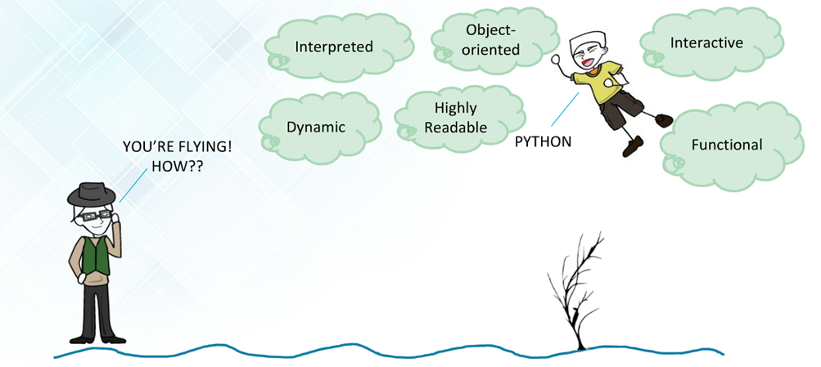
Language Features

Slide 25
Why Us
Kaushalya is built by IT Professions having experience in academia
Our vision is to Skill, Up-Skill and Re-Skill in order to bridge the gap between academia and industry
Training is conducted by experienced IT Professionals
Vendors for major educational institutions and corporates

Slide 26
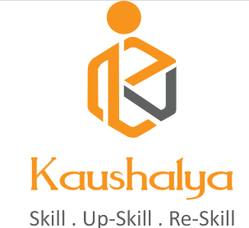
Thank You

