Slide 1
Python – Building Blocks
Raghu Prasad K S
www.kaushalya.tech
9845547471

Slide 2
Introduction
Raghu Prasad K S – BE, MS, CEO of Kasuhalya Technologies
Total of 24 years of experience
7 years as a lecturer in an Engineering College
17 Years into IT
Worked with companies like CISCO,CSC,ICICI,First Apex – NTT Data
Currently into Corporate training and consultancy
Worked with corporates and public sector
Technologies – Java,Python,AI,ML,Web technologies,Java Script technologies (MEAN stack),IOT,Test Automation – Selenium,Jmeter
CSR Activities
Professional Yoga Trainer and motivational speaker

Slide 3
About Us
Kaushalya Technologies (www.kaushalya.tech) is an educational technology company started by IT Professionals and Academicians.
It has offices in Jakkur and Sahakara Nagara in Bengaluru
Kaushalya Technologies are into IT niche skills training, consultancy and educational application development
We conduct FDP, SDP, Internships for educational institutions.
We conduct Boot camp and niche IT skills training for corporates.

Slide 4
Our Major clients
Educational Institutions
Acharya Institute of Technology, REVA University,Dayanand Sagar University, Nagarjuna Engineering College, Bengaluru
BGSIT- Bellur, Malnad Engineering College-Hassan, NIE-Mysore, MYCEM, Mysore, NIT-Manipur
Sindhi College, SB College of Management, Bengaluru
IT Companies
L & T – Mysore,NextGen-Bengaluru,Philips-Bengaluru,Incarnus-Chennai,Aspire Systems-Chennai, Infidata Technologies – Bengaluru, Edulife- Bengaluru

Slide 5
Course Objectives
Introduce trainees to Python as a generic programming language
Introduce trainees to Object Oriented Programming and its usages
Code as you learn
Build ability to solve a problem by developing necessary algorithms
Bridge the gap between actual skills required for the industry and the current skills possessed by the trainees
Prepare trainees for hackathons and placements

Slide 6
Course Outcome
Trainees are expected to gain theoretical and practical exposure in basics of Python
Hands-on and minds-on Learning
Build a project at the end of the training
Learn soft skills aspects such as being a team player and critical thinking ability
Well prepared to participate in hackathon and campus
Well versed with software development life cycle

Slide 7
Training Methodology
It’s combination of theoretical and practical sessions. We will introduce to a concept and use hands-on session to further strengthen their understanding of the concept.
It’s a 60 hour course
Following assessment methodology would be performed
Pre-assessment test
Attendance and attentiveness in the class
Completion of hands-on session
Completion of assignments
Completion of project
Feedback
Post-assessment test
Softcopy of the course material would be handed over to each student at the end of the course.
Joint certificate by the college and Kaushalya would be issued to the trainees

Slide 8
Course Outline
Introduction to Python
Installation of Python and getting started with python
Introduction to IDE and Installation of Anaconda
Features of Python
Object Orientation
File Operations
GUI
Database Interaction

Slide 9
Features Of Python - Building Blocks
Variables
Data Types
Operators
Conditional Statements
Loops
Strings
Overview of Collections
Overview of Class, Objects and Inheritance

Slide 10
Variables
It is a named-literal which helps to store a value in the program.
Can take value that can be modified wherever required in the program.
In Python, a variable need not be declared with a specific type before its usage. As required a variable, can be used and the type will be decided by the value assigned to it. A value can be assigned to a variable using assignment operator (=).
Examples as given below–
x=10 ; print(x) ; type(x) >>> 10 int
y="hi" ; print(y) ; type(y) >>>hi str
Rules for Variable Names in Python
A variable name must start with a letter or the underscore character
A variable name cannot start with a number
A variable name can only contain alpha-numeric characters and underscores (A-z, 0-9, and _ )
Variable names are case-sensitive (age, Age and AGE are three different variables)

Slide 11
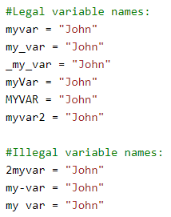
Legal and Illegal Variables

Slide 12


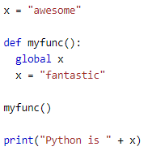
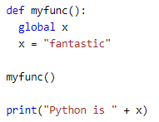
Variable Contd..
Python allows to assign values to multiple variables in one line and can assign the same value to multiple variables in one line as shown in the below examples
Python “print” statement is used to output variables
Global Variables and Global Keyword:
Variables that are created outside of a function (as in all of the examples above) are known as global variables.
Global variables can be used by everyone, both inside of functions and outside. When a variable is created inside a function, that variable is local, and can only be used inside that function. To create a global variable inside a function, you can use the global keyword as shown in the below example

Slide 13
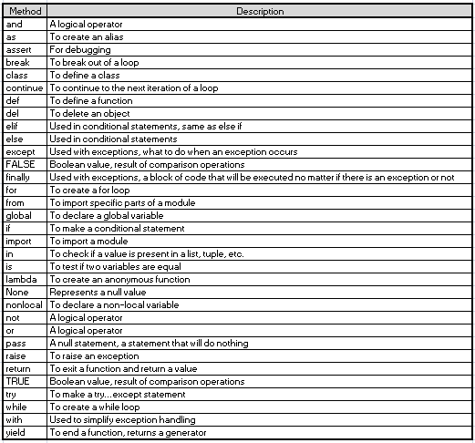
Python Keywords
The keywords have special meaning in any language and they are intended for doing specific task.
Python has a finite set of keywords.
The table in the LHS provides a list of those keywords.

Slide 14
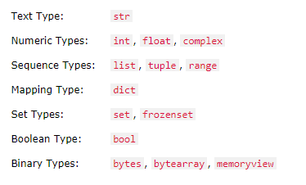
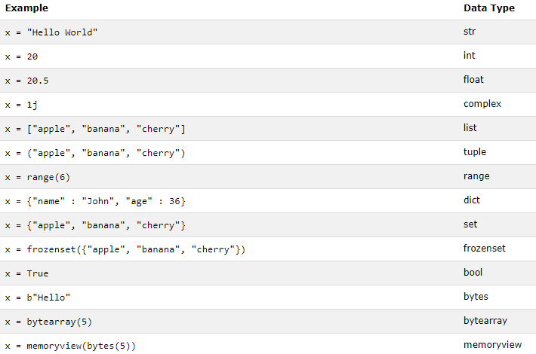
Python Data Types
In any programming, data type plays an important concept. The variables can store data of different types, and different types can do different things. The following are the data types built-in by default, as provided below with examples:

Slide 15
Python Numbers
The three numeric types basically used in Python are:
Int → integer, is a whole number, positive or negative, without decimals, of unlimited length e.g.: x = 1
y = 35656222554887711; z = -3255522
Float → "floating point number" is a number, positive or negative, containing one or more decimals. Float can also be
scientific numbers with an "e" to indicate the power of 10 e.g.: x = 1.10; y = 1.0; z = -35.59 and x = 35e3; y = 12E4;
z = -87.7e100
Complex → they are written with j as imaginary part e.g.: x=3+5j; y=5j; z=-5j
type() function is used to find the type of any object
Type Conversion: to convert from one type to another with the int(), float(), and complex() methods
x = 1 # int ; y = 2.8 # float; z = 1j # complex
#convert from int to float: a = float(x)
#convert from float to int: b = int(y)
#convert from int to complex: c = complex(x)

Slide 16



Python Numbers
Random Number: Python does not have a random() function to make a random number, but Python has a built-in
module called random that can be used to make random numbers
e.g.: import random print(random.randrange(1,10))
Python Casting: Python is an object-orientated language, and as such it uses classes to define data types, including
its primitive types. Casting in python is therefore done using constructor functions:
int() - constructs an integer number from an integer literal, a float literal (by rounding down to the previous whole
number), or a string literal (providing the string represents a whole number)
float() - constructs a float number from an integer literal, a float literal or a string literal (providing the string
represents a float or an integer)
str() - constructs a string from a wide variety of data types, including strings, integer literals and float literals

Slide 17
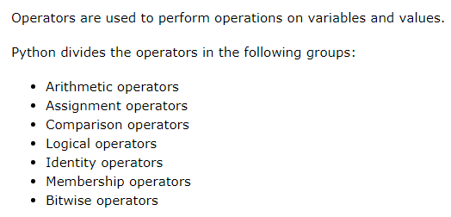
Python Operators

Slide 18
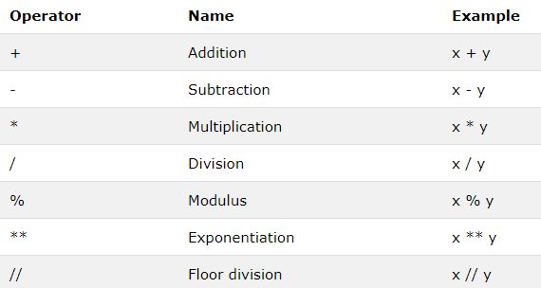
Python Operators - Arithmetic

Slide 19
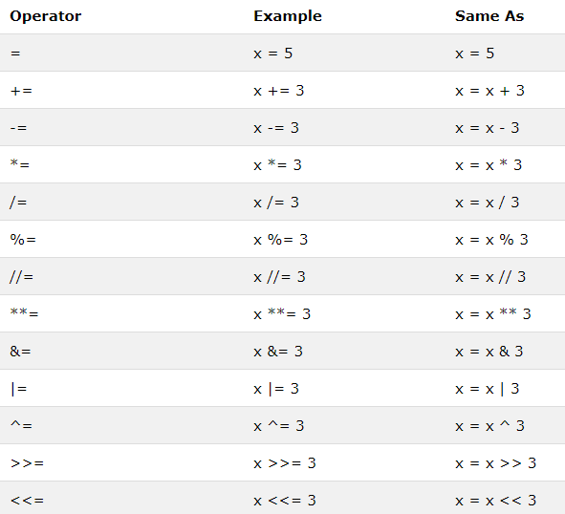
Python Operators – Assignment

Slide 20
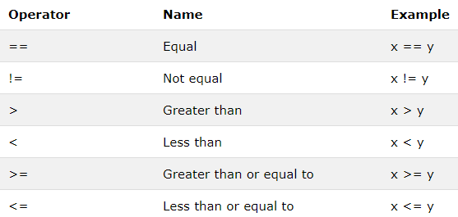
Python Operators - Comparison

Slide 21
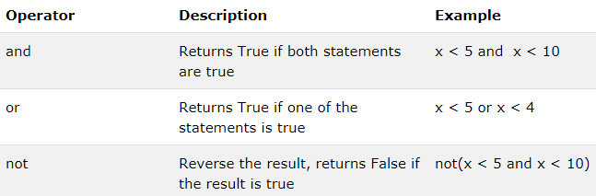
Python Operators - Logical

Slide 22
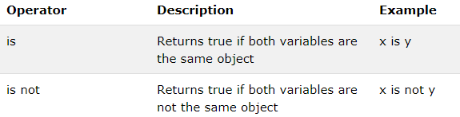
Python Operators - Identity
x = ["apple", "banana"]
y = ["apple", "banana"]
z = x
print(x is z)
# returns True because z is the same object as x
print(x is y)
# returns False because x is not the same object as y, even if they have the same content
print(x == y)
# to demonstrate the difference between "is" and "==": this comparison returns True because x is equal to y
x = ["apple", "banana"]
y = ["apple", "banana"]
z = x
print(x is not z)
# returns False because z is the same object as x
print(x is not y)
# returns True because x is not the same object as y, even if they have the same content
print(x != y)
# to demonstrate the difference between "is not" and "!=": this comparison returns False because x is equal to y

Slide 23
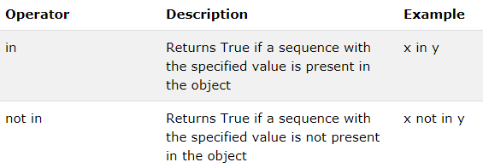
Python Operators - Membership
x = ["apple", "banana"]
print("banana" in x)
# returns True because a sequence with the value "banana" is in the list
x = ["apple", "banana"]
print("pineapple" not in x)
# returns True because a sequence with the value "pineapple" is not in the list

Slide 24
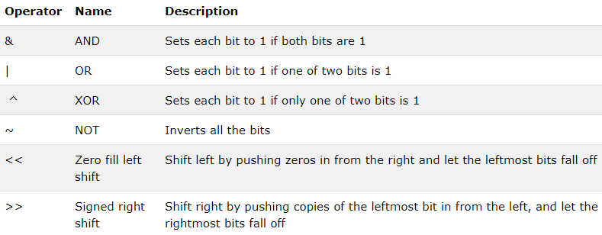
Python Operators - Bitwise

Slide 25
Python Conditional Statements
Python supports the usual logical conditions from mathematics:
Equals: a == b
Not Equals: a != b
Less than: a < b
Less than or equal to: a <= b
Greater than: a > b
Greater than or equal to: a >= b
These conditions can be used in several ways, most commonly in "if statements" and loops.
An "if statement" is written by using the if <condition>: keyword and used along with elif:, else:
Examples to be referred and practiced from the programs listed under the file explorer of anaconda IDE

Slide 26




Python Loops
Python has two primitive loop commands:
while loops:
With the while loop a set of statements can be executed as long the condition is true.
while loop statement can be used alone or along with break, continue and else statements, e.g. shown below

Slide 27

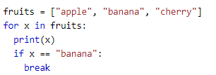


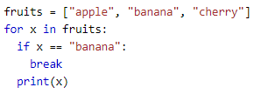

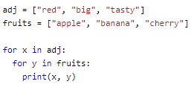



Python Loops
for loops:
for loop is used for iterating over a sequence (that is either a list, a tuple, a dictionary, a set, or a string). It is similar to any other programming languages, and works more like an iterate method as found in other object-orientated programming languages. for loop a set of statements can be executed, once for each item in a list, tuple, set etc. Also they can be used with break, continue, range, else and nested loops statements e.g. as provided below:

Slide 28

Python Strings
String Literals
String literals in python are surrounded by either single quotation marks, or double quotation marks.
'hello' is the same as "hello".
You can display a string literal with the print() function:
Assign String to a Variable
Assigning a string to a variable is done with the variable name followed by an equal sign and the string:
a = "Hello"
print(a)
Multiline Strings
You can assign a multiline string to a variable by using three open and close quotes or three single open and close quotes:
a = """India is a
great country
and we live in harmony."""
print(a)
a = ‘’’India is a
great country
and we live in harmony.’’’
print(a)

Slide 29
Python Strings
Strings are Arrays: Like many other popular programming languages, strings in Python are arrays of bytes representing unicode characters. However, Python does not have a character data type, a single character is simply a string with a length of 1. Square brackets can be used to access elements of the string. The first character has the position 0.
a = "Hello, World!"
print(a[1])
Slicing
A range of characters can be returned by using the slice syntax. The start index and the end index, separated by a colon, has to be specified to return a part of the string.
b = "Hello, World!"
print(b[2:5])
Negative Indexing
Use negative indexes to start the slice from the end of the string:
Get the characters from position 5 to position 1, starting the count from the end of the string:
b = "Hello, World!"
print(b[-5:-2])

Slide 30
Python Strings
String Length : To get the length of a string, use the len() function.
a = "Hello, World!"
print(len(a))
String Methods : Python has a set of built-in methods that you can use on strings.
a = " Hello, World! "
print(a.strip()) # returns "Hello, World!"
a = "Hello, World!"
print(a.lower())
a = "Hello, World!"
print(a.upper())
a = "Hello, World!"
print(a.replace("H", "J"))
a = "Hello, World!"
print(a.split(",")) # returns ['Hello', ' World!']

Slide 31
Python Strings
Check String : To check if a certain phrase or character is present in a string, we can use the keywords in or not in.
txt = "The rain in Spain stays mainly in the plain"
x = "ain" in txt
print(x)
txt = "The rain in Spain stays mainly in the plain"
x = "ain" not in txt
print(x)
String Concatenation : To concatenate, or combine, two strings the + operator can be used.
a = "Hello"
b = "World"
c = a + b
print(c)
a = "Hello"
b = "World"
c = a + " " + b
print(c)

Slide 32
Python Strings
String Format : strings can be combined along with numbers by using the format() method. The format() method takes the passed arguments, formats them, and places them in the string where the placeholders {} are:
age = 36
txt = "My name is John, and I am {}"
print(txt.format(age))
The format() method takes unlimited number of arguments, and are placed into the respective placeholders (as shown below):
quantity = 3
itemno = 567
price = 49.95
myorder = "I want {} pieces of item {} for {} dollars."
print(myorder.format(quantity, itemno, price))
index numbers {0} can also be used for the arguments that are to be placed in the correct placeholders
quantity = 3
itemno = 567
price = 49.95
myorder = "I want to pay {2} dollars for {0} pieces of item {1}."
print(myorder.format(quantity, itemno, price))

Slide 33
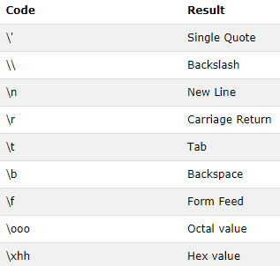
Python Strings
Escape Character : To insert characters that are illegal in a string, use an escape character.
An escape character is a backslash \ followed by the character which has to be inserted.
An example of an illegal character is a double quote inside a string that is surrounded by double quotes:
txt = "We are the so-called "Vikings" from the north.“
txt = "We are the so-called \"Vikings\" from the north.“
Other escape characters used in Python:

Slide 34
Python Collections
List is a collection which is ordered and changeable. Allows duplicate members, lists are written with square brackets.
Tuple is a collection which is ordered and unchangeable. Allows duplicate members, tuples are written with round brackets.
Set is a collection which is unordered and un-indexed. No duplicate members, sets are written with curly brackets.
Dictionary is a collection which is unordered, changeable and indexed. No duplicate members, dictionaries are written with curly brackets, and they have keys and values.

Slide 35
Python – Classes and Objects
Python is an object oriented programming language.
Almost everything in Python is an object, with its properties and methods.
A Class is like an object constructor, or a "blueprint" for creating objects.
Create a Class: To create a class, use the keyword class:
class MyClass:
x = 5
print(MyClass)
Create Object: We can use the class named myClass to create objects:
class MyClass:
x = 5
p1 = MyClass()
print(p1.x)

Slide 36
Python – Classes and Objects
The __init__() Function
The examples above are classes and objects in their simplest form, and are not really useful in real life applications.
To understand the meaning of classes we have to understand the built-in __init__() function.
All classes have a function called __init__(), which is always executed when the class is being initiated. The __init__() function is used to assign values to object properties, or other operations that are necessary to do when the object is being created
class Person:
def __init__(self, name, age):
self.name = name
self.age = age
p1 = Person("John", 36)
print(p1.name)
print(p1.age)

Slide 37
Python – Classes and Objects
Object Methods : Objects can also contain methods. Methods in objects are functions that belong to the object
class Person:
def __init__(self, name, age):
self.name = name
self.age = age
def myfunc(self):
print("Hello my name is " + self.name)
p1 = Person("John", 36)
p1.myfunc()
The self parameter is a reference to the current instance of the class, and is used to access variables that belongs to the class.
It does not have to be named self , it can be called as defined, but it has to be the first parameter of any function in the class.
We can have mysillyobject and abc instead of self

Slide 38
Python – Classes and Objects
Modify Object Properties : Properties on objects can be modified as e.g.
class Person:
def __init__(self, name, age):
self.name = name
self.age = age
def myfunc(self):
print("Hello my name is " + self.name)
p1 = Person("John", 36)
p1.age = 40
print(p1.age)
Properties on the objects and objects can be deleted as shown below using the keyword del
del p1.age
del p1
The pass Statement: class definitions cannot be empty, but for some reason to have a class definition with no content, put in the pass statement to avoid getting an error.
class Person:
pass

Slide 39
Python – Inheritance
Inheritance allows us to define a class that inherits all the methods and properties from another class.
Parent class is the class being inherited from, also called base class.
Child class is the class that inherits from another class, also called derived class.
class Person:
def __init__(self, fname, lname):
self.firstname = fname
self.lastname = lname
def printname(self):
print(self.firstname, self.lastname)
x = Person("John", "Doe")
x.printname()
class Person:
def __init__(self, fname, lname):
self.firstname = fname
self.lastname = lname
def printname(self):
print(self.firstname, self.lastname)
class Student(Person):
pass
x = Student("Mike", "Olsen")
x.printname()

Slide 40
Python – Inheritance
Function Override: When the __init__() function is added, the child class will no longer inherit the parent's __init__() function. Hence The child's __init__() function overrides the inheritance of the parent's __init__() function
class Person:
def __init__(self, fname, lname):
self.firstname = fname
self.lastname = lname
def printname(self):
print(self.firstname, self.lastname)
class Student(Person):
def __init__(self, fname, lname):
Person.__init__(self, fname, lname)
x = Student("Mike", "Olsen")
x.printname()
Python also has a super() function that will make the child class inherit all the methods and properties from its parent:
class Person:
def __init__(self, fname, lname):
self.firstname = fname
self.lastname = lname
def printname(self):
print(self.firstname, self.lastname)
class Student(Person):
def __init__(self, fname, lname):
super().__init__(fname, lname)
x = Student("Mike", "Olsen")
x.printname()

Slide 41
Python – Inheritance
Add Properties
Add a property called graduationyear to the Student class
class Person:
def __init__(self, fname, lname):
self.firstname = fname
self.lastname = lname
def printname(self):
print(self.firstname, self.lastname)
class Student(Person):
def __init__(self, fname, lname):
super().__init__(fname, lname)
self.graduationyear = 2019
x = Student("Mike", "Olsen")
print(x.graduationyear)
The year 2019 should be a variable, and passed into the Student class when creating student objects. To do so, add another parameter in the __init__() function:
class Person:
def __init__(self, fname, lname):
self.firstname = fname
self.lastname = lname
def printname(self):
print(self.firstname, self.lastname)
class Student(Person):
def __init__(self, fname, lname, year):
super().__init__(fname, lname)
self.graduationyear = year
x = Student("Mike", "Olsen", 2019)
print(x.graduationyear)

Slide 42
Python – Inheritance
Add Methods : Add a method called welcome to the Student class:
class Person:
def __init__(self, fname, lname):
self.firstname = fname
self.lastname = lname
def printname(self):
print(self.firstname, self.lastname)
class Student(Person):
def __init__(self, fname, lname, year):
super().__init__(fname, lname)
self.graduationyear = year
def welcome(self):
print("Welcome", self.firstname, self.lastname, "to the class of", self.graduationyear)
x = Student("Mike", "Olsen", 2019)
x.welcome()
If a method is added in the child class with the same name as a function in the parent class, the inheritance of the parent method will be overridden.

Slide 43
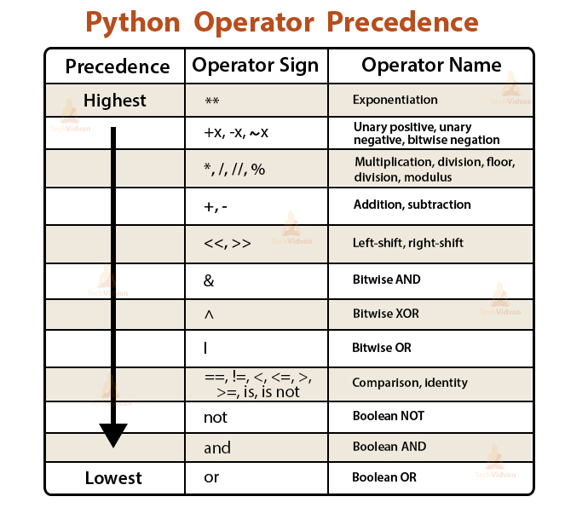
Operator Precedence

Slide 44
Why Us
Kaushalya is built by IT Professions having experience in academia
Our vision is to Skill, Up-Skill and Re-Skill in order to bridge the gap between academia and industry
Training is conducted by experienced IT Professionals
Vendors for major educational institutions and corporates

Slide 45

Thank You

