Slide 1
Introduction to Robotic Process Automation (RPA)
Revolutionizing Business Processes
Raghu Prasad K S
CEO
Kaushalya Technologies
www.Kaushalya.tech
9845547471

Slide 2
Introduction
Raghu Prasad – BE, MS
Total of 29 years of experience
7 years as a lecturer in Engineering College
22 Years into IT
Worked with companies like CISCO, CSC, ICICI, First Apex – NTT Data
Currently into Corporate training, consultancy and application development
Worked with corporates and public sector
Technologies – Java, Python, C#,.Net Framework,AI/ML, Web Technologies, Java Script technologies (MEAN/MERN stack), IOT, Test Automation – Selenium, Jmeter,Block Chain,Cloud,DevOps,MLOps,RPA

Slide 3
What is RPA?
Definition: Technology to automate repetitive, rule-based tasks using software robots.
Key Features:
- Task Automation
- No Code/Low Code
- Non-Intrusive
- Scalable
- AI and ML Integration

Slide 4
Popular RPA Tools
- UiPath: User-friendly and feature-rich.
- Automation Anywhere: Focus on end-to-end automation.
- Blue Prism: Enterprise-grade scalability.
- WorkFusion: AI-driven capabilities.
- Microsoft Power Automate: Seamless Microsoft product integration.

Slide 5
Applications of RPA
- Finance and Accounting: Invoice processing, Financial reporting.
- Human Resources: Onboarding, Payroll processing.
- Customer Service: Order tracking, Ticket routing.
- Healthcare: Patient records management, Claims processing.
- Supply Chain Management: Inventory management, Shipment tracking.

Slide 6
Benefits of RPA
- Efficiency: Increased productivity.
- Accuracy: Reduced errors.
- Cost Savings: Lower operational costs.
- Compliance: Enhanced audit trails.
- Employee Satisfaction: Focus on strategic tasks.

Slide 7
Introduction to UiPath
- UiPath Studio: Creating workflows.
- Orchestrator: Bot deployment and monitoring.
- Data Handling: Variables, arguments, and data tables.
- AI Integration: Intelligent automation capabilities.

Slide 8
Case Studies
- Finance Industry: Automated invoice processing reduced errors by 90%.
- Healthcare: Streamlined patient record updates saved 1,000 hours annually.
- E-commerce: Improved order tracking reduced customer complaints by 30%.

Slide 9
Future of RPA
- Trends:
- Greater AI integration.
- Expansion to cognitive automation.
- Industry-specific RPA solutions.
- Impact:
- Transforming global workforce dynamics.
- Accelerating digital transformation.

Slide 10
Getting Started with UI Path
Visit - https://www.uipath.com/
Click – Try UI Path Free button
Click - Get Automation Cloud for community
Create an Account
Sign In
Create New Organization
Download Studio Desktop
Install and Run
Create Project
Add dependency - UiPath.UiAutomation.Activities

Slide 11
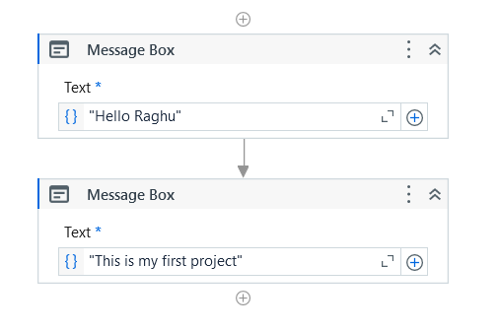
Hands-On Session Display Name

Slide 12
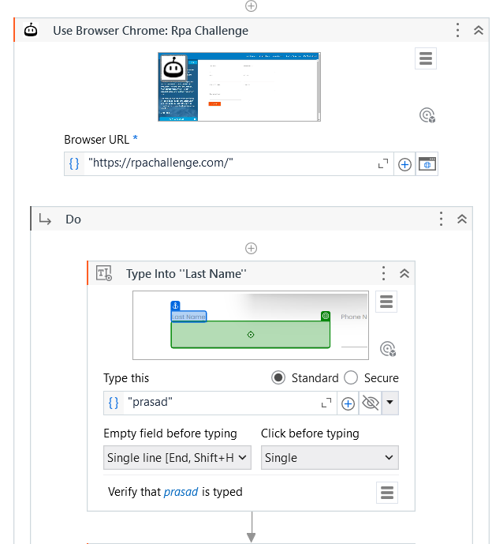
Hands-On Session 1-Data Entry – Part 1 https://rpachallenge.com

Slide 13
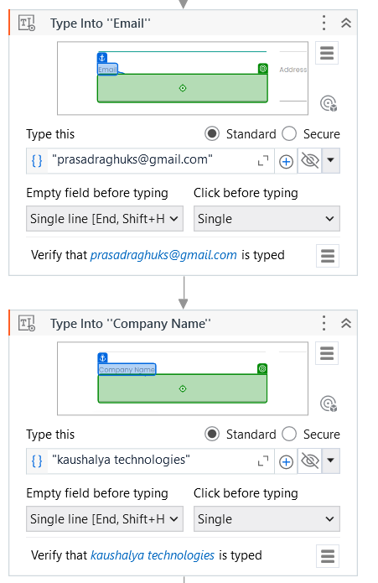
Hands-On Session 1-Data Entry – Part 2

Slide 14
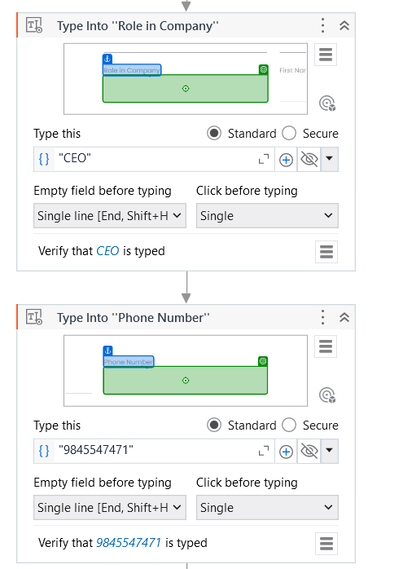
Hands-On Session 1-Data Entry – Part 3

Slide 15
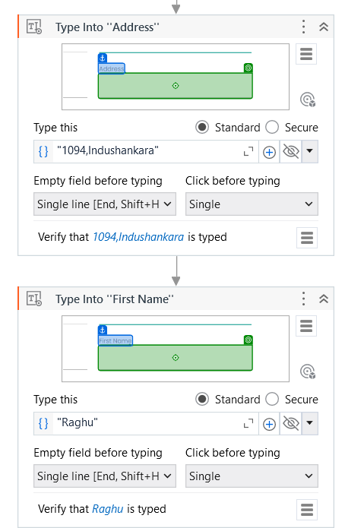
Hands-On Session 1-Data Entry – Part 4

Slide 16
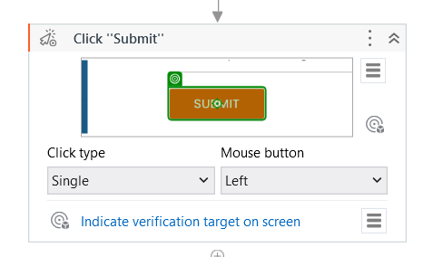
Hands-On Session 1-Data Entry – Part 5

Slide 17
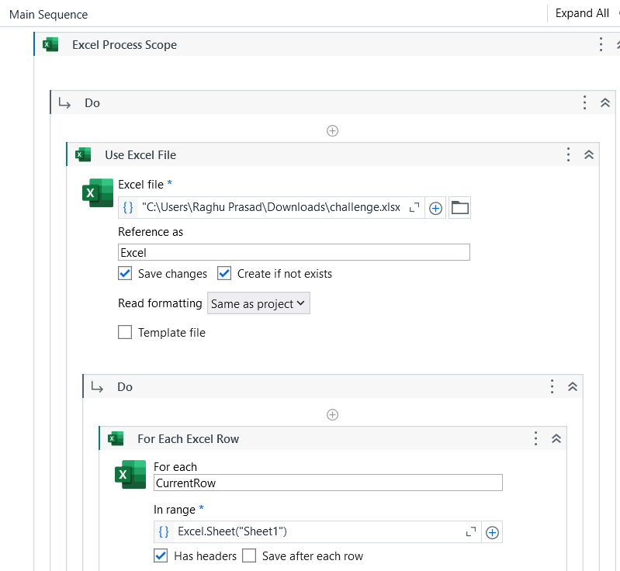
Hands-On Session 2-ReadDataFromExcel – Part 1

Slide 18
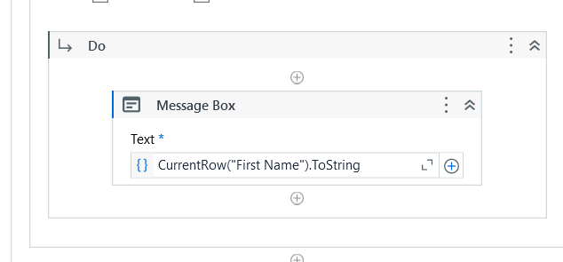
Hands-On Session 2-ReadDataFromExcel – Part 2

Slide 19
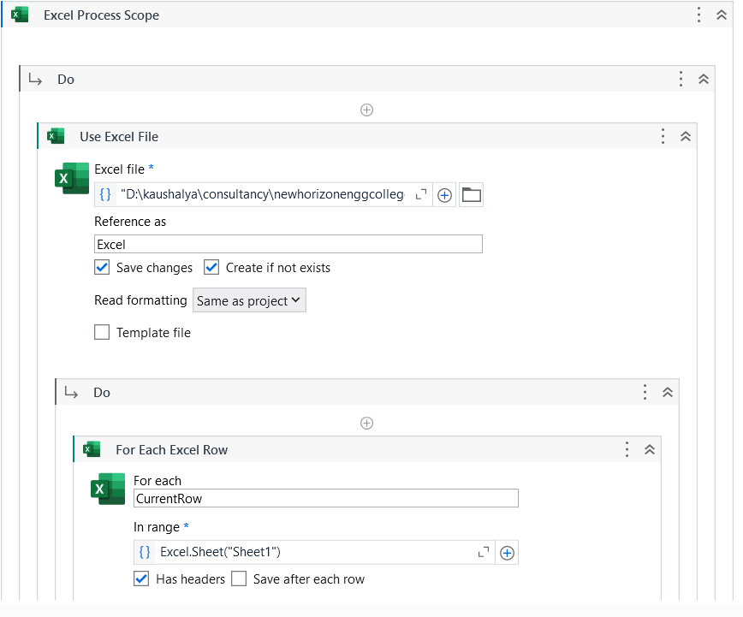
Hands-On Session 3-PopulateDataExceltoForm – Part 1

Slide 20
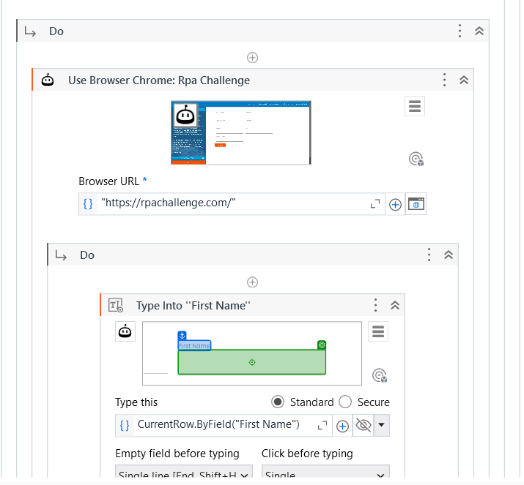
Hands-On Session 3-PopulateDataExceltoForm – Part 2

Slide 21
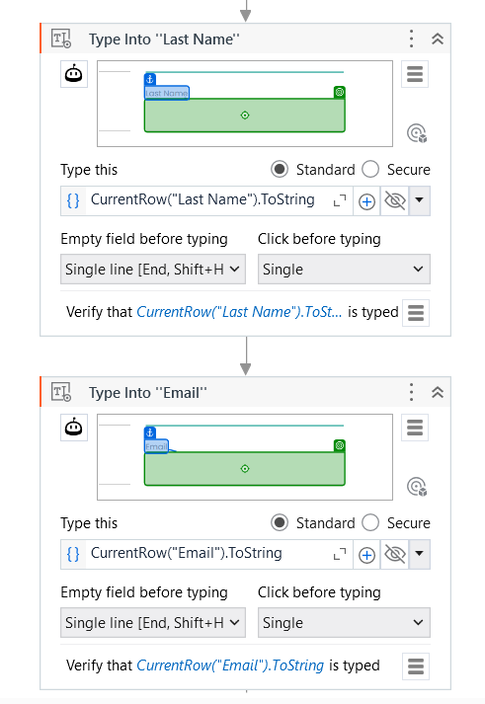
Hands-On Session 3-PopulateDataExceltoForm – Part 3

Slide 22
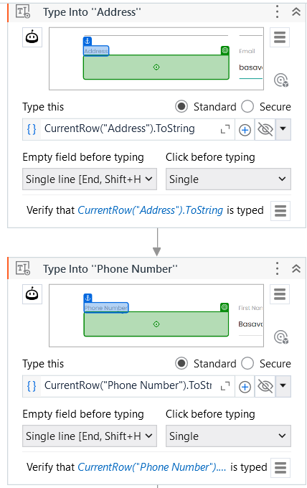
Hands-On Session 3-PopulateDataExceltoForm – Part 4

Slide 23
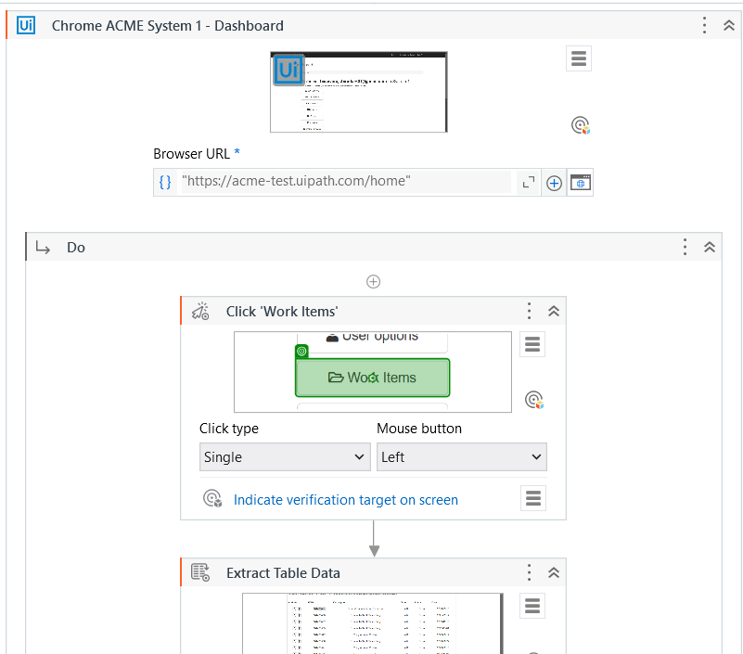
Hands-On Session 4-PopulateData-Excel to Form– Part 1

Slide 24
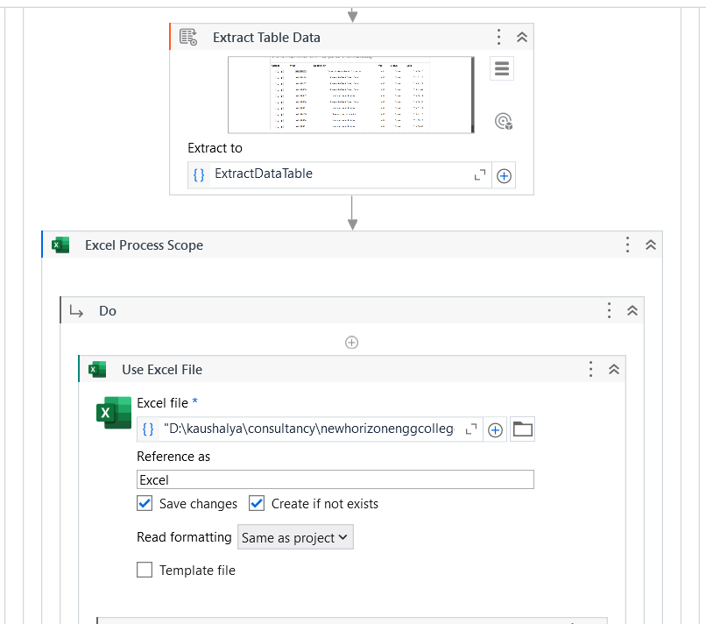
Hands-On Session 4-PopulateData-Excel to Form– Part 2

Slide 25
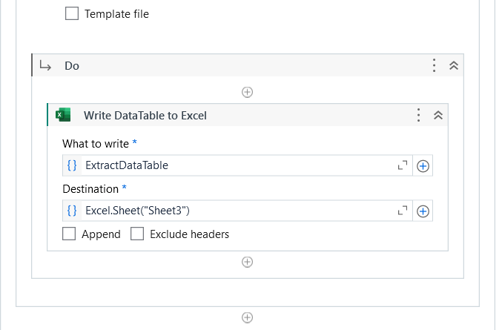
Hands-On Session 4-PopulateData-Excel to Form– Part 3

Slide 26
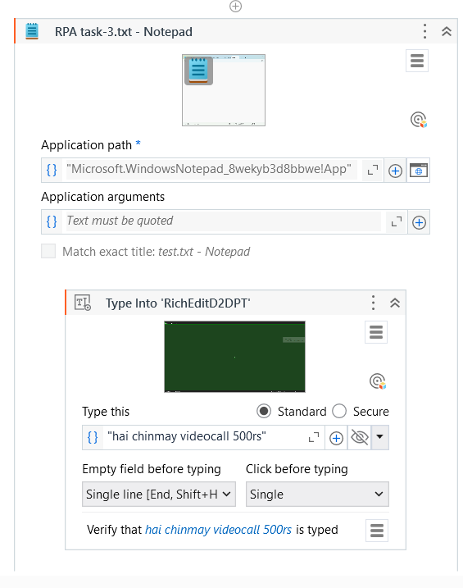
Hands-On Session 5-PopulateData-Field to Notepad

Slide 27
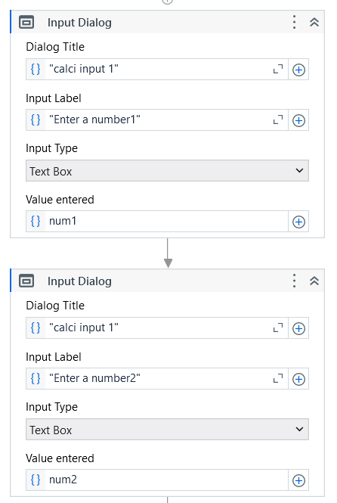
Hands-On Session 6-Calculator-Part1

Slide 28
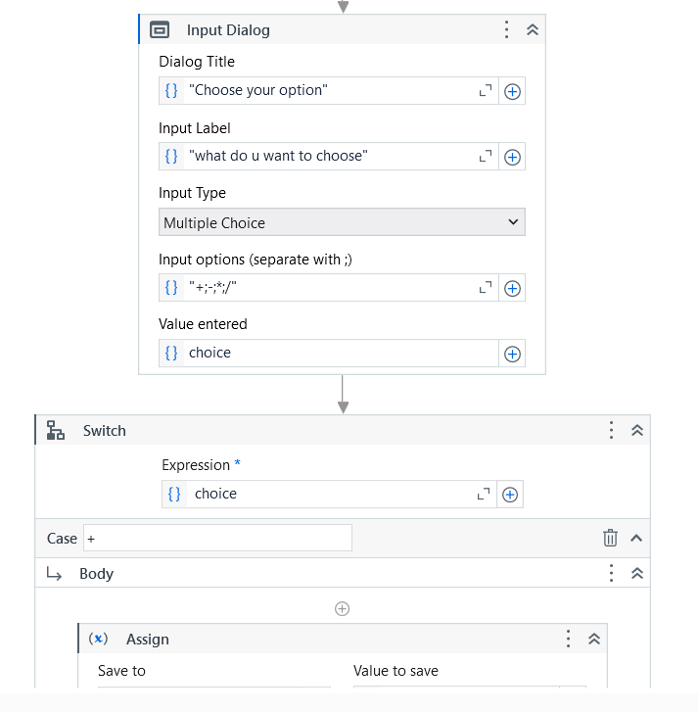
Hands-On Session 6-Calculator-Part2

Slide 29
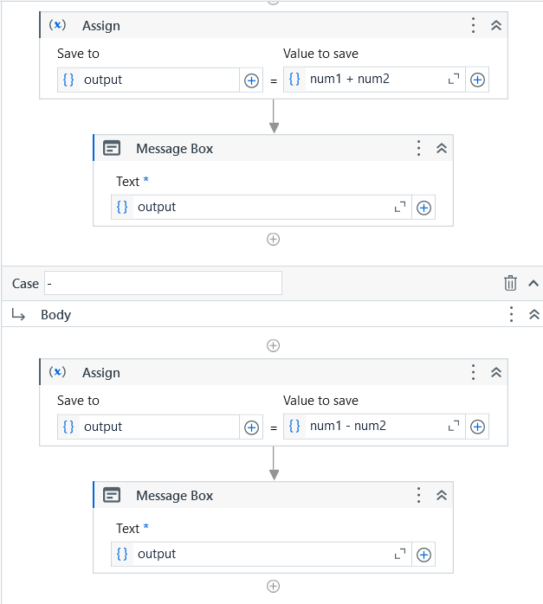
Hands-On Session 6-Calculator-Part3

Slide 30
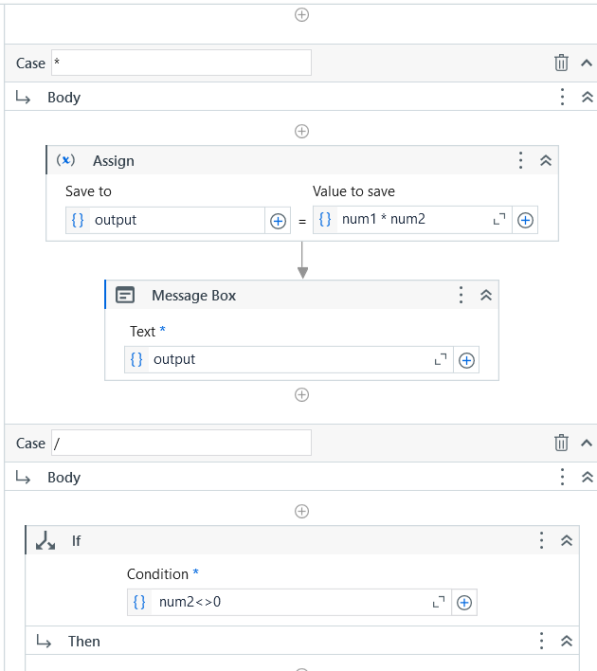
Hands-On Session 6-Calculator-Part4

Slide 31
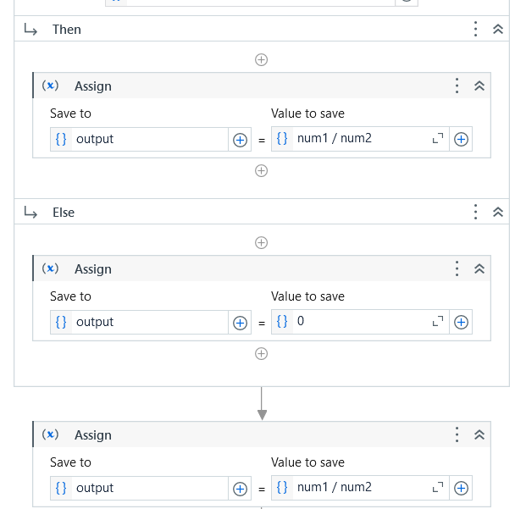
Hands-On Session 6-Calculator-Part5

Slide 32
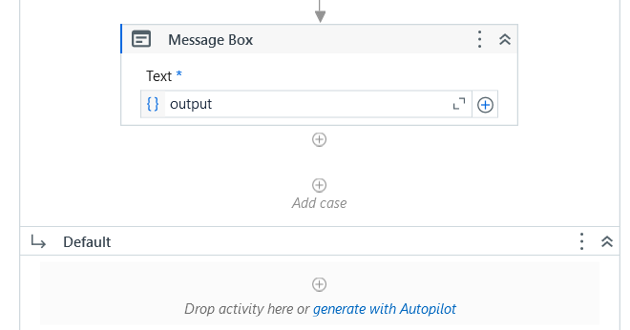
Hands-On Session 6-Calculator-Part6

Slide 33
Q&A
Let’s Discuss on Your Queries
Thank You
www.Kaushalya.tech
9845547471

