Slide 1
IAM – Identity And Access Management
Raghu Prasad
www.kaushalya.tech
9845547471

Slide 2
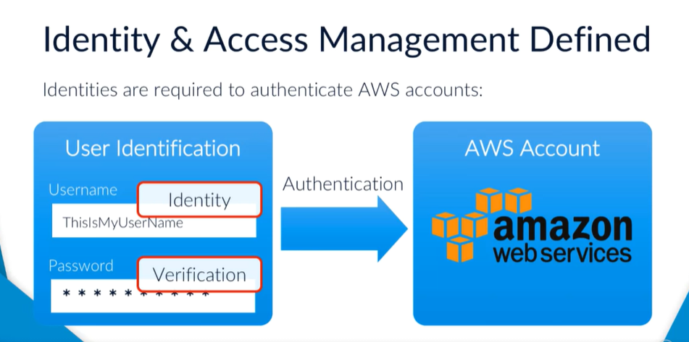
IAM - Introduction

Slide 3
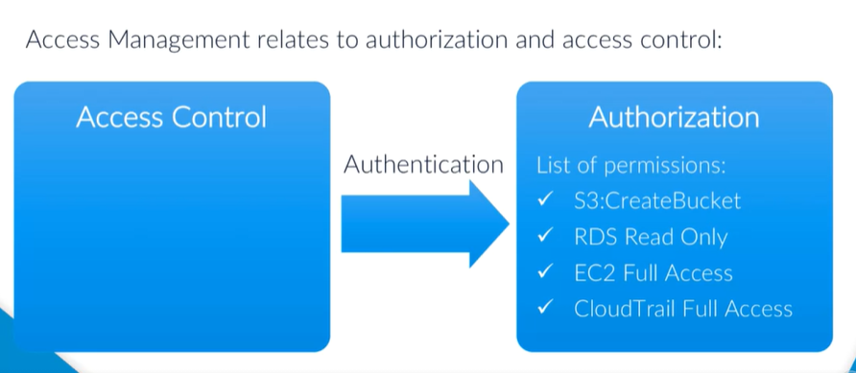
IAM - Introduction

Slide 4
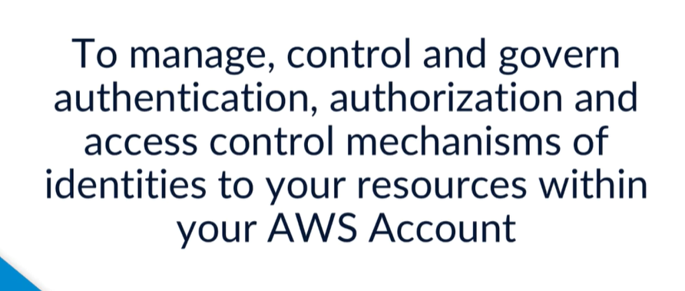
IAM - Introduction

Slide 5
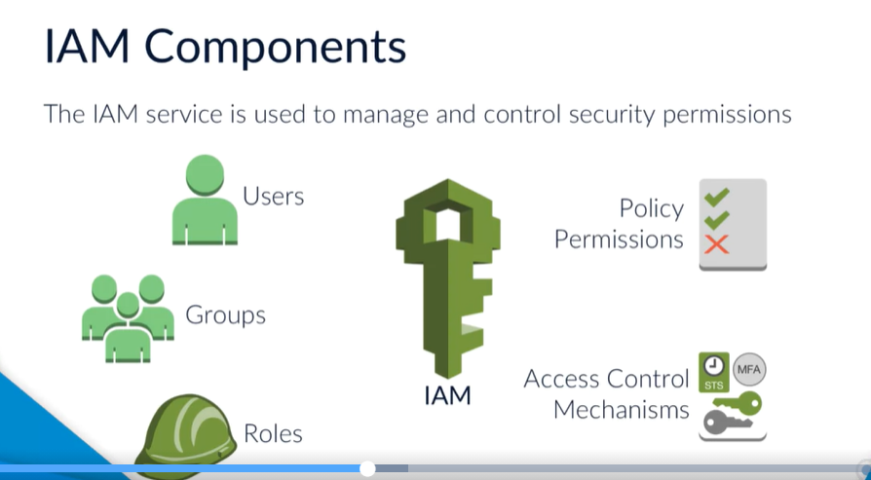
IAM - Introduction

Slide 6
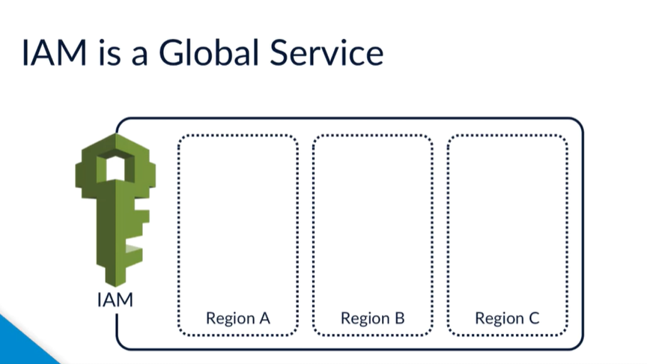
IAM - Introduction

Slide 7
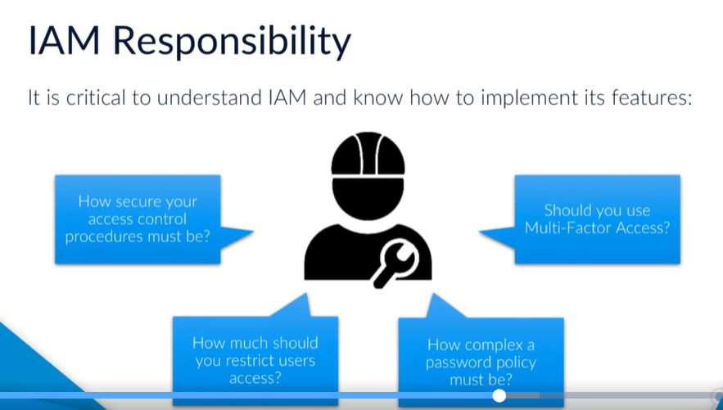
IAM - Introduction

Slide 8
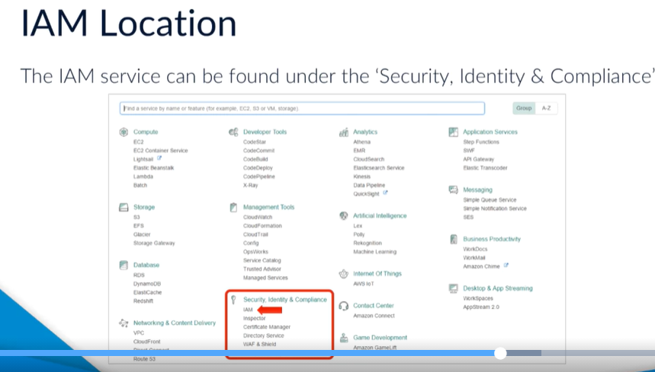
IAM - Introduction

Slide 9
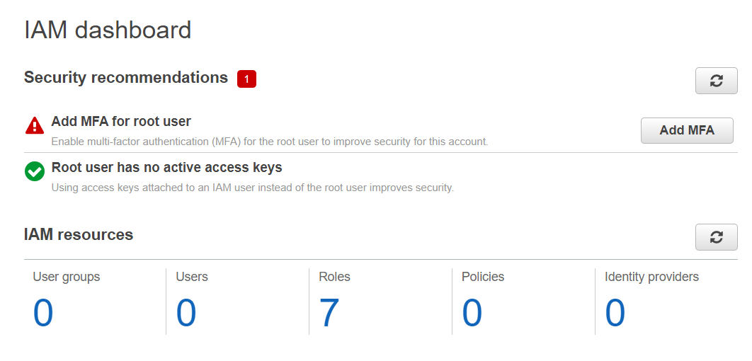
IAM - Introduction

Slide 10
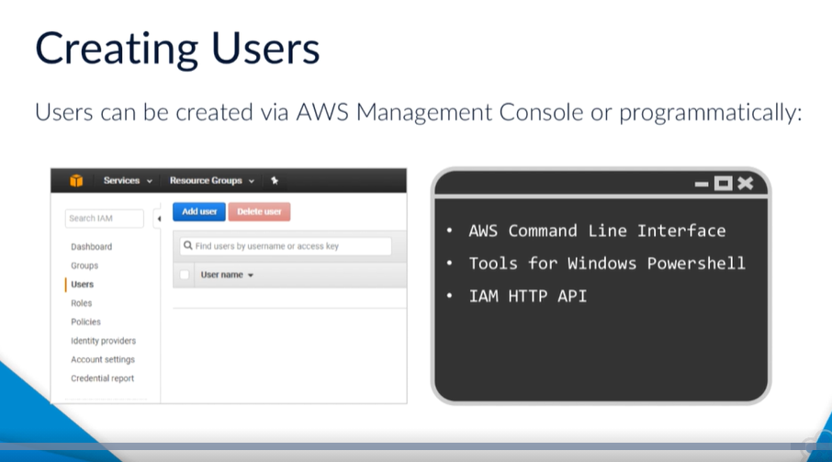
IAM - Introduction

Slide 11
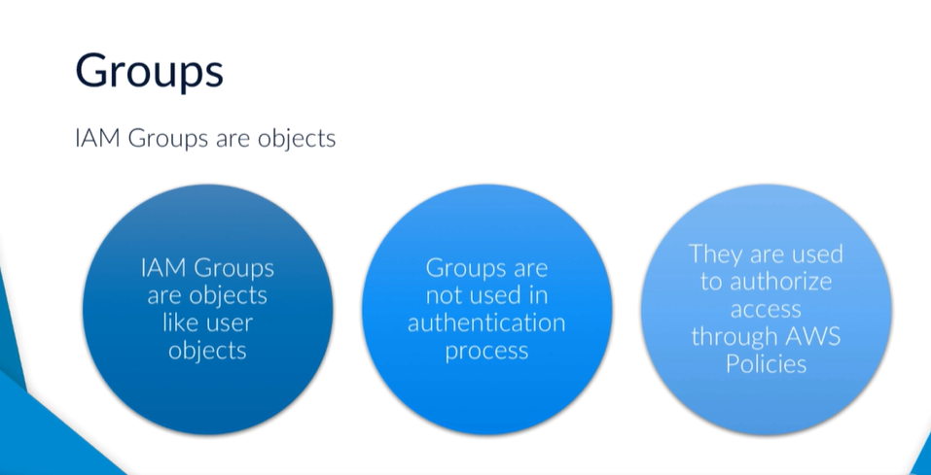
IAM - Introduction

Slide 12
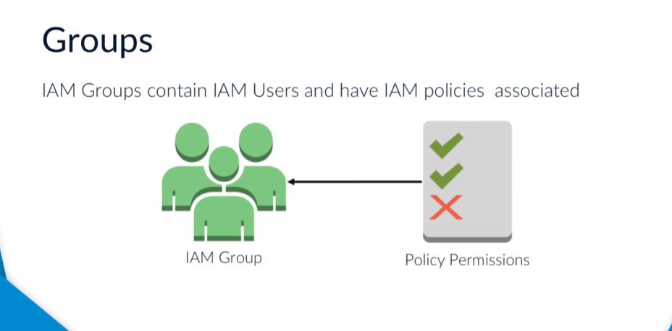
IAM - Introduction

Slide 13
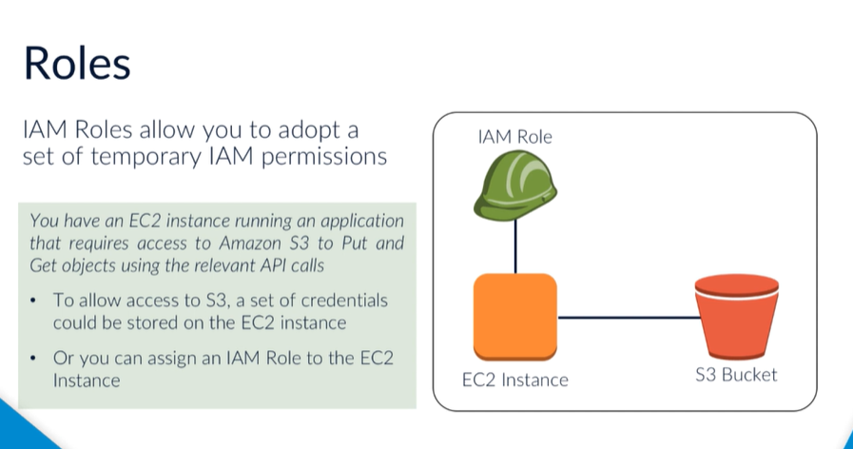
IAM - Introduction

Slide 14
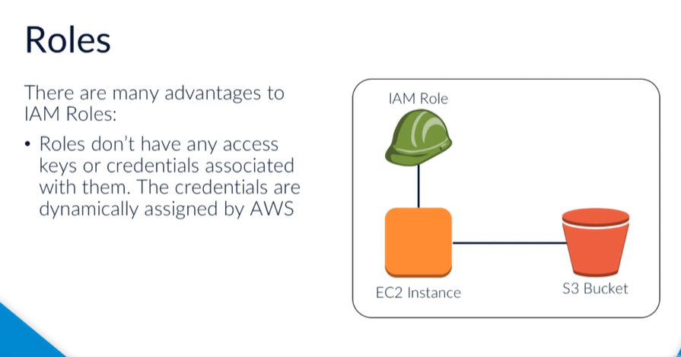
IAM - Introduction

Slide 15
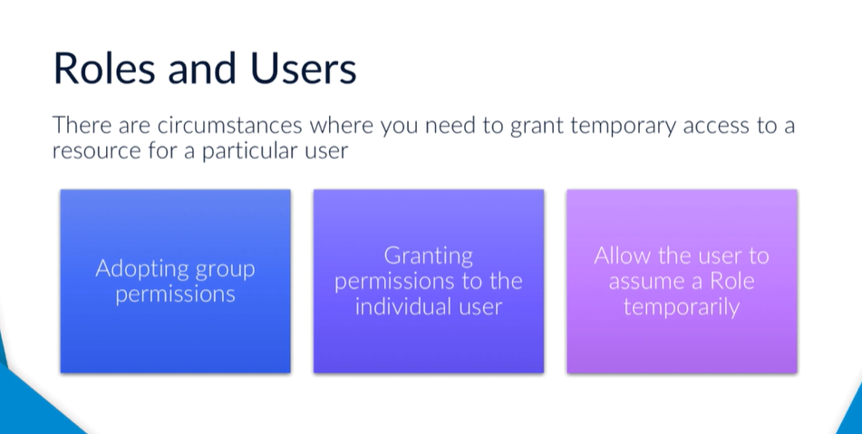
IAM - Introduction

Slide 16

Thank You

