Slide 1
AWS – EC2- Webserver
Raghu Prasad
www.kaushalya.tech
9845547471

Slide 2
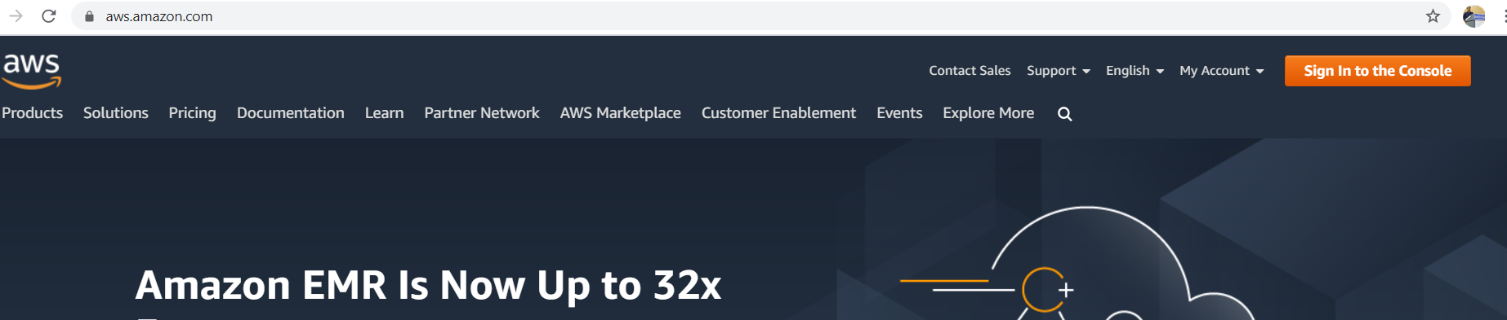
AWS – Sign in to the console
https://aws.amazon.com/

Slide 3
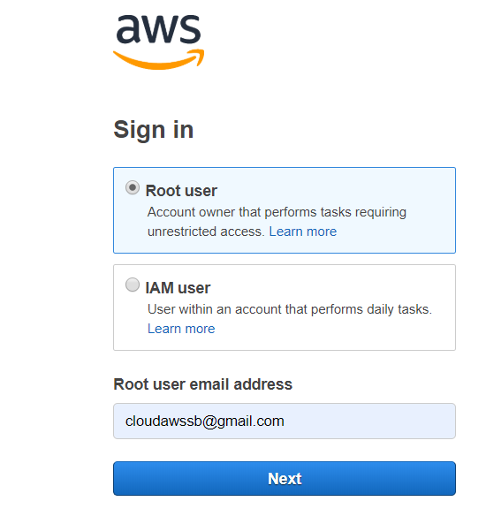
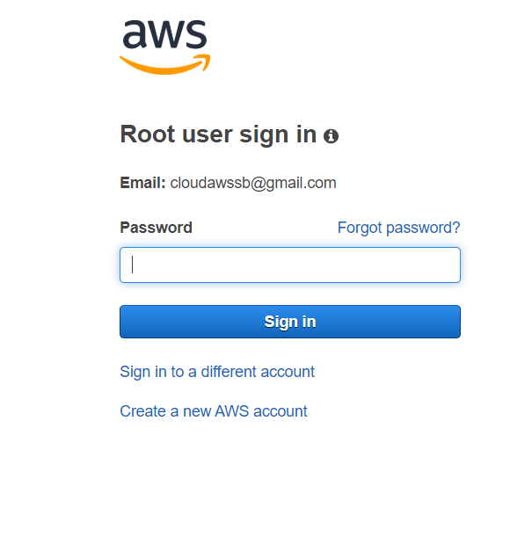
AWS – Sign in to the console
Sign in as root user

Slide 4
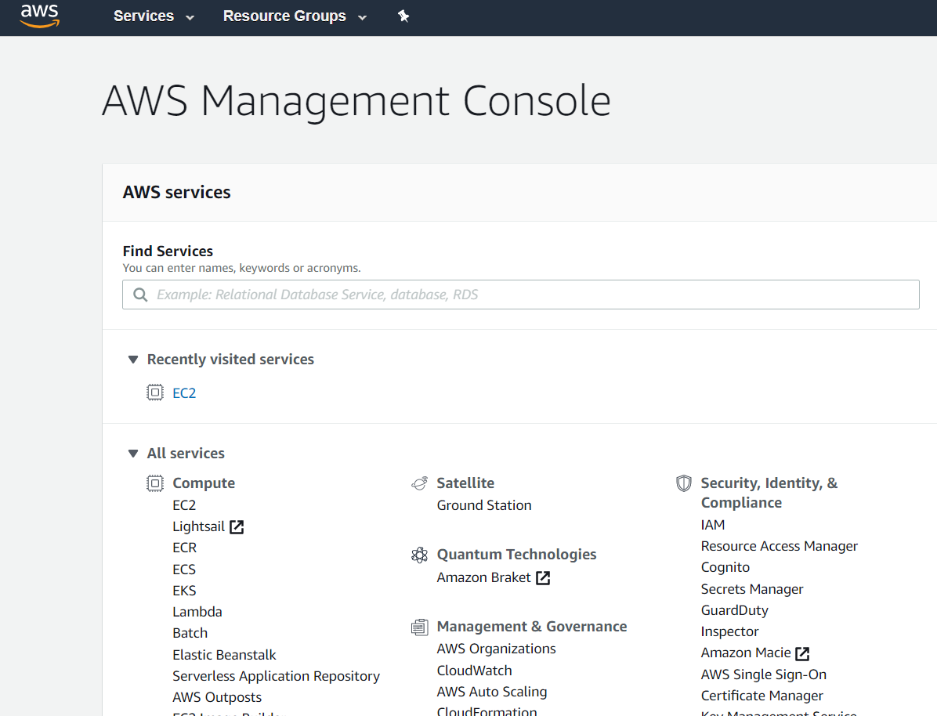
AWS – AWS Services
Home page

Slide 5
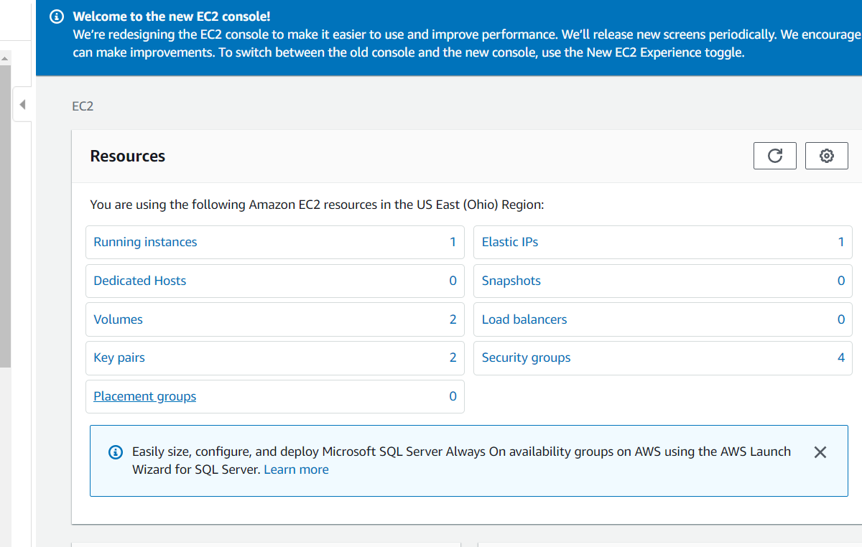
AWS – Compute - EC2
Click on EC2

Slide 6
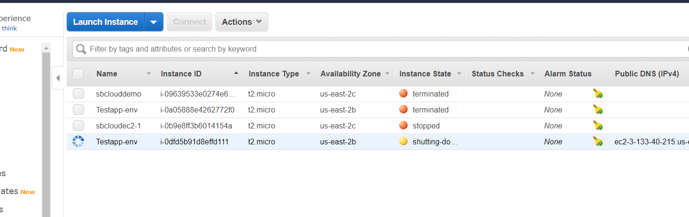
AWS – Compute - EC2
Running Instances – Click on Launch Instance

Slide 7
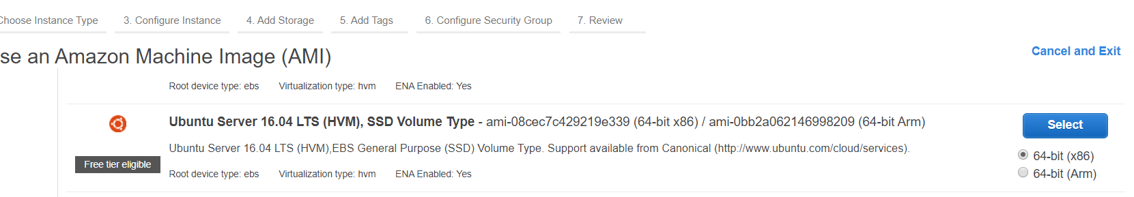
AWS – Compute - EC2
Launch Instance – Ubuntu – Free tier and click Review and launch

Slide 8
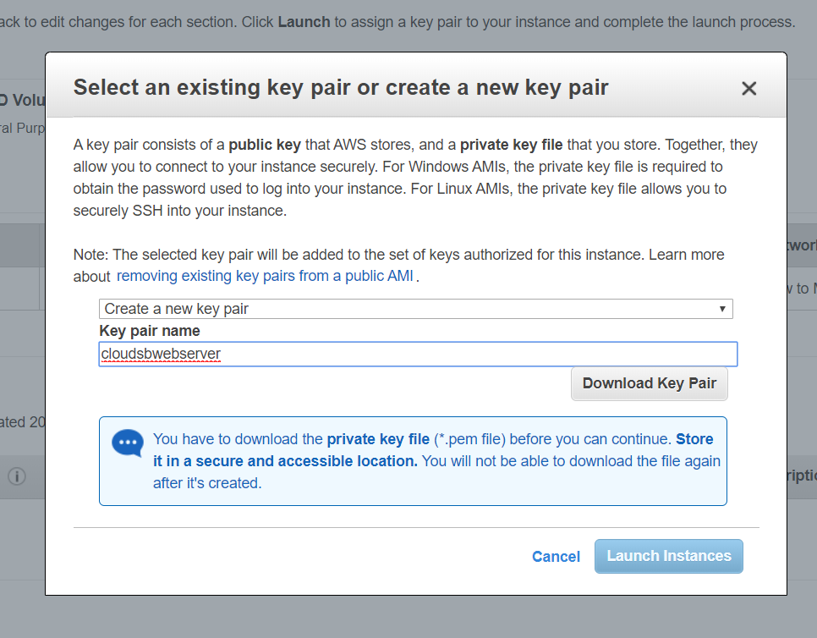
AWS – Compute - EC2
Download key value pair

Slide 9
AWS – Compute - EC2
Download key value pair and Launch Instances

Slide 10
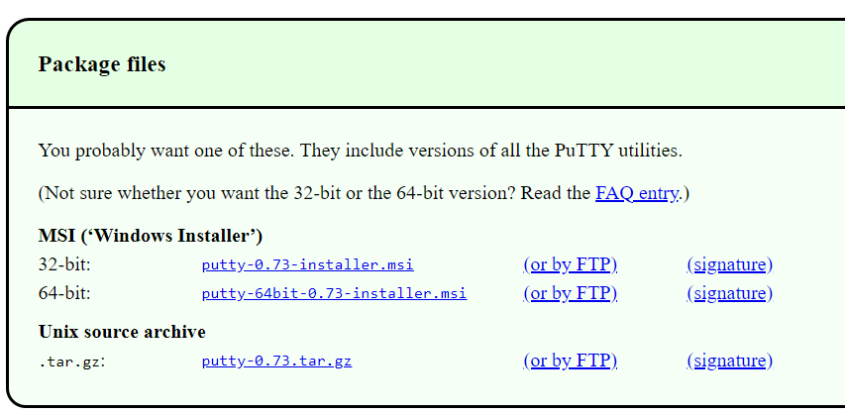
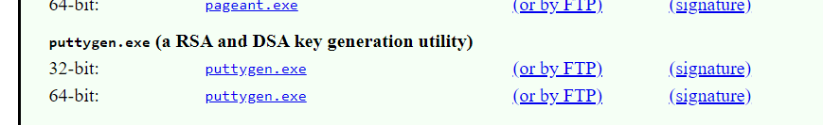
AWS – Compute - EC2
Copy downloaded file to a folder
Download putty and puttygen from https://www.putty.org/

Slide 11
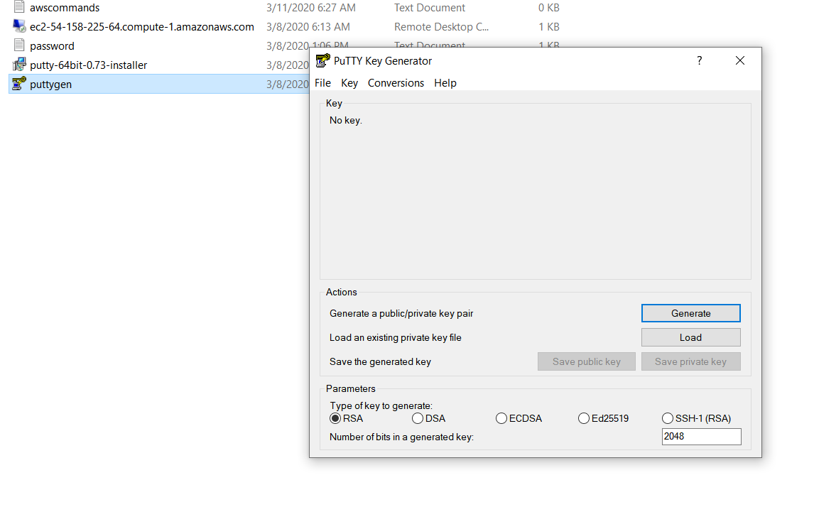
AWS – Compute - EC2
Install putty
Click on puttygen

Slide 12
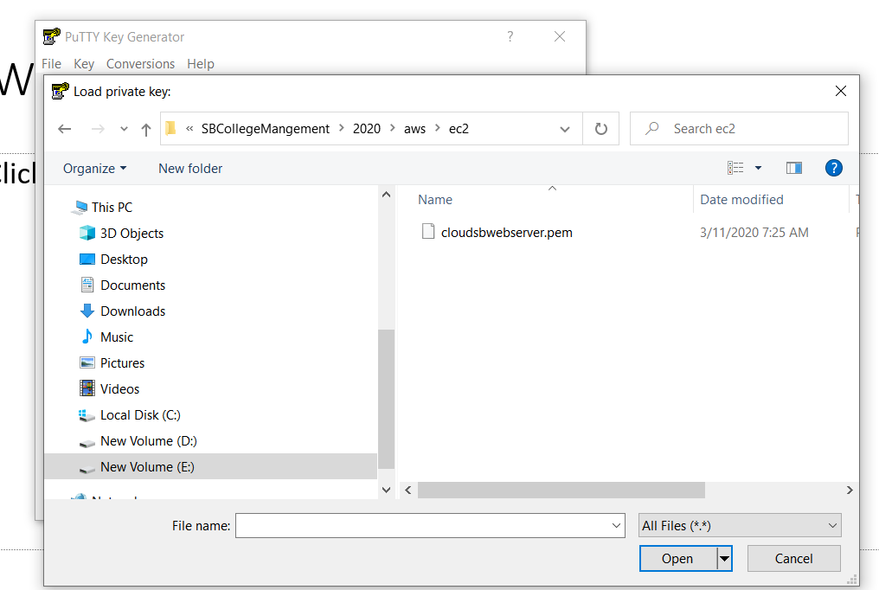
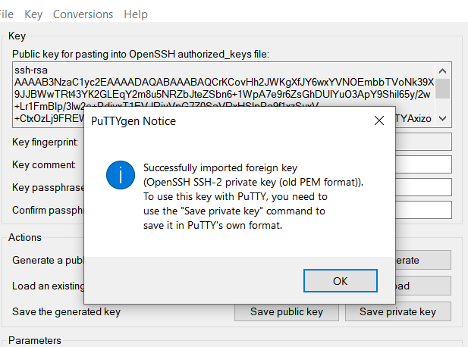
AWS – Compute - EC2
Click on Load and select downloaded pem file

Slide 13
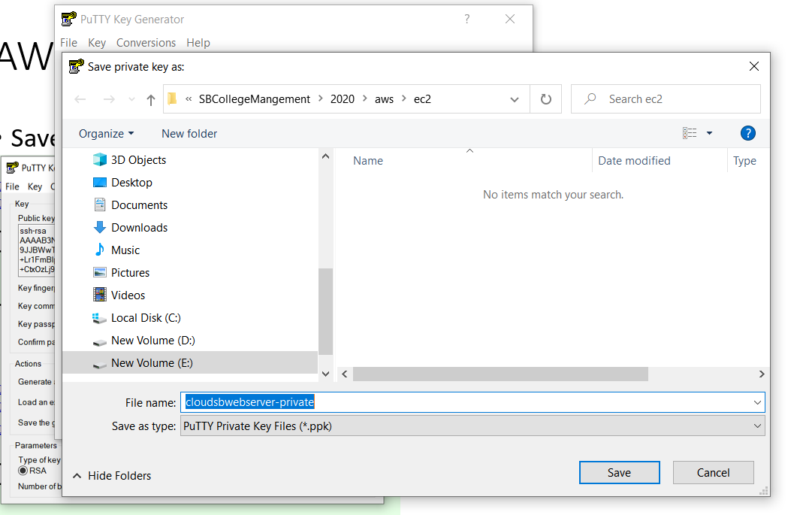
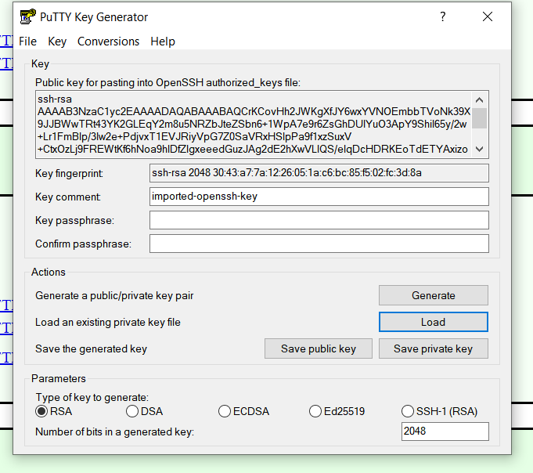
AWS – Compute - EC2
Save private and public key

Slide 14
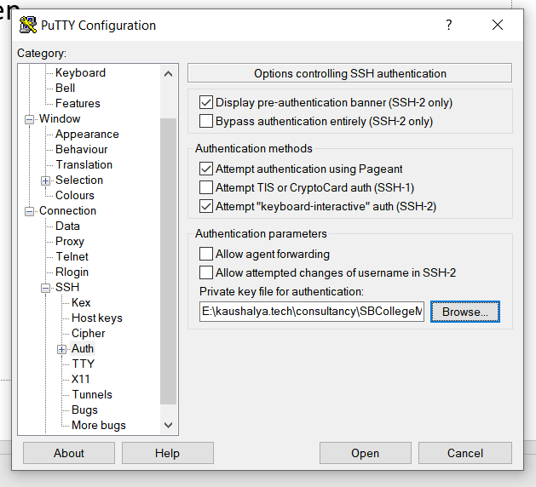
AWS – Compute - EC2
Browse the private key and open

Slide 15
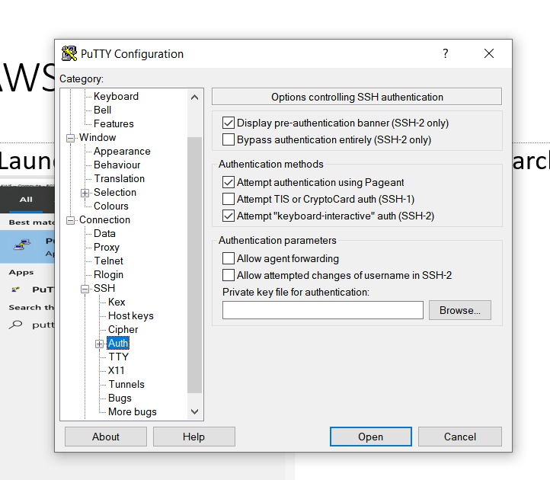
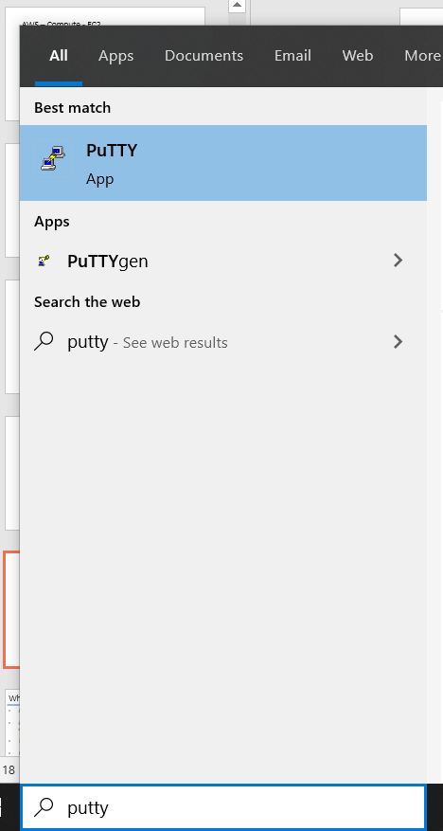
AWS – Compute - EC2
Launch putty by searching in the windows search
Click on SSH and Auth

Slide 16
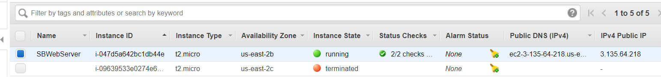
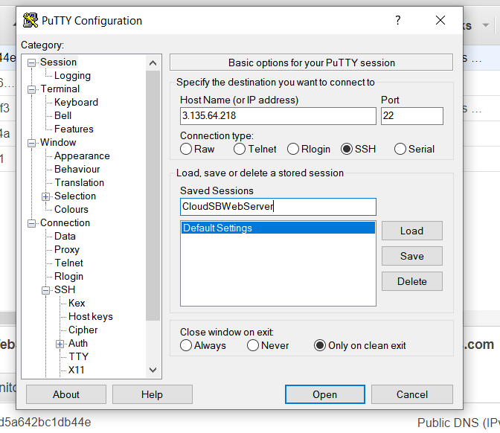
AWS – Compute - EC2
IPV4 address of the EC2 Instance and Save the instance in putty

Slide 17
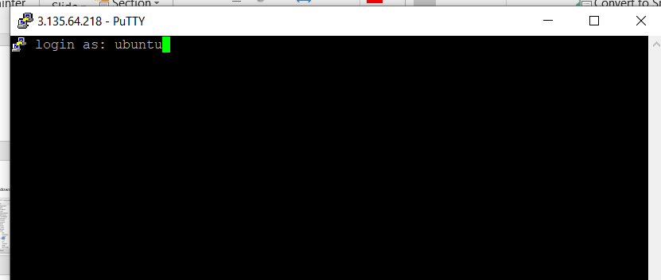
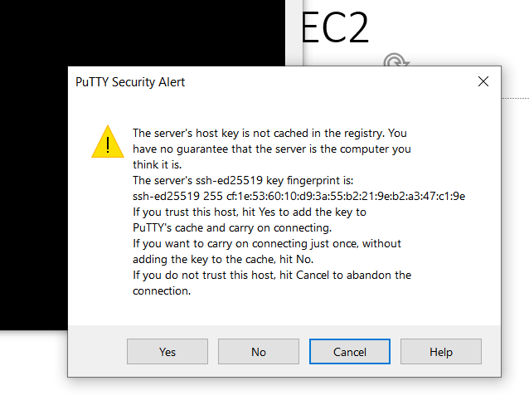
AWS – Compute - EC2
Open the instance anc click Yes and Login as ubuntu

Slide 18
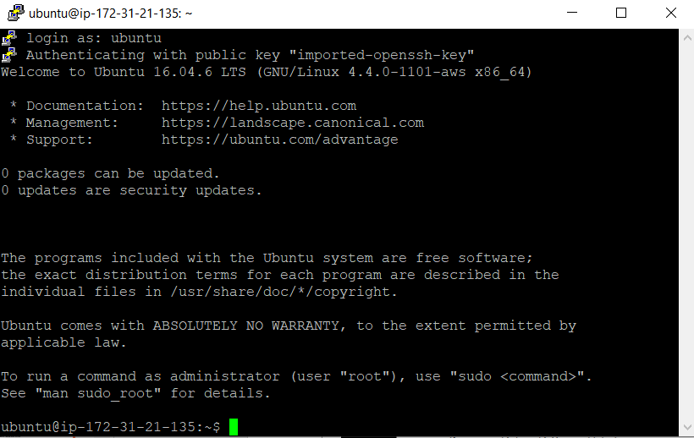
AWS – Compute - EC2
Open the instance anc click Yes and Login as ubuntu

Slide 19
AWS – Compute - EC2
Few commands used to install and run apache server
netstat –antp
apt-get –h
sudo apt-get update
sudo apt-get install apache2
sudo service apache2 stop
sudo service apache2 start

Slide 20
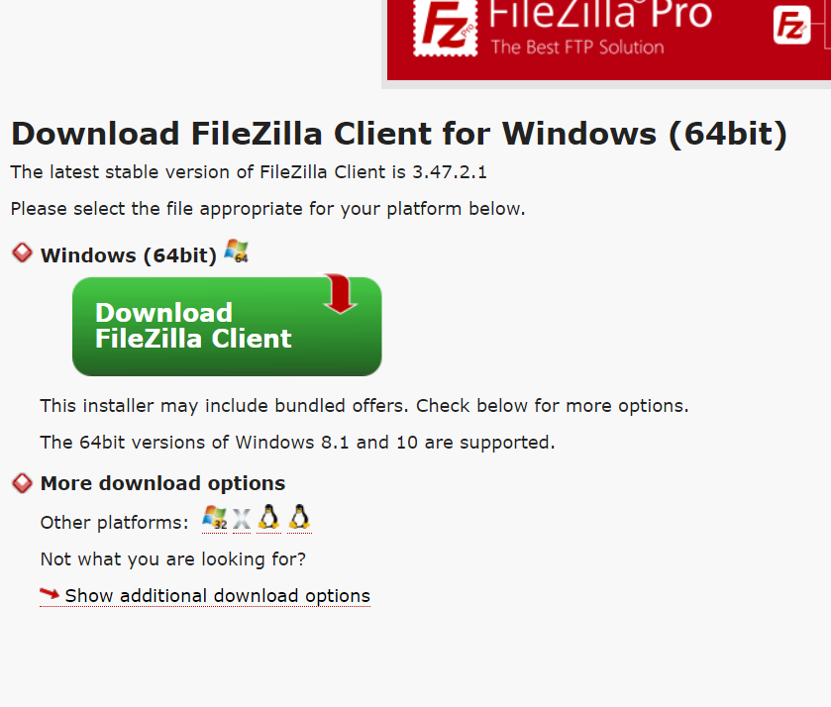
AWS – Compute - EC2
Download Filezilla. Filezilla is required to transfer files to EC2
https://filezilla-project.org/download.php?platform=win64

Slide 21
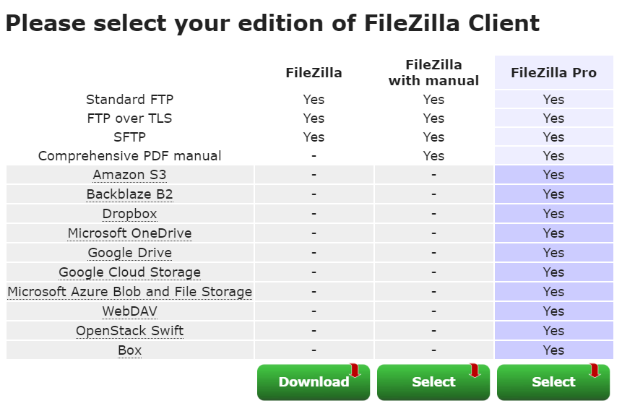
AWS – Compute - EC2
Download FileZilla (first option)

Slide 22

Thank You

