Slide 1
mLab – Database-as-a-Service for MongoDB
Raghu Prasad
www.kaushalya.tech
9845547471

Slide 2
MongoDB - Introduction
MongoDB is a general purpose, document-based, distributed database built for modern application developers and for the cloud era. No database makes you more productive.
MongoDB is a document database designed for ease of development and scaling.
MongoDB offers both a Community and an Enterprise version of the database

Slide 3
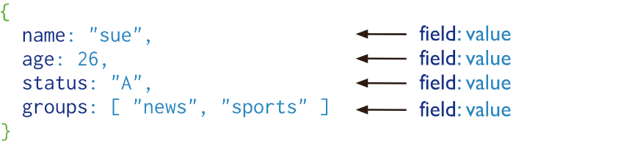
Document Database
A record in MongoDB is a document, which is a data structure composed of field and value pairs. MongoDB documents are similar to JSON objects. The values of fields may include other documents, arrays, and arrays of documents.

Slide 4
Document Database
A record in MongoDB is a document, which is a data structure composed of field and value pairs. MongoDB documents are similar to JSON objects. The values of fields may include other documents, arrays, and arrays of documents.

Slide 5
Document Database
The advantages of using documents are:
Documents (i.e. objects) correspond to native data types in many programming languages.
Embedded documents and arrays reduce need for expensive joins.
Dynamic schema supports fluent polymorphism.
MongoDB stores documents in collections. Collections are analogous to tables in relational databases.
https://docs.mongodb.com/manual/tutorial/getting-started/

Slide 6
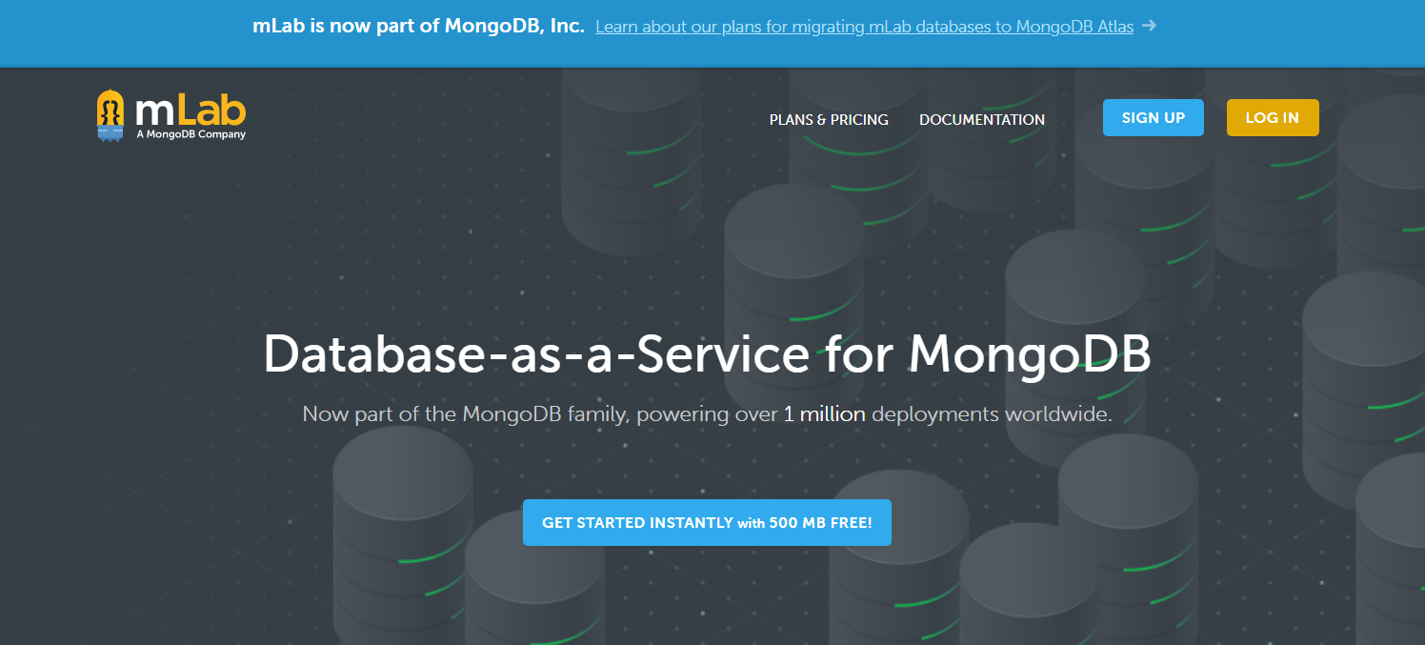
mLab – Cloud Database
Open https://mlab.com/

Slide 7
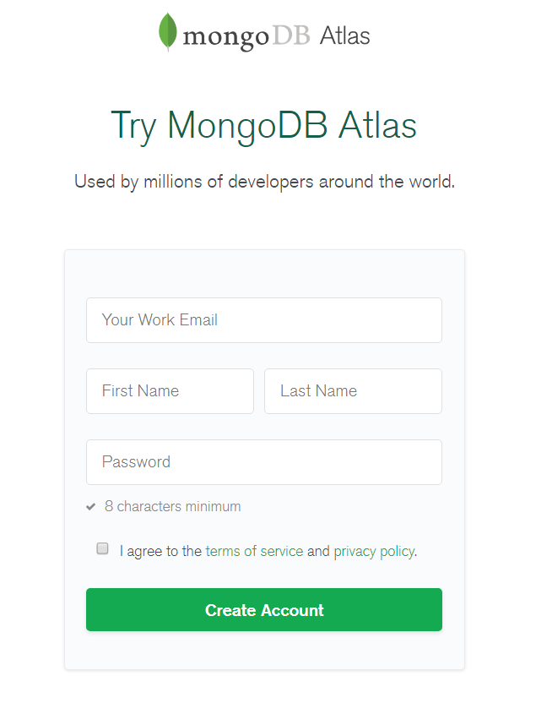
mLab – Cloud Database
SIGN UP

Slide 8
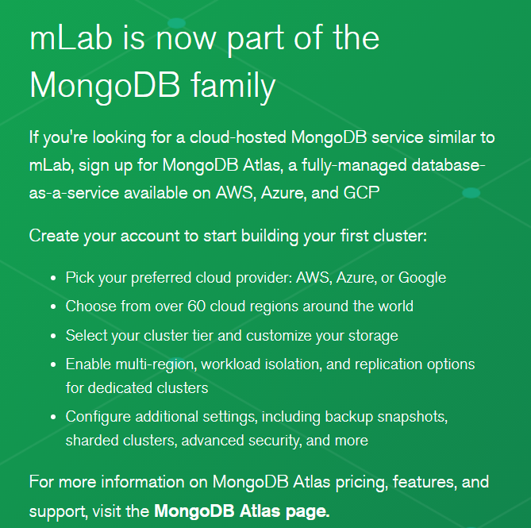
mLab – Cloud Database

Slide 9
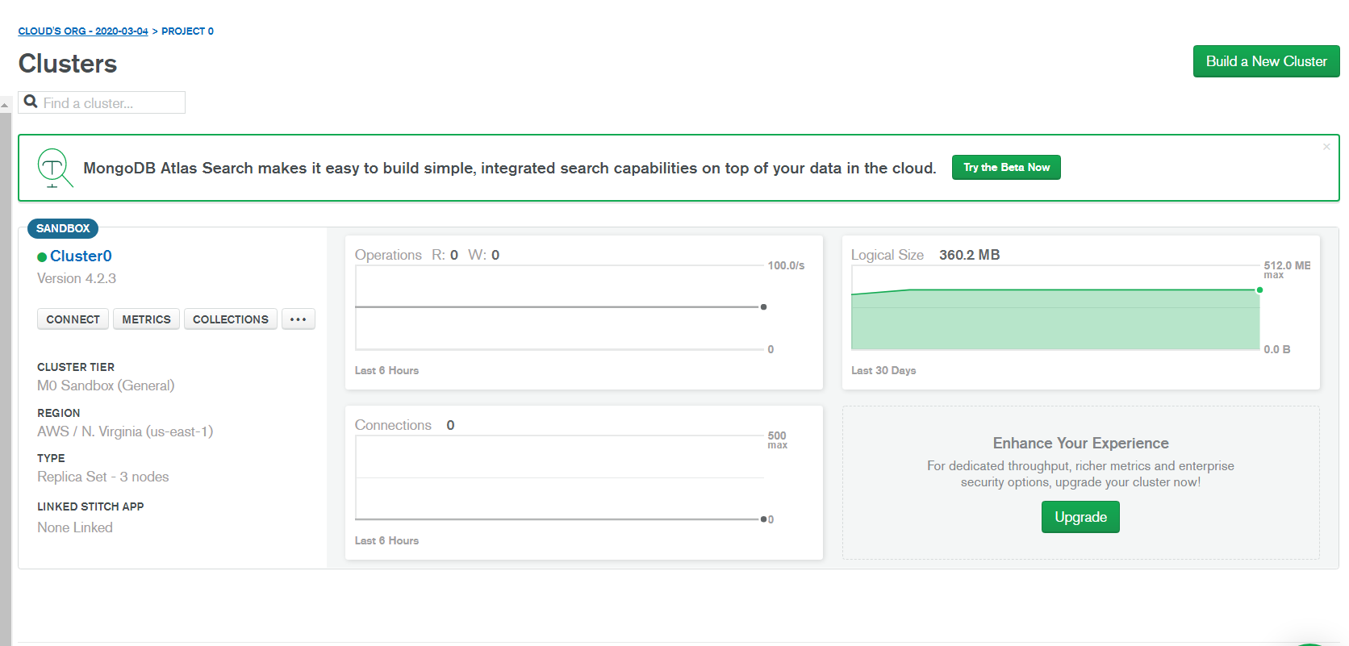
mLab – Cloud Database
Login - https://account.mongodb.com/account/login
Create a cluster

Slide 10
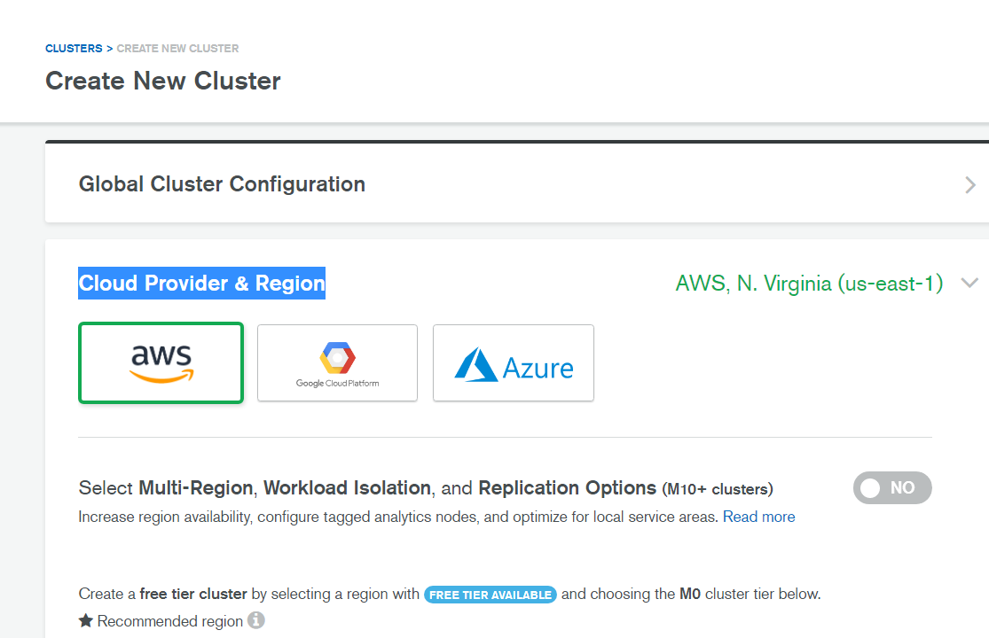
mLab – Cloud Database
Login - https://account.mongodb.com/account/login
Create a cluster

Slide 11
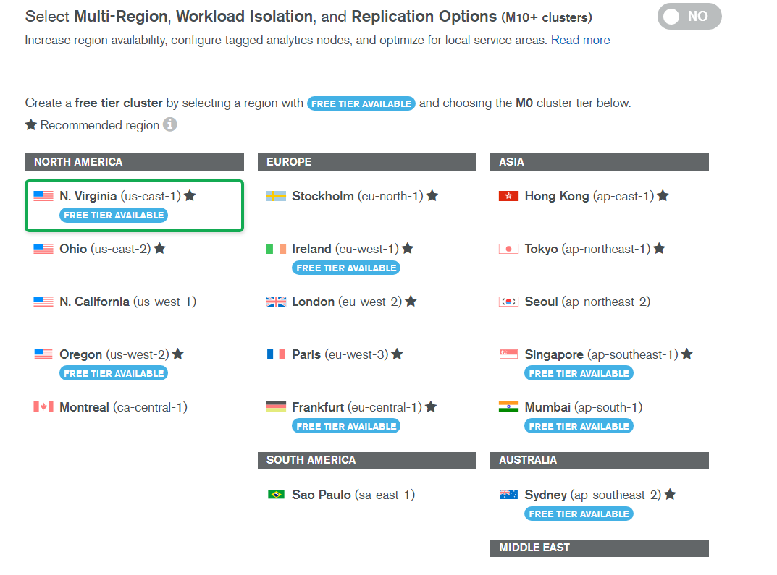
mLab – Cloud Database
Create a cluster

Slide 12
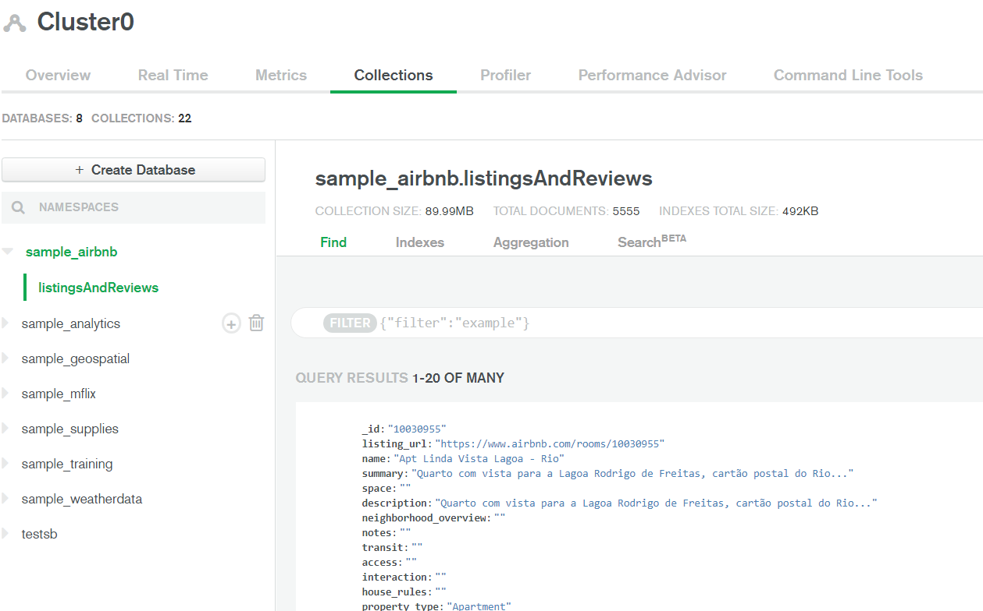
mLab – Cloud Database
Load Collections
Create Database

Slide 13

Thank You

