Slide 1
AWS
Raghu Prasad
www.kaushalya.tech
9845547471

Slide 2
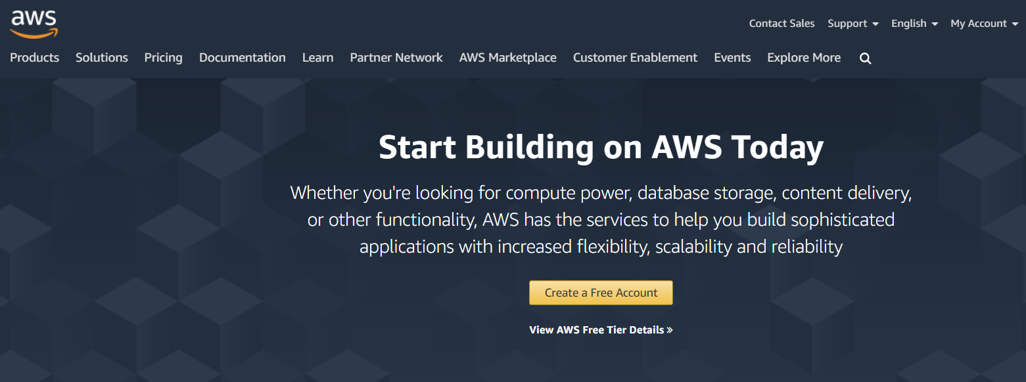
AWS – Create a Free Account
https://aws.amazon.com/

Slide 3
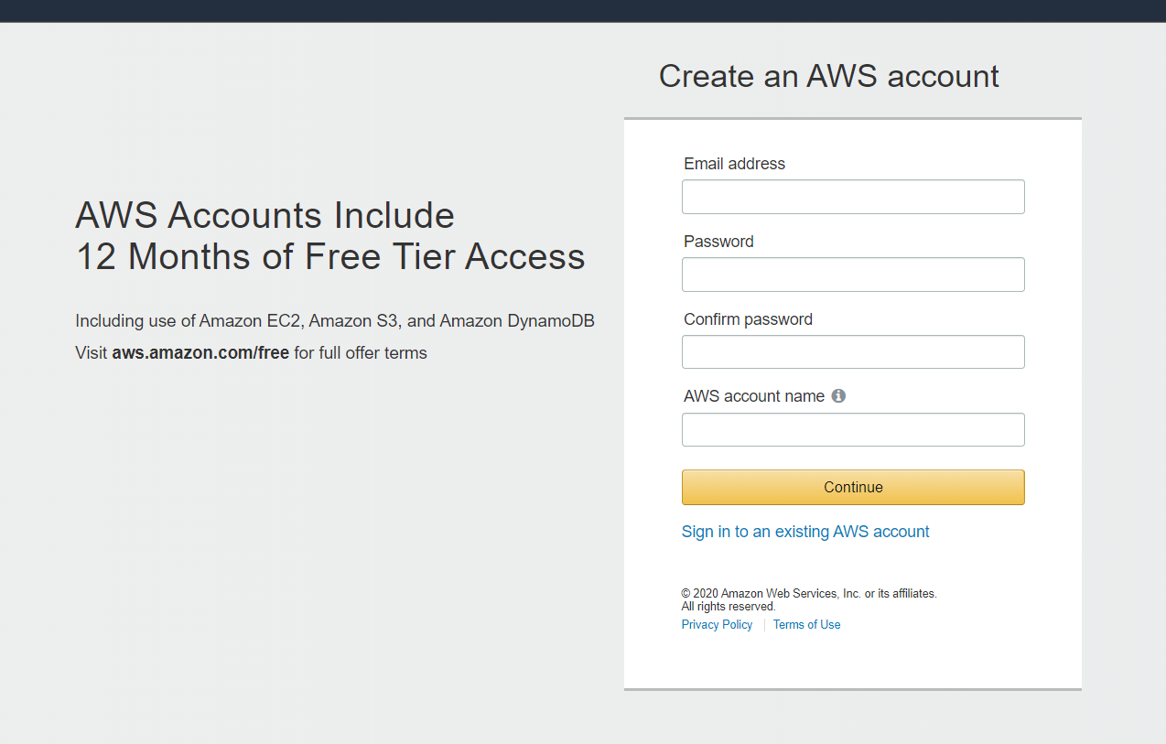
AWS – Create a Free Account
Click on Create a Free Account

Slide 4
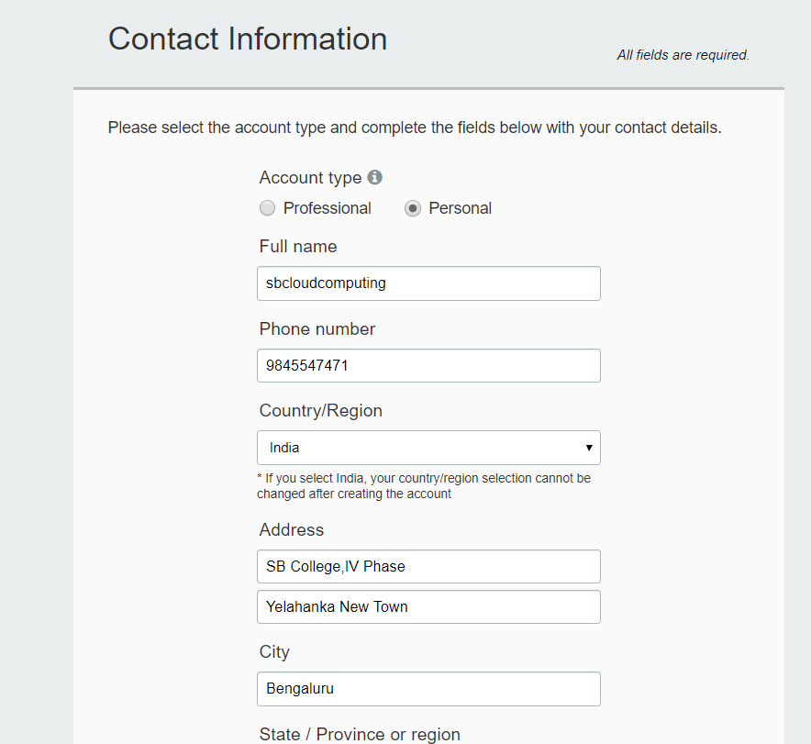
AWS – Create a Free Account

Slide 5
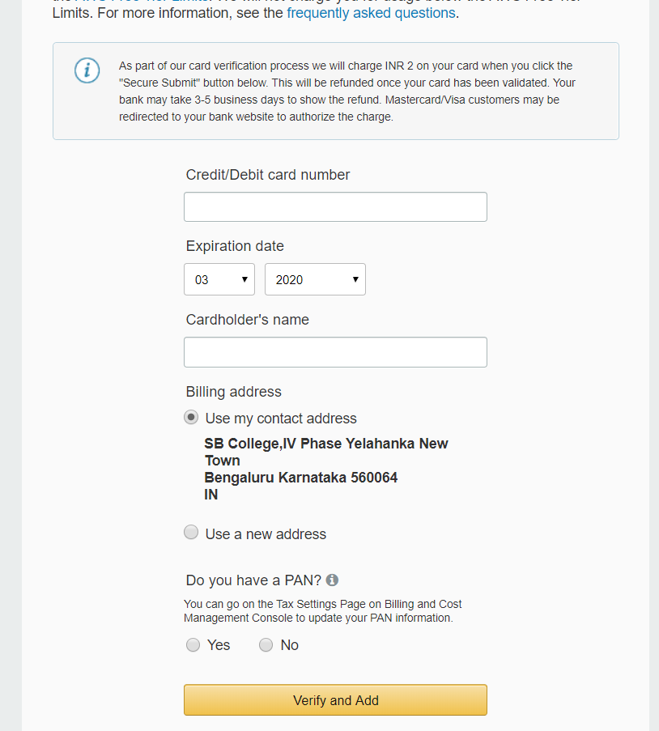
AWS – Payment options

Slide 6
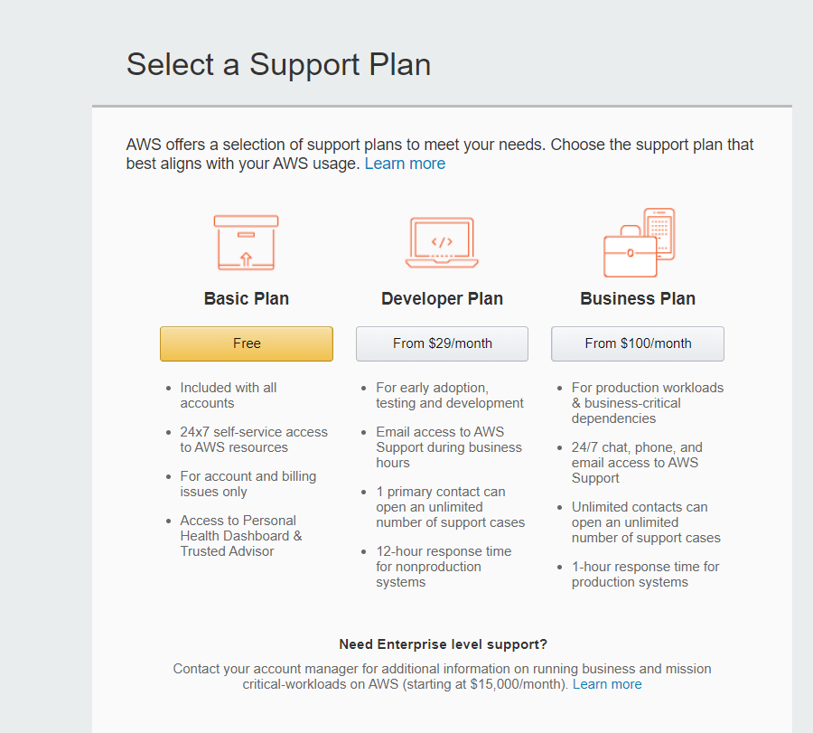
AWS – Support Plan

Slide 7
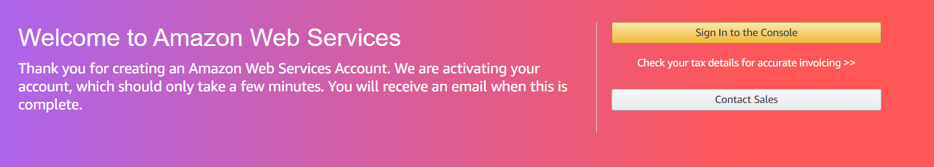
AWS – Confirm through email

Slide 8
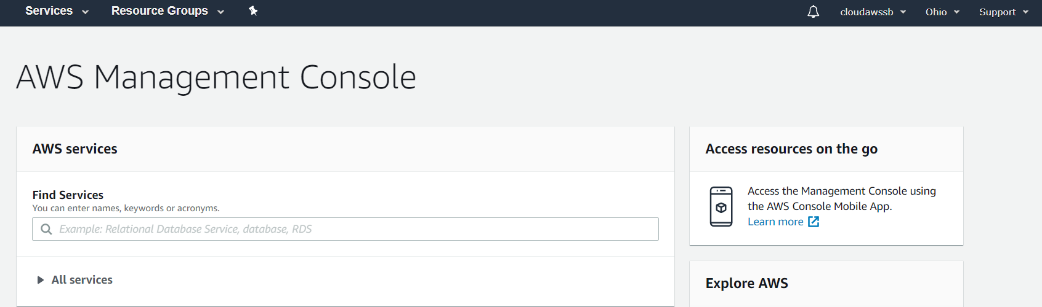
AWS – After Login

Slide 9
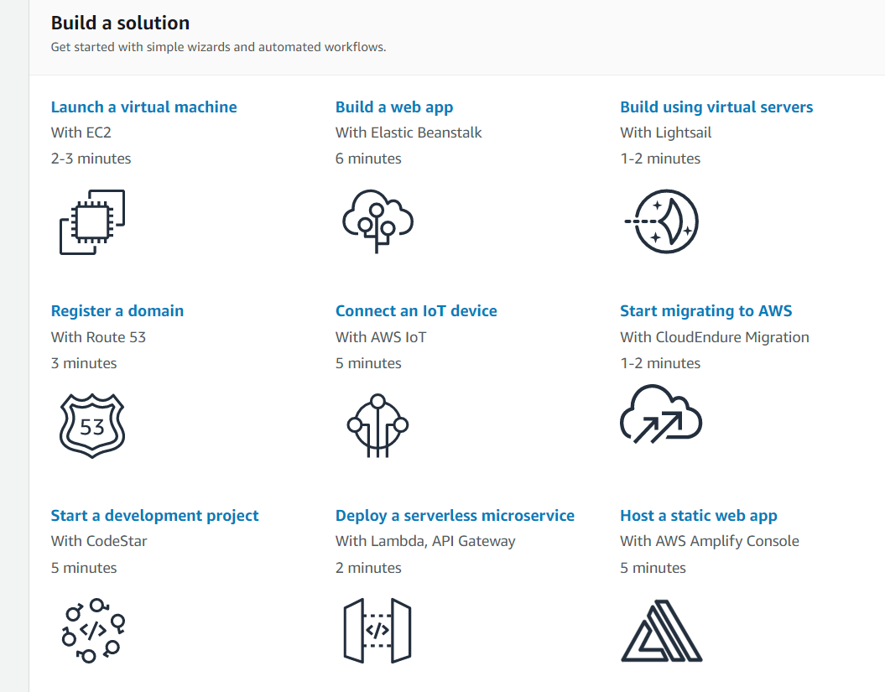
AWS – After Login

Slide 10
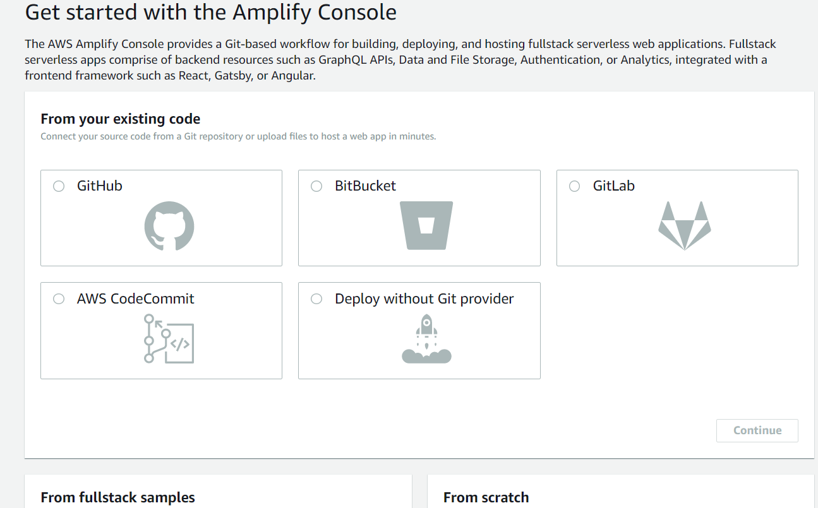
AWS – Host a static website

Slide 11
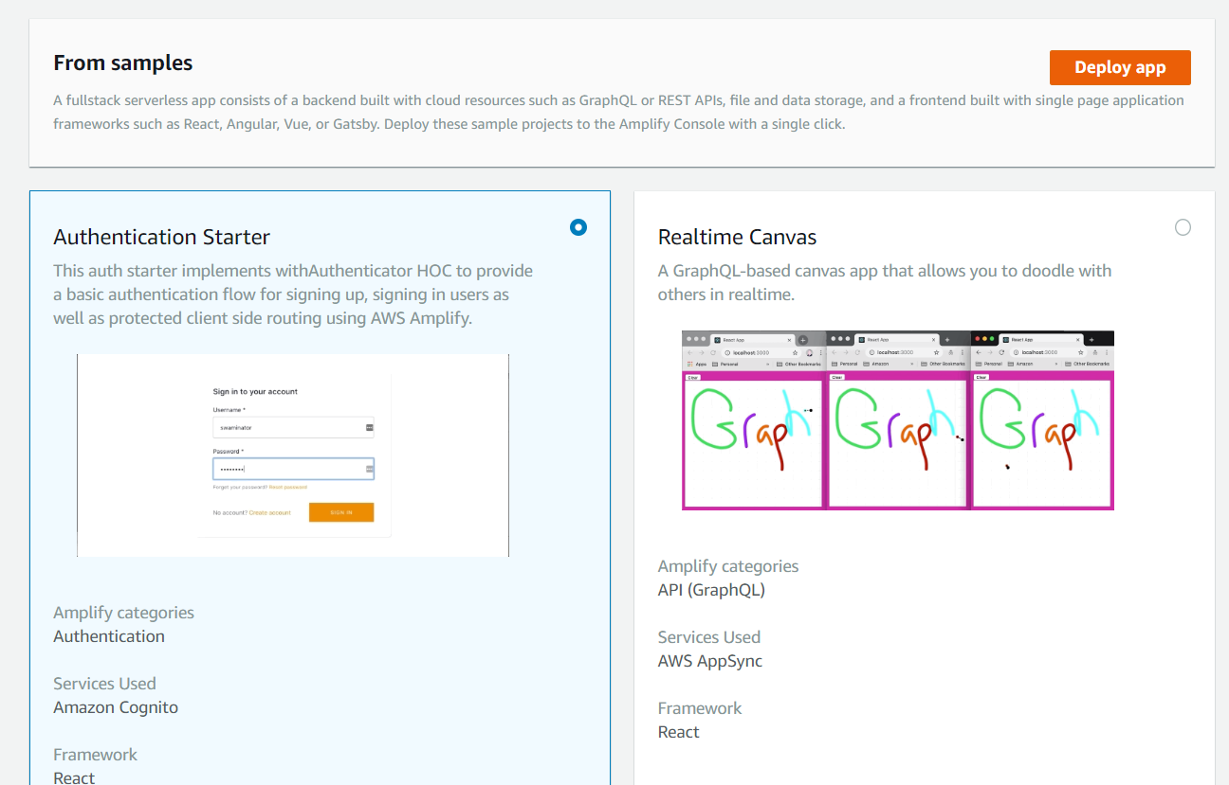
AWS – From Samples

Slide 12
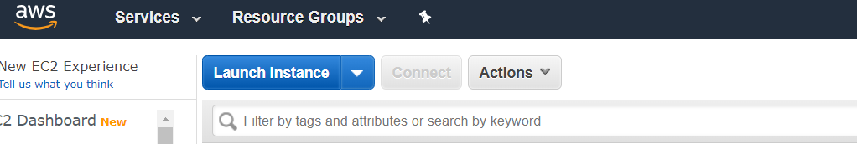
AWS – Compute
EC2 – Elastic Cloud Compute
Launch New Instance

Slide 13
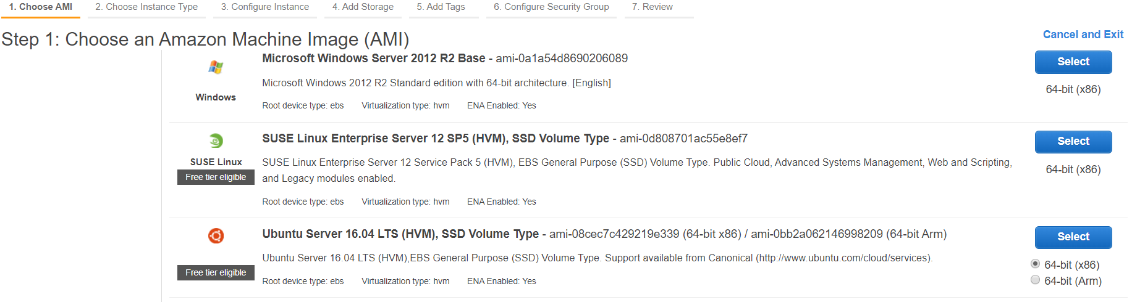
AWS – EC2
EC2 – Elastic Cloud Compute
Select Free tier Ubuntu server

Slide 14
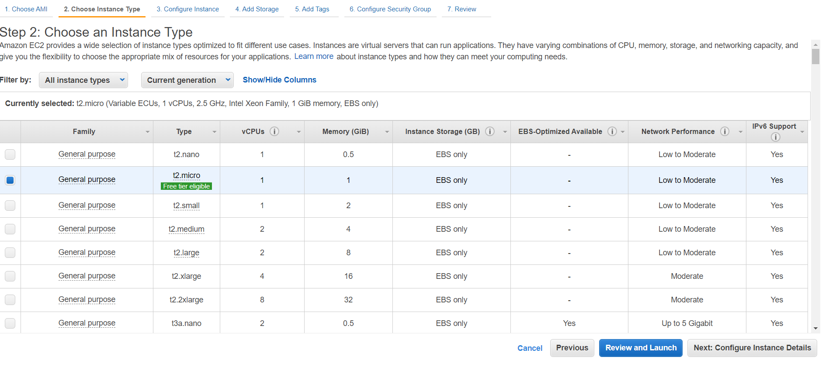
AWS – EC2
Select Free tier Ubuntu server – Click Next

Slide 15
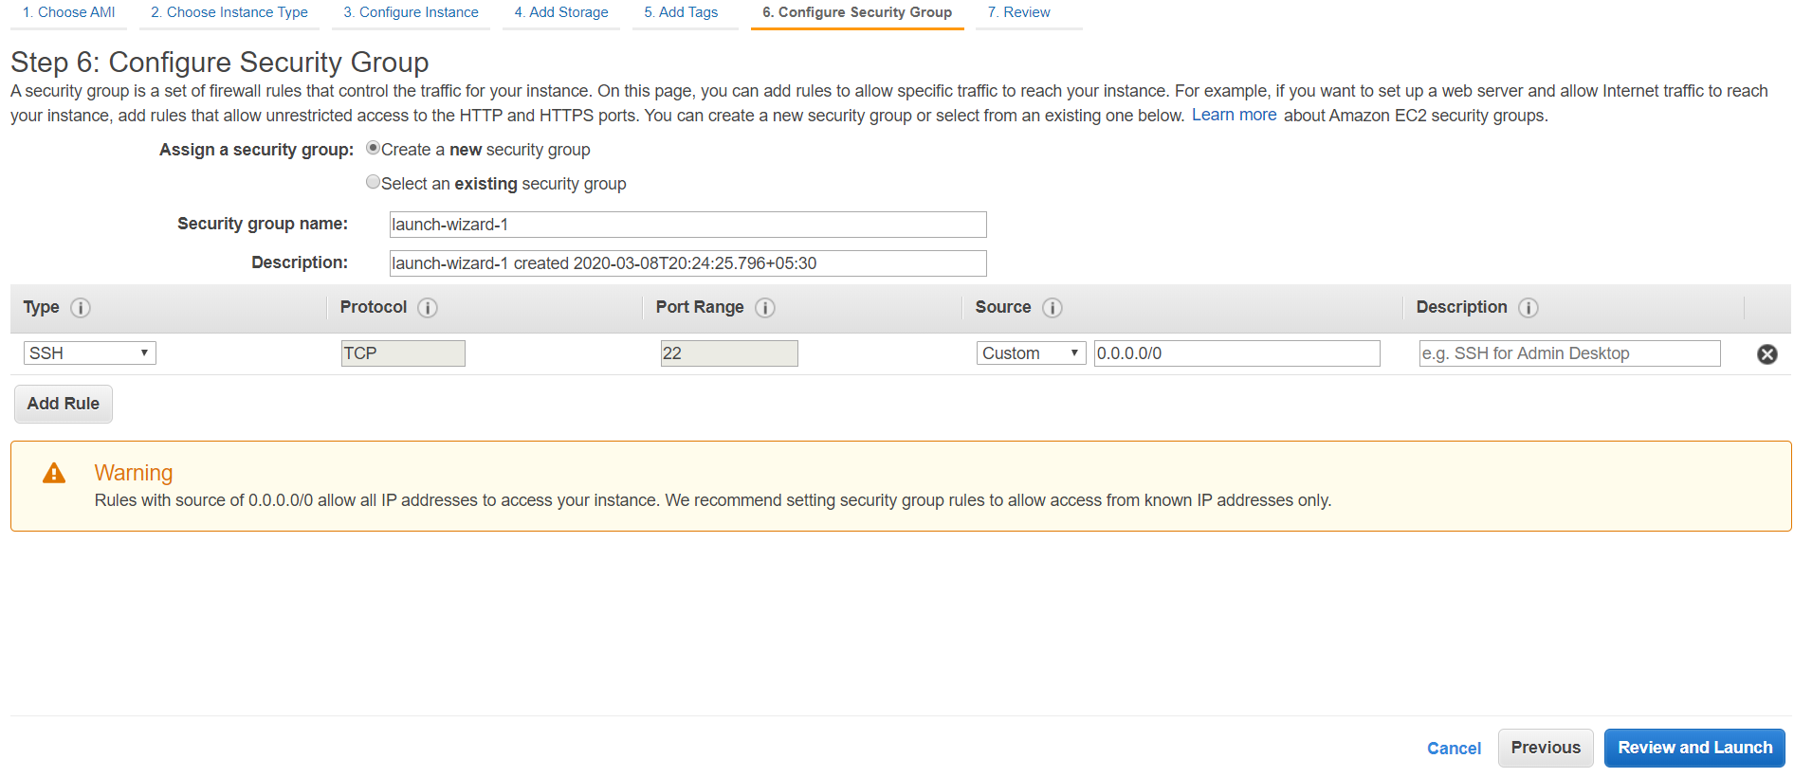
AWS – EC2
Configuration – Security – Source – Any where

Slide 16
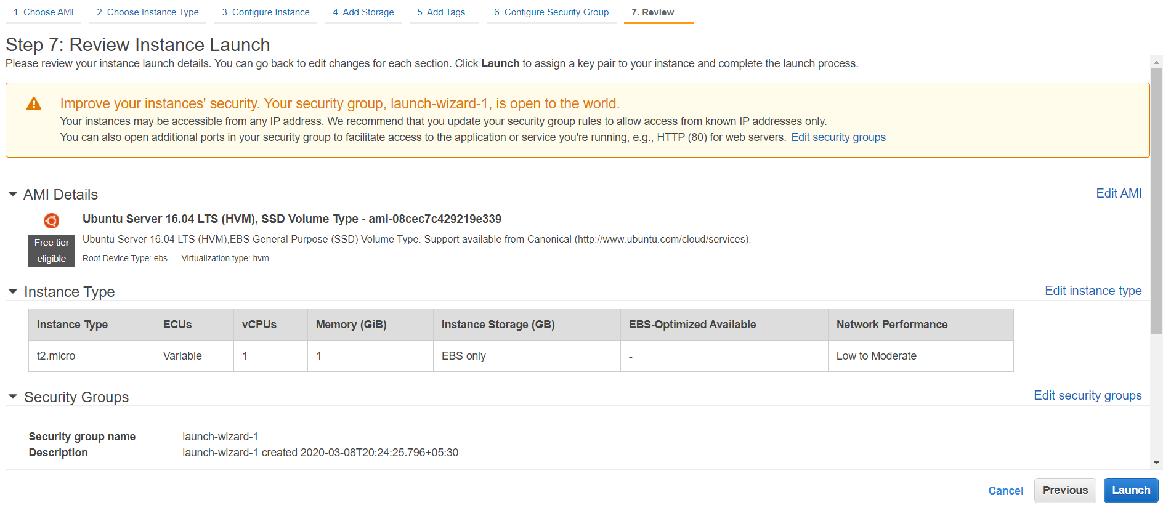
AWS – EC2
7- Review - Launch

Slide 17
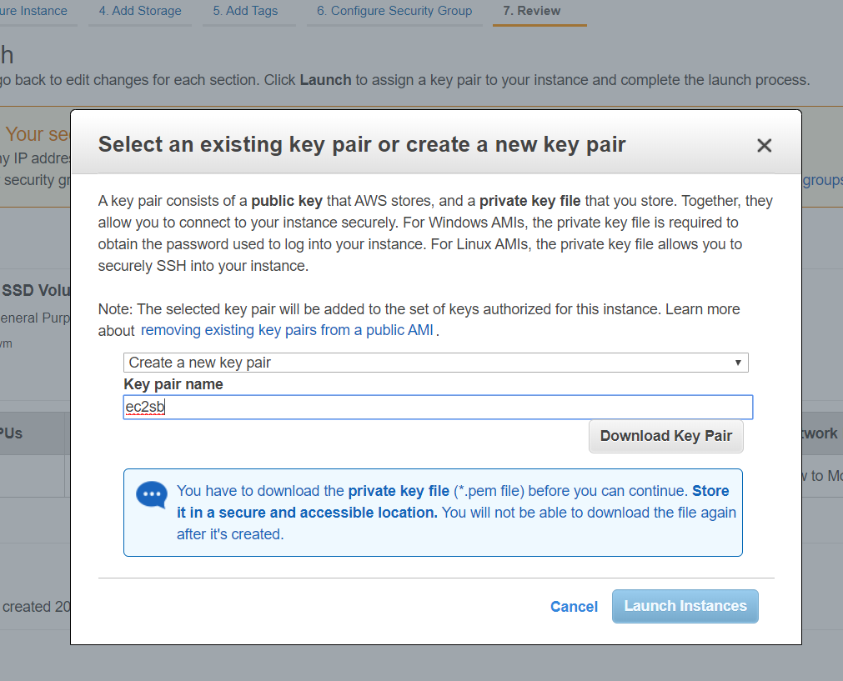
AWS – EC2
7- Review –Create key pair – Download Key Pair- Launch

Slide 18
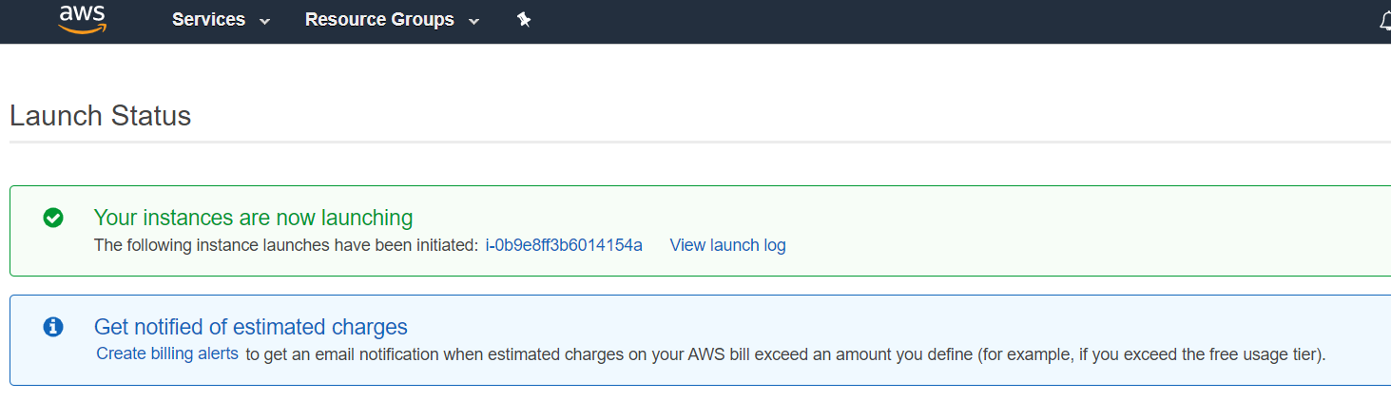
AWS – EC2

Slide 19
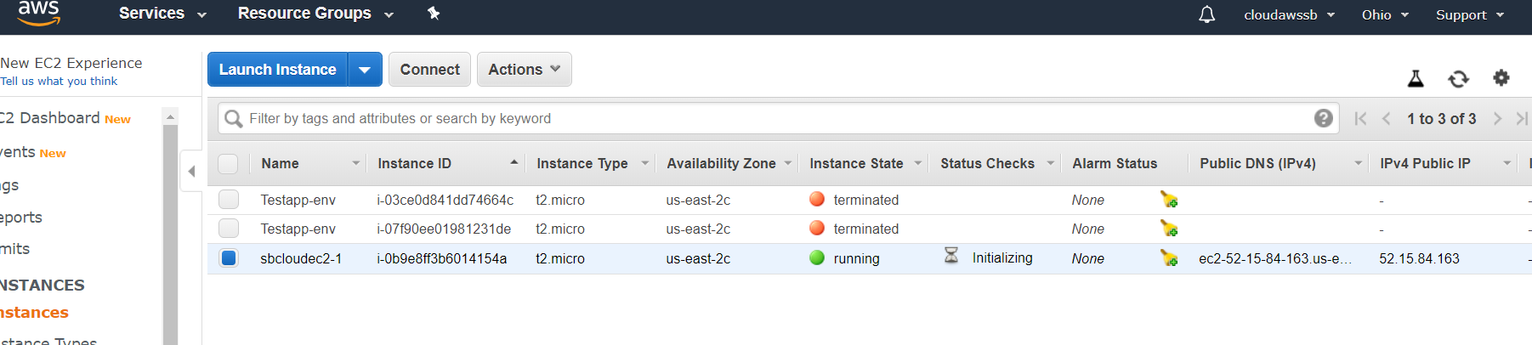
AWS – EC2
View Instances

Slide 20

Thank You

