Slide 1
AWS Simple Storage Service(S3)
Raghu Prasad
www.kaushalya.tech
9845547471

Slide 2
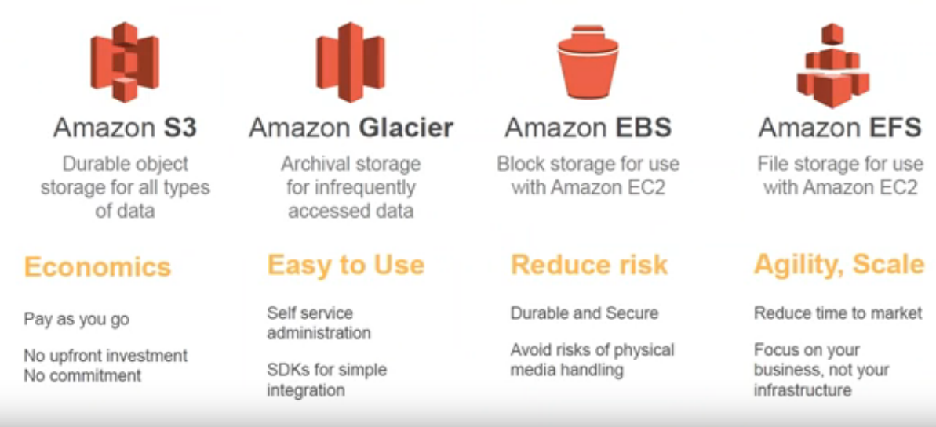
AWS – Storage choices

Slide 3
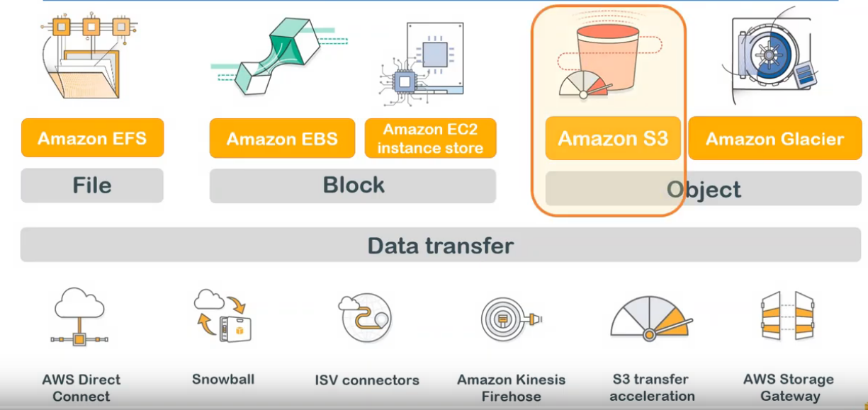
AWS – Storage choices

Slide 4
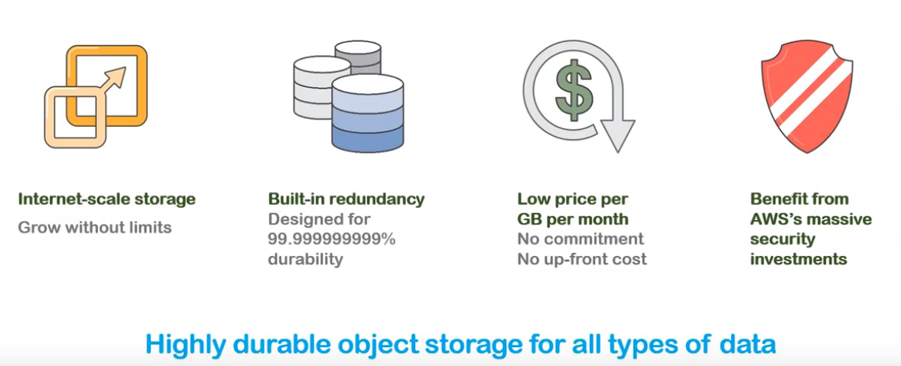
S3 – Introduction
Amazon S3 or Amazon Simple Storage Service is a service offered by Amazon Web Services that provides object storage through a web service interface. Amazon S3 uses the same scalable storage infrastructure that Amazon.com uses to run its global e-commerce network

Slide 5
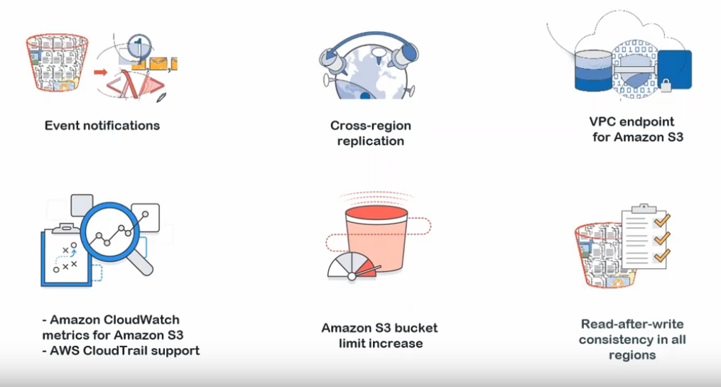
S3 – Features

Slide 6
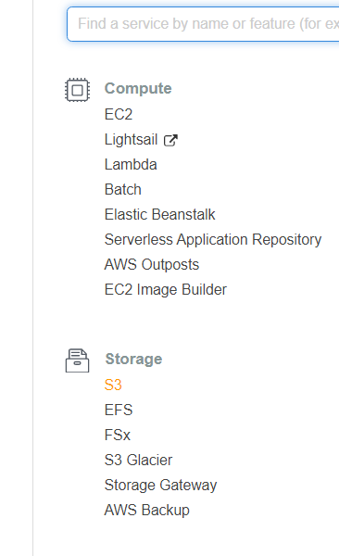
S3 – Hosting a static website
Click on S3 service after logging into AWS

Slide 7
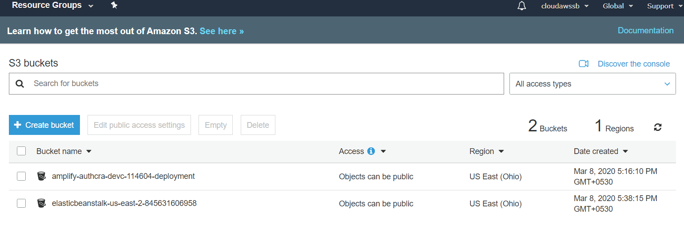
S3 – Hosting a static website
S3 buckets – Click Create bucket

Slide 8
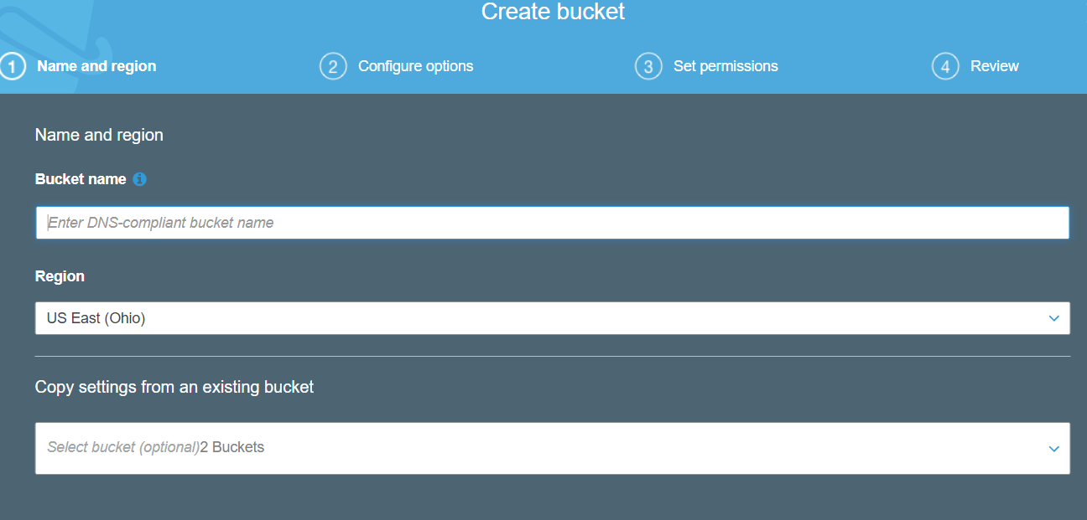
S3 – Hosting a static website
Create bucket

Slide 9
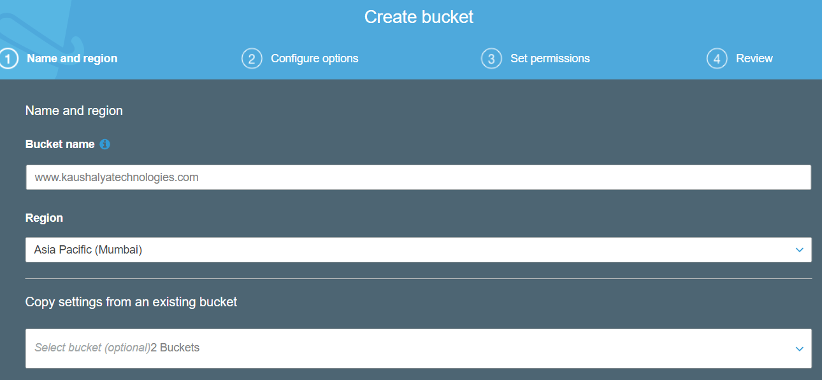
S3 – Hosting a static website
Enter bucket details and click Next

Slide 10
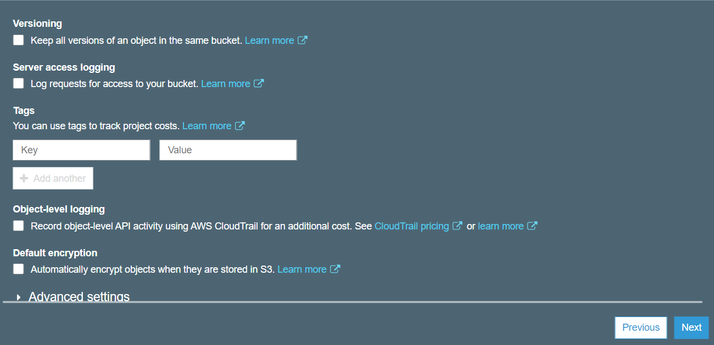
S3 – Hosting a static website
click Next

Slide 11
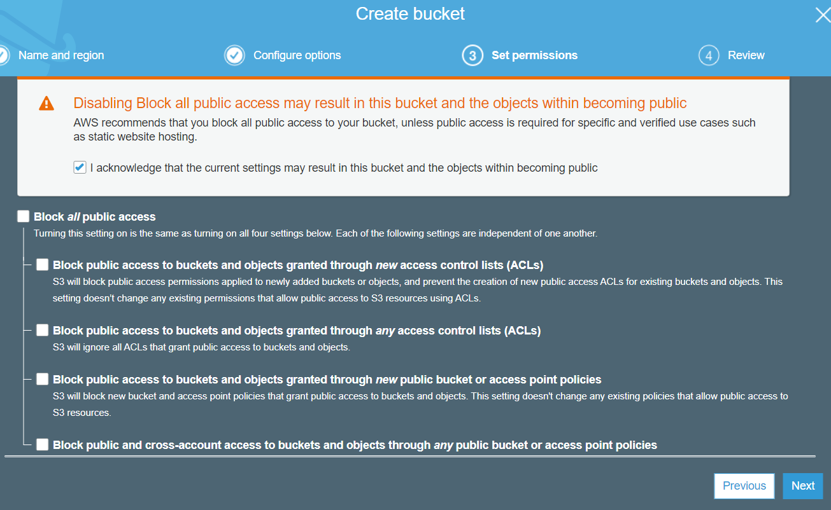
S3 – Hosting a static website
Grant public access to content (Un-check) and click Next

Slide 12
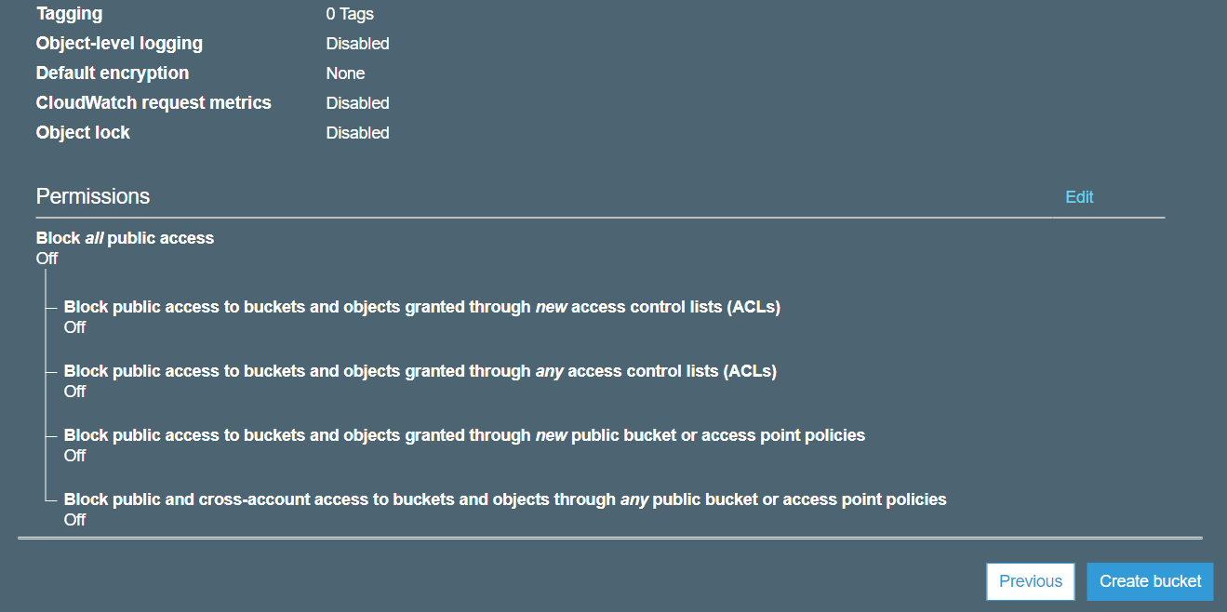
S3 – Hosting a static website
Click on Create bucket

Slide 13
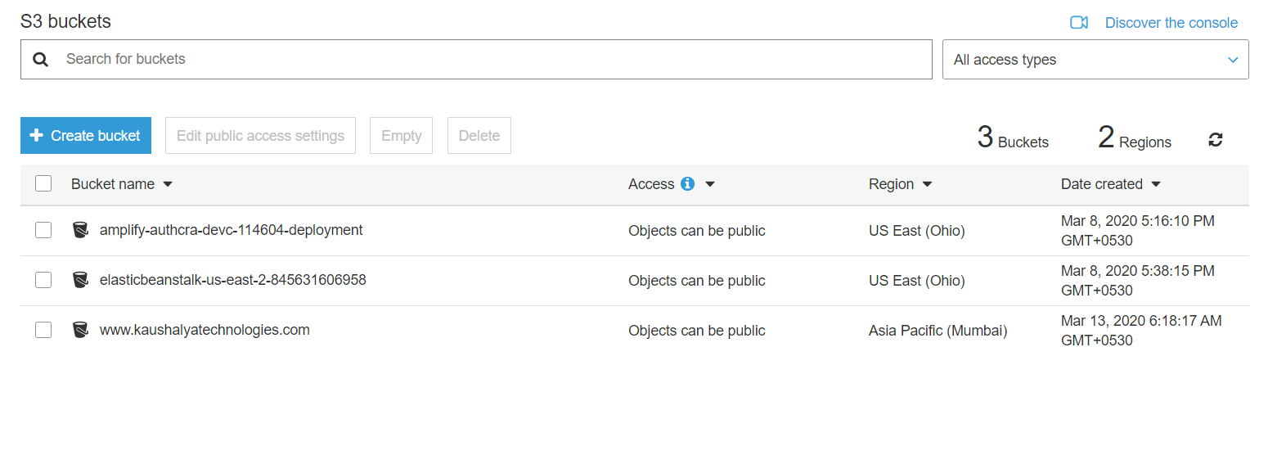
S3 – Hosting a static website
Display of S3 buckets

Slide 14
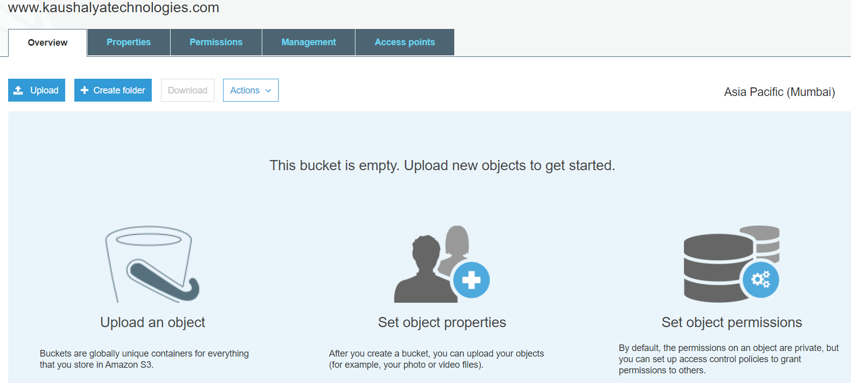
S3 – Hosting a static website
Upload website to S3 by clicking Upload

Slide 15
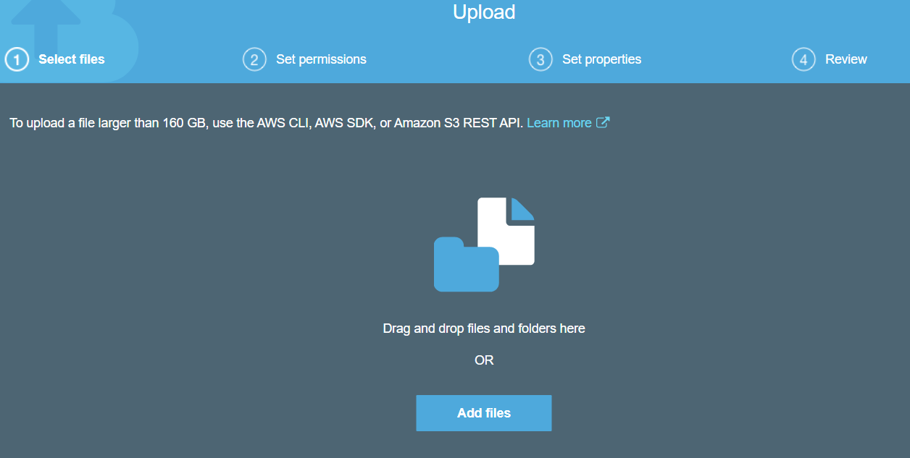
S3 – Hosting a static website
Drag and drop website to S3

Slide 16
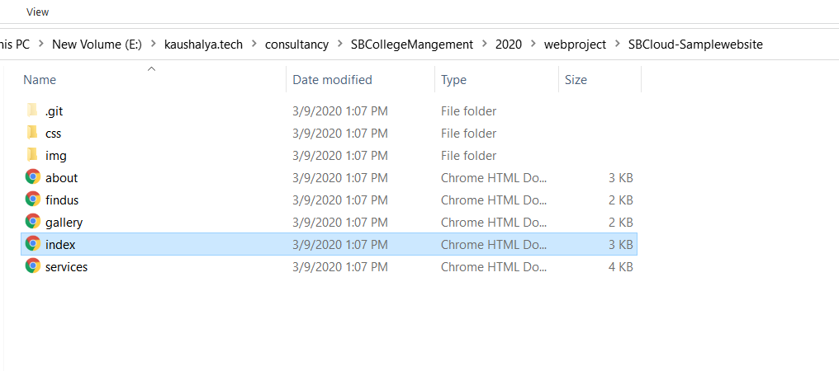
S3 – Hosting a static website
Drag and drop website to S3

Slide 17
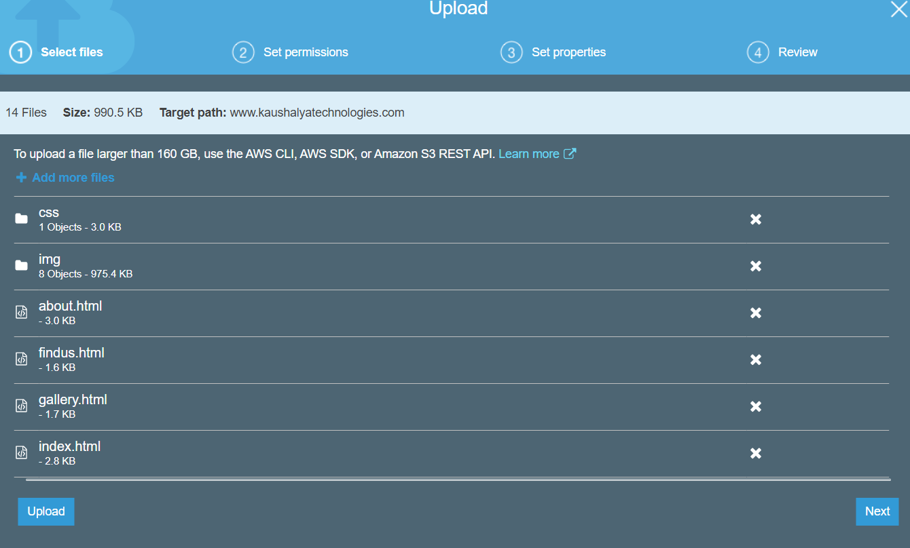
S3 – Hosting a static website
Click Next

Slide 18
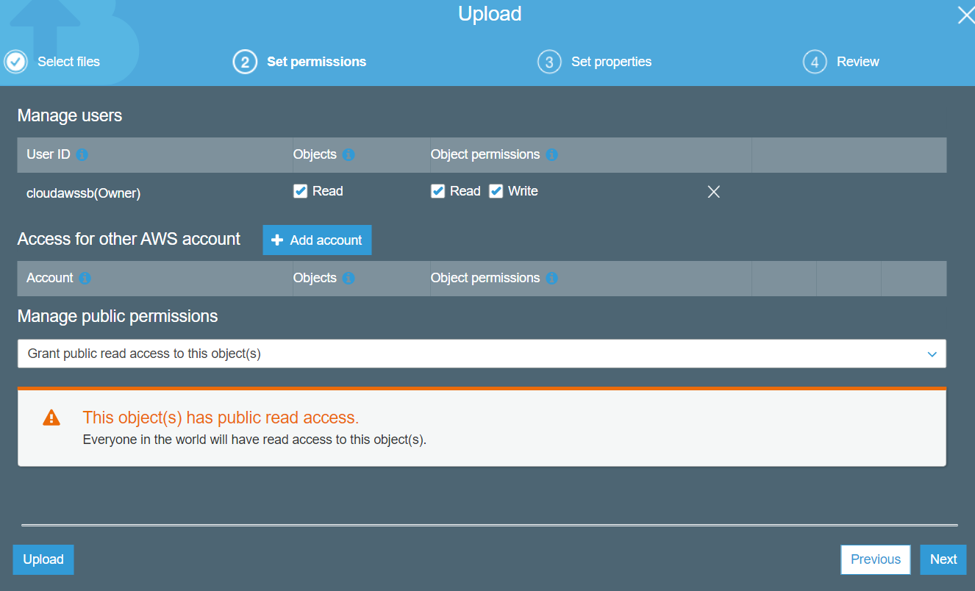
S3 – Hosting a static website
Click Next

Slide 19
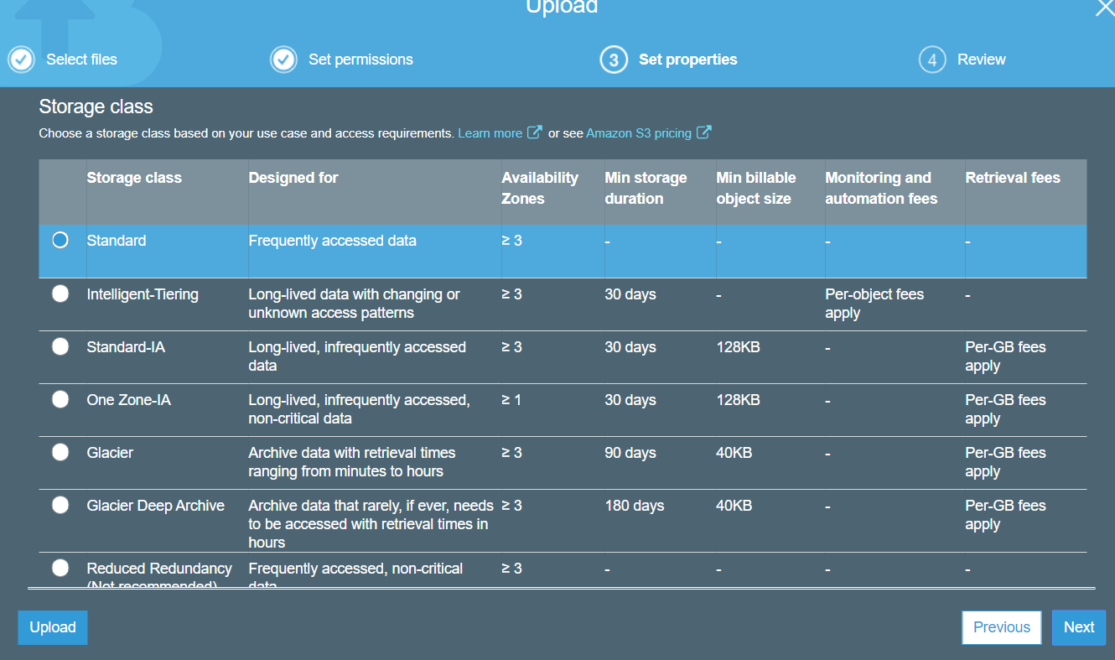
S3 – Hosting a static website
Click Next

Slide 20
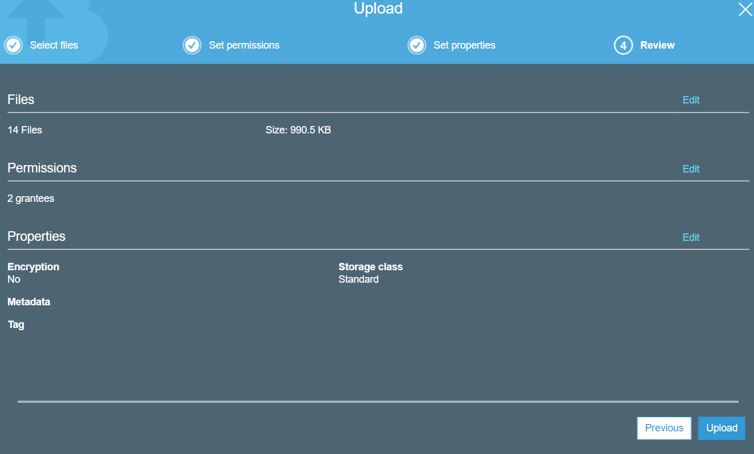
S3 – Hosting a static website
Click Upload

Slide 21
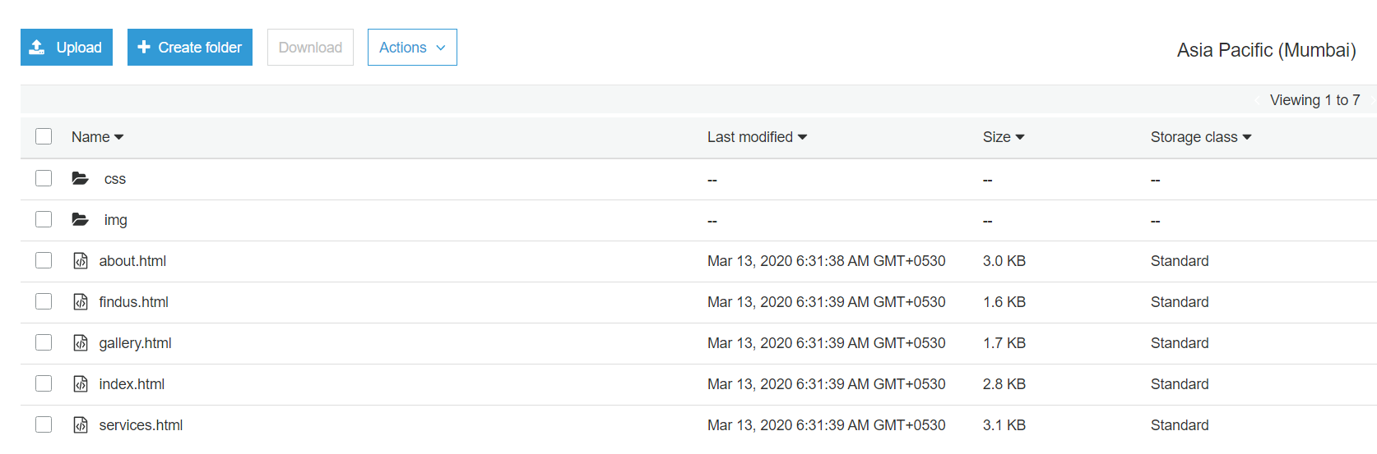
S3 – Hosting a static website
Display of uploaded files in S3

Slide 22
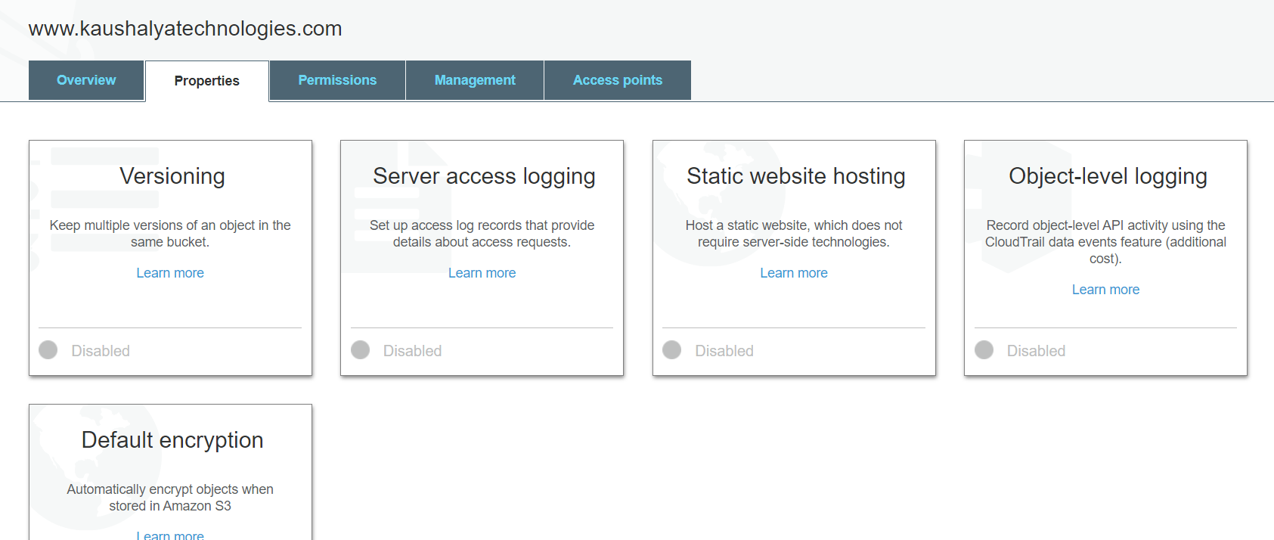
S3 – Hosting a static website
Click on properties and static website hosting

Slide 23
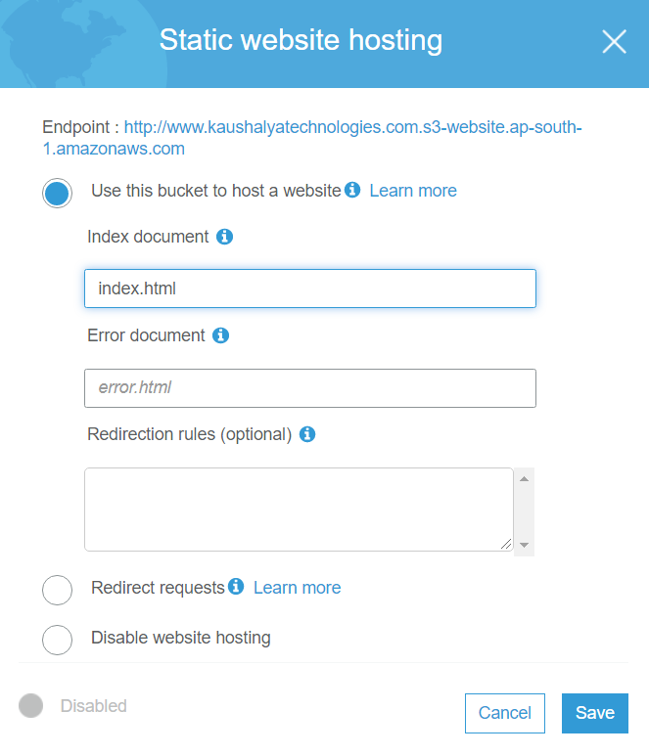
S3 – Hosting a static website
Click on Use this bucket to host a website and enter index.html

Slide 24
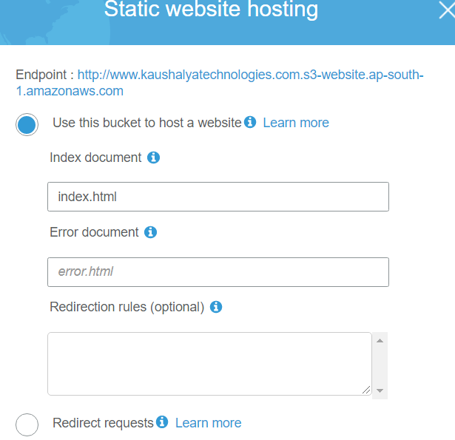
S3 – Hosting a static website
Click on Static website hosting and click end point to view website

Slide 25

S3 – Hosting a static website
View your website

Slide 26
Why Us
Kaushalya is built by IT Professions having experience in academia
Our vision is to Skill, Up-Skill and Re-Skill in order to bridge the gap between academia and industry
Training is conducted by experienced IT Professionals
Vendors for major educational institutions and corporates

Slide 27

Thank You

