Slide 1
Cloud Computing
Raghu Prasad
www.kaushalya.tech
9845547471

Slide 2
Introduction
Raghu Prasad K S – BE, MS, CEO of Kasuhalya Technologies
Total of 27 years of experience
7 years as a lecturer in an Engineering College
17 Years into IT
Worked with companies like CISCO,CSC,ICICI,First Apex – NTT Data
Currently into Corporate training and consultancy
Worked with corporates and public sector
Technologies – Java,Python,AI,ML,Web technologies,Java Script technologies (MEAN stack),IOT,Test Automation – Selenium,Jmeter,Cloud Computing
CSR Activities
Professional Yoga Trainer and motivational speaker

Slide 3
About Us
Kaushalya Technologies (www.kaushalya.tech) is an educational technology company started by IT Professionals and Academicians.
It has offices in Jakkur and Sahakara Nagara in Bengaluru
Kaushalya Technologies are into IT niche skills training, consultancy and educational application development
We conduct FDP, SDP, Internships for educational institutions.
We conduct Boot camp and niche IT skills training for corporates.

Slide 4
Our Major clients
Educational Institutions
Acharya Institute of Technology, REVA University,Dayanand Sagar University, Nagarjuna Engineering College, Bengaluru
BGSIT- Bellur, Malnad Engineering College-Hassan, NIE-Mysore, MYCEM, Mysore, NIT-Manipur
Sindhi College, SB College of Management, Bengaluru,Kristu Jayanti College,Bengaluru
IT Companies
IQVIA,Chennai, ITC Infotech,Bengaluru,NetWoven,Bengaluru,L & T – Mysore,NextGen-Bengaluru,Philips-Bengaluru,Incarnus-Chennai,Aspire Systems-Chennai, Infidata Technologies – Bengaluru, Edulife- Bengaluru,
TechVaraha,Bengaluru

Slide 5
Course Objectives
Introduce trainees to Cloud Computing
Introduce trainees to Cloud Providers and understand most frequently used services of Heroku and Amazon Web Services (AWS)
Code/Configure as you learn
Build ability to deploy and monitor an web application
Bridge the gap between actual skills required for the industry and the current skills possessed by the trainees

Slide 6
Course Outcome
Trainees are expected to gain theoretical and practical exposure in Cloud Computing
Hands-on and minds-on Learning
Learn common services of Heroku and AWS
Learn soft skills aspects such as being a team player and critical thinking ability
Well versed with software development life cycle

Slide 7
Training Methodology
It’s combination of theoretical and practical sessions. We will introduce to a concept and use hands-on session to further strengthen their understanding of the concept.
It’s a 30 hour course
Following assessment methodology would be performed
Pre-assessment test
Attendance and attentiveness in the class
Completion of hands-on session
Completion of assignments
Completion of project
Feedback
Post-assessment test
Softcopy of the course material would be handed over to each student at the end of the course.
Joint certificate by the college and Kaushalya would be issued to the trainees

Slide 8
Course Outline
Introduction to Cloud Computing
Cloud Computing Models
Introduction to GIT
Introduction to Cloud Service provider Heroku
Deploy a web application on Heroku
Introduction to Cloud Databases such as Firebase/MLab
Introduction to AWS and its common services such as S3,Notification Services,Lambda,Dynamo DB, User and Role Mangement,Security etc
Hands-on Sessions on Application Deployment and Monitoring

Slide 9
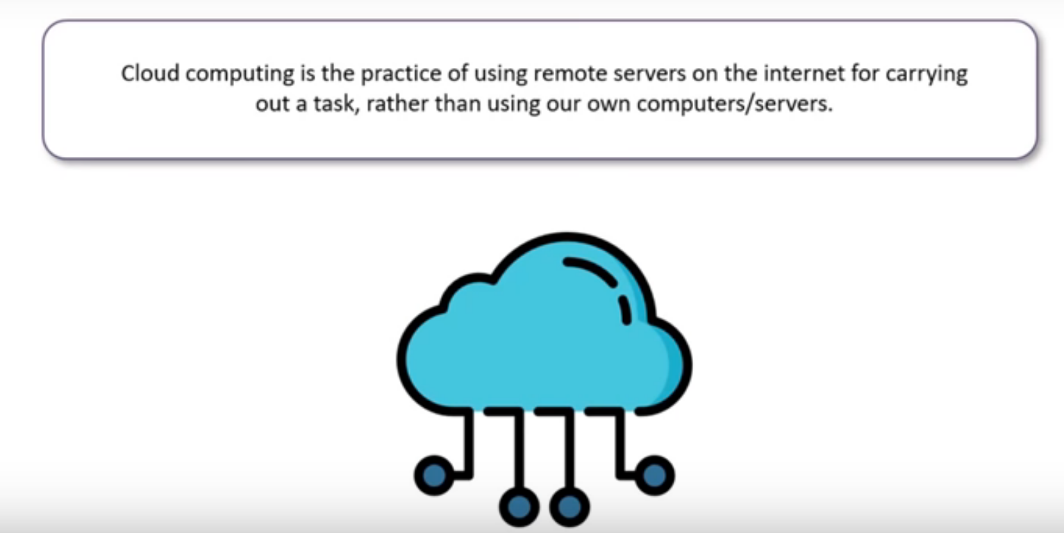
Introduction
Notes:
py: This is normally the input source code that you've written.
.pyc: This is the compiled bytecode. If you import a module, python will build a *.pyc file that contains the bytecode to make importing it again later easier (and faster).
.pyo: This is a *.pyc file that was created while optimizations (-O) was on.
.pyd: This is basically a windows dll file. http://docs.python.org/faq/windows.html#is-a-pyd-file-the-same-as-a-dll

Slide 10
What is Cloud Computing ?
Cloud computing is Web-based computing which allows businesses and individuals to consume computing resources such as virtual machines, databases, processing, memory, services, storage, messaging, events, and pay-as-you-go. Cloud services often improve upon older ones.
For example, the pay-as-you-go model charges for resources as they are used. Unlike traditional computing, if you do not use any resources, you do not need to pay. Similar to a water connection or an electricity line, you have a meter and this meter keeps track of your monthly usage. You then pay for that usage at a given rate.

Slide 11
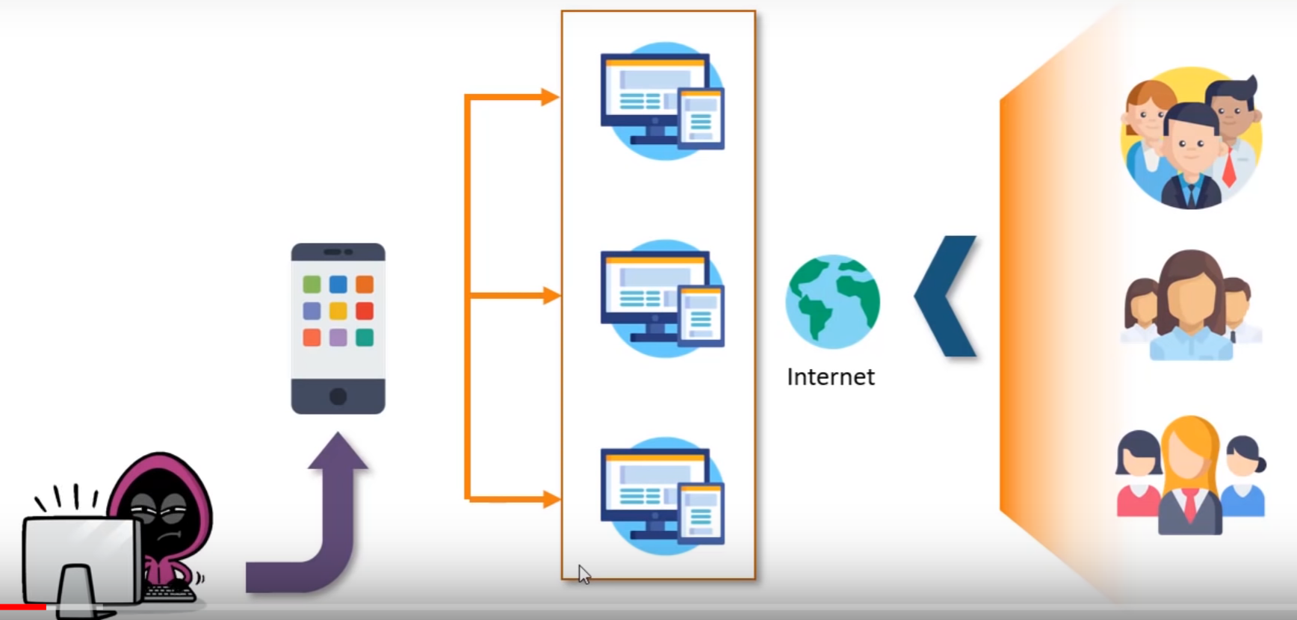
Introduction
Notes:
https://wiki.python.org/moin/PythonImplementations

Slide 12
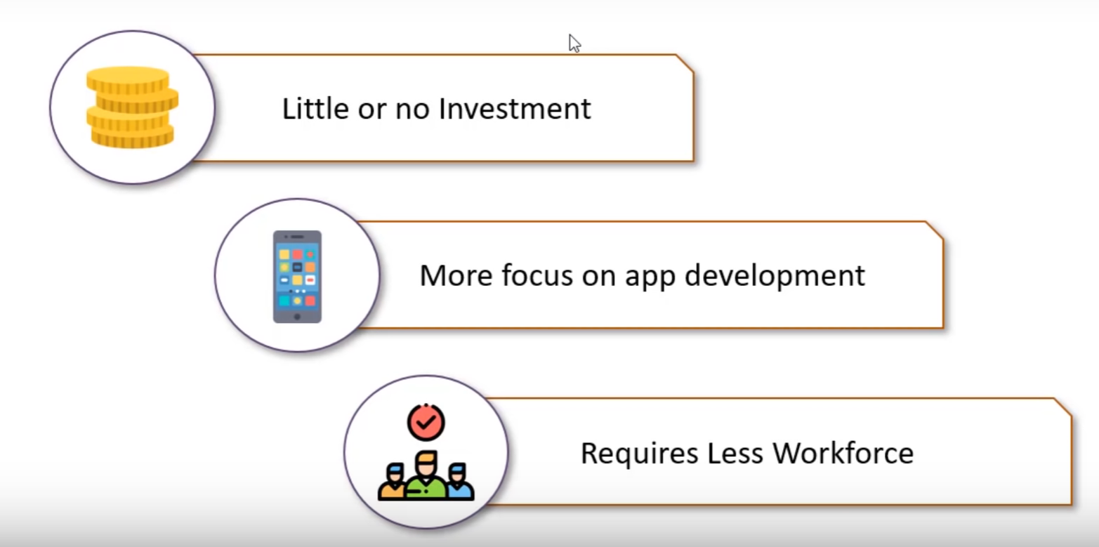
Benefits of Cloud Computing

Slide 13
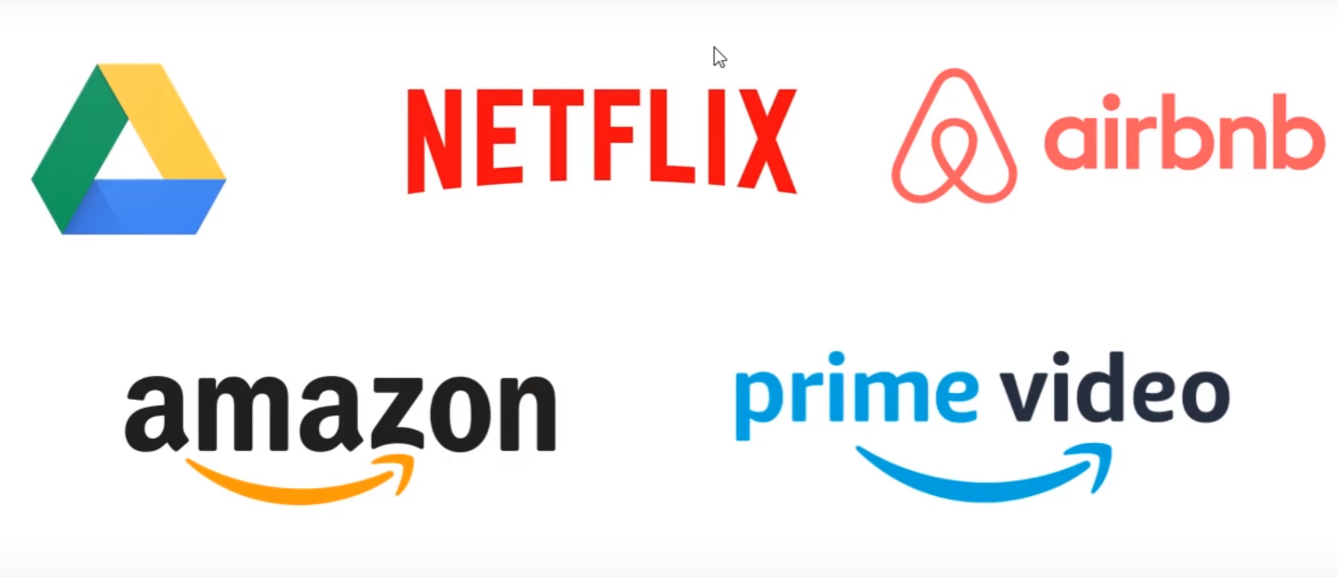
Cloud Products

Slide 14
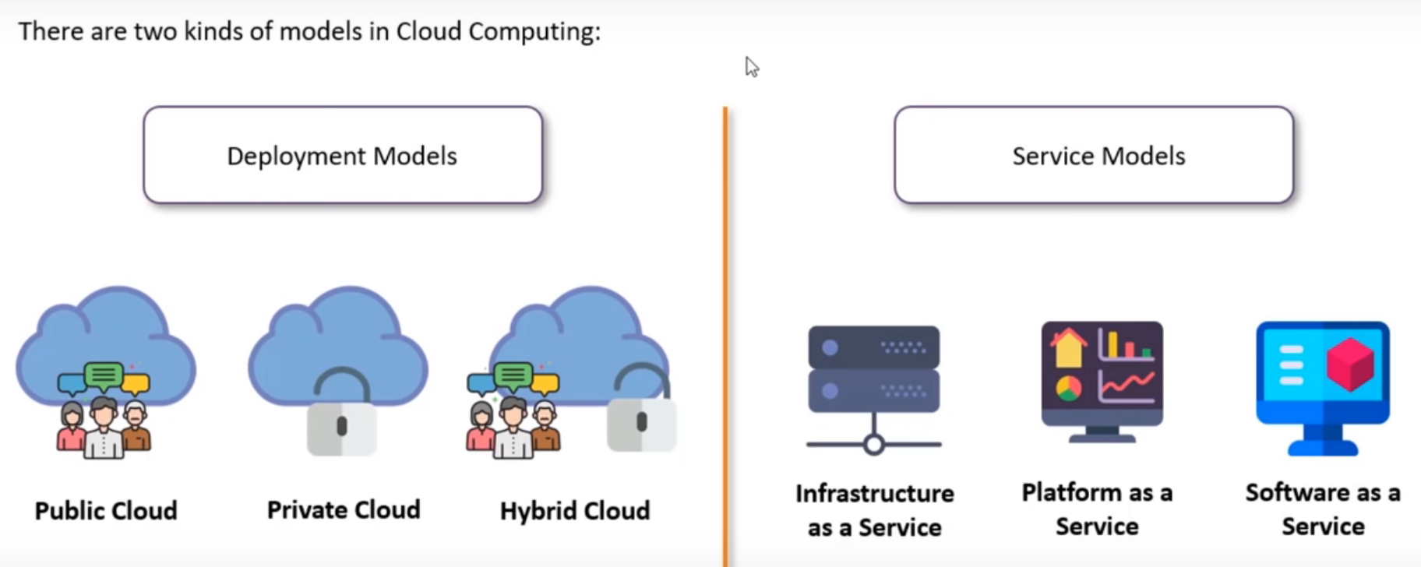
Cloud Computing Models

Slide 15
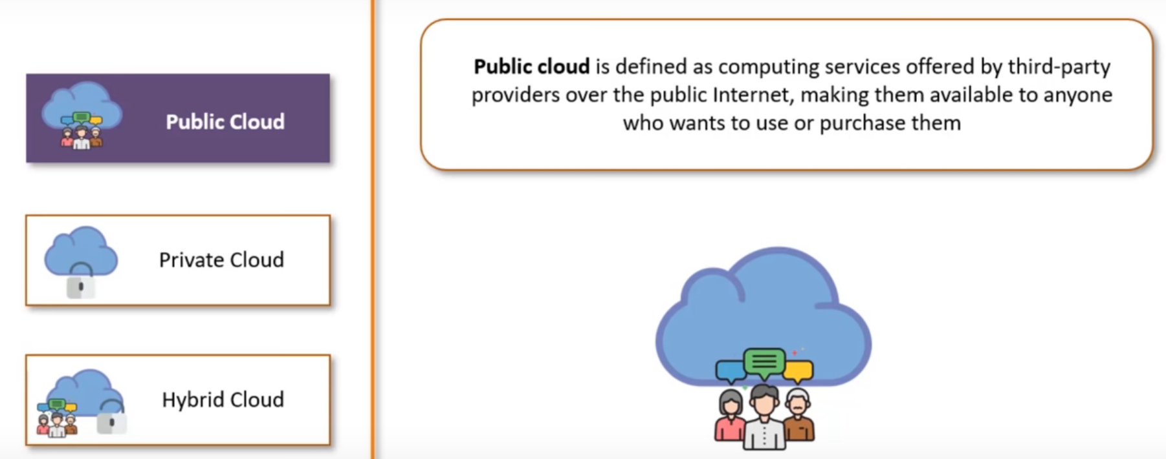
Public Cloud
Notes:
i. Easy
Python is very easy to learn and understand; using this Python tutorial, any beginner can understand the basics of Python.
ii. Interpreted
It is interpreted(executed) line by line. This makes it easy to test and debug.
iii. Object-Oriented
The Python programming language supports classes and objects. We discussed these above.
iv. Free and Open Source
The language and its source code are available to the public for free; there is no need to buy a costly license.
v. Portable
Since it is open-source, you can run Python on Windows, Mac, Linux or any other platform. Your programs will work without needing to the changed for every machine.
vi. GUI Programming
You can use it to develop a GUI (Graphical User Interface). One way to do this is through Tkinter.
vii. Large Library
Python provides you with a large standard library. You can use it to implement a variety of functions without needing to reinvent the wheel every time. Just pick the code you need and continue. This lets you focus on other important tasks.

Slide 16
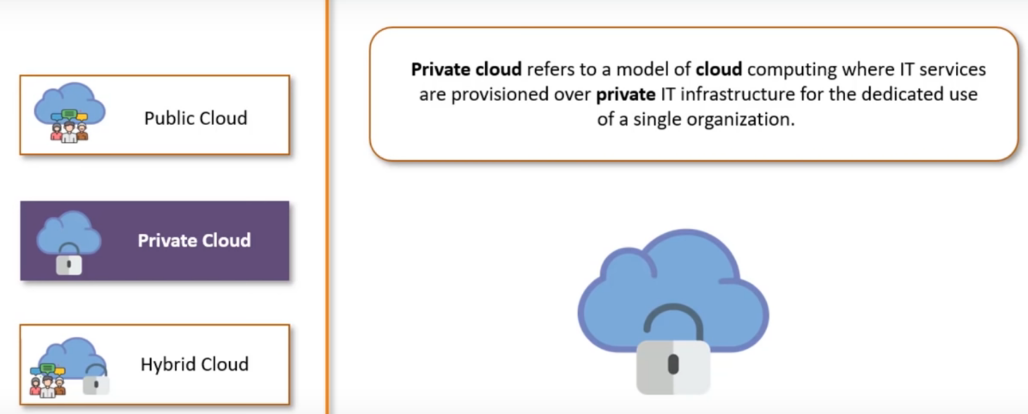
Private Cloud
Notes:
Ref IEEE Spectrum

Slide 17
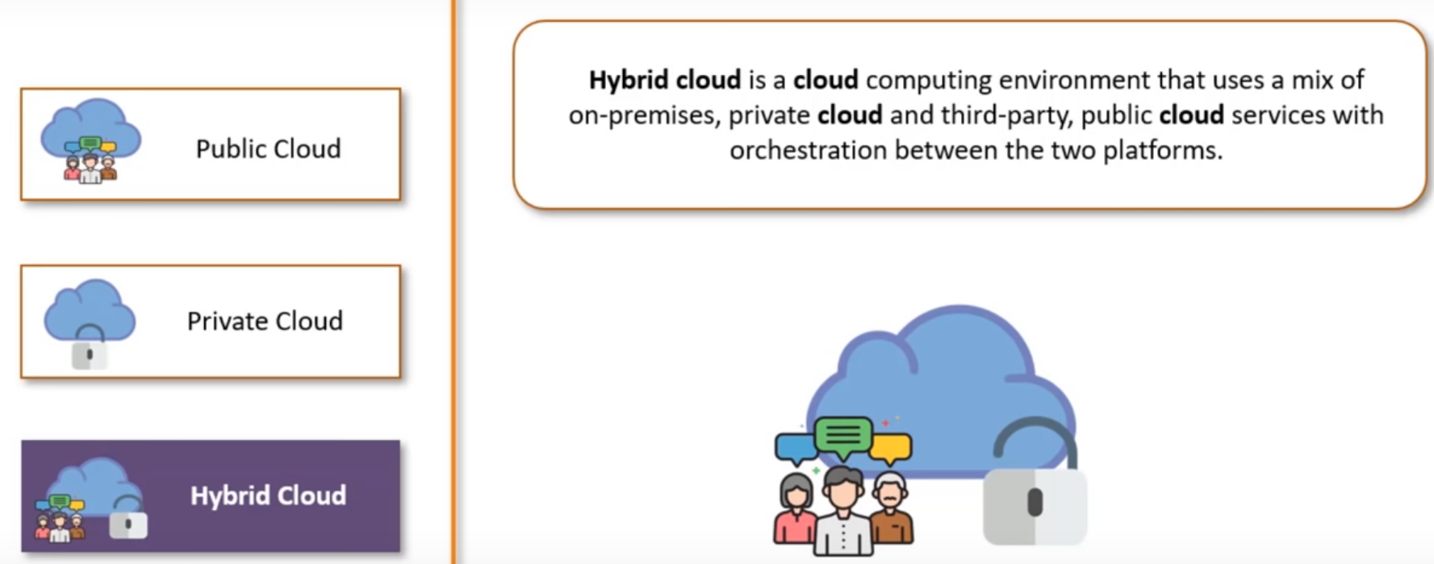
Hybrid Cloud
Notes:
Ref IEEE Spectrum

Slide 18
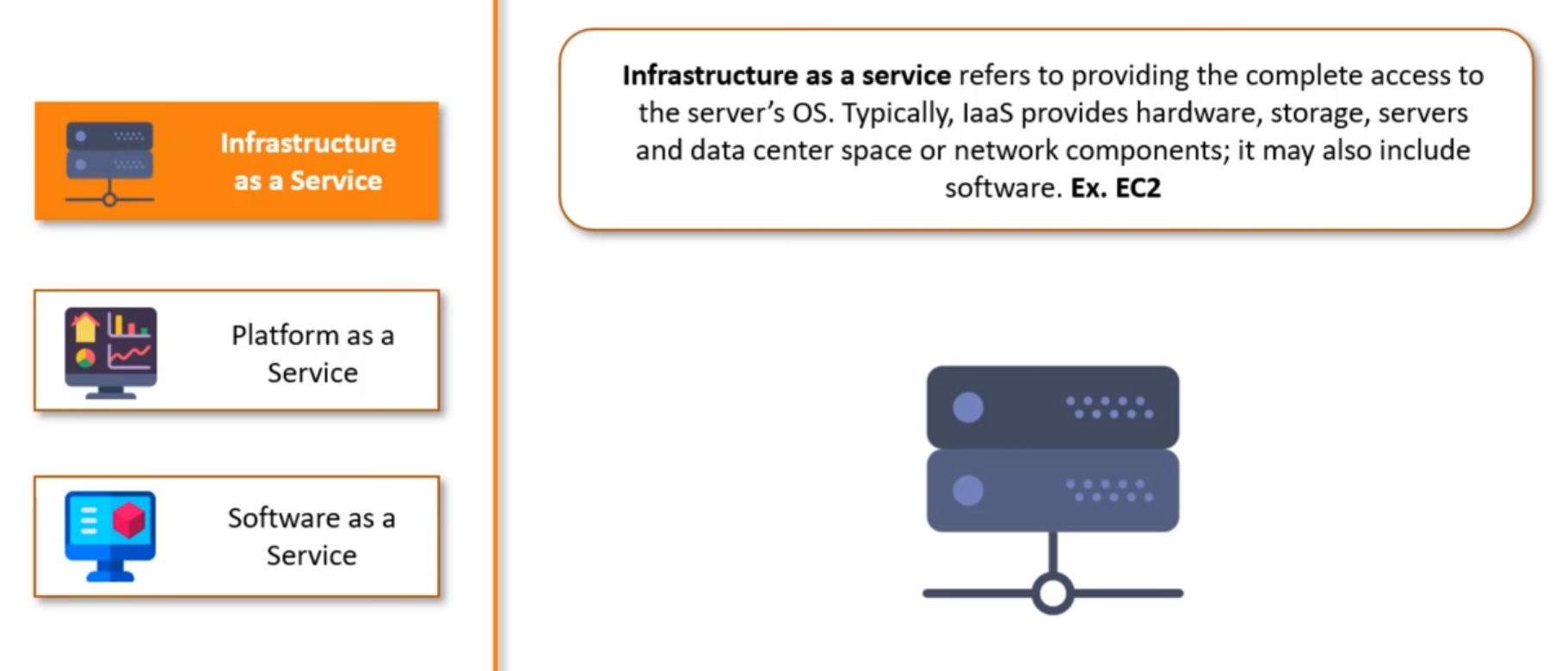
Service Model - IaaS
Notes:
Ref IEEE Spectrum

Slide 19
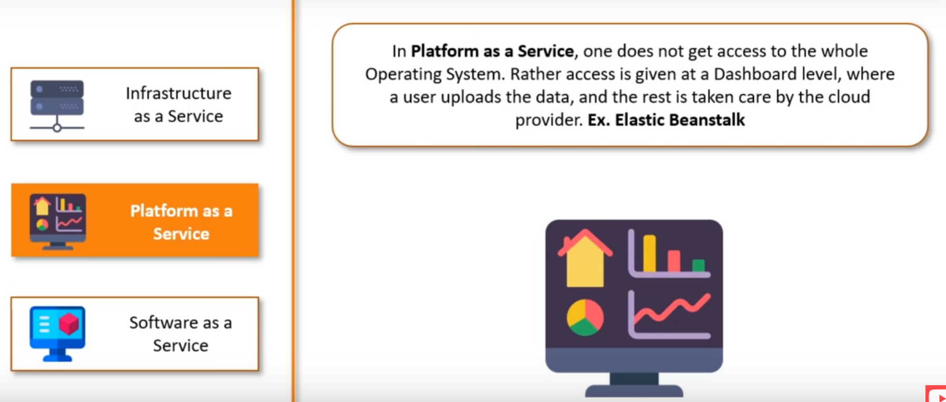
Service Model - PaaS
Notes:
Ref IEEE Spectrum

Slide 20
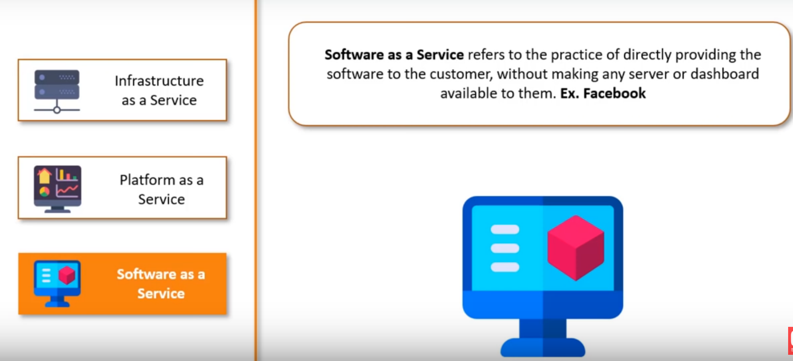
Service Model - SaaS
Notes:
Ref IEEE Spectrum

Slide 21
Major Cloud Providers
Amazon Web Services (AWS)
Microsoft Azure
Google Cloud
Alibaba Cloud
IBM Cloud
Oracle
Salesforce
SAP
Rackspace Cloud
VMWare
https://www.c-sharpcorner.com/article/top-10-cloud-service-providers/
Notes:
Ref IEEE Spectrum

Slide 22
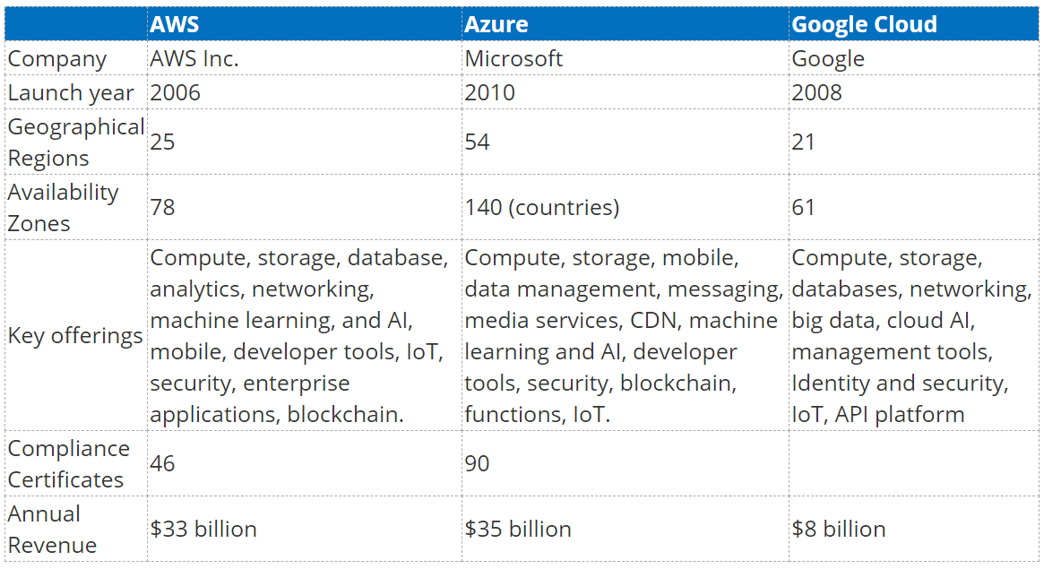
Top 3 Cloud Providers
Notes:
Ref IEEE Spectrum

Slide 23
Key Advantages of Cloud Computing
1. Cloud computing allows a business to cut their operational and fixed monthly costs of hardware, databases, servers, software licenses. Eventually, it will reduce the need for IT resources, including people. All hardware, database servers, web servers, software, products, and services are hosted in the cloud and added to an account as needed.
2. Cloud computing offers 24/7 uptime (99.99% uptime). Cloud servers and data centers are managed by the cloud service provided. Therefore, there is no need for employee management.
3. Cloud computing is scalable and reliable. There is no limit to the number of users or resources. Furthermore, the cloud increases processing and resources as needed. If you do not need resources, you can always scale down.
4. Cloud computing provides maintainability and automatic updates of new software, OS, databases, and third-party software. It also reduces IT labor cost for a business.
5. Cloud service providers have data centers in various locations, which makes them faster and more reliable. Larger companies such as Microsoft and AWS even have data centers around the world.

Slide 24
Why Us
Kaushalya is built by IT Professions having experience in academia
Our vision is to Skill, Up-Skill and Re-Skill in order to bridge the gap between academia and industry
Training is conducted by experienced IT Professionals
Vendors for major educational institutions and corporates

Slide 25

Thank You

