Slide 1
GIT
Raghu Prasad
www.kaushalya.tech
9845547471

Slide 2
GIT - Introduction
Git is a popular file versioning system used globally by numerous developers for their projects. It is lightweight and swift in its performance as compared to the likes. With a number of UI based tools to assist in Git based versioning, it has become extremely convenient for the developers to use Git Versioning System. Git flaunts features like Cheap local branching, convenient staging areas and multiple workflow configurations.
https://www.javacodegeeks.com/2018/03/git-tutorial-for-beginners.html
https://www.youtube.com/watch?v=SWYqp7iY_Tc

Slide 3
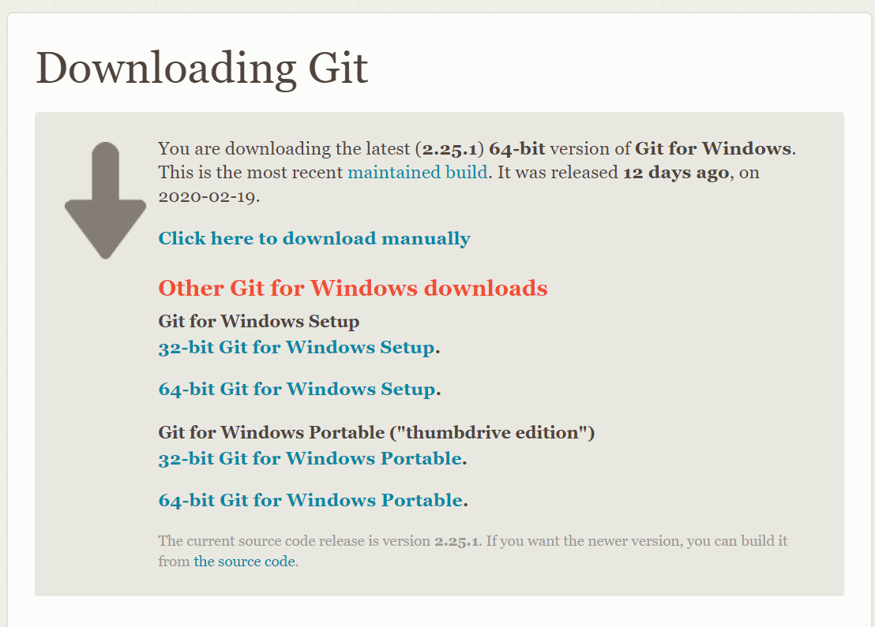
GIT-Setup
1. Download and Install Git from https://git-scm.com/download/win

Slide 4
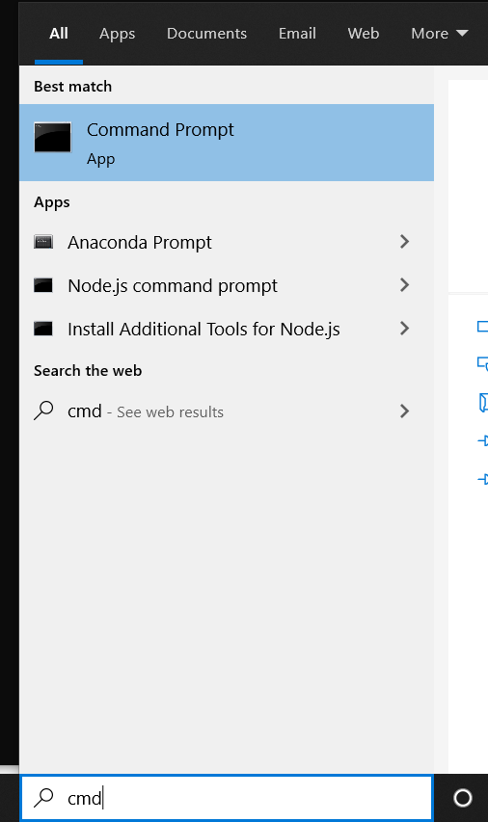
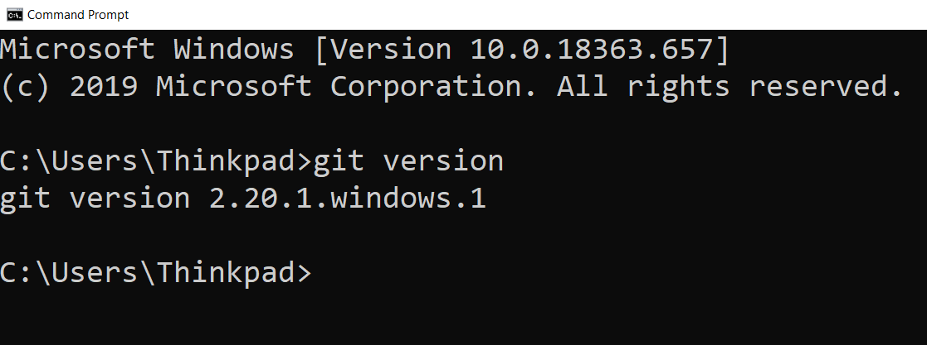
GIT-Setup
2. Check the version of the git using command prompt

Slide 5
Github- Account Creation
GitHub, Inc. is a US-based global company that provides hosting for software development version control using Git. It is a subsidiary of Microsoft, which acquired the company in 2018 for US$7.5 billion. It offers the distributed version control and source code management functionality of Git, plus its own features.
Create an account in Github using https://github.com/join.

Slide 6
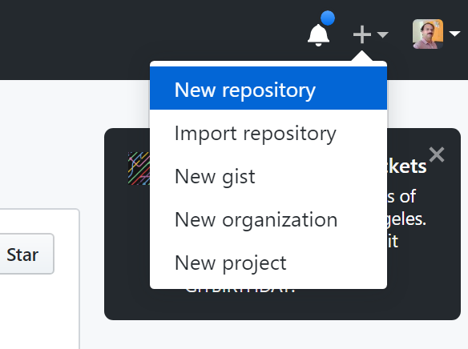
Github- Repository Creation
Login to github and create a repository

Slide 7
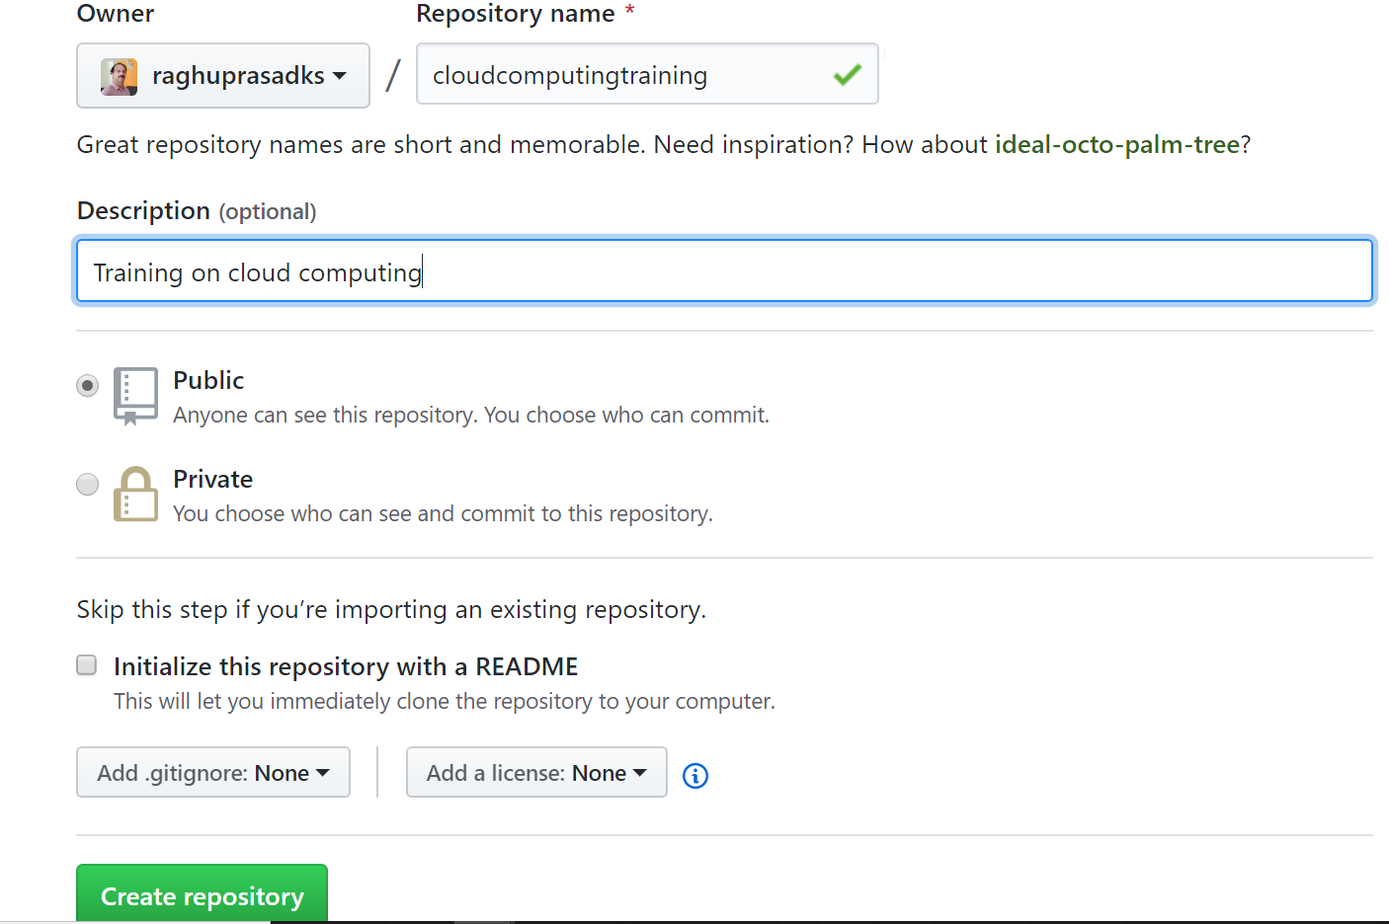
Github- Repository Creation
Create a repository and name it as cloudcomputingtraining

Slide 8
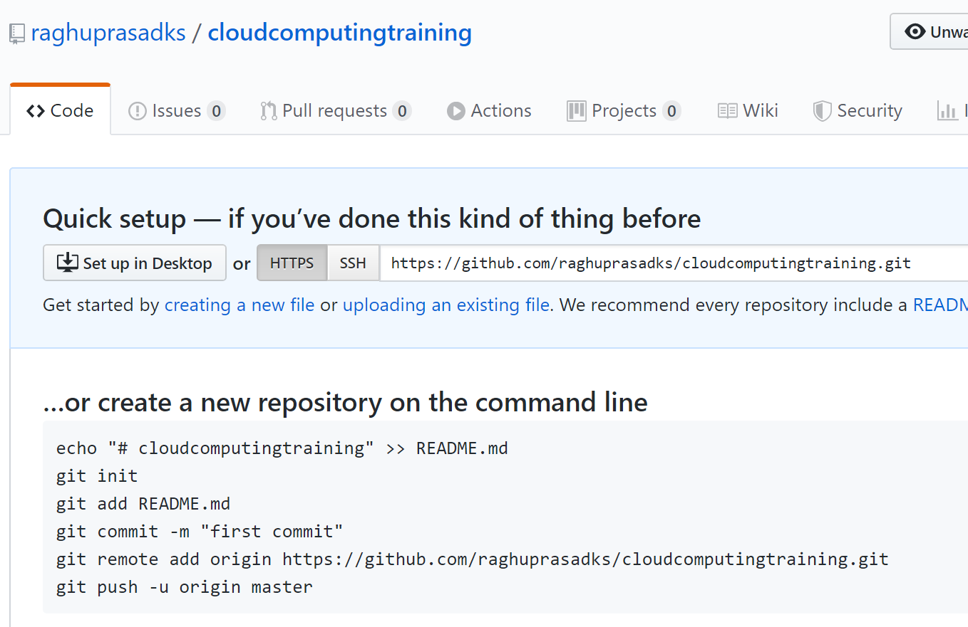
Github- Repository Setup

Slide 9
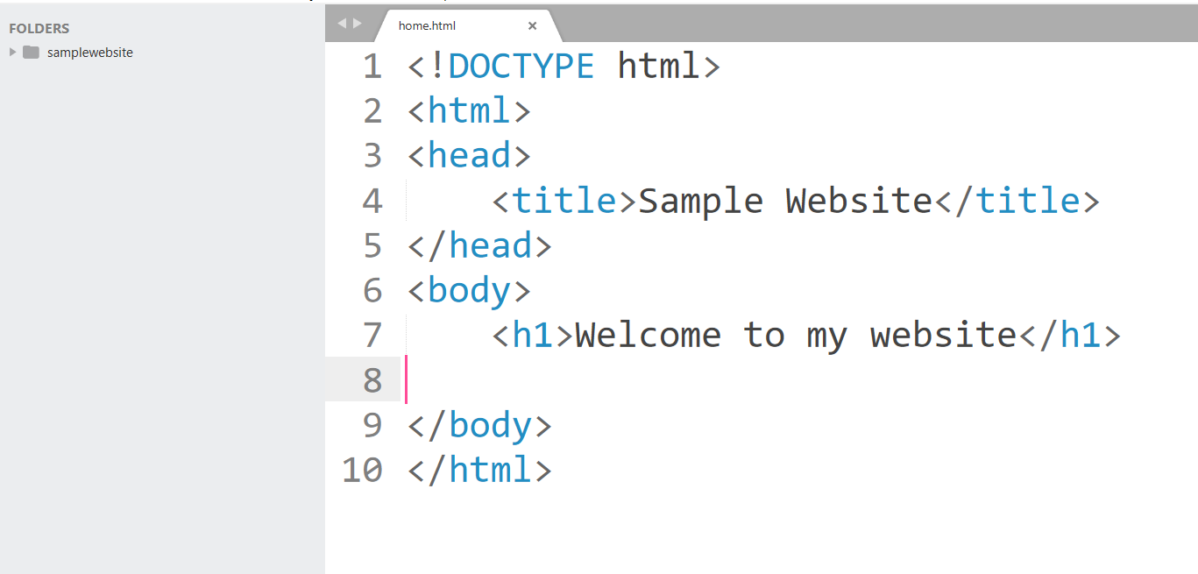
Sample webpage
Create one page html using sublime text
Download Sublime Text 3 using https://www.sublimetext.com/3
Create a webpage and name it as home.html

Slide 10
Source code check-in
1. Go to the folder in which you have created files and issue following commands
git init
git add .
git commit –m “first commit”

Slide 11
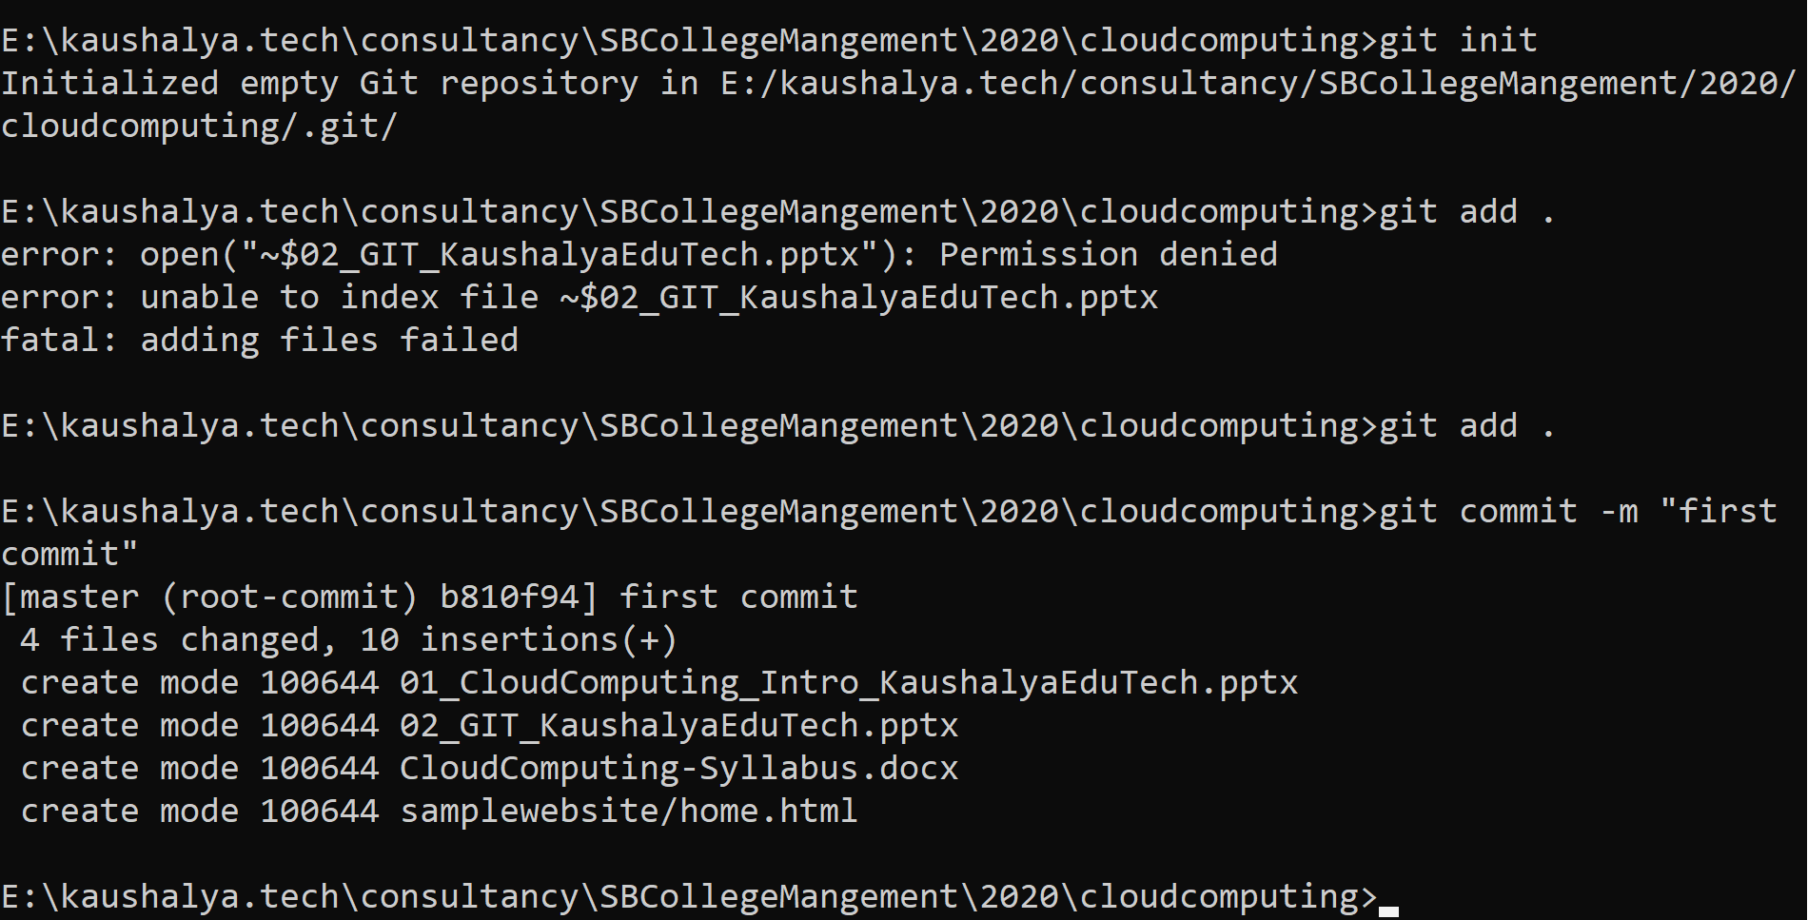
Source code check-in

Slide 12
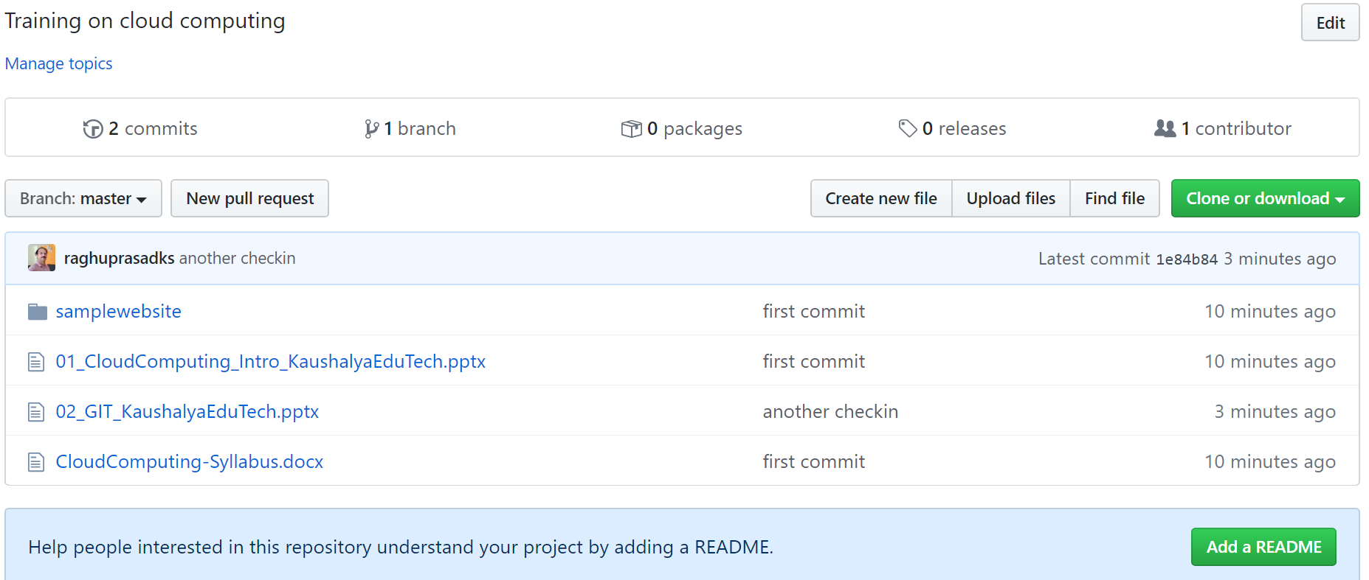
Link local repository with remote
git remote add origin https://github.com/raghuprasadks/cloudcomputingtraining.git
git push -u origin master
Check the pushed code in the github

Slide 13

Thank You

