Slide 1
Heroku – Cloud Service Provider
Raghu Prasad
www.kaushalya.tech
9845547471

Slide 2
Heroku - Introduction
Heroku is a cloud platform as a service (PaaS) supporting several programming languages. One of the first cloud platforms, Heroku has been in development since June 2007, when it supported only the Ruby programming language, but now supports Java, Node.js, Scala, Clojure, Python, PHP, and Go.For this reason, Heroku is said to be a polyglot platform as it has features for a developer to build, run and scale applications in a similar manner across most languages. Heroku was acquired by Salesforce.com in 2010 for $212 million.

Slide 3
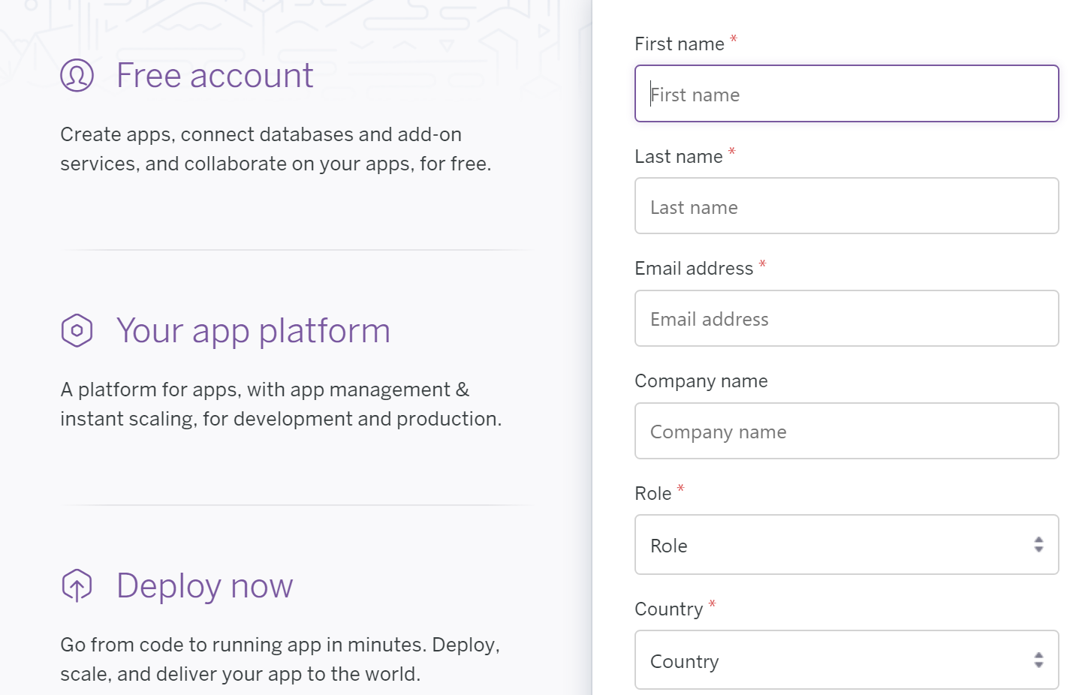
Heroku - Signup
Signup and confirm account creation using mail id

Slide 4
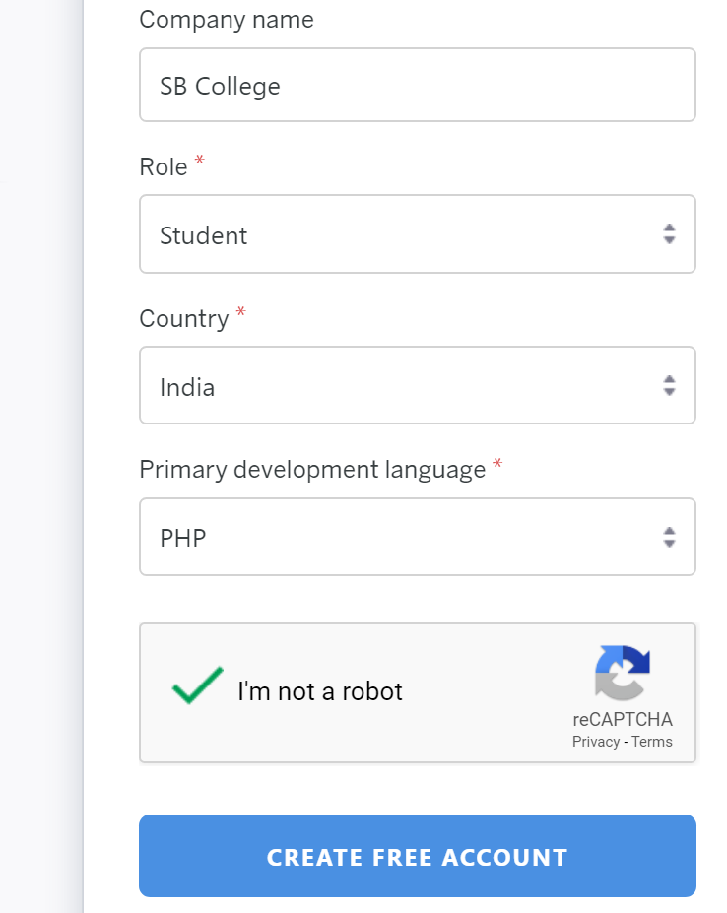
Heroku - Signup
Signup with Heroku using https://signup.heroku.com/

Slide 5
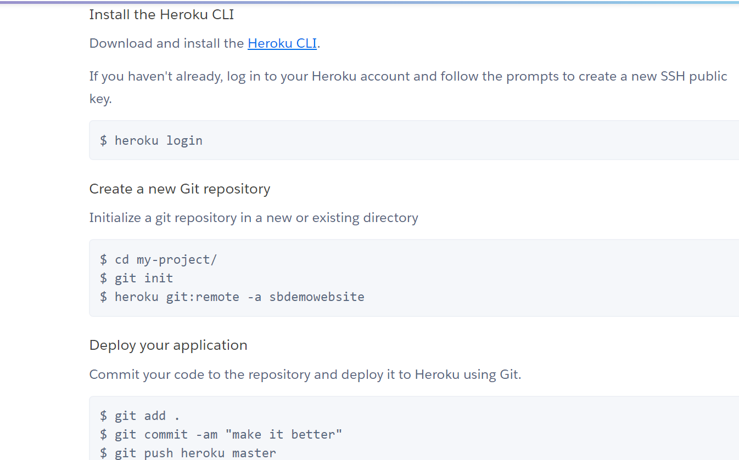
Heroku – Create new app

Slide 6

Thank You

