Slide 1
Python – File Management
Raghu Prasad K S
www.kaushalya.tech
9845547471

Slide 2
File Management / Operations – Using Python
Introduction to File Management
File Management Options for Python
Python and File Operations
Examples refer to Programs under Anaconda File Explorer, 15-FileManagement

Slide 3
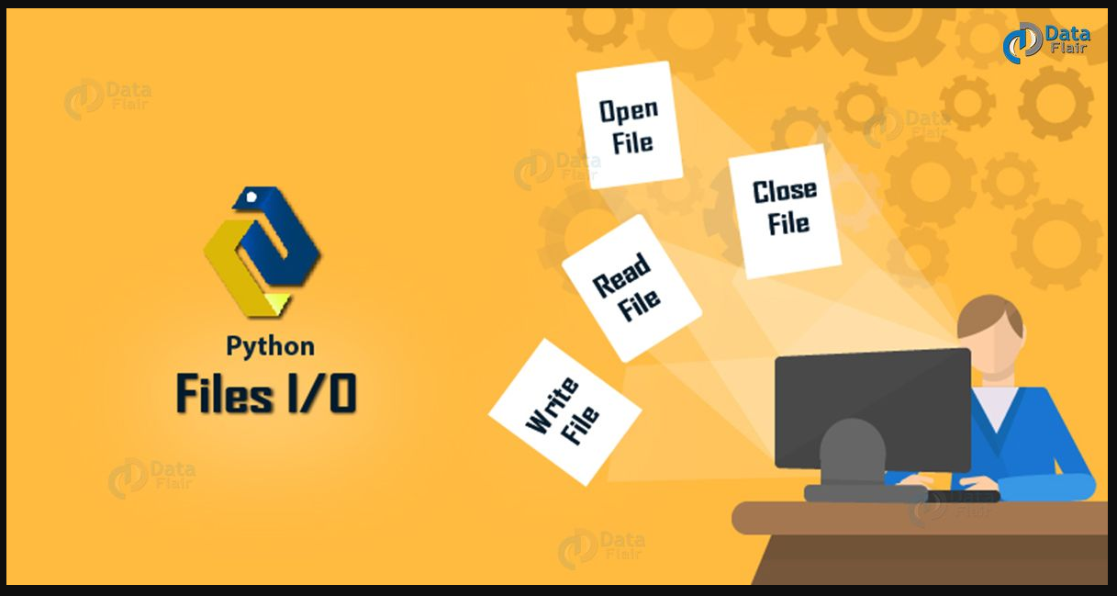
Introduction to File Management
File Management happens to be an important aspect of any application
Python provides several functions working with files CRUD (Create, Read, Update, and Delete)

Slide 4
Introduction to File Management
A file is a location on disk that stores related information and has a name
A hard-disk is non-volatile, and we use files to organize our data in different directories on a hard-disk.
The RAM (Random Access Memory) is volatile; it holds data only as long as it is up. So, we use files to store data permanently. To read from or write to a file, we must first open it. And then when we’re done with it, we should close it to free up the resources it holds (Open, Read/Write, Close)
The key function for working with files in Python is the open() function and need to “import os” library
The open() function takes two parameters; filename, and mode, In addition you can specify if the file should be handled as binary or text mode
"t" - Text - Default value. Text mode
"b" - Binary - Binary mode (e.g. images)

Slide 5
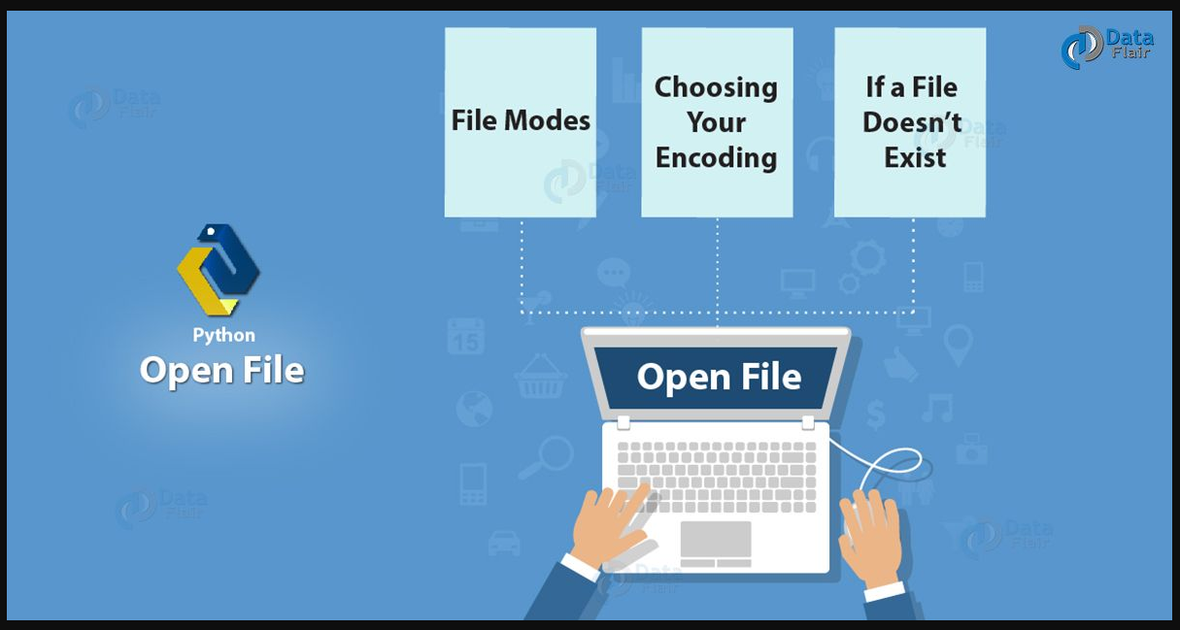
Introduction to File Management

Slide 6
File Management Options for Python
Access Modes Description
r Opens a file for reading only.
rb Opens a file for reading only in binary format.
r+ Opens a file for both reading and writing.
rb+ Opens a file for both reading and writing in binary format.
w Opens a file for writing only.
wb Opens a file for writing only in binary format.
w+ Opens a file for both writing and reading.
wb+ Opens a file for both writing and reading in binary format.
a Opens a file for appending.
ab Opens a file for appending in binary format.
a+ Opens a file for both appending and reading.
ab+ Opens a file for both appending and reading in binary format.

Slide 7
File Management Options for Python
Mode Description
'r' Open a file for reading. (default)
'w' Open a file for writing. Creates a new file if it does not exist or
truncates the file if it exists.
'x' Open a file for exclusive creation. If the file already exists, the
operation fails.
'a' Open for appending at the end of the file without truncating it. Creates a
new file if it does not exist.
't' Open in text mode. (default)
'b' Open in binary mode.
'+' Open a file for updating (reading and writing)

Slide 8
Python and File Operations
Syntax
To open a file for reading it is enough to specify the name of the file
1/ f = open("demofile.txt")
2/ f = open("demofile.txt", "rt")
3/ f = open (“<<filepath>>\demofile.txt")
4/ f = open(“<<filepath>>\demofile.txt", "rt")
Both 1, 2, 3 and 4 are same as "r" for read, and "t" for text are the default values,
you do not need to specify them and also ensure the file exists, or else you will get
an error

Slide 9
Python and File Operations
Open a File on the Server
Assume a file under demofile.txt contents are:
Hello! Welcome to demofile.txt
This file is for testing purposes.
Good Luck!
To open the file, use the built-in open() function.
The open() function returns a file object, which has a read() method for reading the content of the file
f = open("demofile.txt", "r") print(f.read())
Read Only Parts of the File
By default the read() method returns the whole text, but you can also specify how many characters you want to
return (below code return 5 characters of the file
f = open("demofile.txt", "r") print(f.read(5))

Slide 10
Python and File Operations
Read Lines
You can return one line by using the readline() method:
#Read one line of the file
f = open("demofile.txt", "r") print(f.readline())
#By calling readline() two times, you can read the two first lines
f = open("demofile.txt", "r") print(f.readline()) print(f.readline())
#use try and finally
try:
f=open('To do.txt')
print("Before")
print(1/0)
finally:
f.close()
The try block lets you test a block of code for errors.
The except block lets you handle the error.
The finally block lets you execute code, regardless of the result of the try- and except blocks

Slide 11
Python and File Operations
By looping through the lines of the file, you can read the whole file, line by line:
f = open("demofile.txt", "r") for x in f: print(x)
Close Files
It is a good practice to always close the file when you are done with it.
f = open("demofile.txt", "r") print(f.readline()) f.close()
Note: You should always close your files, in some cases, due to buffering, changes made to a file may not show until
you close the file.

Slide 12
Python and File Operations
Write to an Existing File
To write to an existing file, you must add a parameter to the open() function:
"a" - Append - will append to the end of the file
"w" - Write - will overwrite any existing content
Open the file "demofile2.txt" and append content to the file:
f = open("demofile2.txt", "a") f.write("Now the file has more content!") f.close()
#open and read the file after the appending:
f = open("demofile2.txt", "r") print(f.read())
Open the file "demofile3.txt" and overwrite the content:
f = open("demofile3.txt", "w") f.write("Woops! I have deleted the content!") f.close()
#open and read the file after the appending:
f = open("demofile3.txt", "r") print(f.read())
Note: the "w" method will overwrite the entire file

Slide 13
Python and File Operations
Create a New File
To create a new file in Python, use the open() method, with one of the following parameters:
"x" - Create - will create a file, returns an error if the file exist
"a" - Append - will create a file if the specified file does not exist
"w" - Write - will create a file if the specified file does not exist
f = open("myfile.txt", "x")
f = open("myfile.txt", "w")
Delete a File
To delete a file, you must import the OS module, and run its os.remove() function:
#Remove the file demofile.txt
import os os.remove("demofile.txt")

Slide 14
Python and File Operations
Check if File exist
To avoid getting an error, you might want to check if the file exists before you try to delete it:
#Check if file exists, then delete it:
import os
if os.path.exists("demofile.txt"): os.remove("demofile.txt")
else: print("The file does not exist")
Delete Folder
To delete an entire folder, use the os.rmdir() method:
#Remove the folder "myfolder":
import os
os.rmdir("myfolder")
Note: You can only remove empty folders.

Slide 15
Python and File Operations
File Iterate:
The file object has an inbuilt iterate. The following program reads the given file line by line until
StopIteration is raised, i.e. the end of the file is reached.
f=open("myfiledemo.txt","r")
while True:
try:
line=next(f)
print (line)
except StopIteration:
break
f.close()

Slide 16
Python and File Operations
#seek() method : To read or write at a specific position, use the seek() function to
set the current read/write position.
f.seek(offset, from)
Here, the from parameter takes the following values:
0 : offset calculated from the beginning
1 : offset calculated from the current position
2 : offset calculated from the end
file.tell() - Returns the file's current position
f=open("myfiledemo.txt","r+")
f.seek(6,0)
currposition = f.tell()
print('current position',currposition)
lines=f.readlines()
for line in lines:
print(line)
print('position after every line', f.tell())
f.close()
f=open("myfile.txt","r+")
f.seek(6,0)
content=f.read()
print(content)
f.close()

Slide 17
Why Us
Kaushalya is built by IT Professions having experience in academia
Our vision is to Skill, Up-Skill and Re-Skill in order to bridge the gap between academia and industry
Training is conducted by experienced IT Professionals
Vendors for major educational institutions and corporates

Slide 18

Thank You

