Slide 1
Python-Exception Handling
Raghu Prasad K S
www.kaushalya.tech
9845547471

Slide 2
Exception Handling
Introduction to Exceptions
Python Exception Handling
Try Except Finally Block
Assertions
Defining Your Own Exceptions

Slide 3
Introduction to Exceptions
To simplify programming and make applications more robust.
What does robust mean?
In a language without exception handling When an exception occurs, control goes to the
operating system, where a message is displayed and the program is terminated
In a language with exception handling When an exception occurs, control goes to the operating
system, where a message is displayed and the program is terminated
Objective is:
to explore Python Exception Handling
discuss try/except blocks, finally block, and raise block
learn how to define your own python exception

Slide 4
Introduction to Exceptions
Exception handling is the process of responding to exceptions when a computer program runs.
An exception occurs when an unexpected event happens that requires special processing. Examples include a user providing abnormal input, a file system error being encountered when trying to read or write a file, or a program attempting to divide by zero.
Exception handling attempts to gracefully handle these situations so that a program (or worse, an entire system) does not crash. Exception handling can be performed at both the software (as part of the program itself) and hardware levels (using mechanisms built into the design of the CPU)

Slide 5
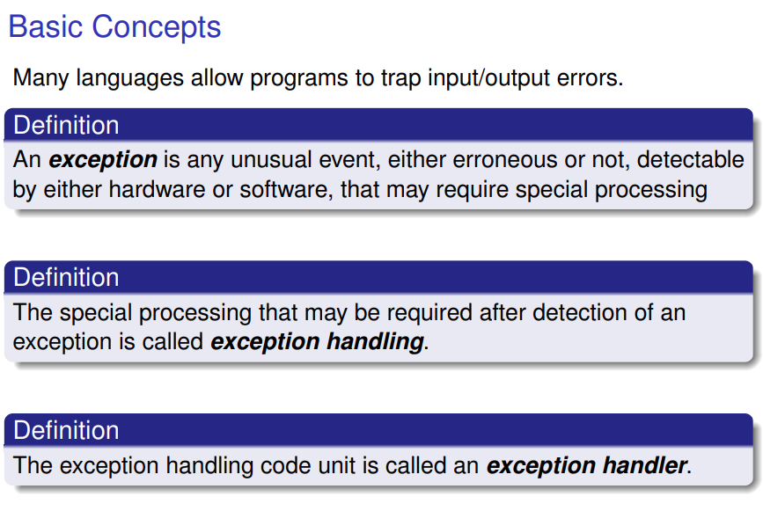
Introduction to Exceptions

Slide 6
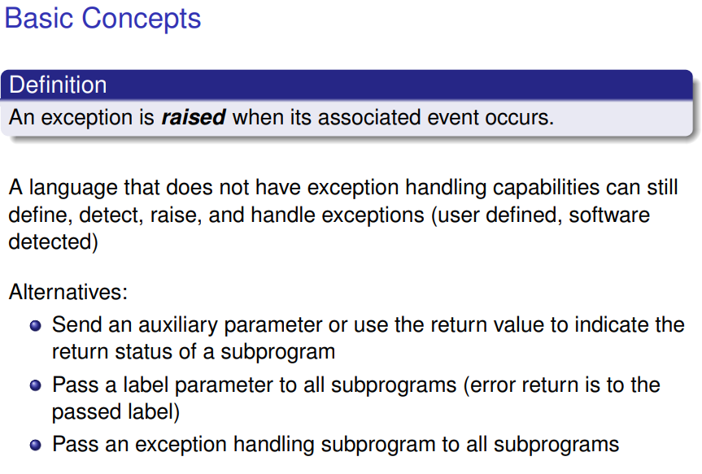
Introduction to Exceptions

Slide 7
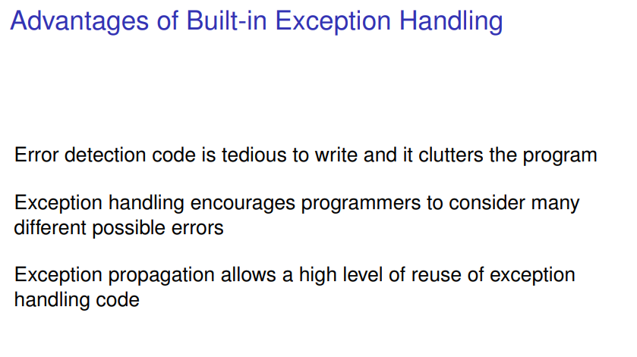
Introduction to Exceptions

Slide 8
Introduction to Exceptions

Slide 9
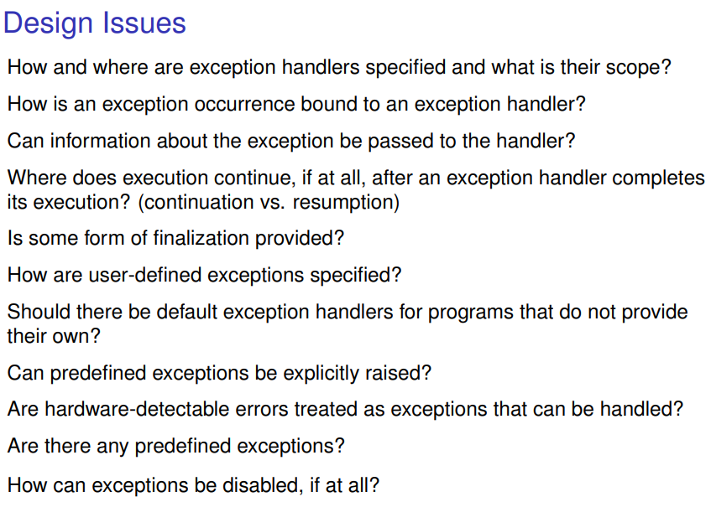
Introduction to Exceptions

Slide 10
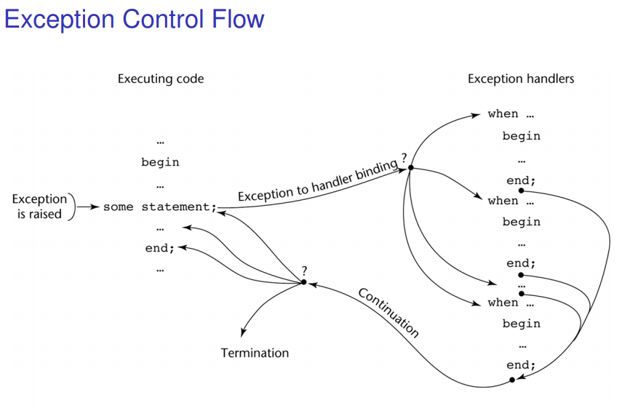
Introduction to Exceptions

Slide 11
Python Exception Handling
Exception Handling
When an error occurs, or exception as we call it, Python will normally stop and
generate an error message. These exceptions can be handled using the try
Statement
The try block lets you test a block of code for errors.
The except block lets you handle the error.
The finally block lets you execute code, regardless of the result of the try- and except blocks
#The try block will generate an exception, because x is not defined
try: print(x)
except: print("An exception occurred")

Slide 12
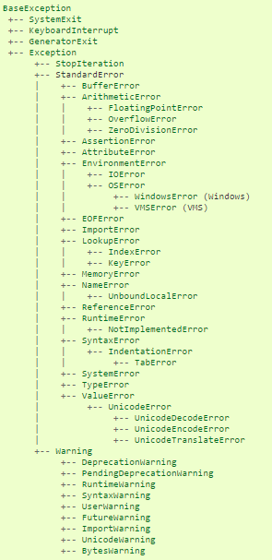
Python Exception Handling Hierarchy

Slide 13
Python Exception Handling - Many Exceptions
You can define as many exception blocks as you want, e.g. if you want to execute a
special block of code for a special kind of error
#The try block will generate a NameError, because x is not defined:
try:
print(x)
except NameError:
print("Variable x is not defined")
except:
print("Something else went wrong")
Output → Variable x is not defined

Slide 14
Python Exception Handling
Else
You can use the else keyword to define a block of code to be executed if no errors were raised:
#The try block does not raise any errors, so the else block is executed:
try:
print("Hello")
except:
print("Something went wrong")
else:
print("Nothing went wrong")

Slide 15
Python Exception Handling
Finally
The finally block, if specified, will be executed regardless if the try block raises an error or not
#The finally block gets executed no matter if the try block raises any errors or not:
try:
print(x)
except:
print("Something went wrong")
finally:
print("The 'try except' is finished")

Slide 16
Python Exception Handling - Raise an exception
As a Python developer you can choose to throw an exception if a condition occurs.
To throw (or raise) an exception, use the raise keyword.
Raise an error and stop the program if x is lower than 0:
x = -1
if x < 0:
raise Exception("Sorry, no numbers below zero")
Output:
Traceback (most recent call last): File “*.py", line 4, in <module> raise Exception("Sorry, no numbers below zero") Exception: Sorry, no numbers below zero

Slide 17
Python Exception Handling - Raise an exception
The raise keyword is used to raise an exception. You can define what kind of error
to raise, and the text to print to the user.
Raise a TypeError if x is not an integer:
x = "hello“
if not type(x) is int:
raise TypeError("Only integers are allowed")
Output:
Traceback (most recent call last):
File "demo_ref_keyword_raise2.py", line 4, in <module>
raise TypeError("Only integers are allowed")
TypeError: Only integers are allowed

Slide 18
Python Exception Handling - Assertion
An assertion is actually a sanity-check for your cynical, paranoid soul. It takes an expression as an argument and
raises a python exception if the expression has a False Boolean value. Otherwise, it performs a No-operation (NOP).
try:
print(1)
assert 2+2==4
print(2)
assert 1+2==4
print(3)
except:
print("An assert failed.")
raise
finally:
print("Okay")
print("Bye")
You may optionally provide a second argument to give out some extra information about the problem.
assert False,"That's a problem"
Traceback (most recent call last):
File “<pyshell#173>”, line 1, in <module> assert False,”That’s a problem”
AssertionError: That’s a problem
1
2
An assert failed.
Okay
Bye
This is because when we ‘raise’ an exception, we aren’t provisioning a handle for it. We can use assertions to check for valid input and output to functions

Slide 19
Python Exception Handling - Own Exceptions
We derive a new class from the Exception class and call it like any other exception.
class MyError(Exception):
print("This is a problem")
raise MyError("MyError happened")
Output:
Traceback (most recent call last):
File “<pyshell#179>”, line 1, in <module>
raise MyError(“MyError happened”)
MyError: MyError happened

Slide 20
Why Us
Kaushalya is built by IT Professions having experience in academia
Our vision is to Skill, Up-Skill and Re-Skill in order to bridge the gap between academia and industry
Training is conducted by experienced IT Professionals
Vendors for major educational institutions and corporates

Slide 21

Thank You

