Slide 1
Manual Testing Introduction
Raghu Prasad K S
www.kaushalya.tech
9845547471

Slide 2
Introduction
Raghu Prasad – BE, MS
Total of 24 years of experience
7 years as a lecturer in Engineering College
17 Years into IT
Worked with companies like CISCO,CSC,ICICI,First Apex – NTT Data
Currently into Corporate training and consultancy
Worked with corporates and public sector
Technologies – Java,Python,AI,ML,Web technologies,Java Script technologies (MEAN stack),IOT,Test Automation – Selenium,JMeter

Slide 3
About Us
Kaushalya Technologies (www.kaushalya.tech) is an educational technology company started by IT Professionals and Academicians.
It has offices in Jakkur and Sahakara Nagara in Bengaluru
Kaushalya Technologies are into IT niche skills training, consultancy and educational application development
We conduct FDP, SDP, Internships for educational institutions.
We conduct Boot camp and niche IT skills training for corporates.

Slide 4
Our Major clients
Educational Institutions
Acharya Institute of Technology, REVA University,Dayanand Sagar University, Nagarjuna Engineering College, Bengaluru
BGSIT- Bellur, Malnad Engineering College-Hassan, NIE-Mysore, MYCEM, Mysore, NIT-Manipur
Sindhi College, SB College of Management, Bengaluru
IT Companies
L & T – Mysore,NextGen-Bengaluru,Philips-Bengaluru,Incarnus-Chennai,Aspire Systems-Chennai, Infidata Technologies – Bengaluru, Edulife- Bengaluru

Slide 5
Agenda
What is Software ?
Projects V/S Products
What is Software Testing ?
Why do we need Testing ?

Slide 6
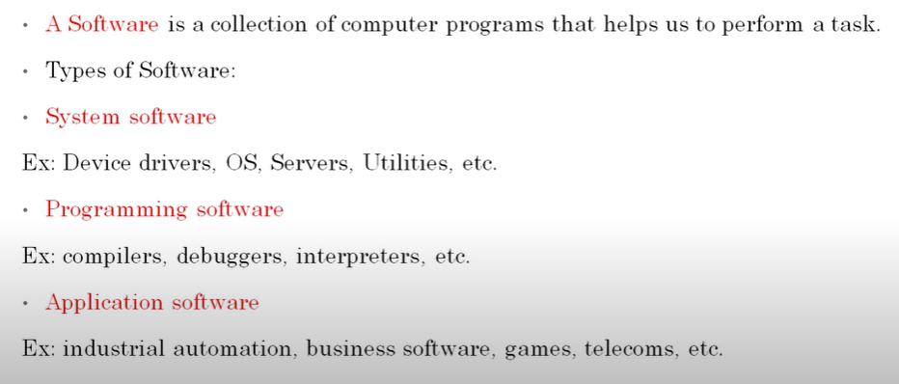
What is Software ?

Slide 7
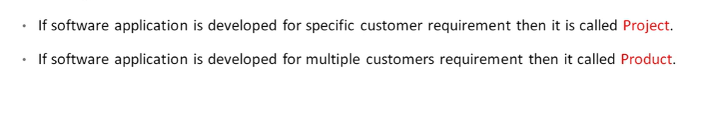
Project Vs Product

Slide 8
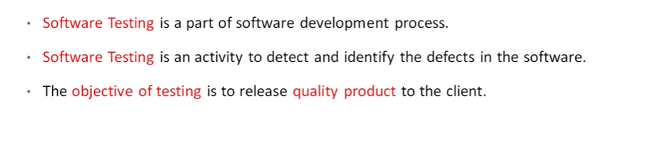
What is software testing ?

Slide 9
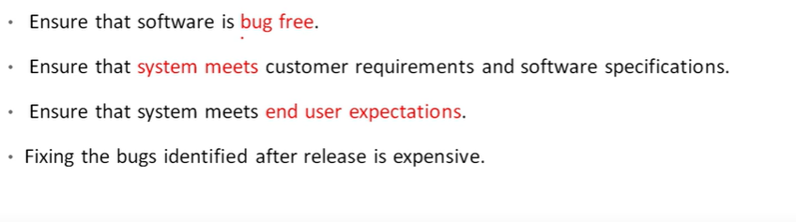
Why software testing is needed?

