Slide 1
Manual Testing SDLC Models
Raghu Prasad K S
www.kaushalya.tech
9845547471

Slide 2
Agenda
SDLC Models

Slide 3
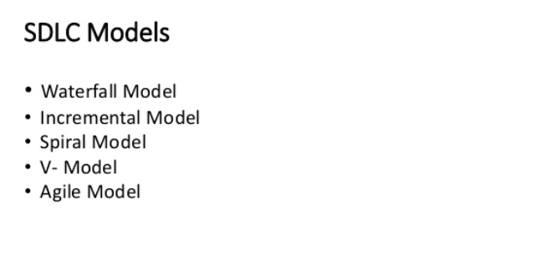
SDLC Models

Slide 4
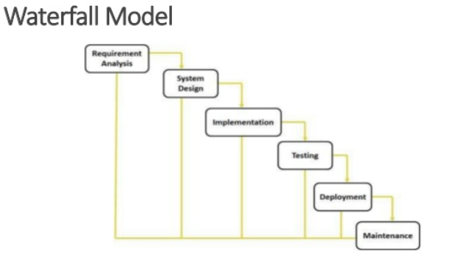
SDLC Models - Waterfall

Slide 5
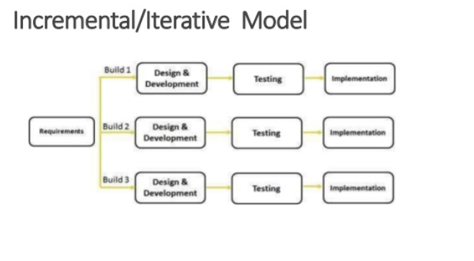
SDLC Models – Iterative Model

Slide 6
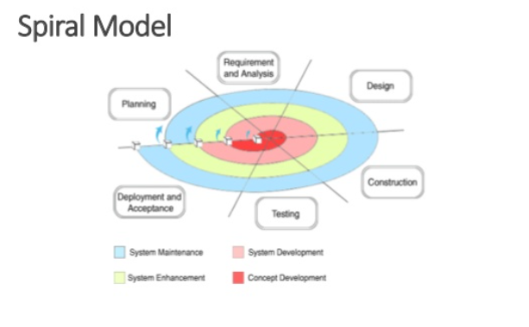
SDLC Models – Spiral Model

Slide 7
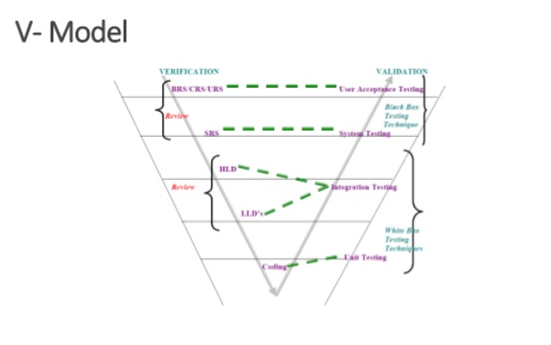
SDLC Models – V Model

Slide 8
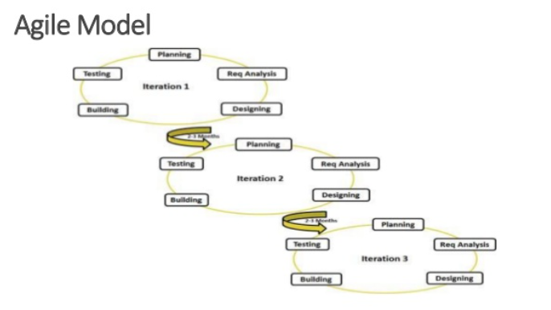
SDLC Models – Agile Model

