Slide 1
Manual Testing SDLC-STLC
Raghu Prasad K S
www.kaushalya.tech
9845547471

Slide 2
Agenda
SDLC V/S STLC
Waterfall V/S V-Model

Slide 3
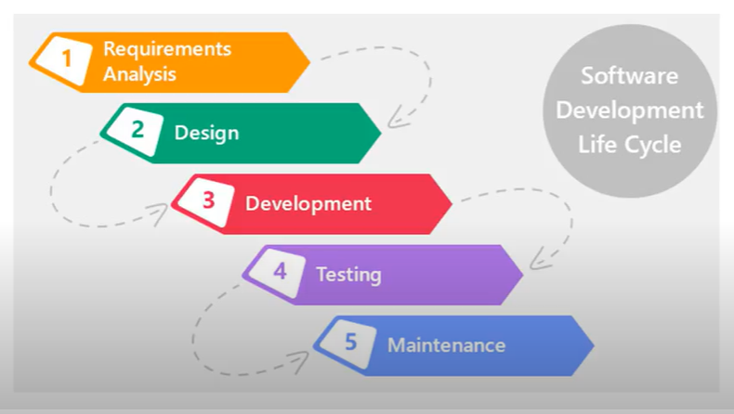
What is SDLC ?

Slide 4
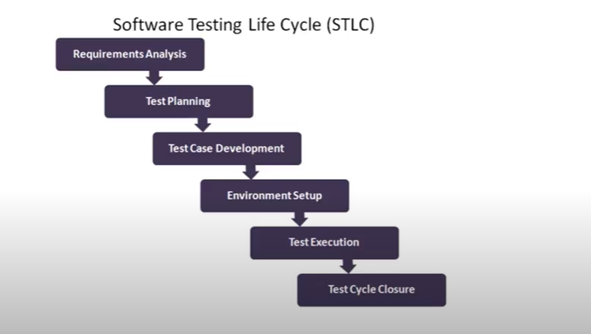
STLC

Slide 5
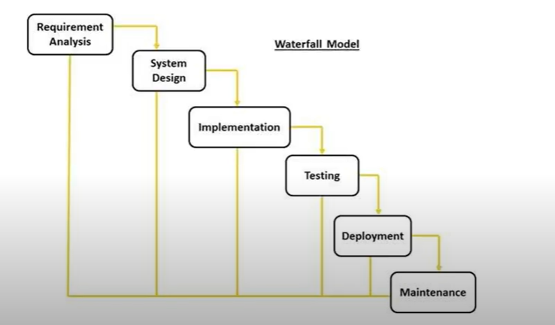
Waterfall Model

Slide 6
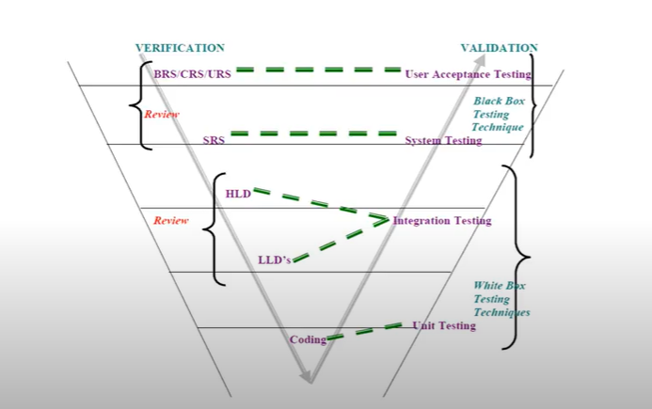
V-Model

