Slide 1
Manual Testing Software Quality
Raghu Prasad K S
www.kaushalya.tech
9845547471

Slide 2
Agenda
What is Software Quality ?
Error,Defect/Bug & Failure
Why there are bugs in software ?

Slide 3
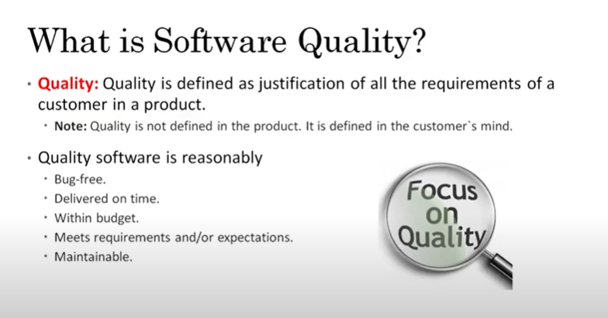
What is Software Quality ?

Slide 4
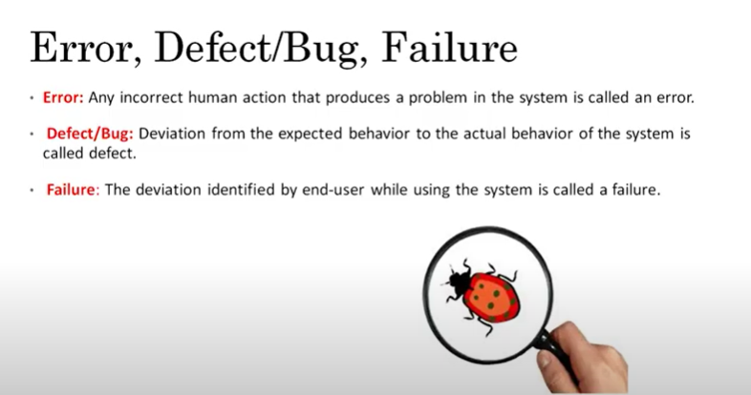
Error,Defect/Bug,Failure

Slide 5
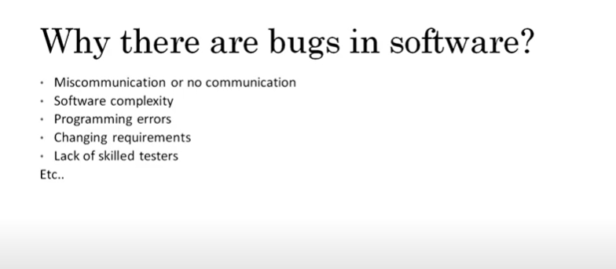
Why there are bugs in software ?

