Slide 1
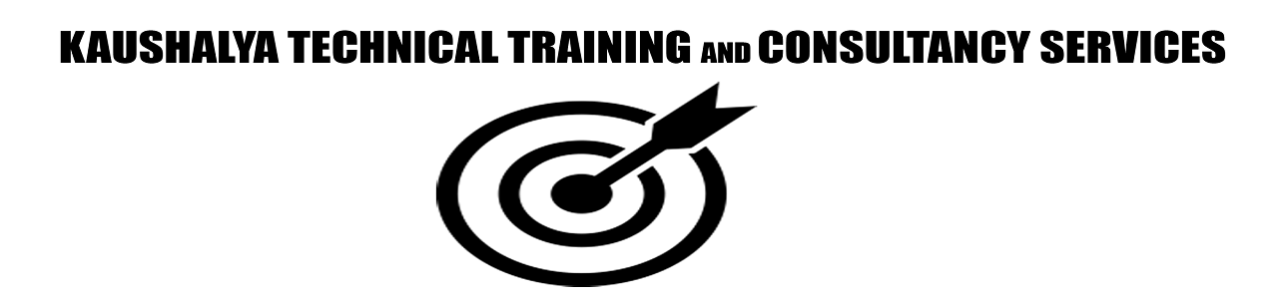
AJAX - JSON
Raghu Prasad
9845547471
www.kaushalya.tech
FB : https://www.facebook.com/raghuprasadkonandur/
Skill Up-Skill Re-Skill
Excellence in action

Slide 2

Introduction
Raghu Prasad – BE, MS
Total of 23 years of experience
7 years as a lecturer in an Engineering College
16 Years into IT
Worked with companies like CISCO,CSC,ICICI,First Apex – NTT Data
Currently into Corporate training and consultancy
Worked with corporates and public sector
Service Offerings – In person/On-line/Corporate/Academic Institutes
Technologies – Java,Python,Web technologies,Java Script technologies (MEAN stack),IOT,Test Automation,Machine Learning,Artificial Intelligence,ERP
Customers – Philips,L & T,NextGen,Incarnus,BGS-IT,Sindhi College,Malnad Enginering College

Slide 3
SESSION 1

Slide 4
JavaScript AJAX
AJAX = Asynchronous JavaScript And XML.
AJAX is not a programming language.
AJAX just uses a combination of:
A browser built-in XMLHttpRequest object (to request data from a web server)
JavaScript and HTML DOM (to display or use the data)
AJAX allows web pages to be updated asynchronously by exchanging data with a web server behind the scenes. This means that it is possible to update parts of a web page, without reloading the whole page.

Slide 5
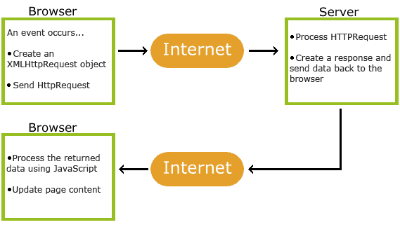
JavaScript AJAX

Slide 6
JavaScript AJAX
AJAX = Asynchronous JavaScript And XML.
AJAX is not a programming language.
AJAX just uses a combination of:
A browser built-in XMLHttpRequest object (to request data from a web server)
JavaScript and HTML DOM (to display or use the data)
AJAX allows web pages to be updated asynchronously by exchanging data with a web server behind the scenes. This means that it is possible to update parts of a web page, without reloading the whole page.

Slide 7
JSON - Introduction
JSON: JavaScript Object Notation.
JSON is a syntax for storing and exchanging data.
JSON is text, written with JavaScript object notation.
What is JSON?
JSON stands for JavaScript Object Notation
JSON is a lightweight data-interchange format
JSON is "self-describing" and easy to understand
JSON is language independent *

Slide 8
Introduction to Java Script Object Notation
JSON (JavaScript Object Notation) is a lightweight data-interchange format.
It is easy for humans to read and write.
It is easy for machines to parse and generate.
It is based on a subset of the JavaScript Programming Language, Standard ECMA-262 3rd Edition - December 1999.
JSON is a text format that is completely language independent but uses conventions that are familiar to programmers of the C-family of languages, including C, C++, C#, Java, JavaScript, Perl, Python, and many others

Slide 9
Introduction to Java Script Object Notation
JSON is built on two structures:
A collection of name/value pairs.
In various languages, this is realized as an object, record, struct,
dictionary, hash table, keyed list, or associative array.
An ordered list of values.
In most languages, this is realized as an array, vector, list, or sequence.

Slide 10
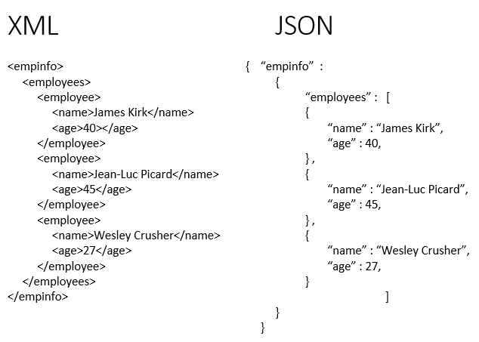
XML Vs JSON

Slide 11
JSON Syntax
The JSON syntax is a subset of the JavaScript syntax.
JSON Syntax Rules
JSON syntax is derived from JavaScript object notation syntax:
Data is in name/value pairs
Data is separated by commas
Curly braces hold objects
Square brackets hold arrays
Example : "name":"John"

Slide 12
JSON –Data Types
Valid Data Types :
In JSON, values must be one of the following data types:
a string, a number, an object (JSON object),an array,a boolean
Example :
String { "name":"John" }
Number { "age":30 }
Object { "employee":{ "name":"John", "age":30, "city":"New York" }}
Arrays {"employee":{ "name":"John", "age":30, "city":"New York" }}
Boolean { "sale":true }

Slide 13
JSON.parse()
A common use of JSON is to exchange data to/from a web server.
When receiving data from a web server, the data is always a string.
Parse the data with JSON.parse(), and the data becomes a JavaScript object
Example - Parsing JSON
Imagine we received this text from a web server:
'{ "name":"John", "age":30, "city":"New York"}‘
Use the JavaScript function JSON.parse() to convert text into a JavaScript object:
var obj = JSON.parse('{ "name":"John", "age":30, "city":"New York"}');

Slide 14
JSON.stringify()
A common use of JSON is to exchange data to/from a web server.
When sending data to a web server, the data has to be a string.
Convert a JavaScript object into a string with JSON.stringify().
Imagine we have this object in JavaScript:
var obj = { name: "John", age: 30, city: "New York" };
Use the JavaScript function JSON.stringify() to convert it into a string.
var myJSON = JSON.stringify(obj);
The result will be a string following the JSON notation.
myJSON is now a string, and ready to be sent to a server:

Slide 15
JSON Objects
Object Syntax - { "name":"John", "age":30, "car":null }
JSON objects are surrounded by curly braces {}.
JSON objects are written in key/value pairs.
Keys must be strings, and values must be a valid JSON data type (string, number, object, array, boolean or null).
Keys and values are separated by a colon.
Each key/value pair is separated by a comma.

Slide 16
JSON Arrays
Arrays in JSON are almost the same as arrays in JavaScript.
In JSON, array values must be of type string, number, object, array, boolean or null.
In JavaScript, array values can be all of the above, plus any other valid JavaScript expression, including functions, dates, and undefined.
[ "Ford", "BMW", "Fiat" ]
{ "name":"John", "age":30, "cars":[ "Ford", "BMW", "Fiat" ] }

Slide 17
JSON HTML
JSON can very easily be translated into JavaScript.
JavaScript can be used to make HTML in your web pages.
HTML Table
Make an HTML table with data received as JSON:

Slide 18
Thank You
Raghu Prasad
9845547471
www.kaushalya.tech
FB : https://www.facebook.com/raghuprasadkonandur/
Skill Up-Skill Re-Skill
Excellence in action

