Slide 1
Web Technologies
Raghu Prasad K S
www.kaushalya.tech
9845547471

Slide 2
Introduction
Raghu Prasad – BE, MS
Total of 29 years of experience
7 years as a lecturer in Engineering College
22 Years into IT
Worked with companies like CISCO, CSC, ICICI, First Apex – NTT Data
urrently into Corporate training, consultancy and application development
Worked with corporates and public sector
Technologies – Java, C#,Python, DataSciences, Web Technologies, Java Script technologies (MEAN,MERN stack), IOT, Test Automation – Selenium, Jmeter,.NET,AWS,Azure,Block Chain

Slide 3
Web Technologies
Web Technology refers to the various tools and techniques that are utilized in the process of communication between different types of devices over the internet.
Web Technology consists of
World Wide Web (WWW) - Web browsers, Hypertext Markup Language (HTML) and Hypertext Transfer Protocol (HTTP).
Web Browser: The web browser is an application software to explore www (World Wide Web). It provides an interface between the server and the client and requests to the server for web documents and services.

Slide 4
Web Technologies
Web Server: Web server is a program which processes the network requests of the users and serves them with files that create web pages.
Web Development: Web development refers to the building, creating, and maintaining of websites.
It includes aspects such as web design, web publishing, web programming, and database management.
It is the creation of an application that works over the internet i.e. websites.

Slide 5
Web Technologies
Web Server: Web server is a program which processes the network requests of the users and serves them with files that create web pages.
Web Development: Web development refers to the building, creating, and maintaining of websites.
It includes aspects such as web design, web publishing, web programming, and database management.
It is the creation of an application that works over the internet i.e. websites.

Slide 6
Web Technologies
Web Development can be classified into two ways:
Frontend Development: The part of a website that the user interacts directly is termed as front end. It is also referred to as the ‘client side’ of the application.
Backend Development : Backend is the server side of a website. It is the part of the website that users cannot see and interact.
It is the portion of software that does not come in direct contact with the users. It is used to store and arrange data.

Slide 7
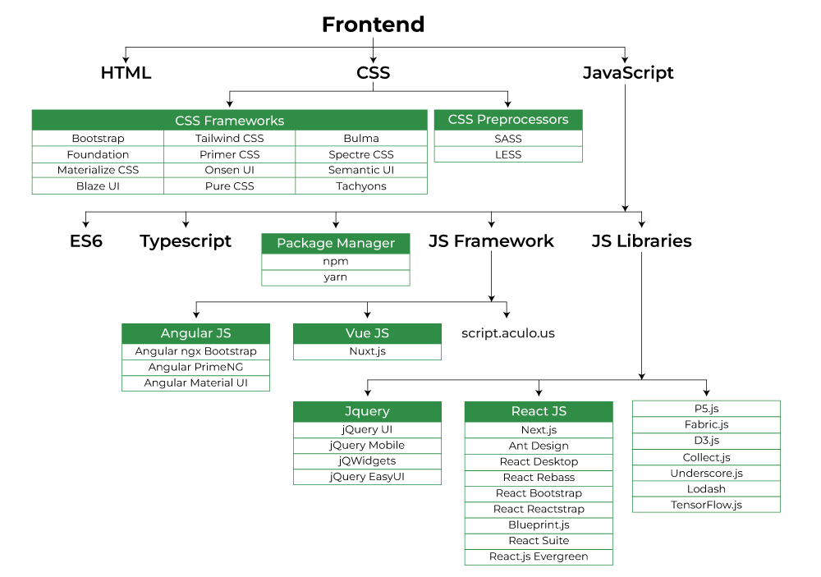
Web Technologies

Slide 8
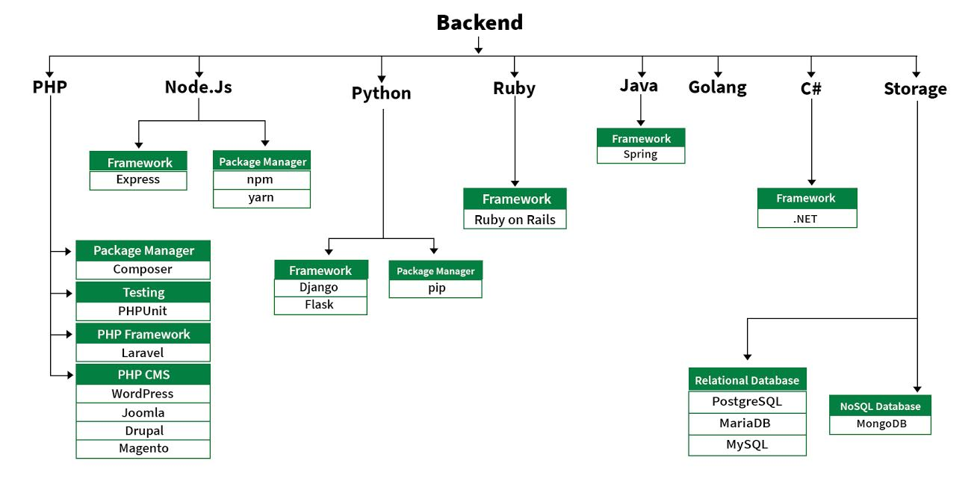
Web Technologies

Slide 9
Web Technologies – Building Blocks
HTML: HTML stands for Hypertext Markup Language.
It is used to design the front-end portion of web pages using a markup language.
HTML is the combination of Hypertext and Markup language.
Hypertext defines the link between the web pages.
The markup language is used to define the text documentation within the tag which defines the structure of web pages.

Slide 10
Web Technologies – Building Blocks
CSS: Cascading Style Sheets fondly referred to as CSS is a simply designed language intended to simplify the process of making web pages presentable.
CSS allows you to apply styles to web pages. More importantly, CSS enables you to do this independent of the HTML that makes up each web page.
JavaScript: JavaScript is a famous scripting language used to create magic on the sites to make the site interactive for the user.
It is used to enhancing the functionality of a website to running cool games and web-based software.

Slide 11
Web Technologies – Building Blocks
AJAX: Ajax is an acronym for Asynchronous Javascript and XML.
It is used to communicate with the server without refreshing the web page and thus increasing the user experience and better performance.
JQuery:
jQuery is an open-source JavaScript library that simplifies the interactions between an HTML/CSS document,
or more precisely the Document Object Model (DOM), and JavaScript. Elaborating the terms, it simplifies HTML document
traversing and manipulation, browser event handling, DOM animations, Ajax interactions, and cross-browser JavaScript development.

Slide 12
Jquery-Libraries
jQuery UI
jQuery Mobile
jQWidgets
jQuery EasyUI
jQuery UI is a curated set of user interface interactions, effects, widgets, and themes built on top of the jQuery JavaScript Library.
Whether you’re building highly interactive web applications, or you just need to add a date picker to a form control,
jQuery UI is a perfect choice.

Slide 13
Top Programming languages for 2023
https://www.forbes.com/sites/forbestechcouncil/2022/12/28/what-your-software-partner-should-know-the-top-programming-languages-of-2023/?sh=1709ba21182b
https://www.simplilearn.com/best-programming-languages-start-learning-today-article
https://www.geeksforgeeks.org/top-10-programming-languages-to-learn/
https://www.analyticsinsight.net/top-10-programming-languages-in-2023-with-the-largest-developer-communities/

Slide 14
Jquery-Libraries
jQuery Mobile is an HTML5 based user interface system designed to make responsive websites and
apps that are accessible on all smartphone, tablet, and desktop devices.
jQWidgets is a JavaScript framework for making web-based applications for PC and mobile devices.
It is a very powerful and optimized framework, platform-independent, and widely supported.
It has more than 60 UI widget that helps to create attractive UI design.

Slide 15
Jquery-Libraries
EasyUI jQuery is an HTML5 framework for using user interface components based on jQuery.
It helps in building features for interactive web and mobile applications saving a lot of time for developers.

Slide 16
Hands-on
Jquery – Hands-on

Slide 17
Q&A Session
Thanks
Visit – www.kaushalya.tech
9845547471

