Slide 1
Introduction to ExplainableAI (XAI)
Raghu Prasad
9845547471
www.kaushalya.tech
CEO

Slide 2
Introduction
Raghu Prasad – BE, MS
Total of 30 years of experience
7 years as a lecturer in an Engineering College
23 Years into IT
Worked with companies like CISCO,CSC,ICICI,First Apex – NTT Data
Currently into Corporate training and consultancy
Worked with corporates and public sector
Service Offerings – In person/On-line/Corporate/Academic Institutes
Consultancy – Consultant to vendor of Atal Tinkering Lab/ECIL-ECIT, Incarnus – Healthcare Service Provider
Technologies – Java,Python,Web technologies,Java Script technologies (MEAN stack),IOT,Test Automation,Machine Learning,Artificial Intelligence,ERP,.NET,Cloud Computing,Devops,MLOps
Customers – ILinkDigital,Operative,Flatworld,IQVIA,Sony,Philips,L & T,NextGen,Incarnus,Aspire system,
NewHorizonCollege Of Engineering,NIE Mysore,Acharya College Of Engineering,SIT-Tumakuru,BGS-IT,Sindhi College,Malnad Enginering College,S B College of Management, REVA University,Nagarjuna Engineering College,Dayanand Sagar University,NIT-Imphal

Slide 3
Topics
Overview of Explainable AI

Slide 4
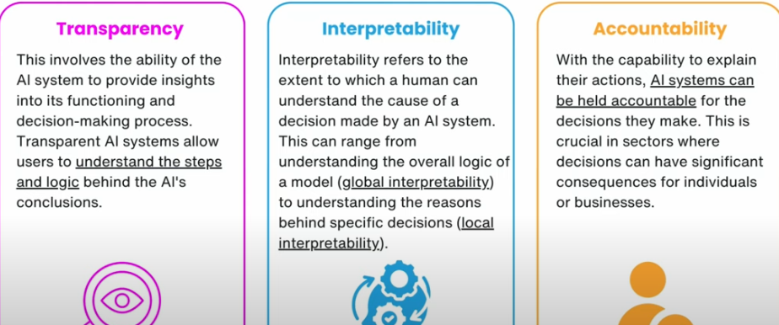
Overview of Explainable AI
Notes:
Transparency – making decision in self driving car,finance.. Healthy or unhealth.. Which factors making as unhealty.. Conducting a surgery..Why surgery is prescribed.

Slide 5
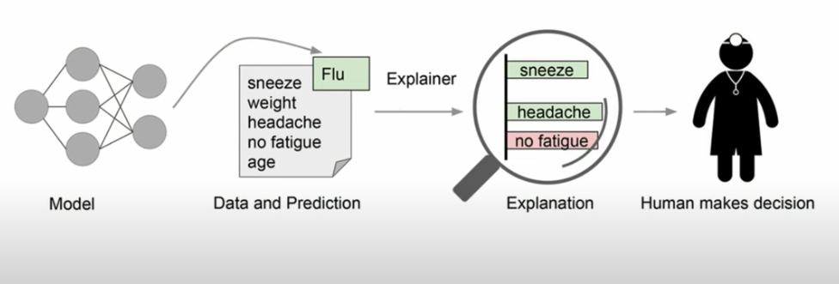
Need for XAI
Notes:
Transparency – making decision in self driving car,finance.. Healthy or unhealth.. Which factors making as unhealty.. Conducting a surgery..Why surgery is prescribed.

Slide 6
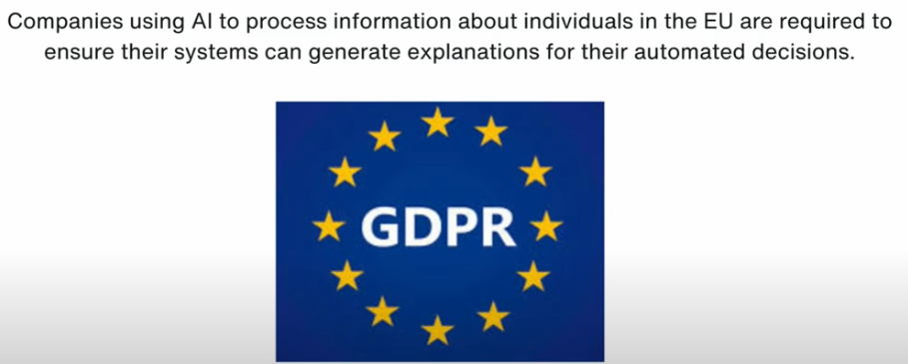

Overview of Explainable AI – Government Regulations
Notes:
Transparency – making decision in self driving car,finance.. Healthy or unhealth.. Which factors making as unhealty.. Conducting a surgery..Why surgery is prescribed.

Slide 7
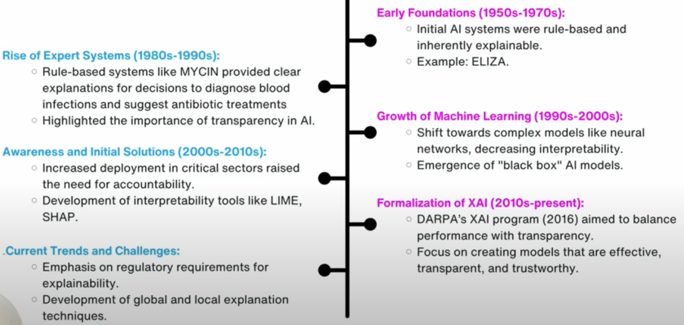
History of XAI
Notes:
Transparency – making decision in self driving car,finance.. Healthy or unhealth.. Which factors making as unhealty.. Conducting a surgery..Why surgery is prescribed.

Slide 8
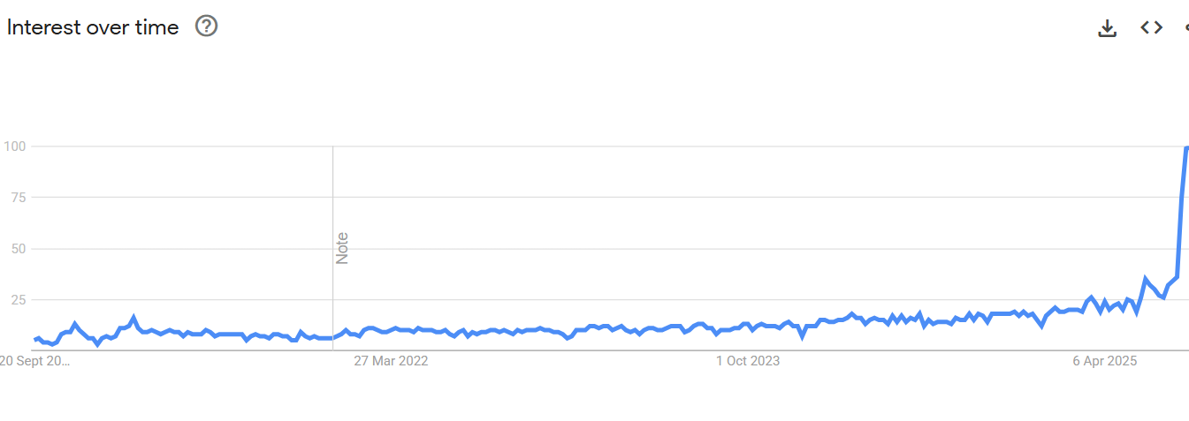
Google Trent on XAI
Notes:
Transparency – making decision in self driving car,finance.. Healthy or unhealth.. Which factors making as unhealty.. Conducting a surgery..Why surgery is prescribed.

Slide 9
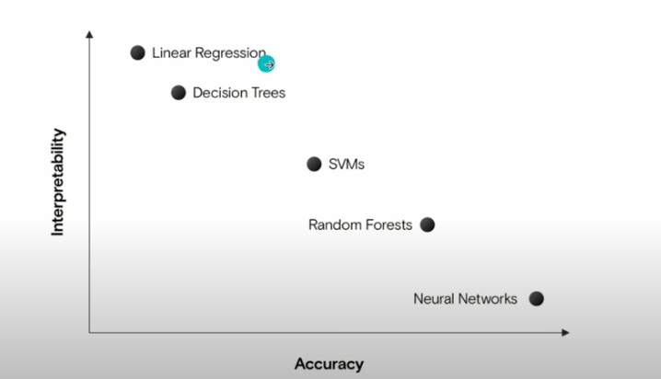
Interpretability Vs Accuracy
Notes:
Transparency – making decision in self driving car,finance.. Healthy or unhealth.. Which factors making as unhealty.. Conducting a surgery..Why surgery is prescribed.

Slide 10
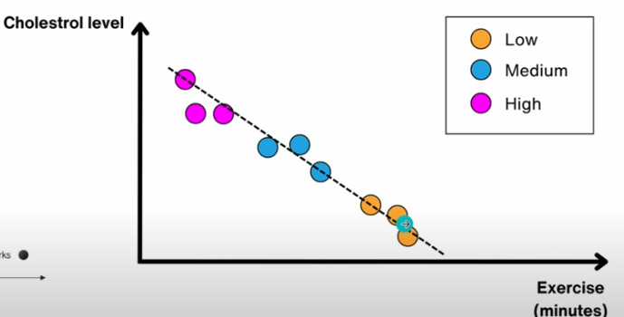
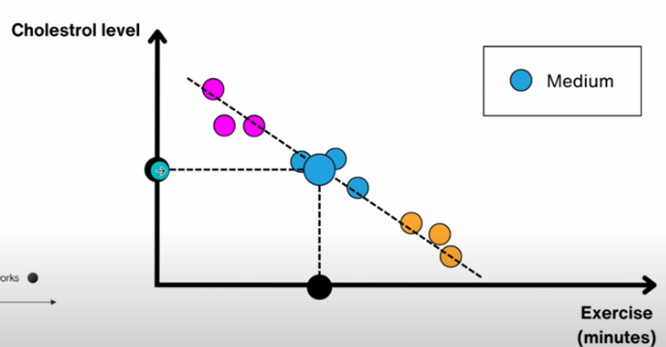
Interpretability in Linear Regression
Notes:
Linear Regression is highly interpretable

Slide 11
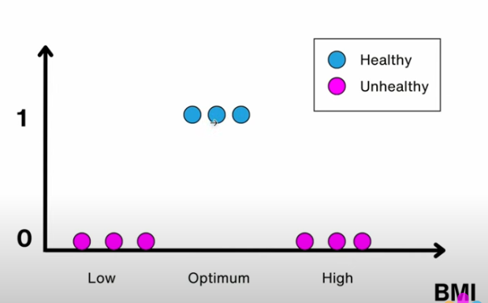
Interpretability in Linear Regression
Notes:
Linear Regression is highly interpretable

Slide 12
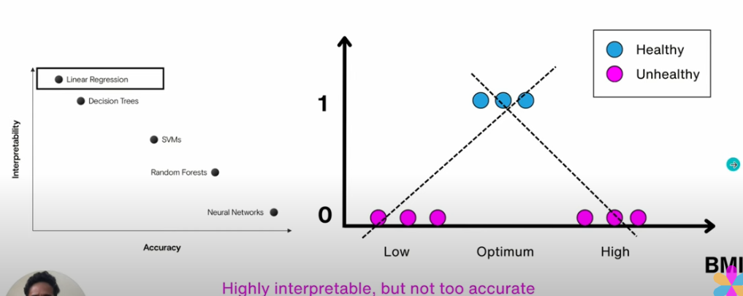
Interpretability in Linear Regression
Notes:
Linear Regression is highly interpretable

Slide 13
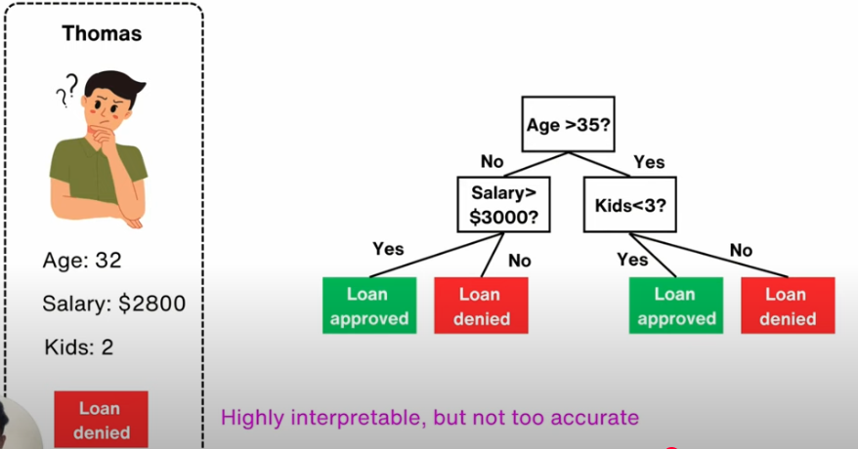
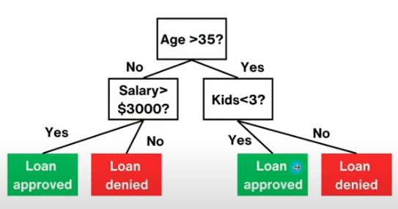
Interpretability of Decision Trees
Notes:
Linear Regression is highly interpretable

Slide 14
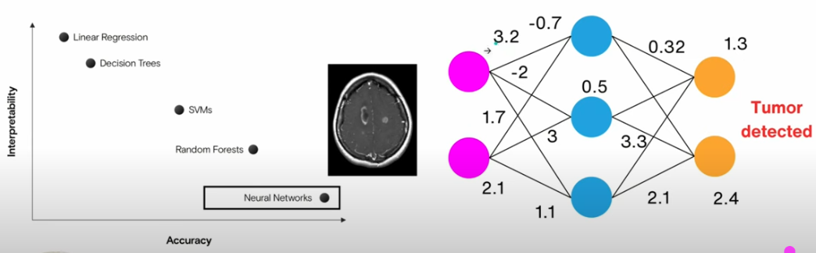

Interpretability of Neural Network
Notes:
Linear Regression is highly interpretable

Slide 15
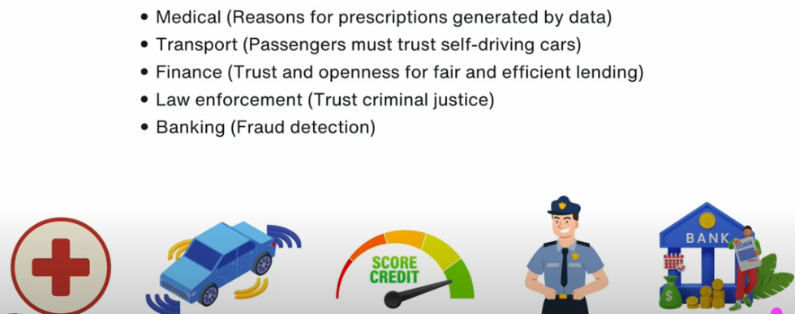
Applications of XAI
Notes:
Linear Regression is highly interpretable

Slide 16
References
Vizuara - https://www.youtube.com/watch?v=-cRzYyTTjzY&list=PLPTV0NXA_ZShaln9GfiHO_c0HzOSqLOGv&index=12
Notes:
Linear Regression is highly interpretable

Slide 17
Thank You
Raghu Prasad
9845547471
www.kaushalya.tech

