Slide 1
SHAP Deep drive
Raghu Prasad
9845547471
www.kaushalya.tech
CEO

Slide 2
Introduction
Raghu Prasad – BE, MS
Total of 30 years of experience
7 years as a lecturer in an Engineering College
23 Years into IT
Worked with companies like CISCO,CSC,ICICI,First Apex – NTT Data
Currently into Corporate training and consultancy
Worked with corporates and public sector
Service Offerings – In person/On-line/Corporate/Academic Institutes
Consultancy – Consultant to vendor of Atal Tinkering Lab/ECIL-ECIT, Incarnus – Healthcare Service Provider
Technologies – Java,Python,Web technologies,Java Script technologies (MEAN stack),IOT,Test Automation,Machine Learning,Artificial Intelligence,ERP,.NET,Cloud Computing,Devops,MLOps
Customers – ILinkDigital,Operative,Flatworld,IQVIA,Sony,Philips,L & T,NextGen,Incarnus,Aspire system,
NewHorizonCollege Of Engineering,NIE Mysore,Acharya College Of Engineering,SIT-Tumakuru,BGS-IT,Sindhi College,Malnad Enginering College,S B College of Management, REVA University,Nagarjuna Engineering College,Dayanand Sagar University,NIT-Imphal

Slide 3
Topics
SHAP Deep drive

Slide 4
Introduction
SHAP is a popular Explainable AI (XAI) technique used to understand why a machine learning model made a particular prediction.
👉 It explains model decisions by showing how each input feature contributed to the output.
⚖️ Based on Game Theory
SHAP comes from Shapley values in cooperative game theory.
Idea:
🧩 Each feature = a “player”
🏆 Prediction = total reward
📊 SHAP distributes credit fairly among features
📈 What SHAP Explains
For a prediction, SHAP shows:
🔺 Features increasing the prediction
🔻 Features decreasing the prediction
⭐ Most important factors
🧠 Model behavior

Slide 5
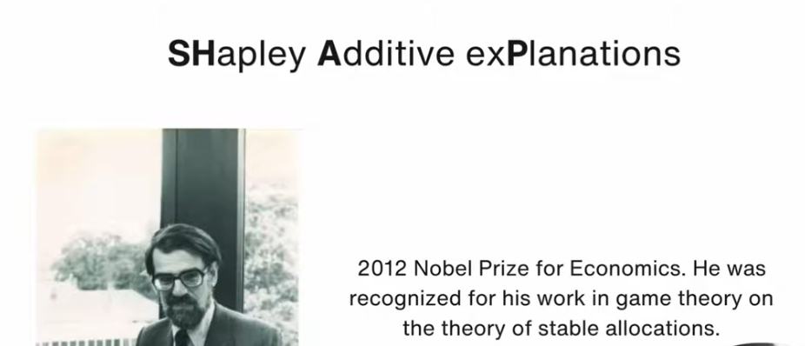
SHAP Introduction

Slide 6
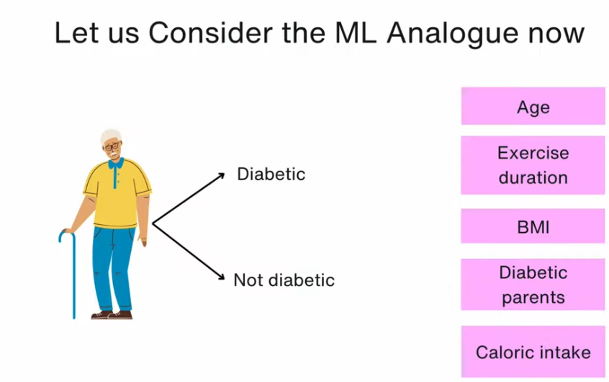
SHAP

Slide 7
SHAP

Slide 8
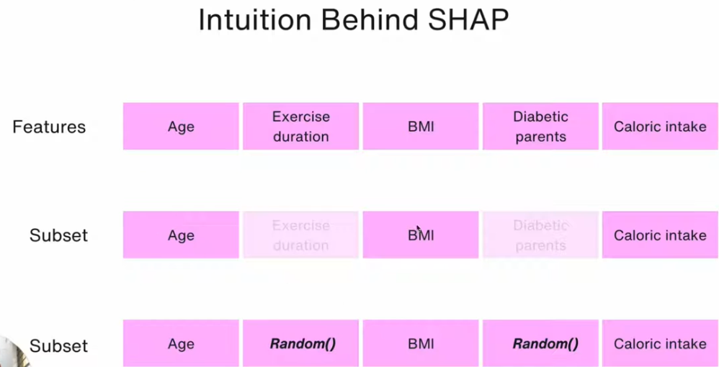
Intuition Behind SHAP

Slide 9
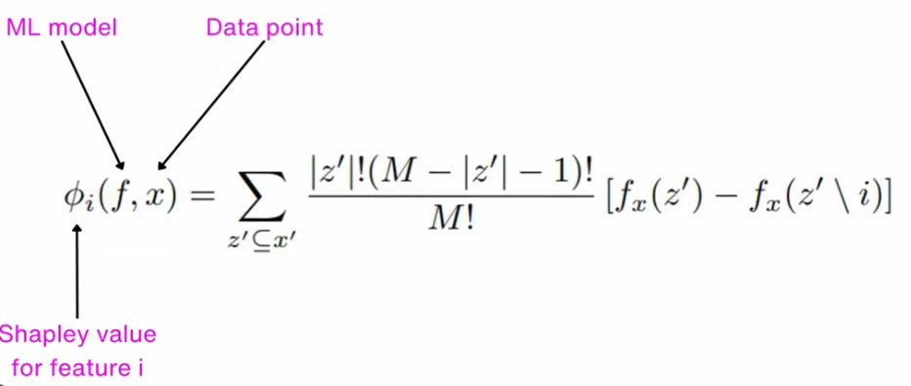
Intuition Behind SHAP
Shap Maths

Slide 10
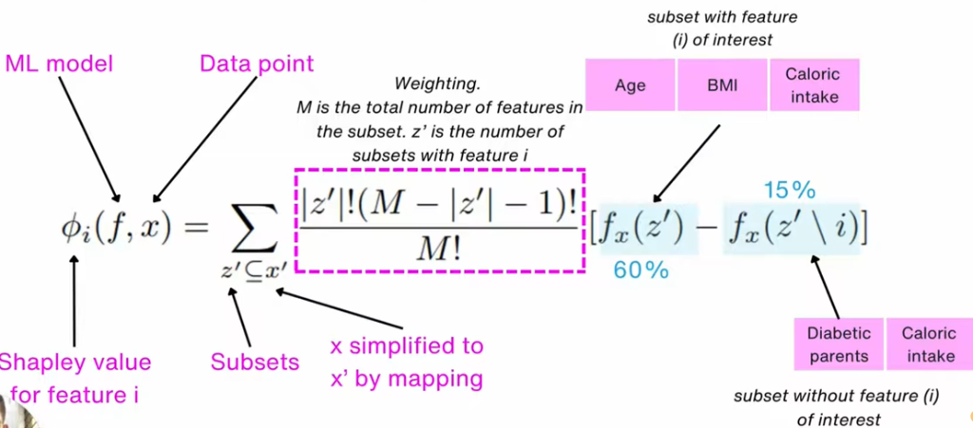
SHAP MATHS

Slide 11
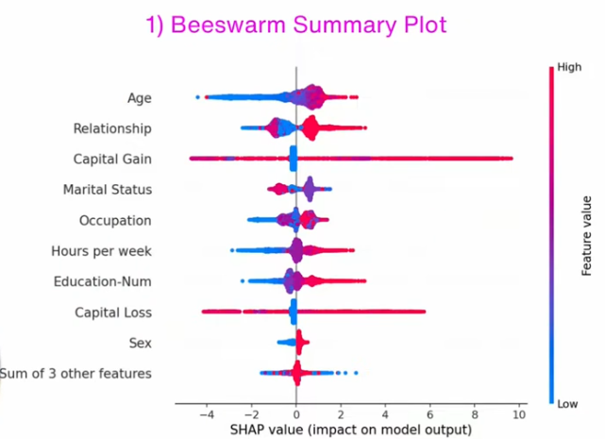
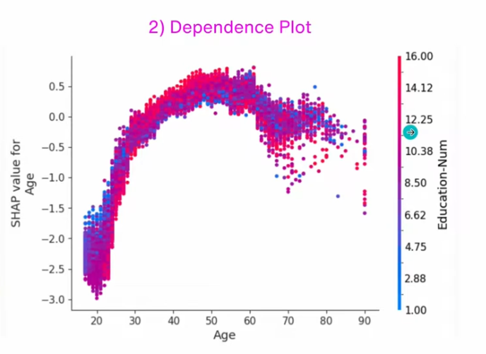
Types of SHAP Plots

Slide 12
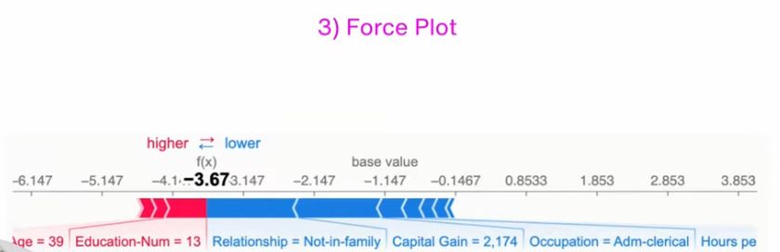
Types of SHAP Plots

Slide 13
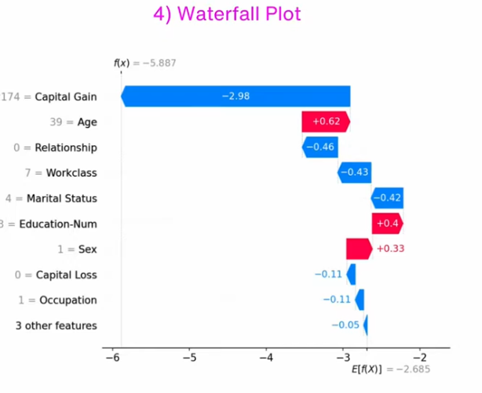
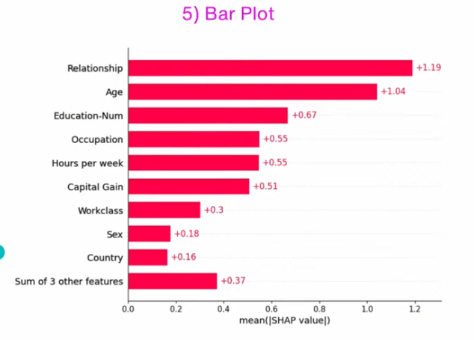
Types of SHAP Plots

Slide 14
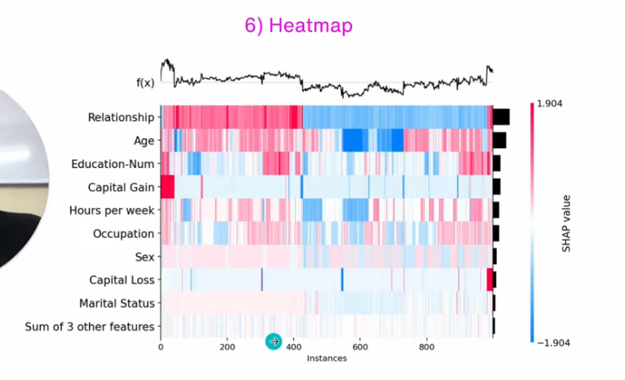
Types of SHAP Plots

Slide 15
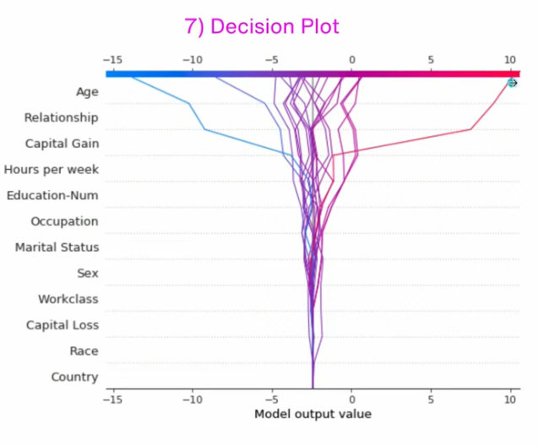
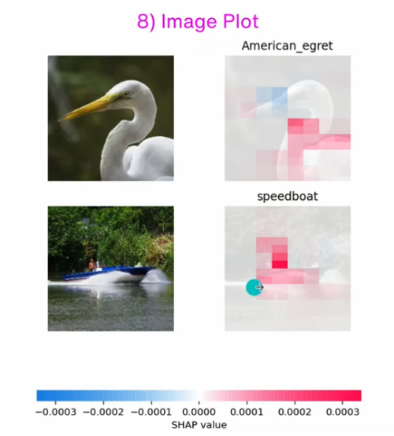
Types of SHAP Plots

Slide 16
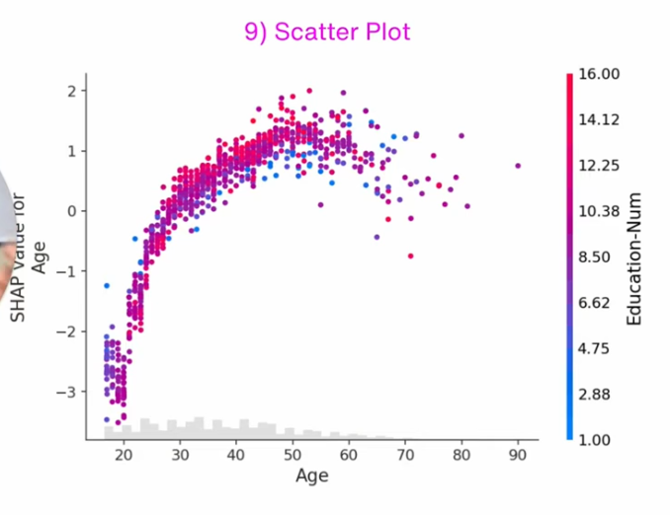
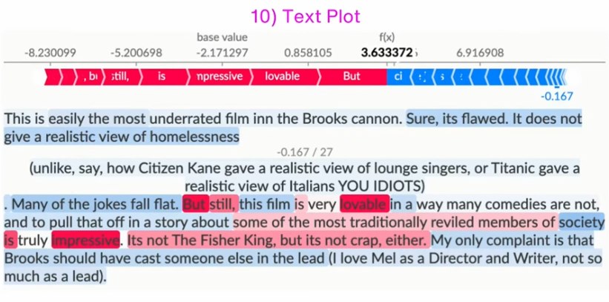
Types of SHAP Plots

Slide 17
References
Original SHAP paper: https://arxiv.org/abs/1602.04938 SHAP GitHub repo: https://github.com/shap/shap
Website: https://shap.readthedocs.io/en/latest/
https://youtu.be/IIgTulcEUFw?si=MT9e4hZye52Ctpkb
Notes:
Linear Regression is highly interpretable

Slide 18
Thank You
Raghu Prasad
9845547471
www.kaushalya.tech

