Slide 1

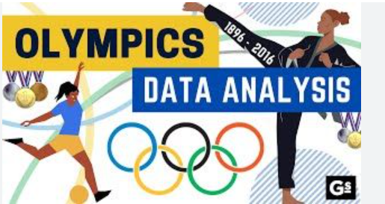
OLYMPICS
ATHLETES DATA ANALYSIS
Exploratory Data Analysis
Model Comparison & Best Model Selection
RAGHURAAM PRAKASAM Department NO: 23-UST-042 Loyola College, Chennai

Slide 2
PROCESS OF THE PROJECT
Collected Olympic athletes data (1900-2016)
Performed Exploratory Data Analysis (EDA)
Handled Class Imbalance using SMOTE
Built 3 Machine Learning Models:
• Logistic Regression
• Decision Tree
• Random Forest
Compared models & selected the best one
Identified key features for medal winning

Slide 3
Data Preprocessing:
Cleaned missing values
Encoded categorical variables
Created binary target (Medal: Yes/No)
SMOTE Technique:
Original: 88% No Medal, 12% Medal (Imbalanced!)
After SMOTE: 50% vs 50% (Balanced)
Created 852 synthetic samples
Model Training:
Train-Test Split: 80-20
Built 3 classification models

Slide 4
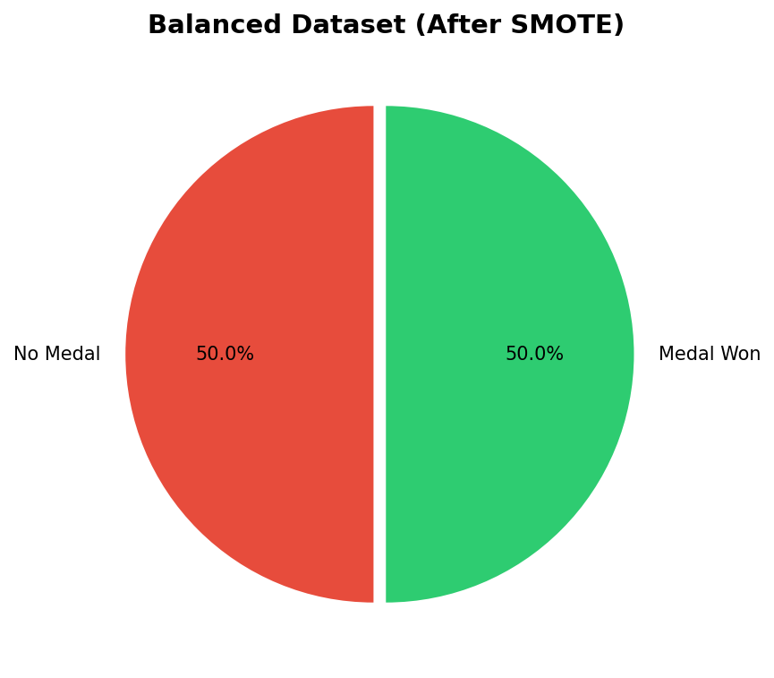
DATASET OVERVIEW
Balanced Dataset:
1,964 samples
Features Used:
• Age (numerical)
• Height (numerical)
• Weight (numerical)
• Sex (encoded)
• Team/Country (encoded)
• Sport (encoded)
• Season (encoded)
Target: Medal Won (1/0)

Slide 5
SMOTE: SOLVING CLASS IMBALANCE
Problem: Imbalanced Dataset
Before SMOTE: 88% No Medal | 12% Medal Won
Models become biased towards majority class
Solution: SMOTE
Synthetic Minority Over-sampling Technique
Creates new synthetic samples for minority class
Uses k-nearest neighbors to generate samples
Result:
After SMOTE: 50% No Medal | 50% Medal Won
Now models can learn equally from both classes

Slide 6
THREE ML MODELS BUILT
LOGISTIC REGRESSION
• Simple linear classifier
• Uses sigmoid function
• Good baseline model
DECISION TREE
• Tree-based splits
• Captures non-linear patterns
• Easy to visualize
RANDOM FOREST
• Ensemble of 100 trees
• Most powerful & robust
• Reduces overfitting

Slide 7
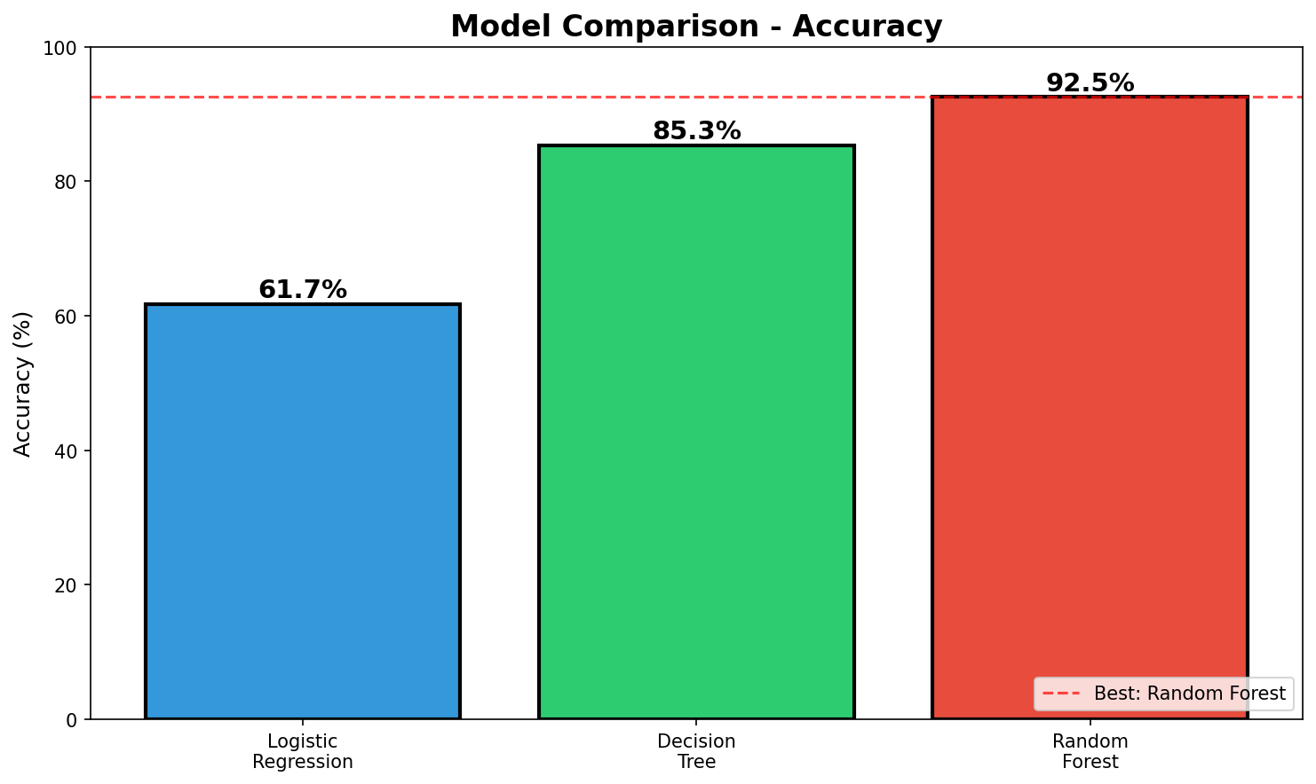
MODEL ACCURACY COMPARISON

Slide 8
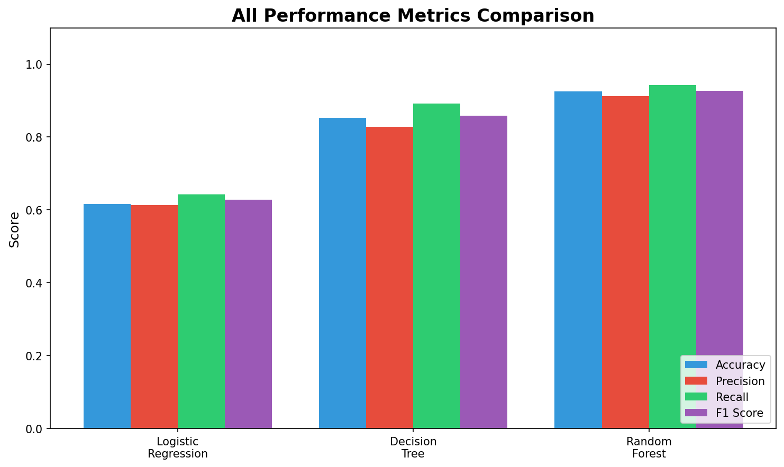
ALL PERFORMANCE METRICS

Slide 9
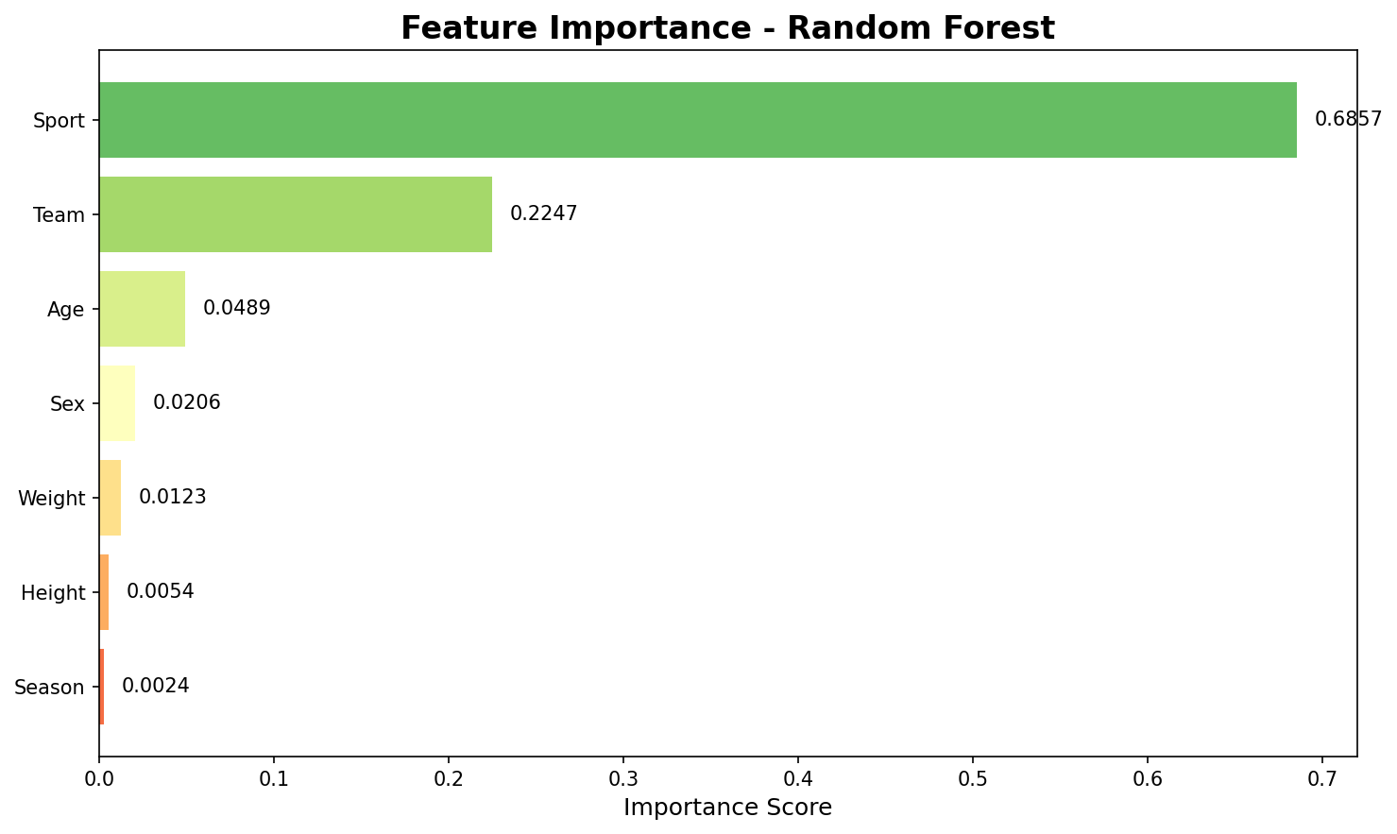
KEY FINDINGS
🏆 WINNER:
Random Forest
92.5% Accuracy
📊 Feature Importance:
1. Sport (68.6%)
2. Team/Country (22.5%)
3. Age (4.9%)
💡 Insight:
Sport type is the
#1 predictor of
medal winning!

Slide 10
CONCLUSION
Successfully analyzed Olympic athletes data
Applied SMOTE to handle class imbalance
Built and compared 3 ML models
Random Forest selected as BEST (92.5%)
Key Takeaways:
• Sport type is the top predictor
• Country/Team matters for success
• SMOTE improved model performance

Slide 11
THANK YOU!
RAGHURAAM PRAKASAM Department NO: 23-UST-042 Loyola College (Autonomous), Chennai

