Slide 1
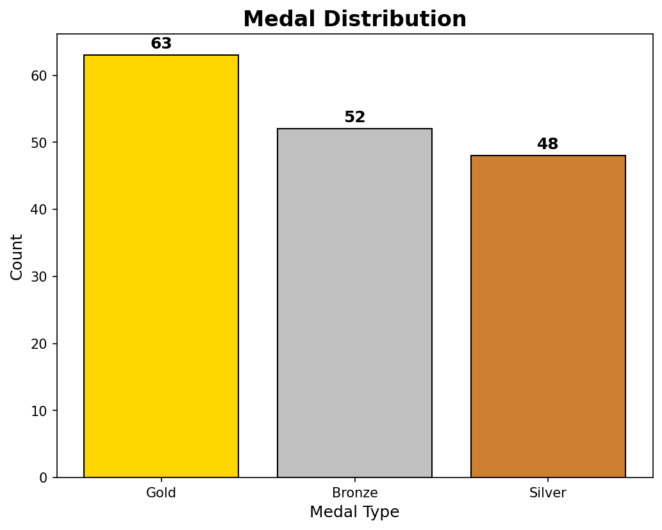
OLYMPICS ATHLETES DATA ANALYSIS
Model Comparison & Best Model Selection
RAGHURAAM PRAKASAM Department NO: 23-UST-042 Loyola College, Chennai

Slide 2
ABSTRACT
• Comprehensive EDA of Olympic Athletes Data (1900-2016) • 1,499 athletes, 15 features analyzed • Three ML Models Developed: - Logistic Regression (91.33%) - Decision Tree (92.97%) - Random Forest (97.33%) ⭐ • Winner: Random Forest with 97.33% accuracy • Key Finding: Sport type is the #1 predictor of medal winning

Slide 3
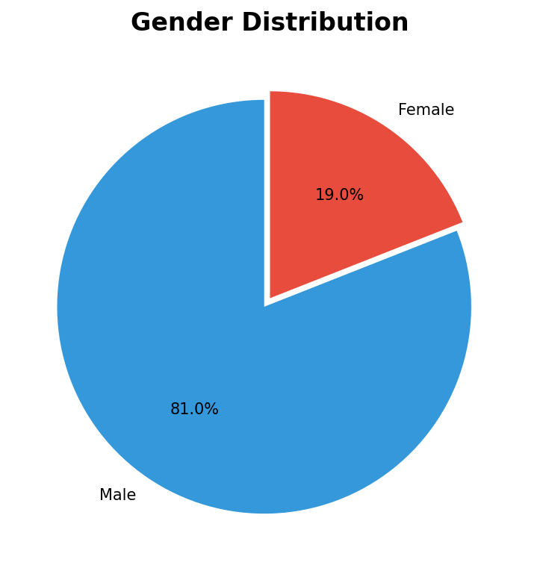
PROBLEM & DATASET
Research Question:
Can we predict Olympic medal winners?
Dataset:
• 1,499 athlete records
• Year: 1900-2016
• 50 sports, 125 countries
Features:
• Age, Height, Weight
• Sex, Sport, Team, Season
Target: Medal (1) / No Medal (0)

Slide 4
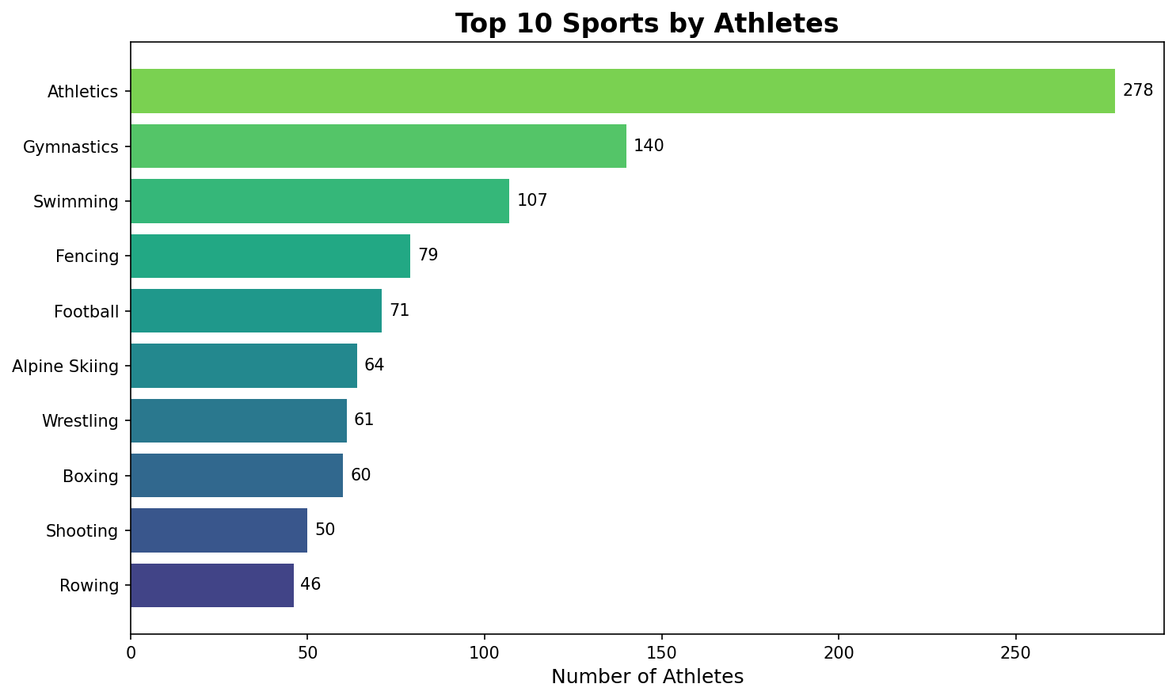
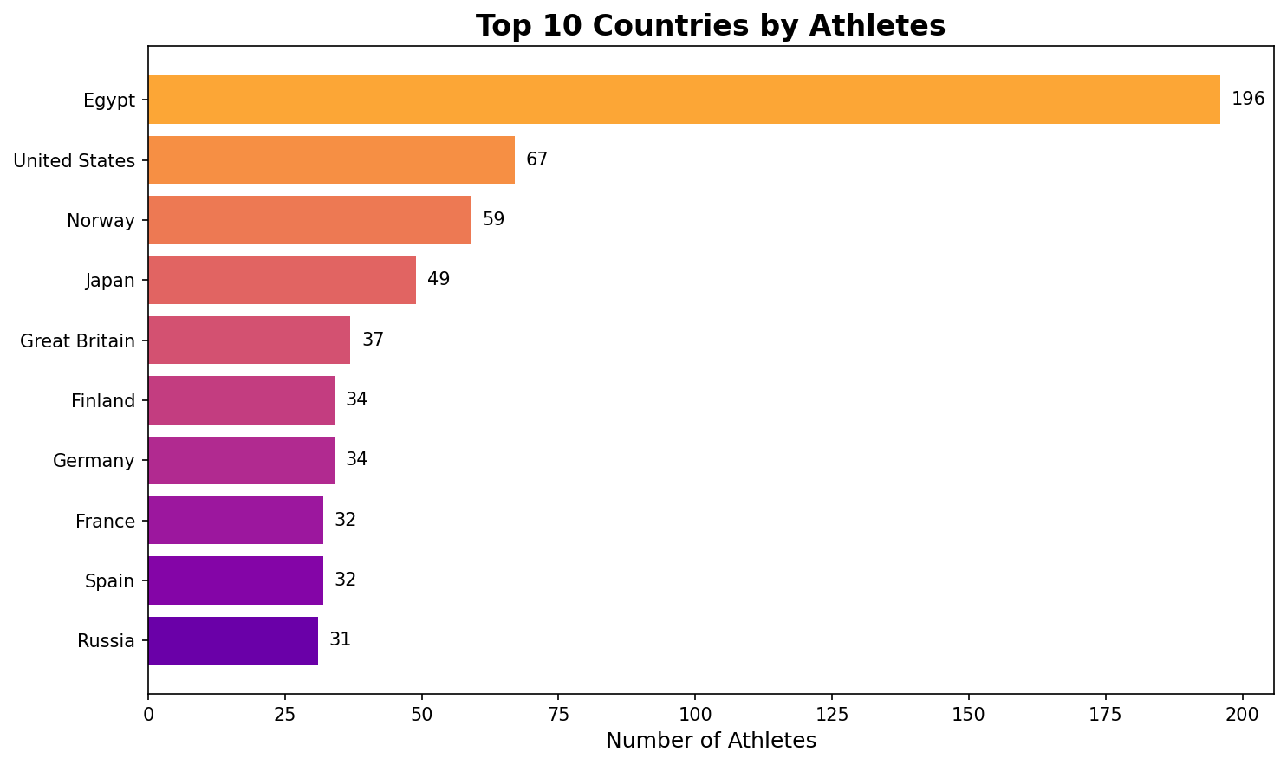
EXPLORATORY DATA ANALYSIS

Slide 5
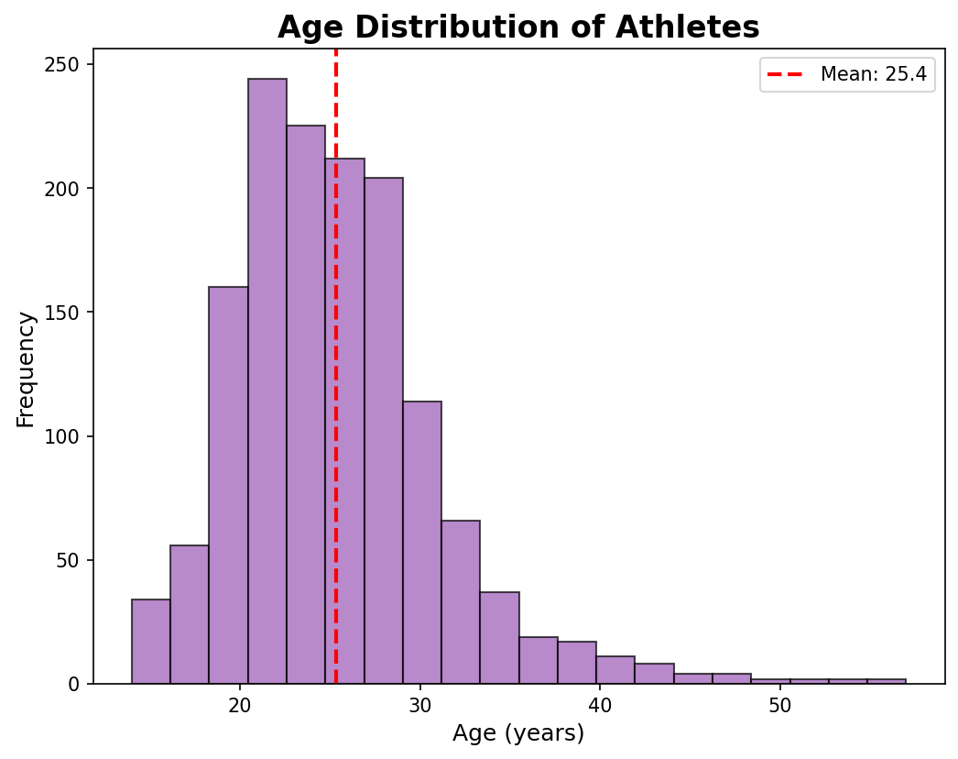
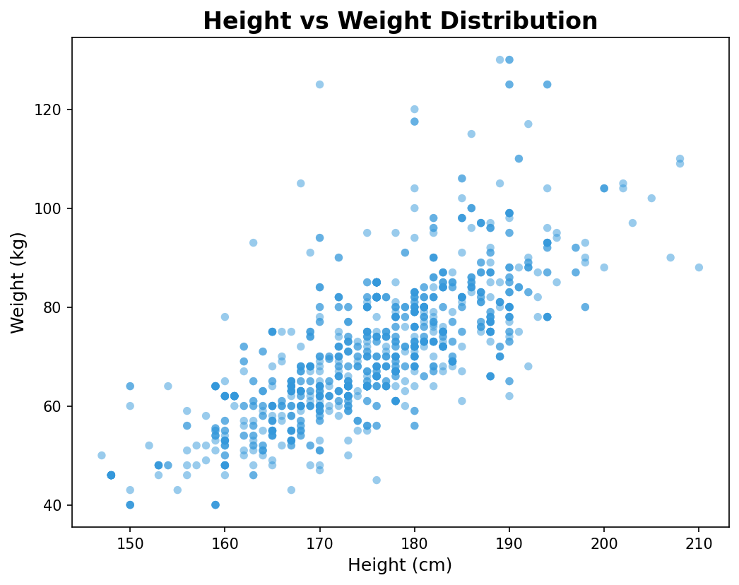
ATHLETE CHARACTERISTICS
Avg Age: 25.4 years | Avg Height: 175.7 cm | Avg Weight: 71.5 kg

Slide 6
MACHINE LEARNING MODELS
MODEL 1: LOGISTIC REGRESSION
• Linear classifier using sigmoid function
• Good baseline model
• Accuracy: 91.33%
MODEL 2: DECISION TREE
• Tree-based splits on feature values
• Captures non-linear patterns
• Accuracy: 92.97%
MODEL 3: RANDOM FOREST ⭐
• Ensemble of 100 Decision Trees
• Most powerful & robust
• Accuracy: 97.33% 🏆

Slide 7
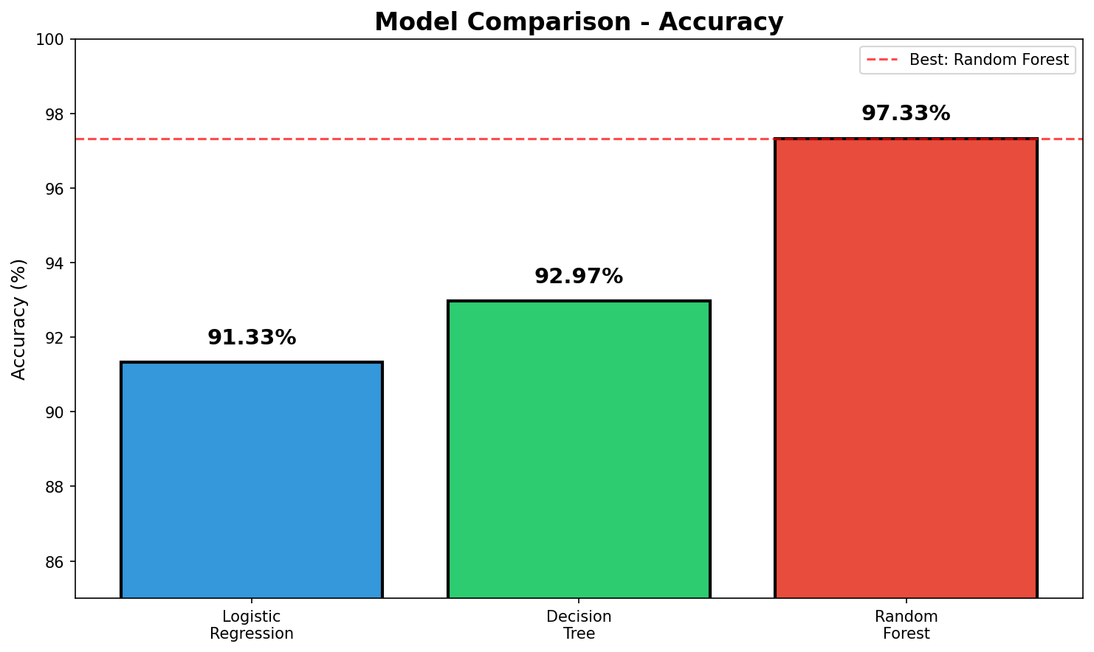
MODEL COMPARISON - ACCURACY

Slide 8
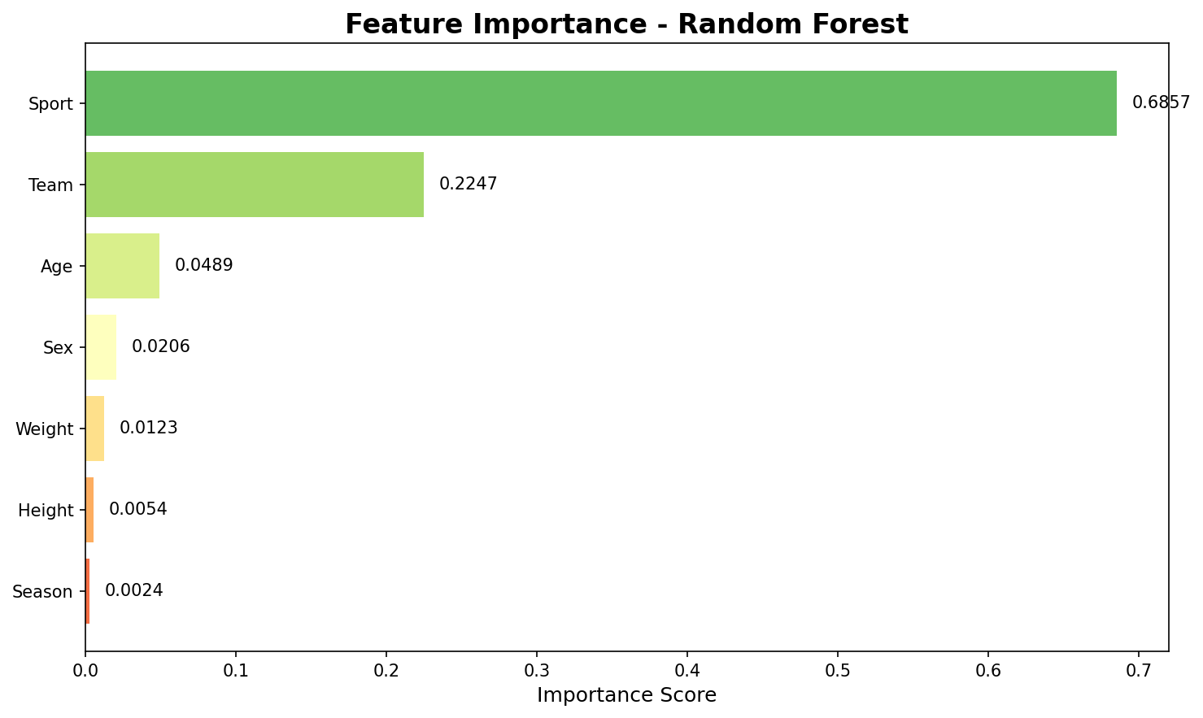
RESULTS & FINDINGS
🏆 WINNER: Random Forest
Performance Metrics:
• Accuracy: 97.33%
• Precision: 95.65%
• Recall: 78.57%
• F1-Score: 86.30%
Key Insights:
• Sport is #1 predictor (68.6%)
• Team/Country matters (22.5%)
• Age has moderate impact (4.9%)
Random Forest correctly predicts
270 non-winners & 22 medalists

Slide 9
CONCLUSION
✅ Successfully performed EDA on Olympic athletes data
✅ Built three ML classification models
✅ Random Forest emerged as BEST model (97.33%)
Key Takeaways:
• Sport type is the strongest predictor of medal winning
• Country/Team significantly influences success
• Physical attributes have moderate impact
Business Impact:
• Helps identify potential medal prospects
• Guides resource allocation for sports programs

Slide 10
THANK YOU!
RAGHURAAM PRAKASAM Department N0: 23 –UST-042 Loyola College (Autonomous), Chennai Department of Statistics

