Slide 1
SKD PRODUCTION ANALYSIS
Passenger SKD vs Truck SKD Data Source: Rolling Plan
Total: 10,857 Units | Pass: 9,113 | Truck: 1,744

Slide 2
EXECUTIVE SUMMARY
TOTAL
10,857
100%
PASSENGER
9,113
83.9%
TRUCK
1,744
16.1%
KEY INSIGHTS
• Passenger SKD dominates with 9,113 units (83.9%)
• Truck SKD accounts for 1,744 units (16.1%)
• Passenger to Truck ratio is 5.2:1
• Stage III dominates in both categories (~94%)

Slide 3
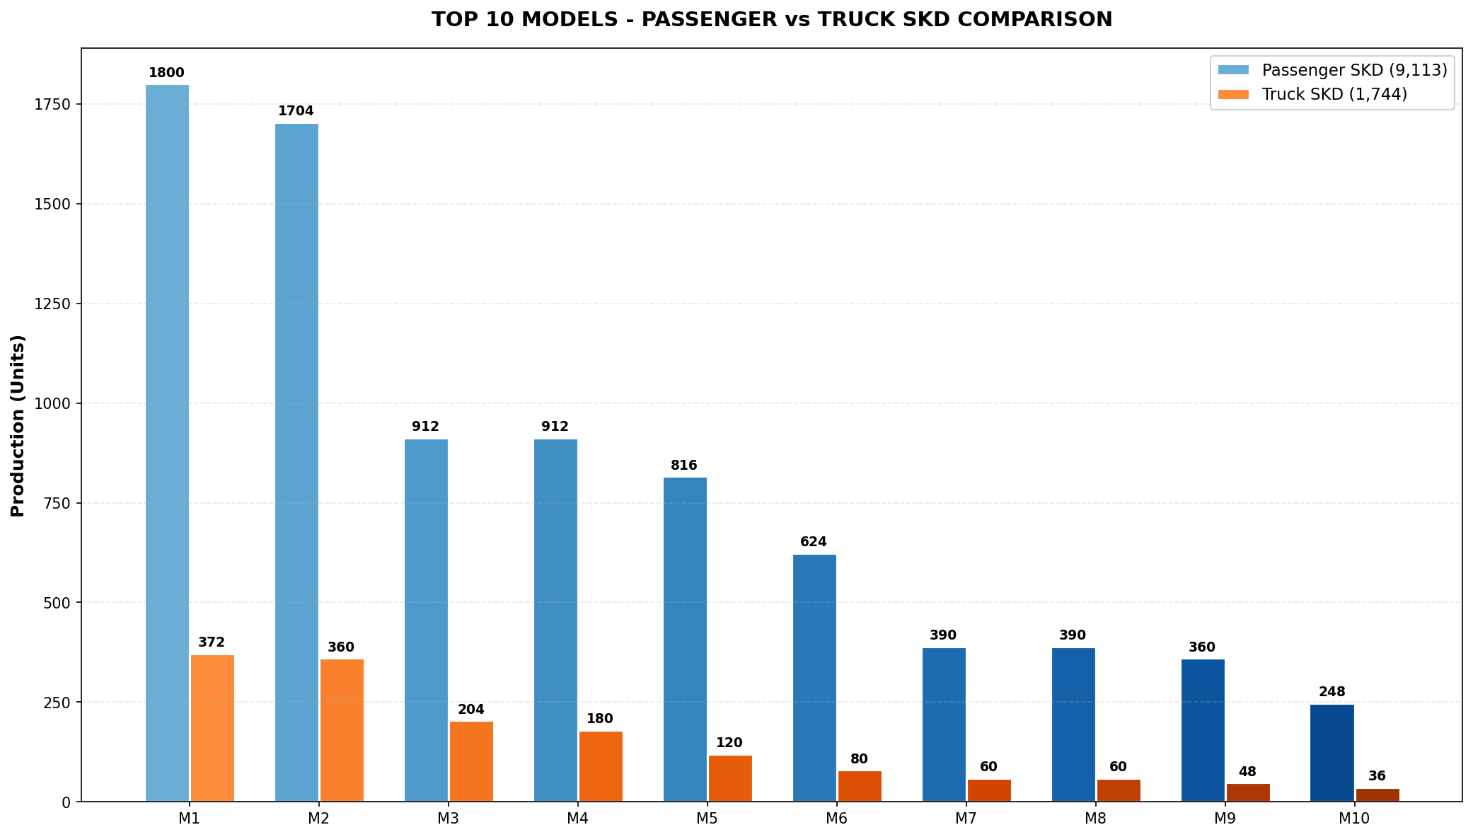
TOP 10 MODELS - COMPARISON
INTERPRETATION
• Highest Pass SKD: V6256809 (1,800) | Highest Truck SKD: V6553403 (360) • Top 10 Pass contribute 89.5% | Top 10 Truck contribute 87.2%

Slide 4
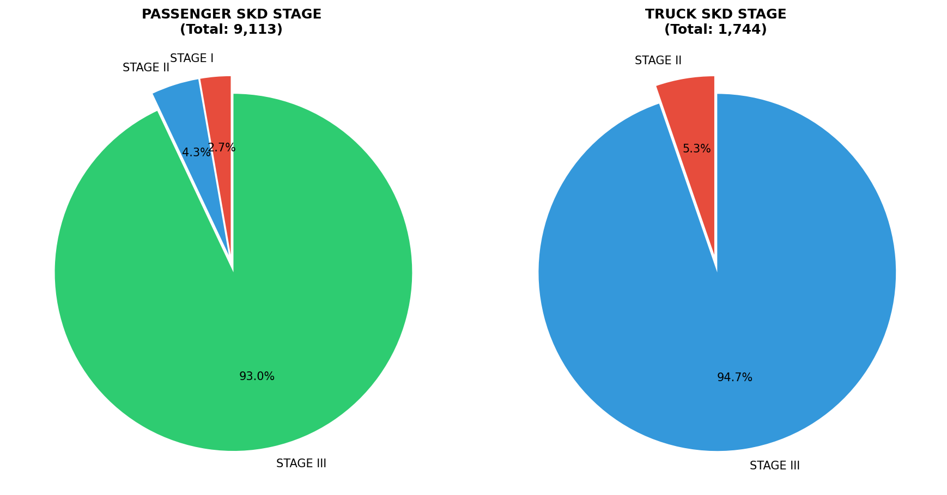
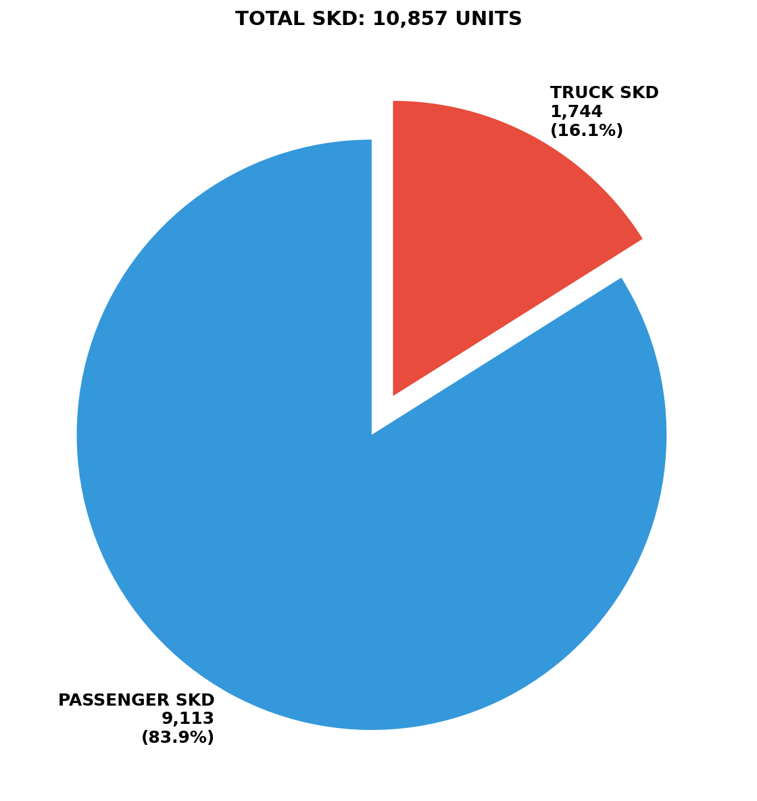
STAGE-WISE DISTRIBUTION
INTERPRETATION
• Stage III: Pass 93.0% | Truck 94.7% • Stage II significant in Truck SKD

Slide 5
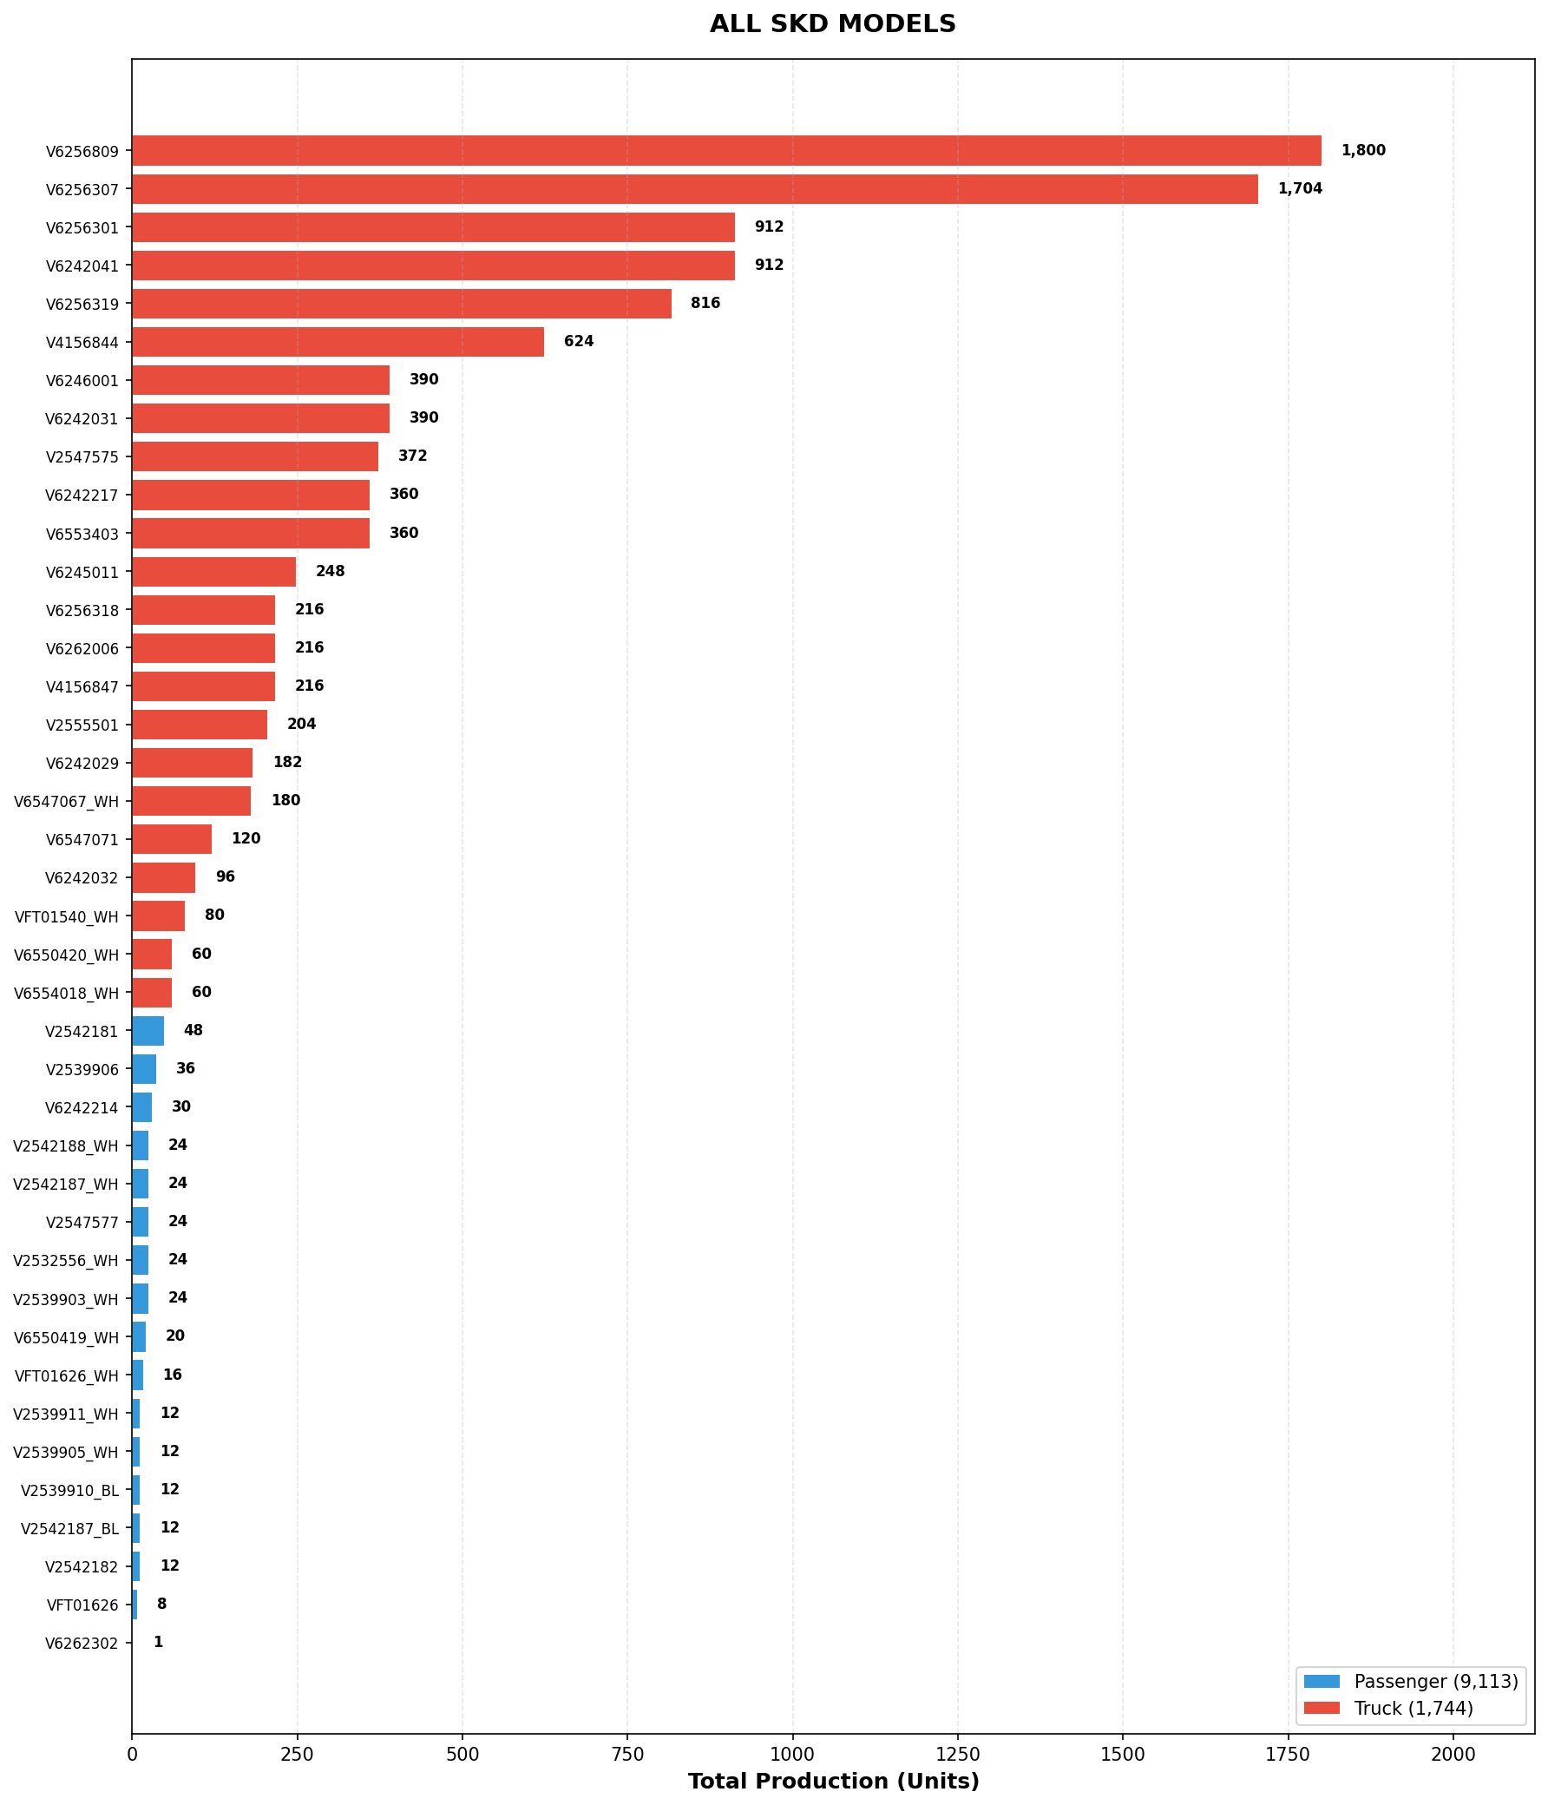
ALL SKD MODELS - COMPLETE VIEW

Slide 6
CONCLUSION
Production Focus
Passenger SKD (9,113 units) - 83.9% of total
Stage Optimization
Stage III dominates (~94%) - complete build preference
Model Concentration
Top 5 models contribute majority of production
Truck Potential
Truck SKD - 16.1% of total, growth potential
Data Source
Rolling Plan - Sheet3 (IO SKD models)

