Slide 1
SKD PRODUCTION - EMISSION ANALYSIS
Passenger: 9,809 | Truck: 1,832

Slide 2
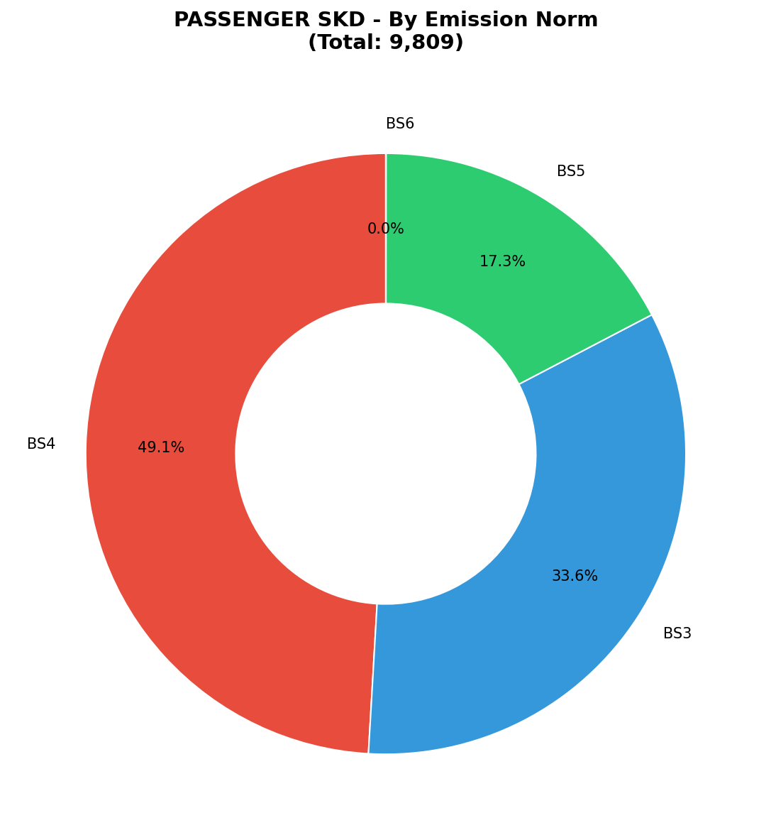
PASSENGER SKD - By Emission Norm (DOUGHNUT CHART)
KEY INSIGHTS
• Total: 9,809 units
• BS3: 3,294 (33.6%)
• BS4: 4,814 (49.1%)
• BS5: 1,700 (17.3%)
• BS6: 1 (0.0%)

Slide 3
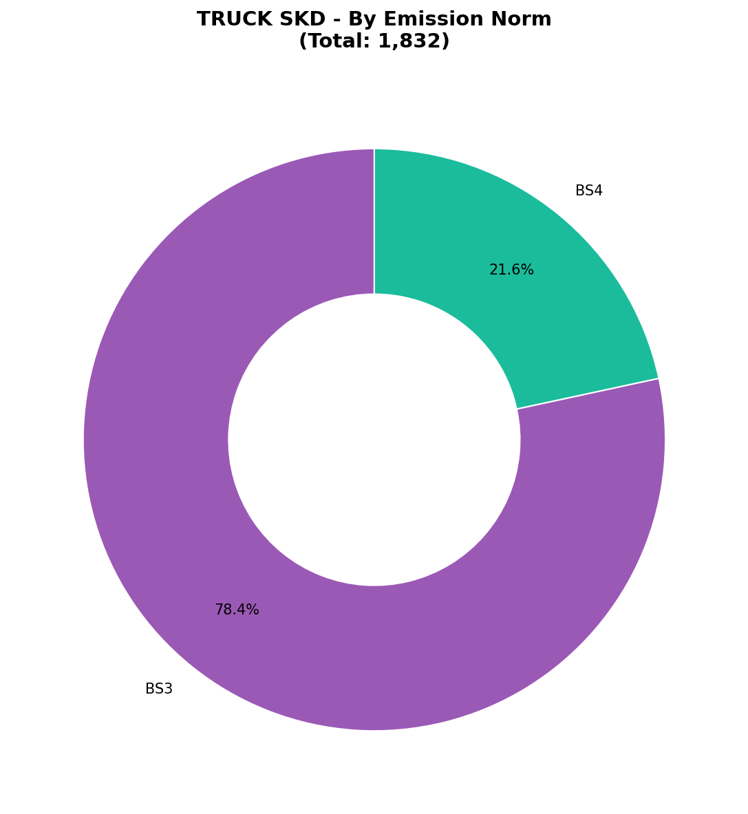
TRUCK SKD - By Emission Norm (DOUGHNUT CHART)
KEY INSIGHTS
• Total: 1,832 units
• BS3: 1,436 (78.4%)
• BS4: 396 (21.6%)

Slide 4
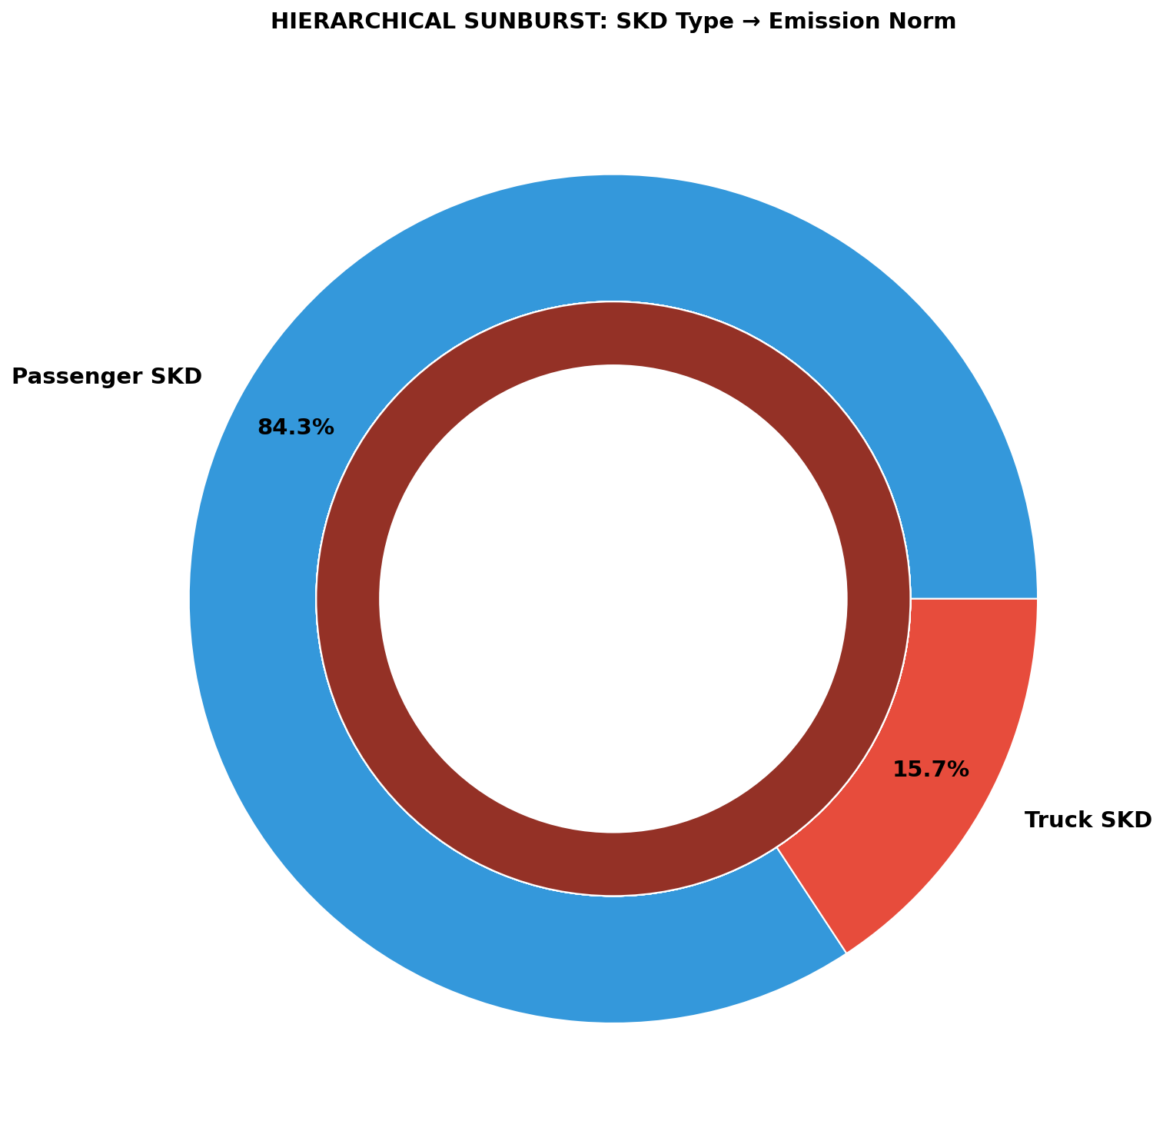
HIERARCHICAL VIEW - SKD Type & Emission Norm
Outer Ring: SKD Type (Blue=Passenger, Red=Truck) | Inner Ring: Emission Standards

