Slide 1
Design and Simulation of a Multi-Bit Binary Adder and Subtractor
Digital Electronics Final Project | Logisim Simulation | Section 9
Team Member | Roll Number
Vikas | 2620030391
Aman | 2620030458
L. Manasa Pranavi | 2620030500
D. Raghuramakrishna | 2620030446
Section 9

Slide 2
Introduction and Objective
The Arithmetic Logic Unit (ALU) is a key part of the CPU, and addition and subtraction are its most basic operations. This project extends a 4-bit Ripple Carry Adder into a single adder/subtractor circuit, where one control input M selects the operation, and verifies it by simulation in Logisim.
Objectives
M = 0
S = A + B
M = 1
S = A − B
Understand half adder, full adder and ripple carry adder
Perform subtraction using 2’s complement (A + B′ + 1)
Select add or subtract with a single control bit M
Build and verify the 4-bit circuit in Logisim
2

Slide 3
Theory and Logic Circuit
Half Adder
Full Adder
Ripple Carry Adder
Adds two bits A and B
Sum = A ⊕ B
Carry = A · B
Gates: 1 XOR + 1 AND
No carry-in, so it cannot chain
Adds A, B and Carry-in
Sum = A ⊕ B ⊕ Cin
Cout = AB + Cin(A ⊕ B)
= 2 half adders + 1 OR gate
4 full adders in series
Cout of each stage feeds Cin of the next
Carry ripples from LSB to MSB
Delay = n × t(FA), so it slows as n grows
Adder to subtractor: A − B = A + B′ + 1 (2’s complement). An XOR gate on each B bit gives B ⊕ M, which inverts B when M = 1. M also drives the first Cin, supplying the +1. M = 0 passes B unchanged with Cin = 0, so the same hardware adds.
Gates used: XOR, AND, OR (inside the full adders).
3

Slide 4
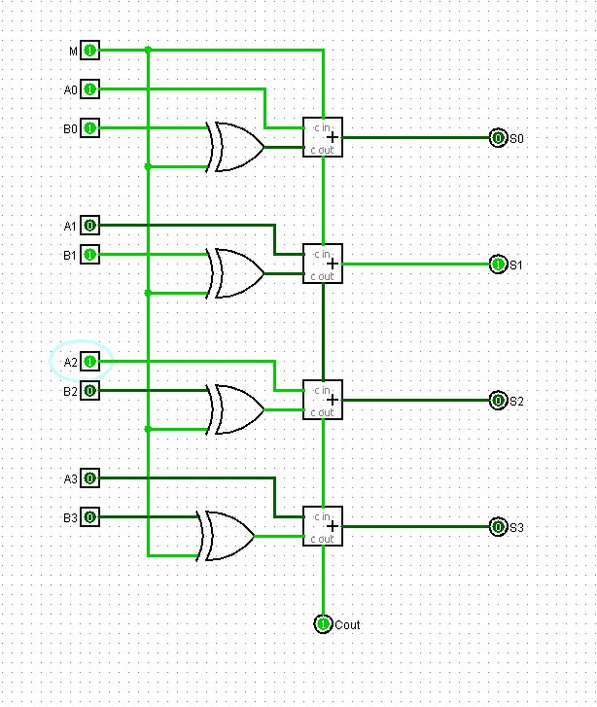
Circuit Design in Logisim
How it works
Each B bit passes through an XOR with M; M also feeds the first Cin
M = 0: B unchanged, Cin = 0, so S = A + B
M = 1: B inverted, Cin = 1, so S = A − B (e.g. 5 − 3: B′ = 1100, sum = 0010)
Carry ripples from S0 to S3 and out on Cout
Addition test cases (M = 0)
# | A | B | Exp. S | Exp. Cout | Why
1 | 0000 | 0000 | 0000 | 0 | Identity (zero)
2 | 0001 | 0001 | 0010 | 0 | Simple: 1+1
3 | 1111 | 0001 | 0000 | 1 | Overflow boundary (15+1)
4 | 0111 | 1000 | 1111 | 0 | 7+8 = 15 (max unsigned)
5 | 1001 | 0111 | 0000 | 1 | Overflow (9+7 wraps)
6 | 1111 | 1111 | 1110 | 1 | Max + Max (15+15)
7 | 0101 | 1010 | 1111 | 0 | 5+10 = 15
8 | 1000 | 1000 | 0000 | 1 | Overflow boundary (8+8)
4

Slide 5
Simulation Results
Mode | Inputs A |  |  |  | Inputs B |  |  |  | Outputs
M | A3 | A2 | A1 | A0 | B3 | B2 | B1 | B0 | S3 | S2 | S1 | S0 | Cout
0 | 0 | 1 | 0 | 1 | 0 | 0 | 1 | 1 | 1 | 0 | 0 | 0 | 0
0 | 0 | 1 | 1 | 0 | 0 | 0 | 1 | 1 | 1 | 0 | 0 | 1 | 0
0 | 1 | 0 | 0 | 1 | 0 | 1 | 1 | 1 | 0 | 0 | 0 | 0 | 1
0 | 1 | 1 | 1 | 1 | 0 | 0 | 0 | 1 | 0 | 0 | 0 | 0 | 1
1 | 0 | 1 | 0 | 1 | 0 | 0 | 1 | 1 | 0 | 0 | 1 | 0 | 1
1 | 0 | 0 | 1 | 1 | 0 | 1 | 0 | 1 | 1 | 1 | 1 | 0 | 0
1 | 1 | 0 | 0 | 1 | 1 | 0 | 0 | 1 | 0 | 0 | 0 | 0 | 1
1 | 0 | 1 | 1 | 1 | 0 | 0 | 1 | 0 | 0 | 1 | 0 | 1 | 1
M = 0 (rows 1–4): S = A + B. M = 1 (rows 5–8): S = A − B. For subtraction, Cout = 1 means no borrow (result is positive); Cout = 0 means the result is negative, in 2’s complement form.
5

Slide 6
Conclusion and Applications
Conclusion
Applications
A 4-bit adder/subtractor was designed and simulated in Logisim
One control bit M selects A + B or A − B using the same ripple carry hardware
Simulated outputs matched the 2’s complement results
ALU add/subtract in processors such as RISC-V
Program counter increment (PC + 4) and branch target addresses
Load/store address calculation
Calculators, counters and DSP hardware
Limitation and improvements: carry delay grows as n × t(FA). Use a Carry Look-Ahead Adder for speed, extend to 8 or 16 bits, add overflow detection and a signed display.
References: M. Morris Mano and M. D. Ciletti, Digital Design, 6th ed., Pearson, 2018. S. Harris and D. Harris, Digital Design and Computer Architecture: RISC-V Edition, Morgan Kaufmann, 2021.
6

