Slide 1
LOGISIM DIGITAL LOGIC PROJECT
Automatic Street Light Control System Using Combinational Logic
Day Mode (0) / Night Mode (1) Switching with Mobility Sensing in Logisim
Day (0) / Night (1)
Mobility Factor
Logisim Engine

Slide 2




FUNCTIONAL SPECIFICATION
System Operational Modes
Day Mode (0)
Night Mode — Idle (1)
Night Mobility Factor
Daytime state ($L=0$). Street lights remain completely OFF (0% draw).
Night mode ($L=1$) with no mobility ($M=0$). Dim power mode (30% intensity).
Night mode ($L=1$) with mobility ($M=1$). Triggers full light output (100% intensity).

Slide 3
LOGISIM ENVIRONMENT SETUP
Input & Output Pin Definitions
Pin Name | Logisim Pin Category | Bit Width | Hardware Equivalent | Active Logic Mapping
E | Input Pin | 1 Bit | Master Enable Switch | Logic 1 = System Powered
L | Input Pin | 1 Bit | Night Light Sensor (LDR) | Logic 0 = Day Mode | Logic 1 = Night Mode
M | Input Pin | 1 Bit | Mobility / Motion Sensor | Logic 1 = Vehicle or Pedestrian Detected
F | Output Pin | 1 Bit | Full Power Luminaire LED | Logic 1 = 100% Brightness Active
D | Output Pin | 1 Bit | Dim Standby Luminaire LED | Logic 1 = 30% Eco Power Active

Slide 4
COMBINATIONAL LOGIC SPECIFICATION
System Truth Table
E (Enable) | L (0=Day, 1=Night) | M (Mobility) | F (Full Output) | D (Dim Output) | Operational State Description
0 | X | X | 0 | 0 | Master Shutdown (System Disabled)
1 | 0 (Day) | 0 (No Motion) | 0 | 0 | Day Mode — Lights OFF
1 | 0 (Day) | 1 (Motion) | 0 | 0 | Day Mode — Mobility Ignored (Lights OFF)
1 | 1 (Night) | 0 (No Motion) | 0 | 1 | Night Mode — Idle Dim Standby (30%)
1 | 1 (Night) | 1 (Motion) | 1 | 0 | Night Mode — Mobility Triggered Full Light (100%)

Slide 5



LOGISIM MINIMIZATION
Boolean Logic Expressions
Full Brightness Output Pin (F)
Active when Enabled AND Night Mode (L=1) AND Mobility Detected (M=1):
Dim Standby Output Pin (D)
Active when Enabled AND Night Mode (L=1) AND No Mobility (M=0):

Slide 6
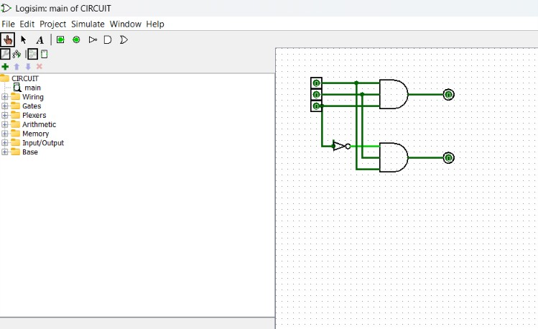

Slide 7

LOGISIM FEATURE
Combinational Analysis Synthesis
Logisim Synthesis Workflow
Inputs Window: Declare pin variables E, L, M
Outputs Window: Declare output pins F and D
Expression Generator: Auto-synthesize gate netlist

Slide 8
PERFORMANCE & EFFICIENCY
Smart Energy Optimization
70%
Total Energy Reduction via Night Mobility Sensing
100% OFF
30% Power
On-Demand
Zero Energy Consumed During Day Mode (L=0)
Night Idle Dim Standby Mode (L=1, M=0)
Full Intensity Only Upon Motion Detection (L=1, M=1)

Slide 9
SIMULATION VERIFICATION COMPLETE
Logisim Simulation & Demonstration
Ready for live Poke Tool interactive pin toggling (Day: L=0, Night: L=1 & Motion verification).
Automatic Street Light Control System | Combinational Logic Project

