Slide 2
Midterm Solution
Team 5
Lakshmi Prabha Swaminathan
Harikrishna Ramakrishnan
Raghuram Parthasarathy

Slide 3
Problem 1 – Credit Card Payment Defaulter
Response Variable – Default Payment
Variables Used:
-> Gender
-> Education
-> Sex
-> History of Payment

Slide 4
Problem 1 – Data Cleansing
Education and Marriage has anomalies. Cleansed using PowerBI.
Basic sanity checks for 0 and NULL are done
Performing the count on the 6 payment columns to determine the largest occurred payment status.

Slide 5
Problem 1 – Logistic Regression
Taking the sample
Set the seed to make your partition reproducible
Split the data into training and testing
Construct a logistic regression model using the variables
Summary of the fit
Measures of prediction
Find the overall error rate and confusion matrix
Plot the ROC as well as the lift curve

Slide 6
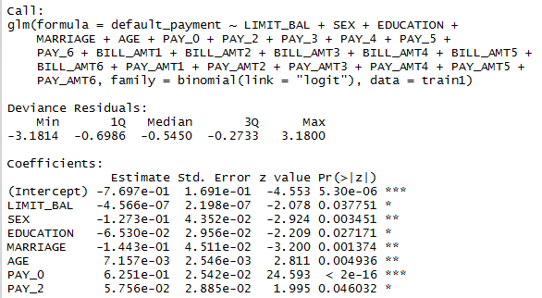
Problem 1 – Logistic Regression
Data with max number of *’s is an important factor for prediction

Slide 7
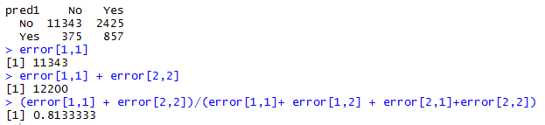
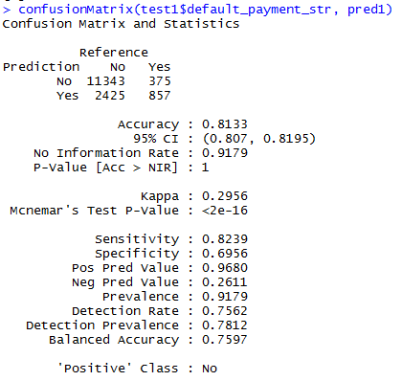
Problem 1 – Logistic Regression
  Overall Error and Confusion Matrix

Slide 8
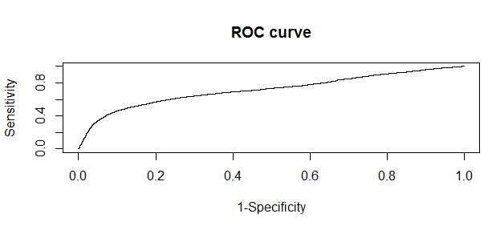
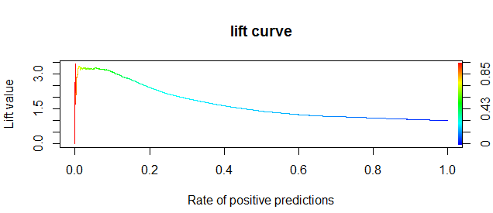
Problem 1 – Logistic Regression
  ROC and Lift Curves

Slide 9
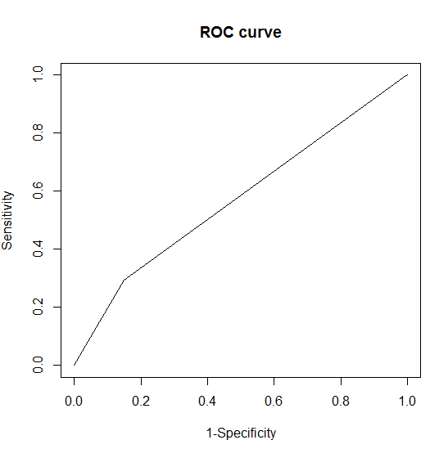
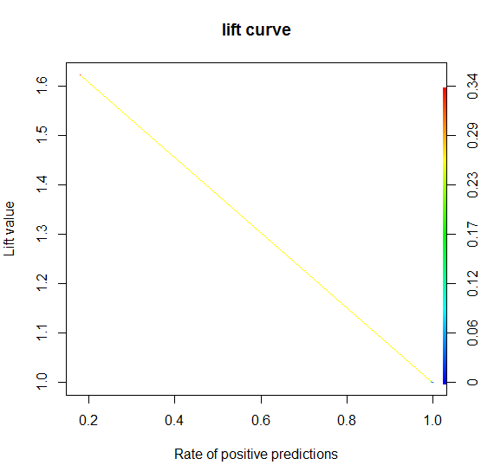
Problem 1 – Neural Network
Repeat the steps similar to logistic regressions
Find the overall error rate and confusion matrix
Plot the ROC and lift curves

Slide 10
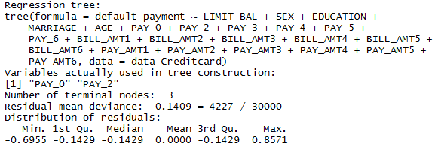
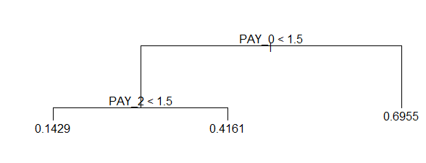
Problem 1 – Classification Tree
Repeat the steps similar to logistic regressions
Plot the tree
Split the dataset into a training set and a test set
Build the tree based on the training set
Evaluate its performance on the test data

Slide 11
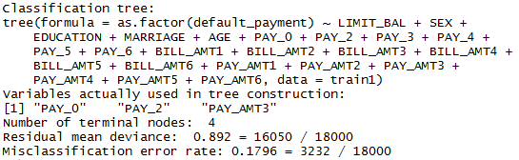
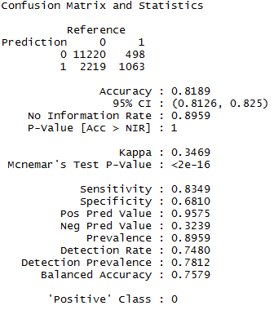
Problem 1 – Classification Tree
Confusion Matrix

Slide 12
Problem 2 – Clean and pre-process the data
Read the ad.data file
Read the ad.names file
Removing 1st 2 rows
Removing the unwanted texts that starts with "|"
Binding the columns
replace ? with NA
separating heightcolumn and converting to numeric for mean
Find the mean
Replace NA with mean of column
separating width and converting to numeric for mean
Replace NA with mean of column (width)
Remove local column NA's

Slide 13
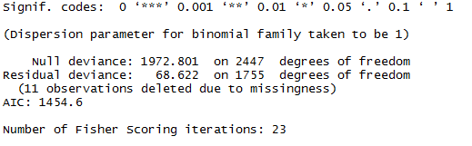
Problem 2 – Logistic Regression
Taking the sample data
Set the seed to make your partition reproductible
Split the data into training and testing
Fitting data into model
Predicting values
Error and Confusion Matrix

Slide 14
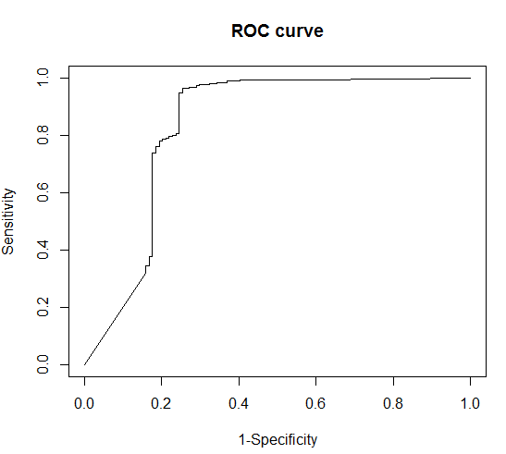

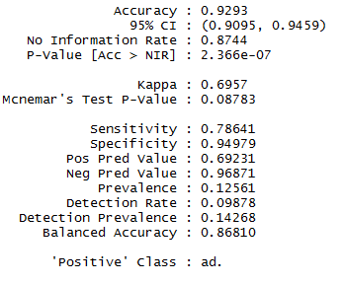
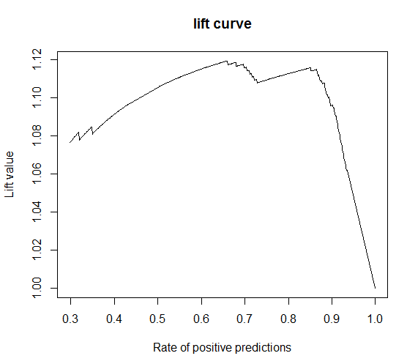
Problem 2 – Logistic Regression
Overall Error:
Confusion Matrix:
Error rate = 7%

Slide 15

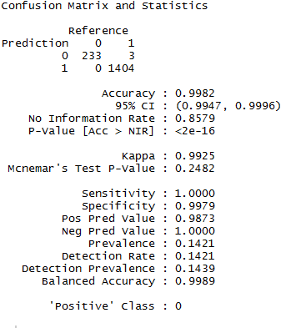
Problem 2 – Neural Network
Overall Error:
Confusion Matrix:
Error Rate: 1%

Slide 16
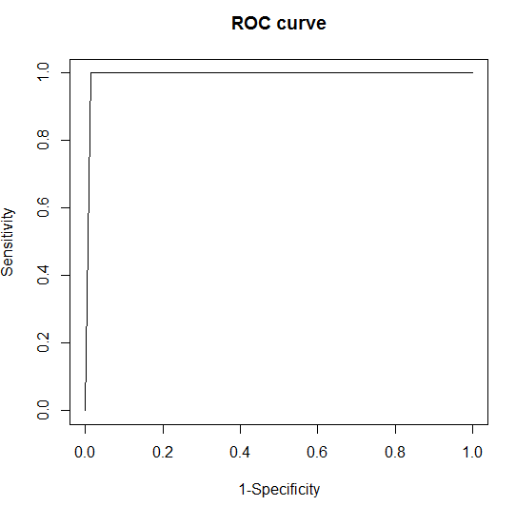
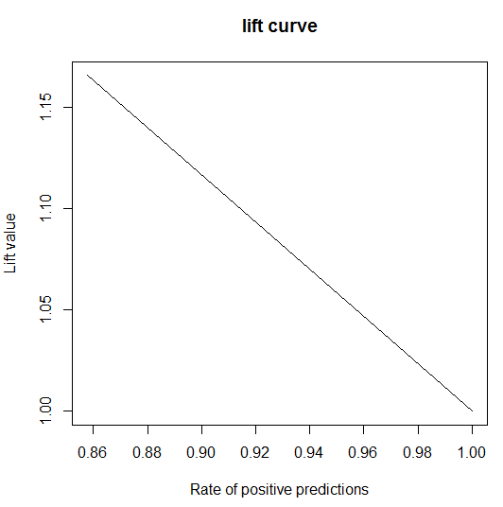
Problem 2 – Neural Network

Slide 17

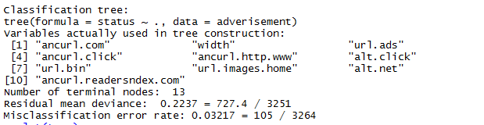
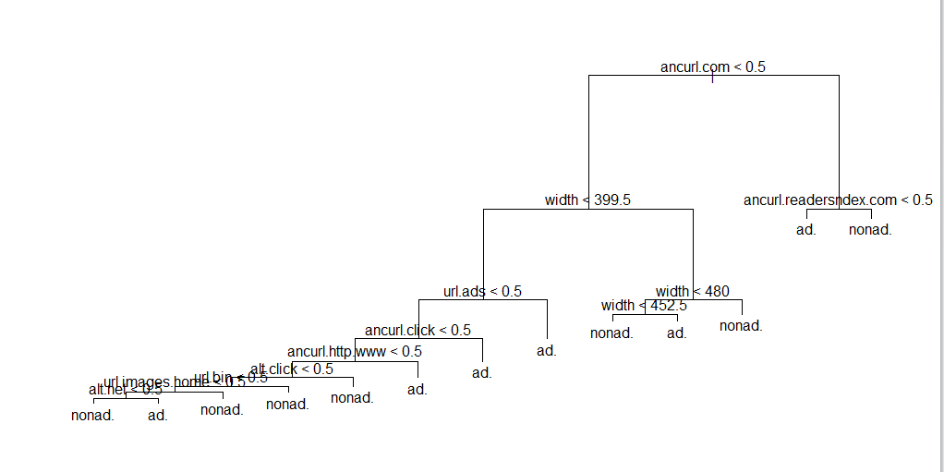
Problem 2 – Classification Tree

Slide 18
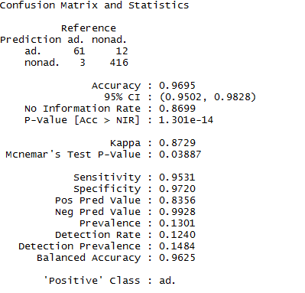
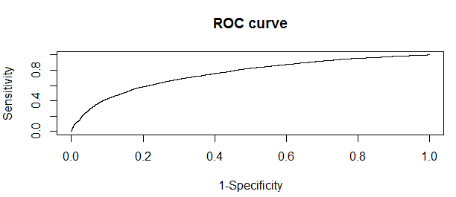
Problem 2 – Classification Tree
Error Rate = 3.2%

Slide 19
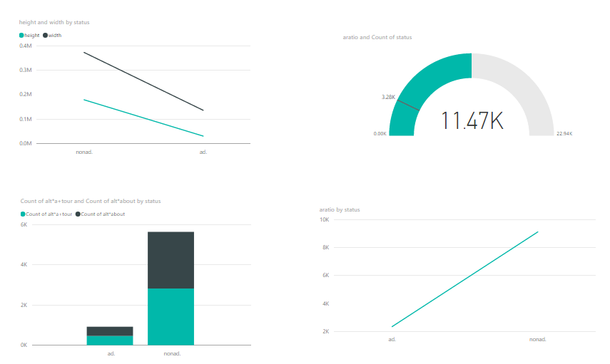
Problem 2 – Power Bi Visualization

Slide 20


Slide 21
Thank you! ☺

