Slide 2

PREDICTING ALZHEIMER’S USING VARIOUS PARAMETERS
Team 5
Lakshmi Prabha Swaminathan
Raghuram Parthasarathy
Harikrishna Ramakrishnan

Slide 3
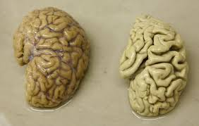
Alzheimer’s Brain Comparison
Brain affected with Alzheimer (without meningitis layer)
Normal Brain

Slide 4
Dataset – Neuropsychological Tests
We are considering 5 tests
MMSE (Mini Mental State Examination)
Orientation, word recall, attention and calculation, language abilities, visual construction
Scores range from 0 to 30. Less than 26 indicates Alzheimer's
FAQ (Functional Activities Questionnaire)
It is an informant (caregiver) based measure of functional abilities
The informant provides details of target person on 10 complex, higher order activities
Scores range from 0 to 30. A cut-point of 9 (dependent in 3 or more activities) is recommended.
• Dependent = 3 • Requires assistance = 2 • Has difficulty, but does by self = 1 • Normal = 0
NPI (Neuropsychiatric Inventory)
Administered by clinician to the caregiver. He is asked a set of questions he needs to answer. He should be aware of the behavior of the patient.
It assesses 10 or 12 behavioral domains in dementia.
GDS (Geriatric Depression scale)
Response for 10 questions recorded. Each question can take 0-3 value.
• 1–4 No cause for concern • 5–9 Strong probability of depression • 10+ Indicative of depression
MOCA (Montreal Cognitive Assessment)
The MoCA test is a one-page 30-point test administered in approximately 10 minutes.

Slide 5
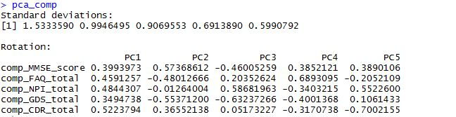
Dimensionality Reduction - PCA
Algorithms used – PCA
We perform this to determine the significant test of the 5 tests
FAQ is the principal component.
We infer that functional ability of patients is an important factor in neuropsychological assessment than the other tests.

Slide 6
Dataset – Neurogenetic Tests
Translocase of outer mitochondrial membrane 40 homolog (yeast), also known as TOMM40, is a protein which in humans is encoded by the TOMM40 gene. Clinical significance
In humans, certain alleles of this gene have been statistically associated with an increased risk of developing late-onset Alzheimer's disease. One study has found that TOMM40 risk alleles appears twice as often in people with Alzheimer's disease than those without it.
There are two genes ie. TOMM40 A1 and TOMM40 A2

Slide 7
Clustering in neurogenetics dataset
Algorithms used – K means clustering
This is an unsupervised learning classification
Uses:
Distribution of protein synthesis between two genes

Slide 8
Dataset – Neuroimaging
Dataset used is MRI scans of the brain
Python is used to perform image processing
The following packages are used : Numpy, Opencv, Scipy
Uses:
Extract hippocampus region of the brain
Size difference in hippocampus region of the brain

Slide 9
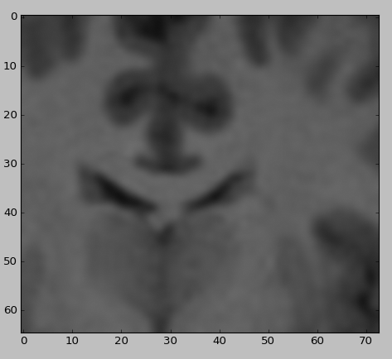
Steps in neuroimage processing
Step 1:
Neuroimage segmentation to get the area of interest in the image (hippocampus region)

Slide 10

Steps in neuroimage processing
Step 2:
Laplacian transformation ( Normalization)

Slide 11

Steps in neuroimage processing
Step 3:
Edges detection

Slide 12

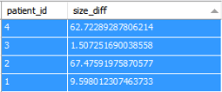
Steps in neuroimage processing
Step 4:
Corners detection
Size difference

Slide 13
Steps in neuroimage processing
Step 5:
Loading the corners data in MySQL

Slide 14
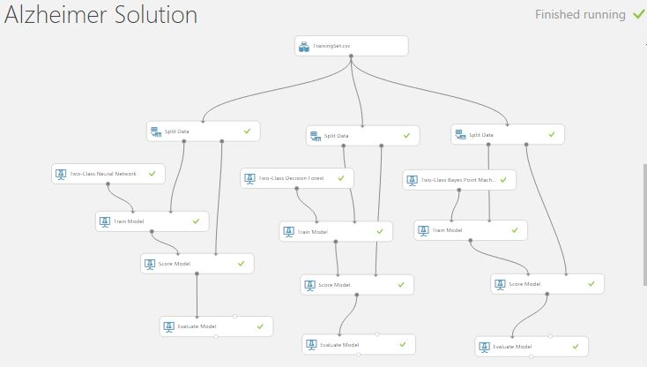
Azure Model

Slide 15
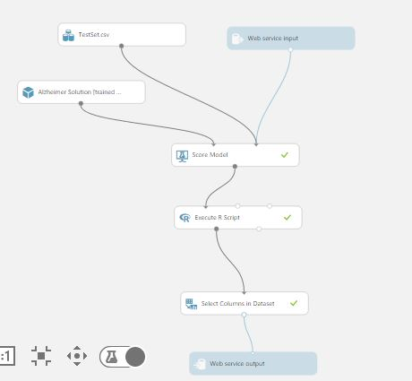
Predictive Model

Slide 16
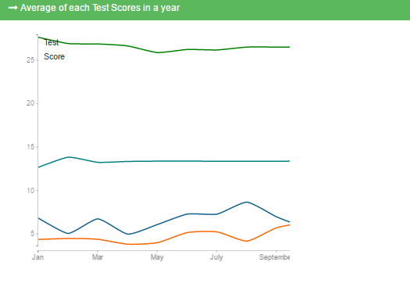
Visualization using D3

Slide 17
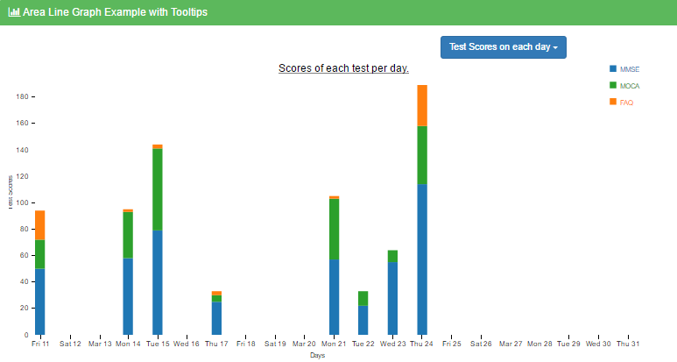
Visualization using D3

Slide 18
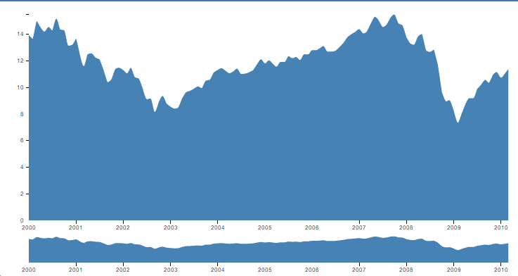
Visualization using D3

Slide 19
Alzheimer disease prediction
This is a supervised classification problem
Algorithms that best fit our requirement are Naïve Bayesian, Random Forest and Neural Networks
Parameters that have been considered
FAQ score
Protein synthesis
Hippocampus size difference
We are performing binary classification of Alzheimer (0 or 1)

Slide 20



Thank you! ☺

