Slide 1


RSO Automation Binders
13 December 2016

Slide 2

BUSINESS CASE TEAM
Ruchi Goyal (Project Manager)
Reema D’Mello (Business Analyst)
Raghuram Parthasarathy (Developer)
Harish Gunasekaran (QA Tester)
Shashwat Mehra (Developer)
Guided by Professor Gail Raynus

Slide 3
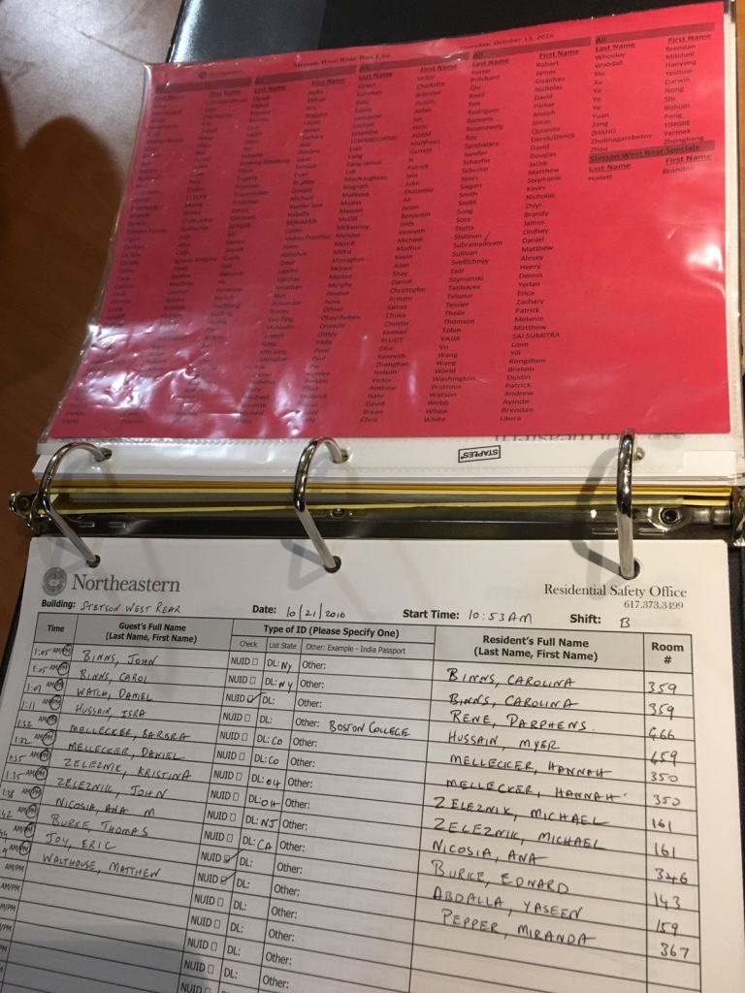
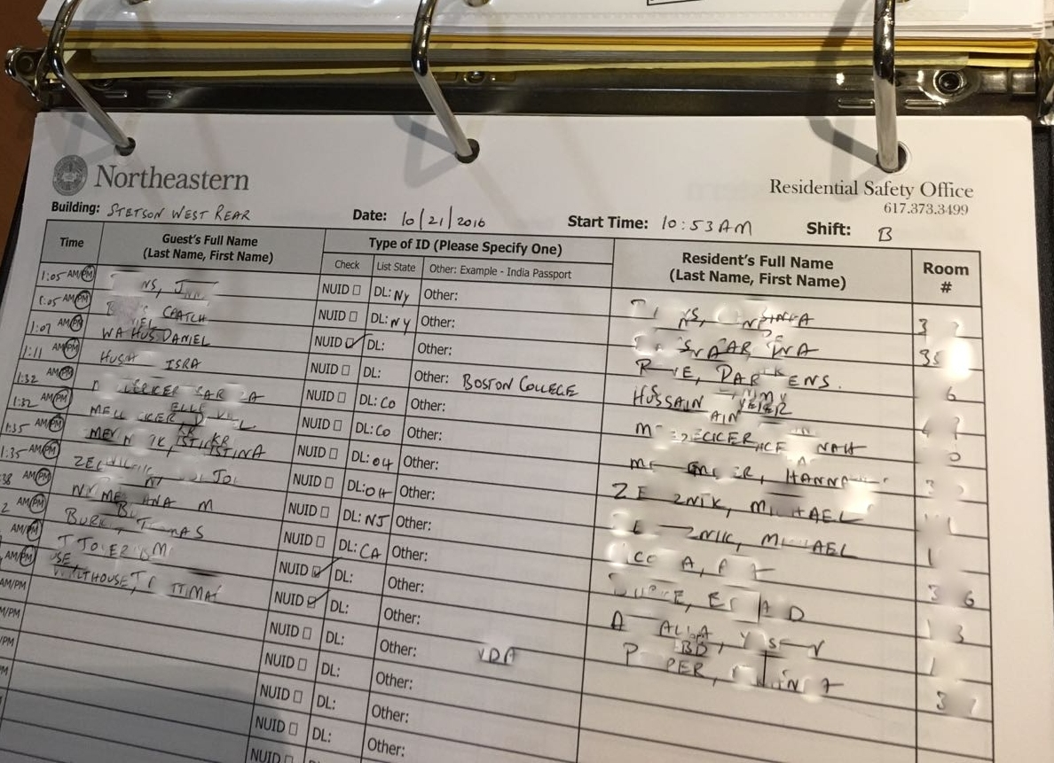
Glossary
Sign in sheet: It is used to enter the details of the guests manually by proctors.
Ban List: It is the list of people who are banned to enter the particular building.
Binder: The binder consist of the list of residents staying in that building, banned list , sign in sheets and the rules for signing in guests and others.
Blow by Scenario: Occasionally, people run past the proctor station or try to gain access to the building without adhering to sign-in procedure
Sample Sign In Sheet Sample Ban List

Slide 4
What ?
The current process includes proctors manually entering the records of all the guests by checking their identification and looking them up on the banned list
This process is very time consuming and there are long queues during rush hours or special events
There is no database which contains the records of all the guests, but the information is scattered in multiple sheets of paper which leads to inconvenience when retrieving data later on
Objectives ?
The new application will prevent people in the banned list from entering the resident hall and reduces manual errors.
The guests need not wait for a long time during rush hours to enter the resident halls.
The application has a quick response time that improves the efficiency of the staffs by reducing the time taken for sign in .
All the guest and resident records are stored in a database and can be retrieved easily whenever needed
Problem Statement

Slide 5

Assumptions and Dependencies
All staff and employees will be trained accordingly in their respective data entry, timesheet, and reporting tasks on the new web-based system
Funding is available for training
Funding is available for purchasing hardware/software for web-based system
All department heads will provide necessary support for successful project completion
Project has executive-level support and backing

Slide 6

BUSINESS REQUIREMENTS
The solution shall provide secure data storage for all guest’s information, student information and their visit histories.
The solution shall provide capability to alert NUPD in case of medical and non-medical emergencies.
The system shall provide ability to validate the identification of students as well as guests
The system shall provide ability to check the guests against banned list
The system shall provide capability of adding up to 5 guests per student

Slide 7
USER & FUNCTIONAL REQUIREMENTS
Login:
Proctor, NUPD and supervisor should login to the system
System Validation:
System shall validate the user credentials
System shall notify the proctor with a green light and display the details if the student is a valid resident
System shall notify proctor with a red light and display the details if the student is not a resident or is in banned list
System shall automatically generate alert if the user in banned list
Monitor Alerts:
Proctor shall have the ability to create medical and non-medical alerts
NUPD shall have the ability to update the comments on the alerts
Supervisor shall have the ability to manage the alerts and view their status
Access the database
Supervisor and NUPD shall have access to the database

Slide 8
NON-FUNCTIONAL REQUIREMENTS
Access Security:
The system shall allow only authorized user to log in.
The system shall allow only the authorized NUPD officials and supervisors to access the database information
Availability:
The system shall be available 24* 7 throughout the year
Efficiency:
The system shall notify the alerts to the NUPD, supervisors and proctors without any delay.
The system shall support in rush hours and should support for the ever increasing number of the residents
Integrity:
The system shall maintain and protect all the personal information about the residents and guests
Survival:
The system shall identify the internet connection issues to work efficiently and accurately.
The system shall notify the proctor/supervisor about the internet connection issues, if any.
The technical support shall be available as and when needed.
Interoperable:
The system shall be accessible from the mobile devices as well as from the web browsers.
The system shall be able to work with any web browser. (IE > 8.0; Mozilla Firefox; Google Chrome)

Slide 9

SOLUTION
The RSO Automation application project will provide a secure and faster interface for managing the entry of students and guests into the Northeastern Residential buildings.
It will provide an integrated database where all details are stored and every entry is logged
Supervisors and NUPD can now view the alerts and respond as appropriate
Resident/ Guest
Proctor
RSO Automation
Supervisor/ NUPD

Slide 10


Alternative Analysis
Stay with the current system
Continued occurrence of a high number of blow by scenarios
No centralized data and proper database management
Huge queues during rush hours
No proper maintenance of binders and records
Prone to manual errors
Non-eco-friendly.

Slide 11
PROJECT DOCUMENTS
BUSINESS CASE
USE CASE
ACTIVITY DIAGRAMS
PROCESS FLOW DIAGRAM
REQUIREMENTS DOCUMENT
WIRE SKETCH

Slide 12


RSO - Personas
TASKS:
Log on to the system
Swipe students NU ID
Swipe in Guest ID
Check banned list alerts
5. Create emergency alert
6. Create non-emergency alert
7. Create blow-by alert
PROCTOR
TASKS:
Log on to the system 4. Monitor non-emergency alert
Monitor banned list alert 5. Check database for previous records
Monitor emergency alert
SUPERVISOR

Slide 13



RSO - Personas
TASKS:
Provide valid NU ID
Provide valid Guest ID
GUEST
RESIDENT
TASKS:
Provide valid Photo ID
TASKS:
Log on to the system 4. Monitor non-emergency alert
Monitor banned list alert 5. Check database for previous records
Monitor emergency alert
NUPD

Slide 14
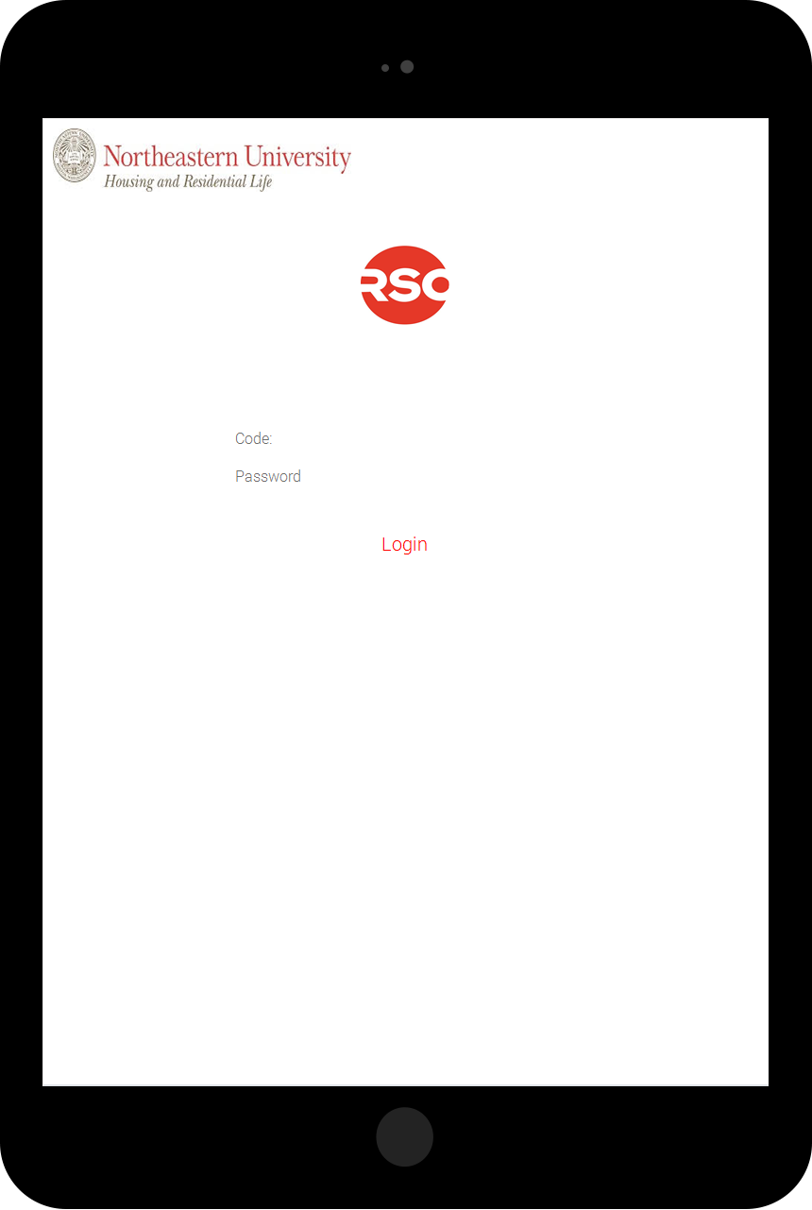
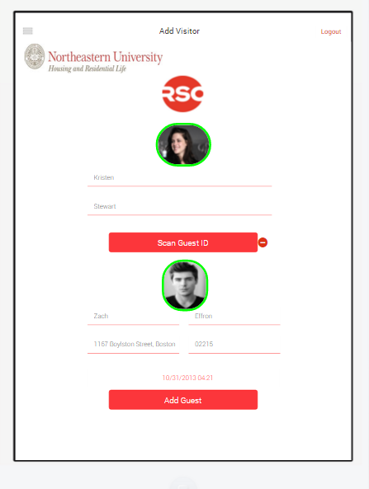
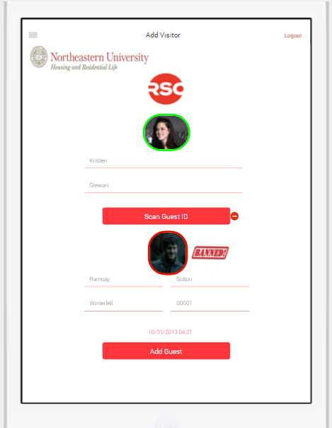
UI - PROCTOR

Slide 15
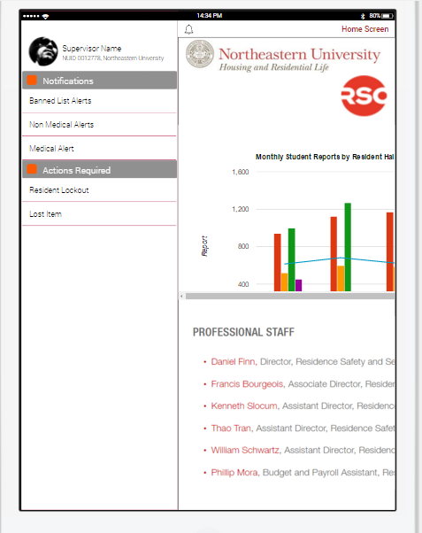
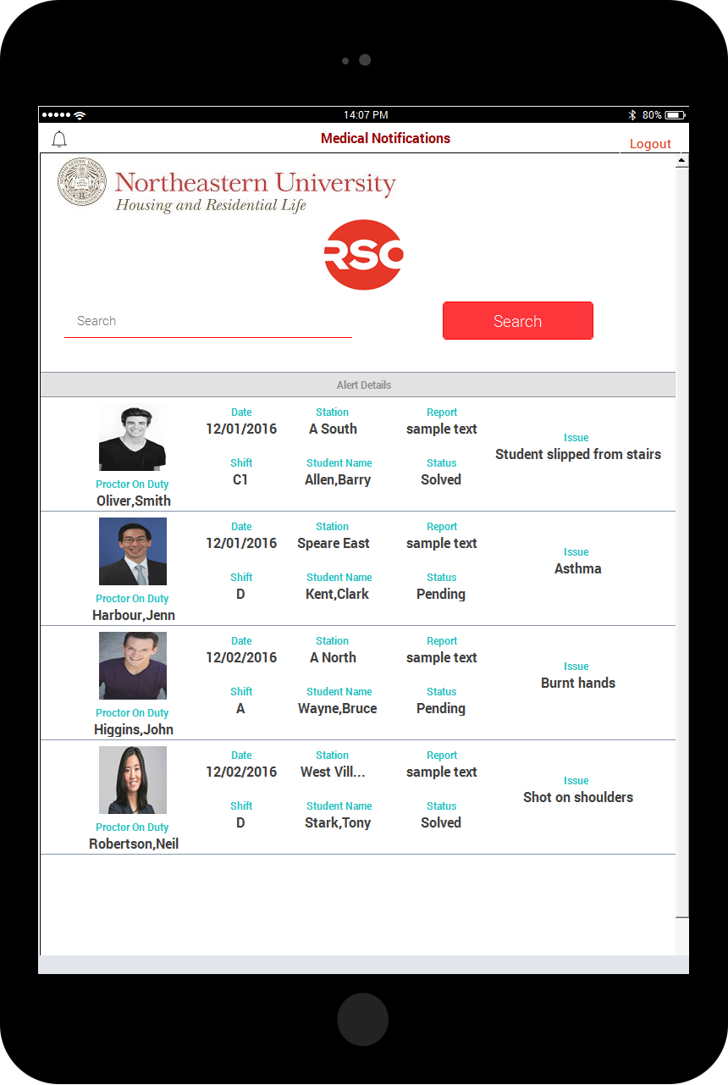
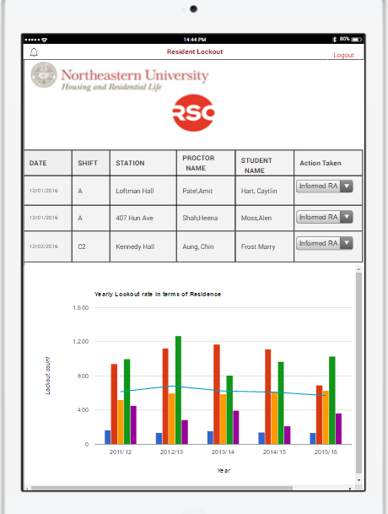
UI – RSO SUPERVISOR

Slide 16
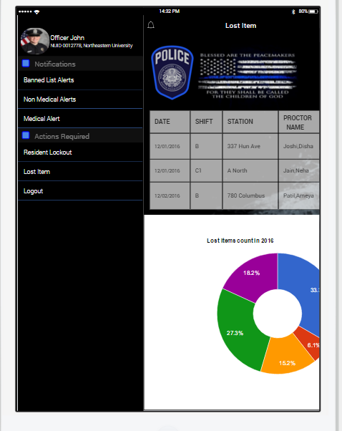
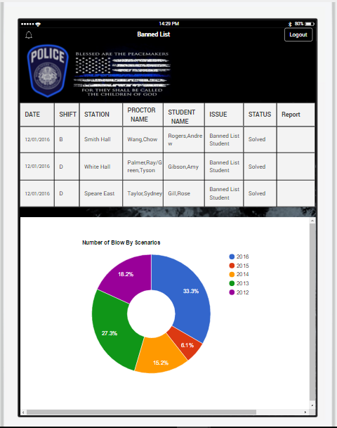
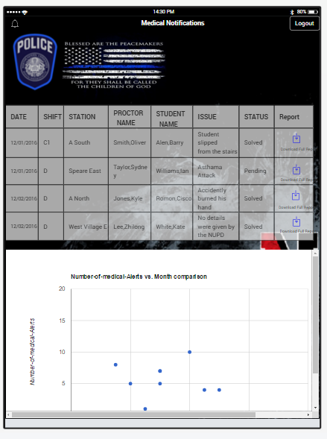
UI– NUPD

Slide 17

UI Prototype : Demo

Slide 18

Questions ?

