Slide 1
Advanced Healthcare Chat Bot using Python
Submitted in the partial fulfillment for the award of the degree of
BACHELOR OF ENGINEERING
IN
CSE (INTERNET OF THINGS)
Submitted by:
Raghu Ram Vadlamudi 19BCS4596
Ranjith Banjerjee 19BCS4619
Harsh Raj 19BCS4586
Arthi Reddy Dharma 19BCS4593
Under the Supervision of:
RAJAT TIWARI
Department of AIT-CSE
DISCOVER . LEARN . EMPOWER

Slide 2
Outline
Introduction to Project
Problem Formulation
Objectives of the work
Methodology used
Results and Outputs
Conclusion
Future Scope
References

Slide 3
Introduction to Project.
Today’s people are busy with their works reception, workplace work and additional addicted to the web. They are not involved in their health. So they avoid traveling to hospitals for little issues.it may become a significant drawback.
So, we will offer a thought to make a health care chatbot system using AI that may identify the illness and supply basic information regarding the illness before consulting a doctor.
The system application uses question and answer protocol within the style of a chatbot to answer user queries. The response to the question is replied supported by the user question.
The system is developed to scale back the tending price and time of the users because it isn't potential for the users to go to the doctors or consultants once in real-time required.

Slide 4
Introduction to Project.
Chatbots are programs built to automatically engage with received messages. Chatbots can be programmed to respond the same way each time, to respond differently to messages containing certain keywords, and even to use machine learning to adapt their responses to fit the situation.
A developing number of hospitals, nursing homes, and even private centers, presently utilize online Chatbots for human services on their sites. These bots connect with potential patients visiting the site, helping them discover specialists, booking their appointments, and getting them access to the correct treatment.
In any case, the utilization of artificial intelligence in an industry where individuals’ lives could be in question, still starts misgivings in individuals. It brings up issues about whether the task mentioned above ought to be assigned to human staff.

Slide 5
Problem Formulation
Chatbot is an Entity that imitates human discussion in its particular accepted set-up together with a text or vocal language The aim of this system is to replicate a person’s discussion.
The system gives a response by use of an efficient Graphical User Interface such that if an actual person is chatting with the user.
Chatterbot that can be used in various fields like education, healthcare, and route assistance. The system takes plain text as input and answering all types of questions output by qualified users is the output.
The database used in the project is MySQL. The illustration and execution of SQL in the pattern matching operation are required. The data of the chatbot are deposited in the database.

Slide 6
Objectives of the Work
The main aim of the project AI is the Based Healthcare chatbot system, which is easy to use and more secure than the current system it will cure diseases and helps to maintain proper health in the current system. This system reduces the possibility of diseases.
Also, it provides accurate information about the health Symptoms and medicines to the patients. For end-users, it became easy to gain access to healthcare websites and explore different types of services. The AI-based chatbots are fast, reliable, and precise.
The chatbot gives us suggestions for the symptoms we face and it also suggests us the doctor for the consultation.

Slide 7
Methodology used
The following methodology will be followed to achieve the objectives defined for the proposed research work:
1. A detailed study of health care chatbots will be done.
2. Installation and hands-on experience on existing approaches of health care chatbot will be done. Relative pros and cons will be identified.
3. Various parameters will be identified to evaluate the proposed system.
4. A comparison of the newly implemented approach with existing approaches will be done.
The healthcare chatbot is designed by using python in the backend.
For a conversation between user and system we use Python(Tkinter model)
The dataset files are CSV file format which is trained in the initial stage of the application mode and also used as testing mode.

Slide 8
Methodology used
For a conversation between user and system and the user is used named Python , Tkinter, Numpy, Pandas
The database files are in CSV format which is trained in the initial stage of the application mode.
Pattern Matching is predicated on representative stimulus-response blocks. A sentence (stimuli) is entered, and output (response) is created consistent with the user input Eliza and ALICE were the first chatbots developed using pattern recognition algorithms.
The Artificial Intelligence Markup Language (AIML) was created from 1995 to 2000, and it is based on the concepts of Pattern Recognition or Pattern Matching technique

Slide 9
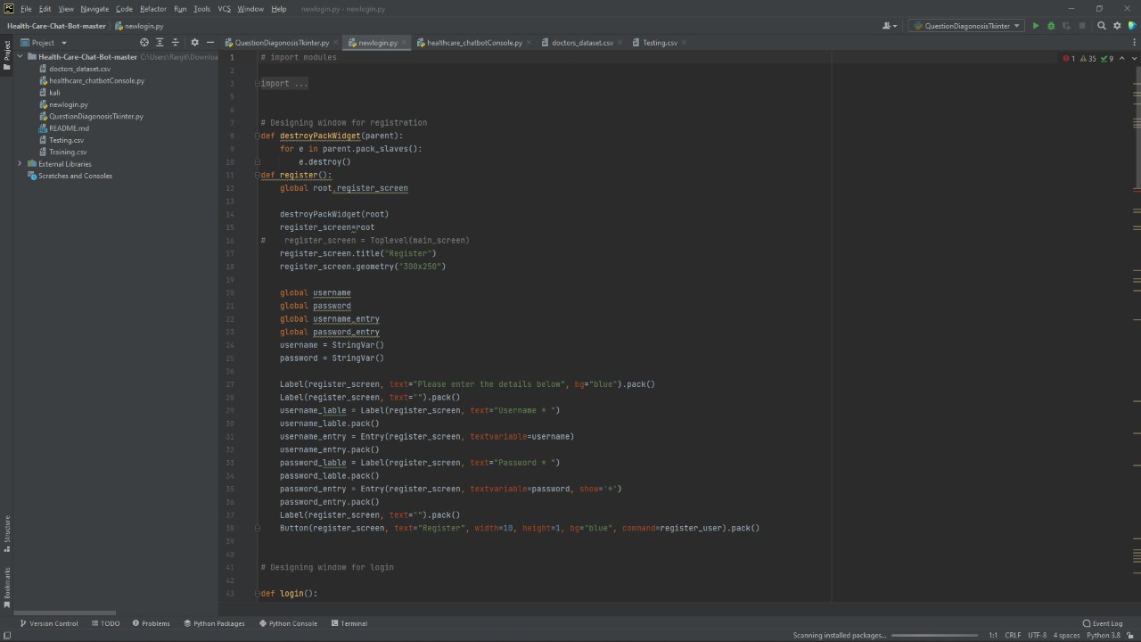
Results and Outputs

Slide 10
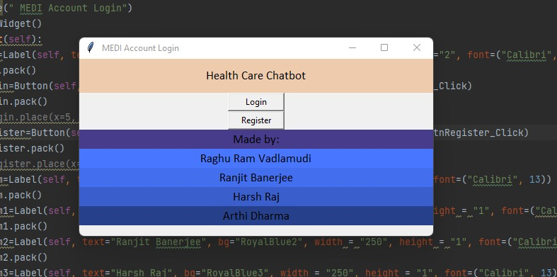
Results and Outputs

Slide 11
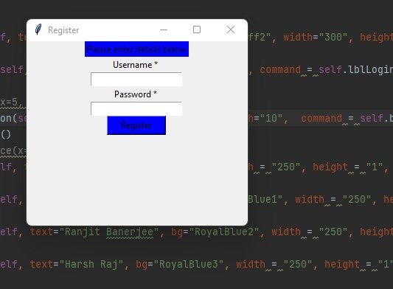
Results and Outputs

Slide 12
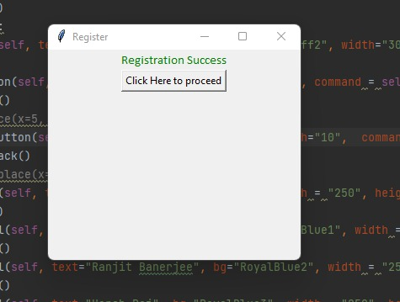
Results and Outputs

Slide 13
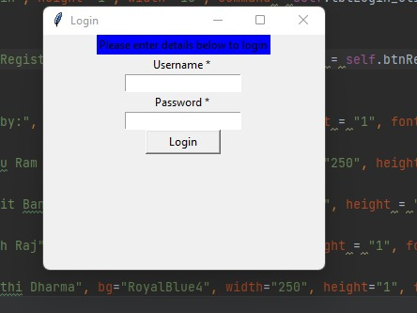
Results and Outputs

Slide 14
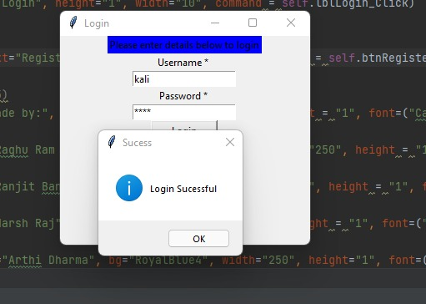
Results and Outputs

Slide 15
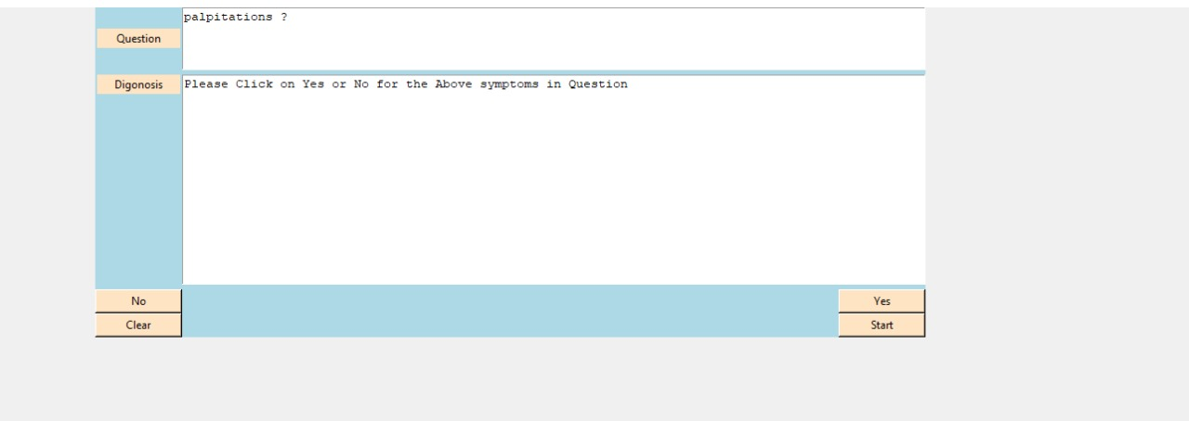
Results and Outputs

Slide 16
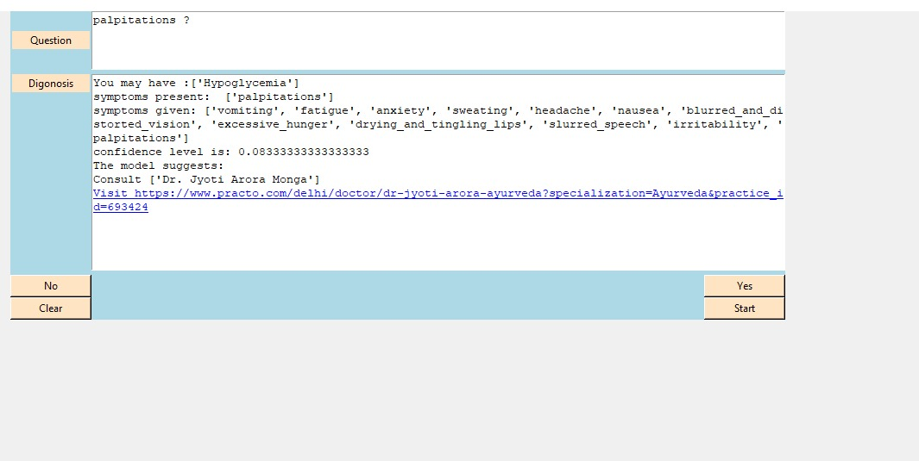
Results and Outputs

Slide 17
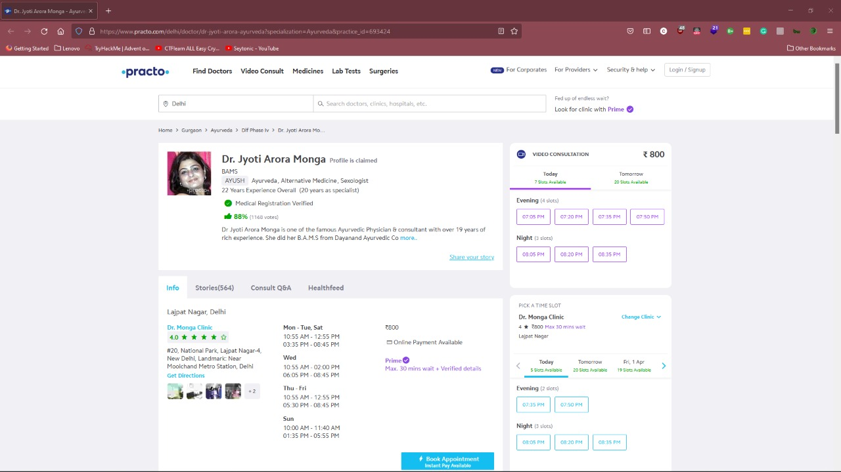
Results and Outputs

Slide 18
Conclusion
Chatbot is a great tool for conversation language between humans and machines. The application is developed for obtaining a fast response from the bot which implies with no delay it provides the correct result to the user. It’s ended that, the usage of chatbot is user friendly and might be utilized by someone who is aware of the way to sort in their own language.
Currently, chatbots are not supported by everyone's language and cannot understand informal language. Hence, there is good scope to remove such language barriers from chatbots. Embedded AI helps the computer system function like a human.AI chatbot making our chatbot capable and intelligent to answer complex queries. With the help of AI Chatbot, you can improve the current answer using the previous interaction. Such a chatbot system conducts intelligent interactions and saves the customer time.

Slide 19
Future Scope
Future scope of the project could be an AI-Based Healthcare chatbot system that can also include a mobile assistant in it which will be more functions will be added and can be accessed by many users.
Which will also reduce the time and will also be accurate in the health details of patients given to the doctors.
Future scope of this healthcare chatbot system will help hospitals to provide healthcare support online 24 x 7, it answers deep as well as general questions.
It also helps to generate leads and automatically delivers the information of leads to sales. By asking the questions in series it helps patients by guiding what exactly he/she is looking for.

Slide 20
References
[1] Automatic Extraction of Chatbot Training Data from Natural Dialogue Corpora, Bayan AbuShawar, Eric Atwell
[2] Chatbot Evaluation and Database Expansion via Crowdsourcing, Zhou Yu, Ziyu Xu, Alan W Black, Alexander I. Rudnicky
[3] AI BASED CHATBOT, Prof.Nikita Hatwar, Ashwini Patil, Diksha Gondane
[4] Data Mining: Concepts and Techniques Jiawei Han and Micheline Kamber
[5] H. Kopka and P. W. Daly, Data Mining Practical Machine Learning Tools and Techniques Ian H. Witten Eibe Frank Mark A. Hal
[6] https://www.cse.iitb.ac.in/ bibek/WriteUP2016:pdfhttp : ==cs224d:stanford:edu=
[7] https://scikit-learn.org
[8] http://www.nltk.org
[9] http://www.wikipedia.org
[10] https://chatbotsmagazine.com/the-complete-beginner-s-guidetochatbots8280b7b906ca.i2zgql2op

