Slide 1

AWS

Slide 2
Agenda
01
Cloud Computing
02
What is AWS ?
03
AWS Services
04
Deploy a Spring boot application

Slide 3

Cloud Computing
Cloud computing is the delivery of computing services—including servers, storage, databases, networking, software, analytics, and intelligence—over the Internet (“the cloud”) to offer faster innovation, flexible resources, and economies of scale.
Services Providers
Amazon Web Services (AWS)
Microsoft Azure.
Google Cloud.
….many more ….

Slide 4
What is AWS?
Amazon Web Services (AWS) is a highly available, secure cloud services platform that offers more than 100 cloud applications. Providing a pay-as-you-go system removes the requirement for capital to be provided upfront. It helps in controlling, auditing, and managing identity, configuration, and usage.

Slide 5
Uses of AWS
A small manufacturing organization uses their expertise to expand their business by leaving their IT management to the AWS.
A large enterprise spread across the globe can utilize the AWS to deliver the training to the distributed workforce.
An architecture consulting company can use AWS to get the high-compute rendering of construction prototype.
A media company can use the AWS to provide different types of content such as ebox or audio files to the worldwide files.

Slide 6
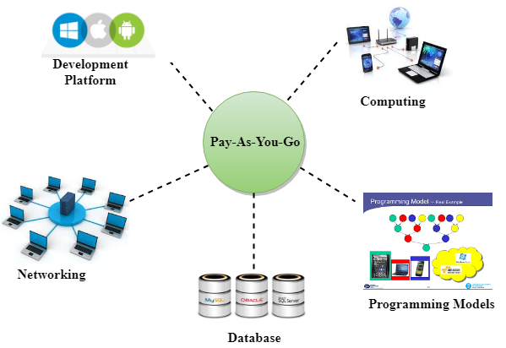
PAY AS YOU GO

Slide 7
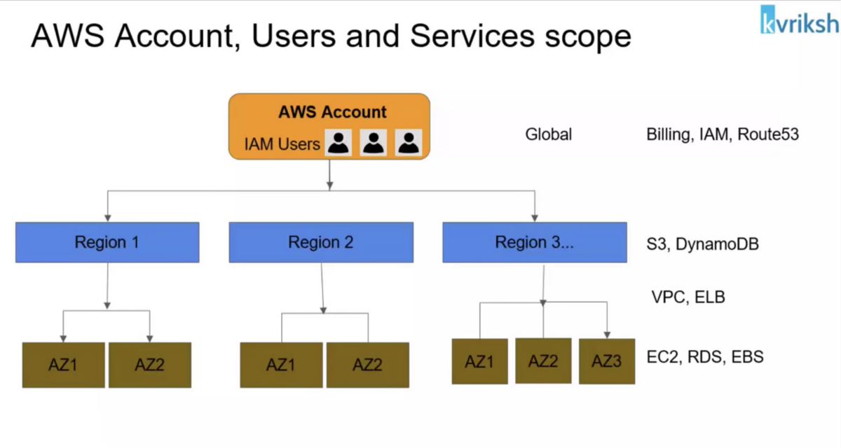

Slide 8
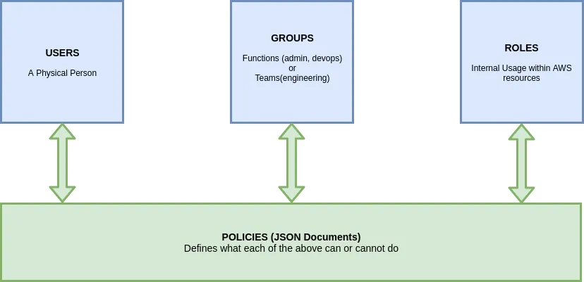

Slide 9
Now Lets go to aws website
First create account in aws (12 months free)
Then signin into the account
Now activate MFA
Then create any EC2 instance
Deploy project in aws

Slide 10
THANK YOU

