Slide 1

Smarter Transfer Credit Evaluation
From zero units and weeks of waiting to a clear status for every course, on day one.
Clopay Code Crafters · FDE AI Hackathon 5.0 · Problem 1 · Boston University
Notes:
Open with the one-line promise: faster for evaluators, clearer for students, and the department still decides.

Slide 2



Every course, every student, one syllabus at a time
800+
0 units
1 by 1
12 mo
transfer students a year at BU
shown for every pending course
manual syllabus comparisons
to settle all credit
Students
Evaluators
Departments
Cannot tell what is happening, chase old syllabi, and do not know how much degree progress is secure.
Compare descriptions, outcomes and credit hours manually, again for every student.
Must keep the final say. Any tool may recommend, never decide.
TransferHub · Clopay Code Crafters
Notes:
BU takes 800+ transfers a year. Courses without an equivalency show 0 units, students chase syllabi, evaluators compare by hand.

Slide 3



What they asked for, and what we built
Faster
Every course triaged into a lane at upload. Known equivalencies apply instantly. Everything else arrives pre-ranked with reasons. Decisions feed back so the next student is instant.
More transparent
Per-course status, an animated timeline, notes, reminders and role dashboards replace "0 units".
Less stressful
Syllabi are asked for only where they matter. Applicants get a preview before admission. Documents are read for them.
Department decides
Configurable approval stages. AI and rules never reject and never exceed 70% confidence on their own.
TransferHub · Clopay Code Crafters
Notes:
Four tests in the brief. Each has a concrete feature you can click.

Slide 4






One pipeline from upload to posting
›
›
›
›
›
Upload
Rules
Equivalency
Match
People
Posted
Transcript or documents
Grade, credits, age, caps
Known match applies
AI or built-in rules rank
Faculty to final approver
Grade T, student notified
The learning loop. Every approved decision is saved as a reusable equivalency with effective dates, and AI results are cached across students, so the second student with the same course never waits.
TransferHub · Clopay Code Crafters
Notes:
Walk left to right. Rules first, then known equivalencies, then AI or built-in rules, then the people.

Slide 5
The six-course story, upload to posting
External course
Lane
What the student sees
CSC 110 Intro to Programming
Applied
BU CS 111 · 4 cr
MAT 210 Calculus I
Applied
BU MA 123 · 4 cr
ECO 101 Microeconomics
Applied
BU EC 101
CSC 220 Data Structures
Likely match
Suggested CS 112 · pending CS dept
CSC 240 Discrete Math
Needs syllabus
CS 131 or MA 293 · evaluator picks
CIS 150 Linear Algebra (quarter)
4 qtr → 2.66 cr
Elective or MA 242 · evaluator decides
Result: 12 credits secure at upload, three pending items each with a named next step.
TransferHub · Clopay Code Crafters
Notes:
Maya Rivera moves from Bay State Community College. Three known, two maybe, one quarter-system course converted 4 x 2/3 = 2.66.

Slide 6
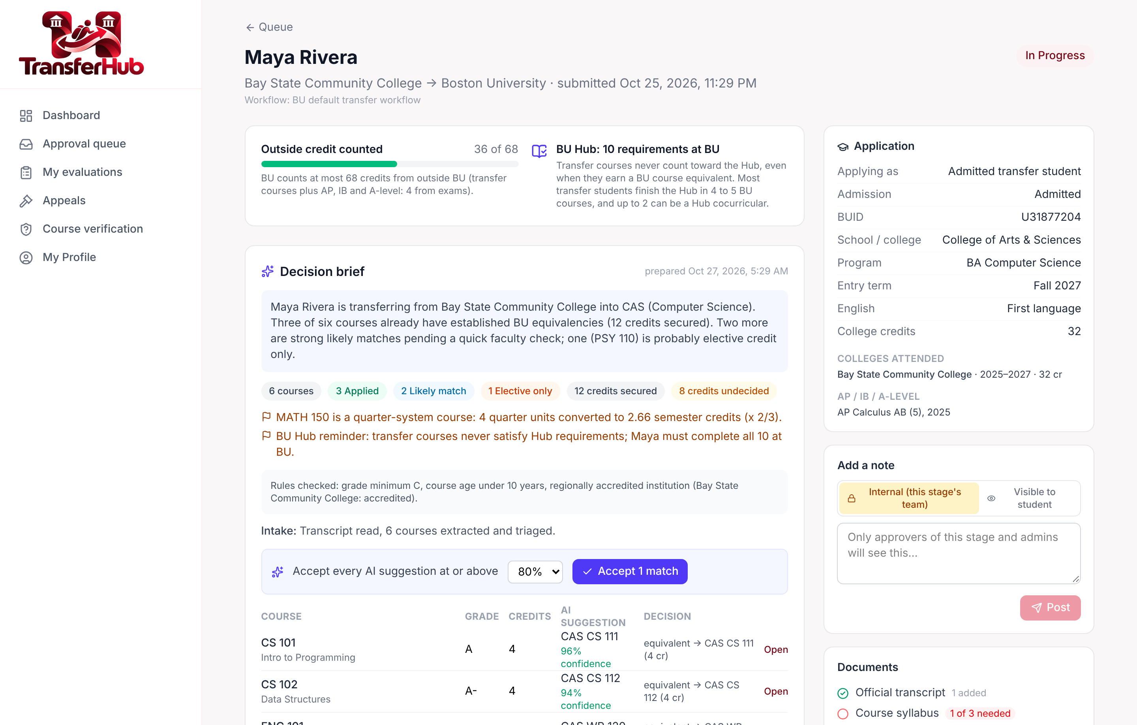
Evaluators: everything in one place
Reviewer brief
Policy flags, credit math and Hub rule, generated for free.
Ranked suggestions
Each with a plain-language reason. One click accepts all above X%.
Approve in bulk
Queue-level approve for clean requests.
Always overridable
Faculty can change any match by hand.
TransferHub · Clopay Code Crafters
Notes:
Request review: timeline, reviewer brief, ranked suggestions with rationale, one-click accept above a threshold, bulk approve in the queue.

Slide 7
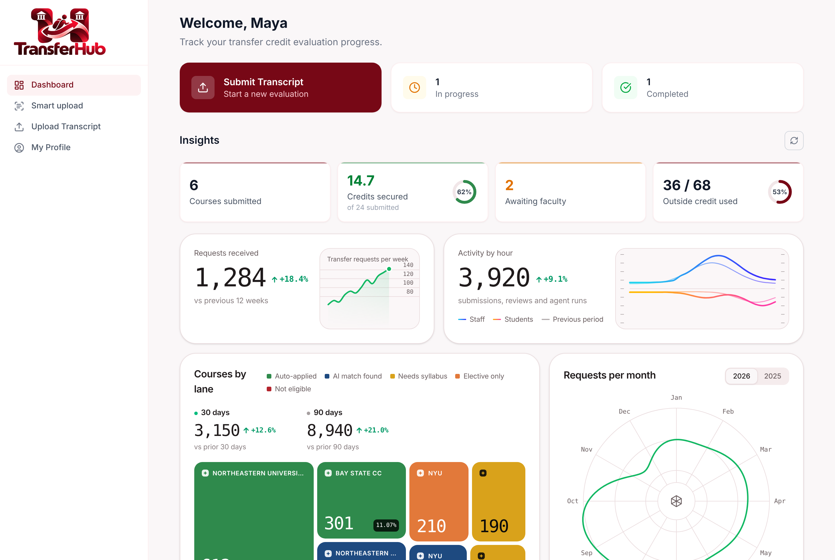



Students: no more black box
See every course
Status and next action per course.
Live timeline
Which stage, who owns it, how long.
Nudge
Ask for an update, rate-limited.
Only needed syllabi
And why each one matters.
TransferHub · Clopay Code Crafters
Notes:
Per-course lanes, timeline, internal vs student notes, nudge reminders, dashboards.

Slide 8
Beyond the ask
What turns an evaluator tool into a platform
Notes:
Now the part nobody asked for.

Slide 9
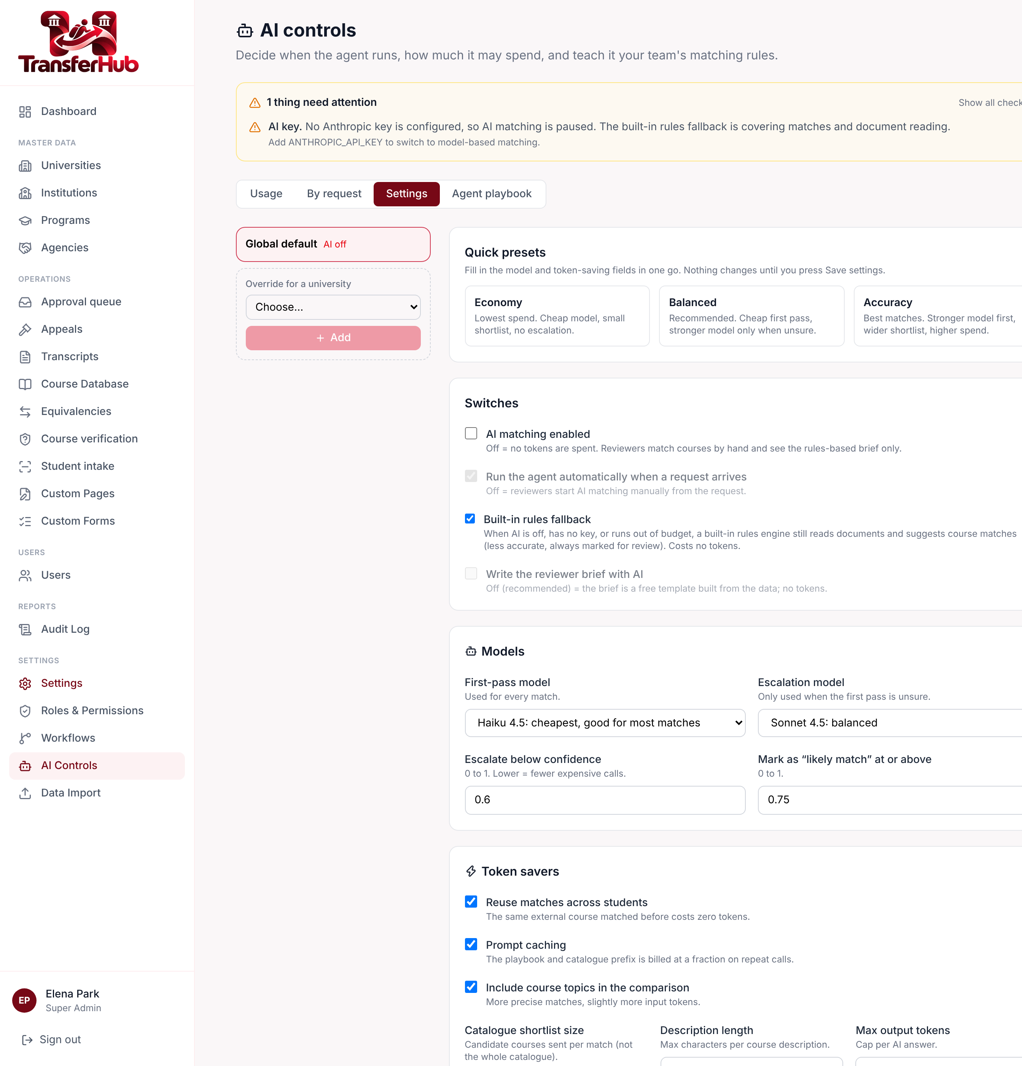
AI that keeps working when AI is off
1
Claude
Cheap model first, stronger one only when unsure. Reads PDFs and photos, ranks matches.
2
Built-in rules
Zero tokens. Reads text PDFs, classifies, extracts fields, ranks courses by title, topic, code and credits. Capped at 70% confidence.
3
Human
Faculty and students can always edit or override. Nothing is ever auto-rejected.
Falls through automatically: key missing, switch off, budget used, or API error.
TransferHub · Clopay Code Crafters
Notes:
No API key yet, budget exhausted, or an outage: the built-in rules engine reads documents and suggests matches. One super-admin switch.

Slide 10
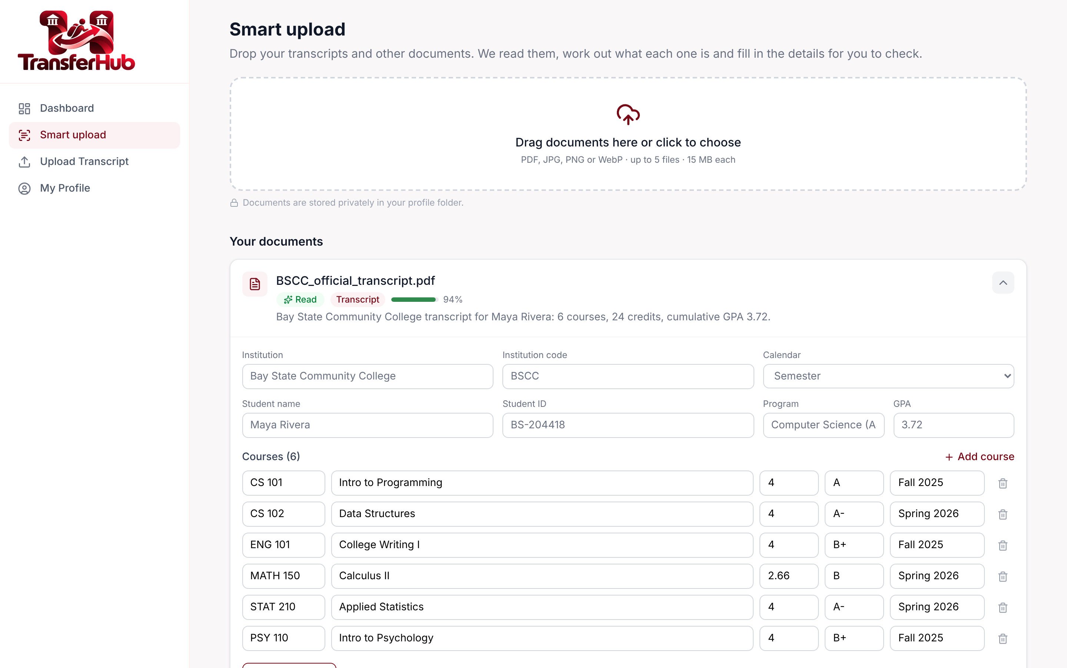
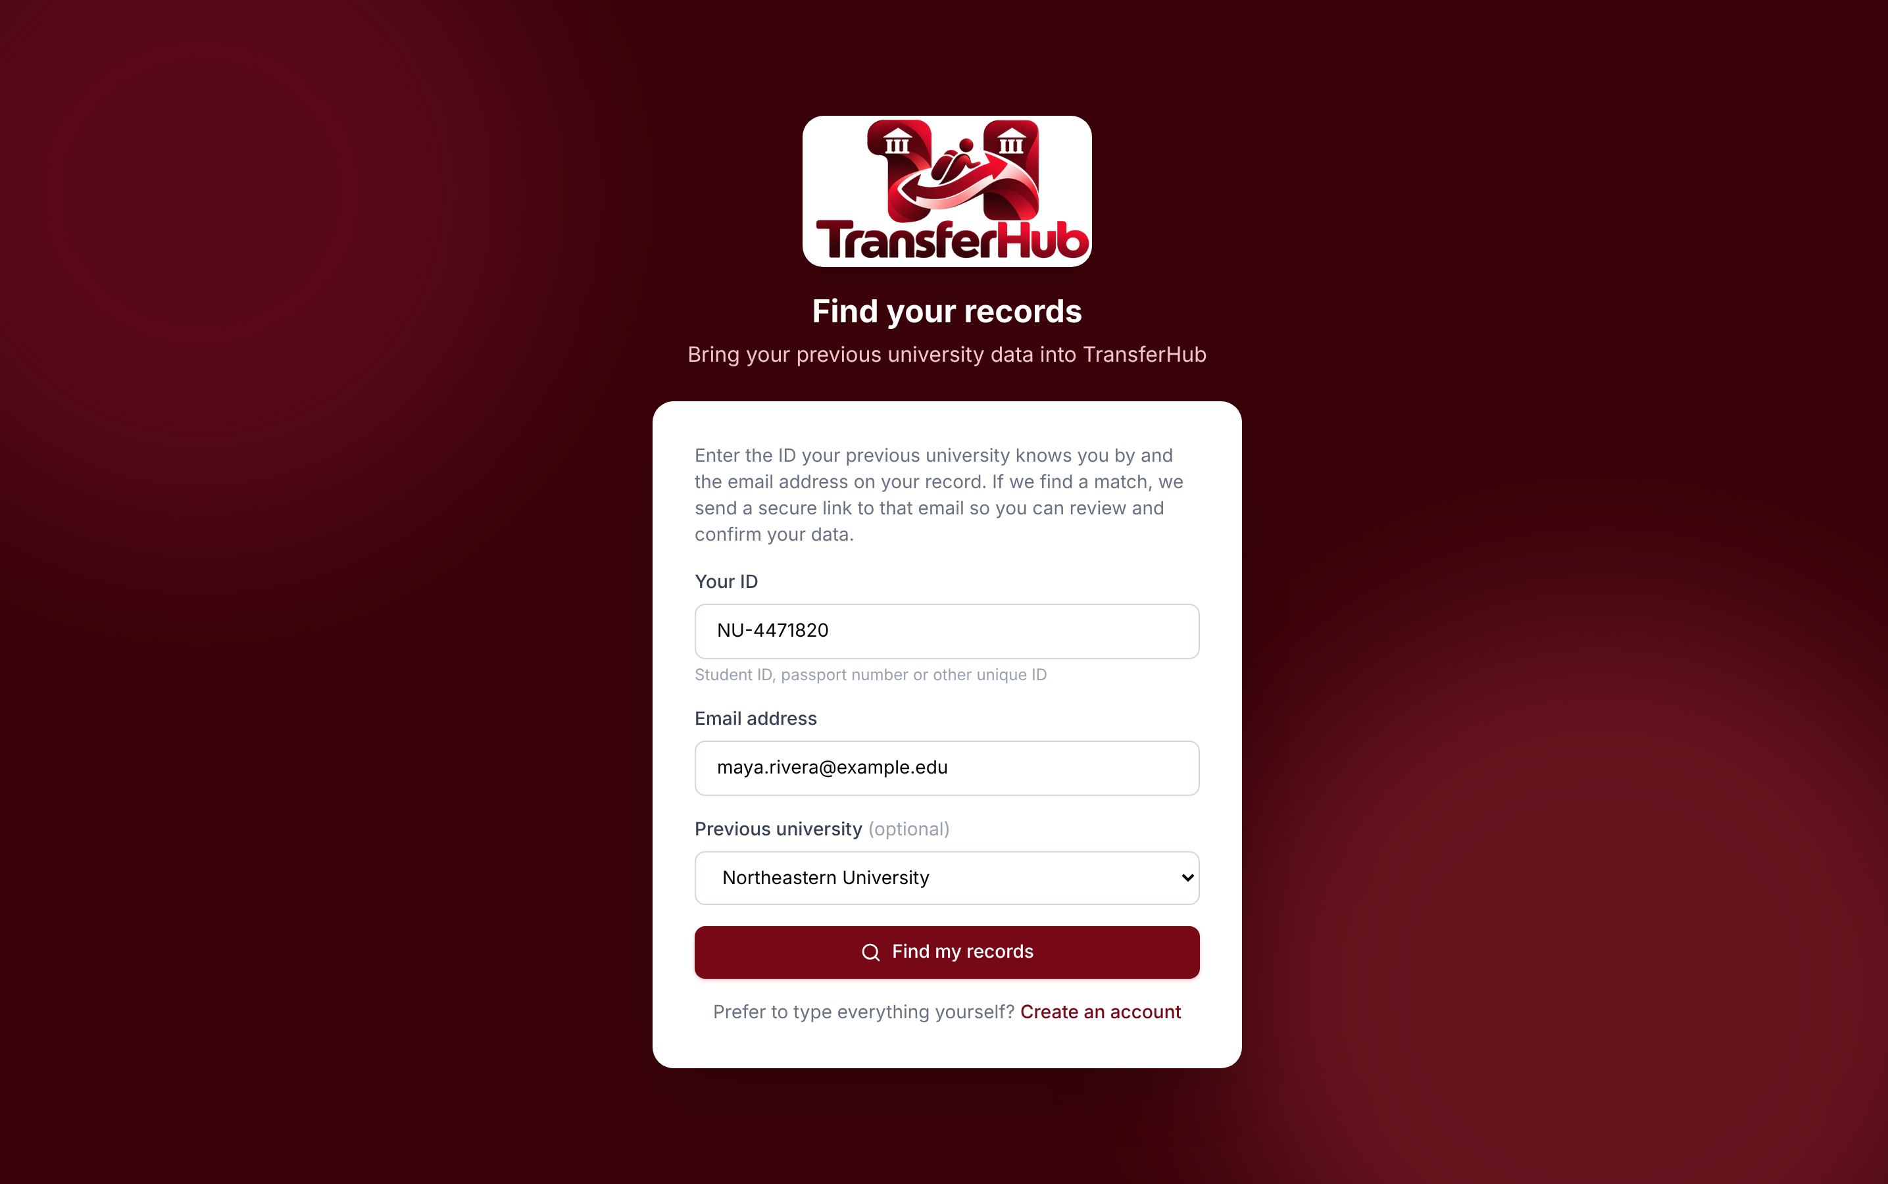





Reads the documents. Gets students in five ways
Self-register
Email link
QR code
Registrar profile
Agency bulk API
TransferHub · Clopay Code Crafters
Notes:
Smart upload classifies and extracts. Intake channels all end at a confirm step before an account exists.

Slide 11
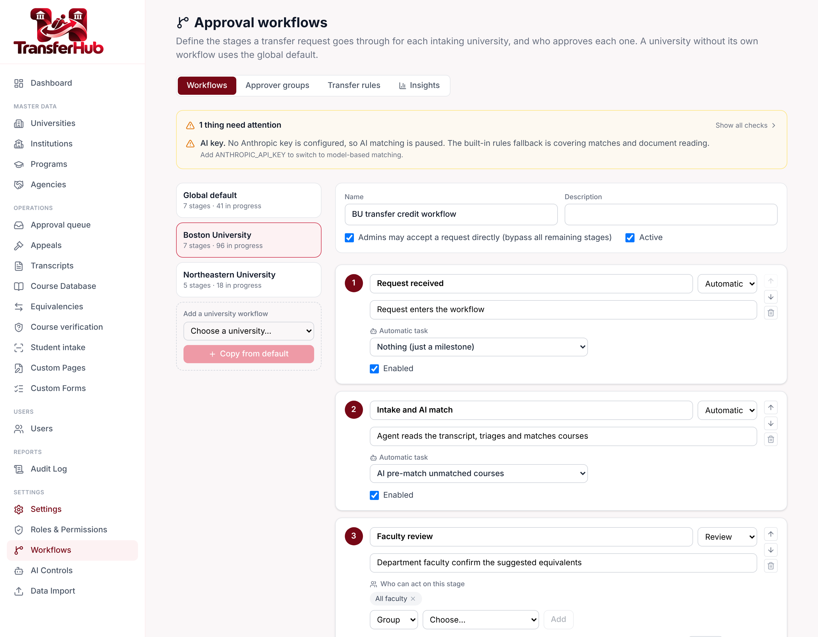
BU's actual rules, enforced and explained
Credit cap 68 transfer / 60 first-year / 80 MET, incl. AP, IB, A-level
Grades C or better. P/F and S/U go to review, with exceptions
Age and accreditation Over 5 years or unaccredited goes to review
Not eligible Internships, research, military and life experience
Hub Transfer courses never satisfy it. Always stated
Stages, owners, SLAs, auto-approve, bypass and appeals are configured per university.
TransferHub · Clopay Code Crafters
Notes:
Policy engine mirrors BU's published rules. Workflow engine is configured per university.

Slide 12






Built as a platform, not a prototype
Multi-university
Live permissions
Partner API
Universities, programs, courses and topics, shared many-to-many with per-university switches.
Role by module by operation matrix, enforced on every change. Admins are scoped to their universities.
Hashed keys, Excel templates, a review queue and per-row email reports.
Dashboards
Azure-ready
Two-university exchange
Animated analytics for every role, on desktop and mobile.
App Service, Azure SQL, Blob storage, GitHub Actions deploy.
Source and target both see each transfer, request and upload documents into the student folder, and remind each other.
TransferHub · Clopay Code Crafters
Notes:
Multi-university master data, permissions matrix, partner API, dashboards, Azure deployment.

Slide 13
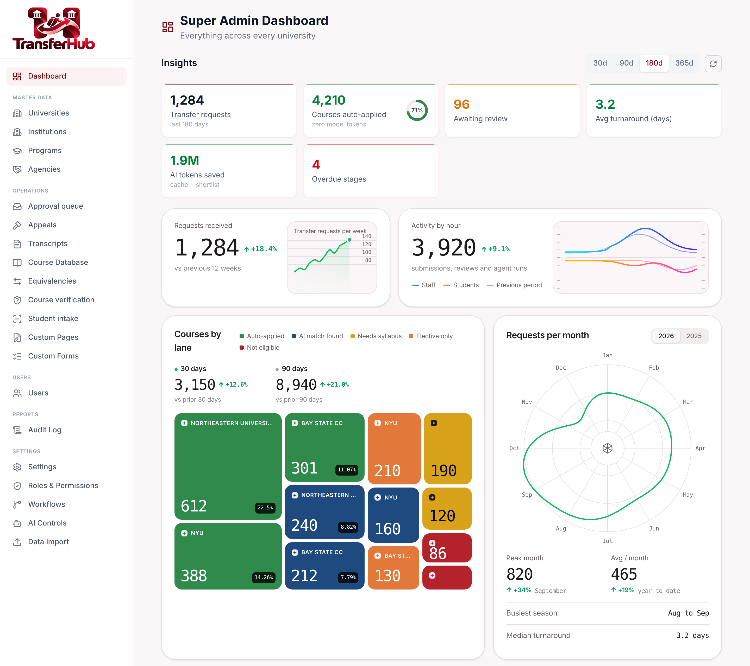
Cheap to run: every token has to earn its place
1
Lexical shortlist
Catalogue ranked locally, only top N sent
2
Cross-student cache
Same course, one model call, ever
3
Cheap model first
Escalate only when unsure
4
Prompt caching
Playbook reused across calls
5
Budgets
Monthly and per-request caps, then fallback to rules
TransferHub · Clopay Code Crafters
Notes:
Shortlist is lexical and free. Cache means the same external course costs one call ever.

Slide 14
Scorecard: 22 requirements vs. the code
Open
One-year deadline tracker · programme rules (Econ/Bio caps, substitutions)
Partial
Side-by-side course diff · one-to-many mappings · 5-credit lab rule (BU to confirm)
Built
Lanes, quarter 2/3, grade rules, BU caps, Hub, appeals, workflow, learning loop, degree progress, accuracy backtest, Maya demo data
TransferHub · Clopay Code Crafters
Notes:
We compared every rule and ask in the design docs with the code. 17 built, 3 partial, 2 open. Full table in _designs/GAP_ANALYSIS.md.

Slide 15
What we have not proven yet, and what comes next
Not proven yet
Next
No Anthropic key yet: AI paths are unverified, the rules fallback carries the demo
No BU baseline for evaluator minutes or turnaround, so the saving is not yet quantified
SQL logic was written and reviewed but has no automated tests
Quarter rounding (2.66) follows the brief; BU to confirm
1
Apply migrations and seeds, then rehearse the demo
2
Run the backtest on live data and publish the top-3 rate
3
Side-by-side course comparison
4
One-year deadline and programme rules
5
Turn on Claude and measure
TransferHub · Clopay Code Crafters
Notes:
Be honest: no live Claude key, no BU baseline numbers. Plan to close the gaps.

Slide 16

Faster for evaluators. Clearer for students. Final say stays with the department.
Live demo next
Raghuram Raichooti
Sankara Varaprasad
Swetha Katkkoori
Harshil Shah Parimal
Notes:
Close on the promise and invite the live demo.

