Slide 1


Live demo: one transfer, end to end
From a new student account to a department decision that teaches the system.
Clopay CodeCrafters · Evoke FDE AI Hackathon 5.0 · Problem 1 · Boston University
https://transferhub.wcubeprojects.in/
Notes:
About 8 minutes. Two browser profiles: student and staff. Login page has one-click demo login buttons, so no passwords are typed on screen.

Slide 2
What you will see
a
b
c
d
e
f
g
Create the user
Upload the documents
Auto-capture into the request
Submit for transfer
Approve and decide
Configure the workflow
AI stats
Student self-registration
Smart Upload reads them
Courses pre-filled, target set
Live tracker, lanes, top-3
Side-by-side, learning loop
Stages, approvers, SLAs
Spend and usage, kept apart
Student
Student
Student
Student
Faculty / Admin
Admin
Super admin
The story. Maya Rivera moves from Bay State Community College to Boston University with six courses: three known, two "maybe", one quarter-system.
Notes:
Seven steps, student first, then staff, then the super admin view. Data is synthetic.

Slide 3
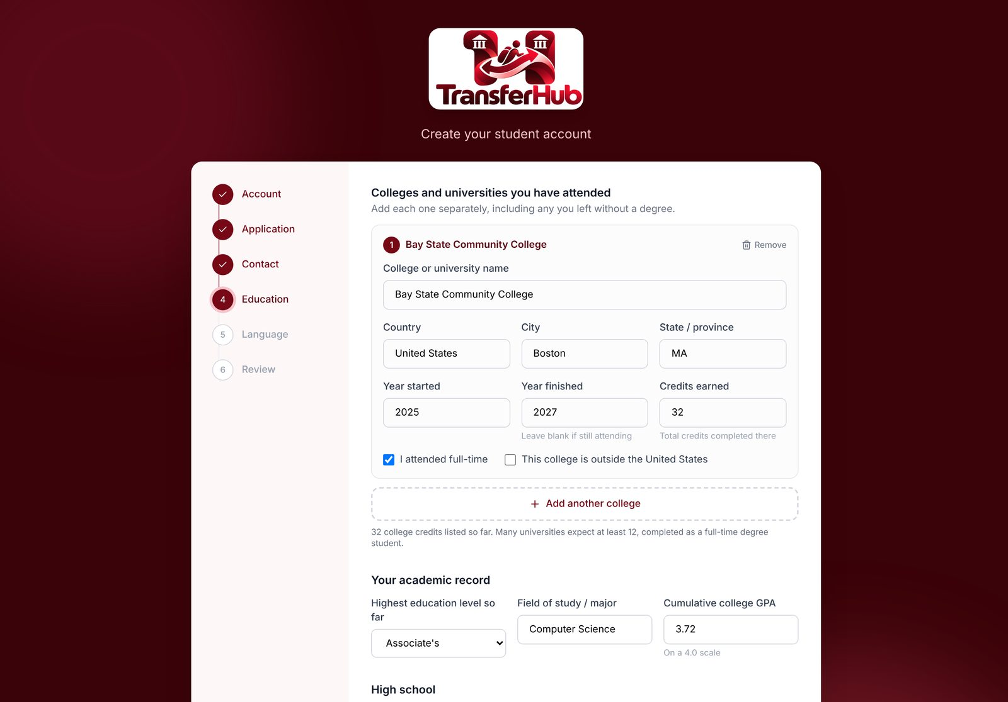
Creating the user
a
Student
1
Account
2
Application: target university, program, school
3
Contact and emergency contact
4
Education history, every college + AP / IB / A-level
5
Language and outside-US check
6
Review, then signed straight in
BU rules need this as structured data: applicant type sets the credit cap.
Notes:
Public /register. Six built-in steps plus any extra steps the admin adds through the student-registration Custom Form. The student is signed in at the end.

Slide 4
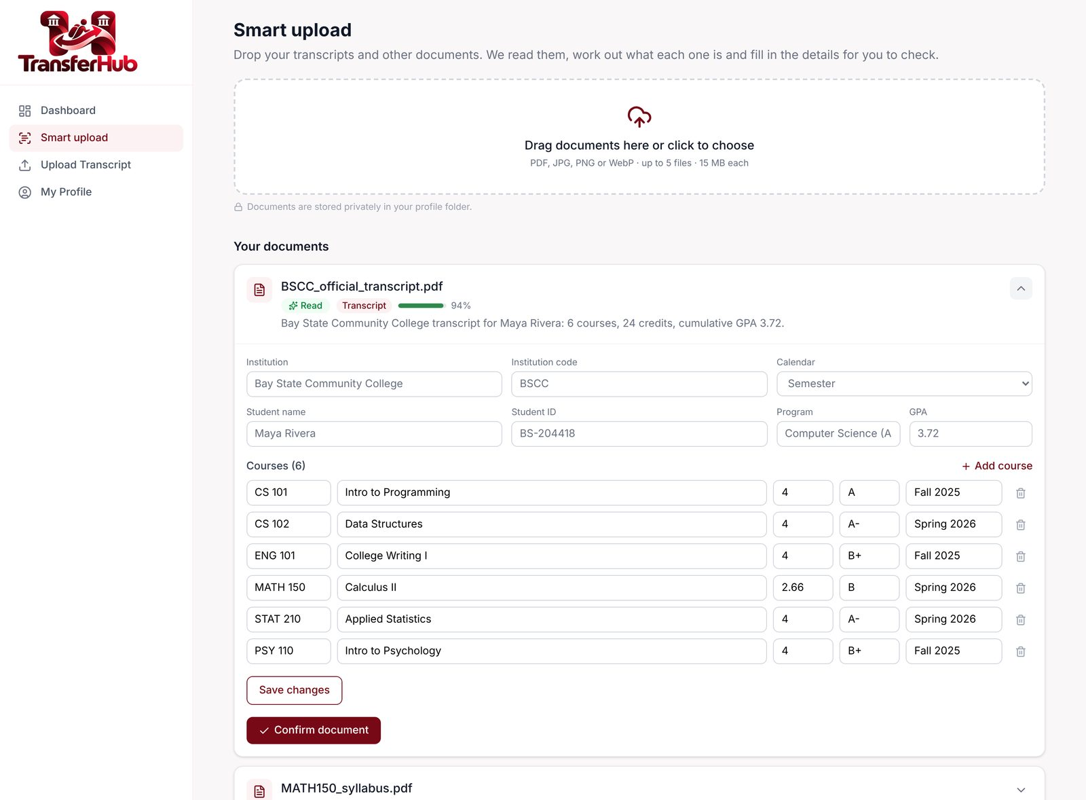




Uploading the documents
b
Student
Transcript
College, term, courses, credits, grades
ID / passport
Name, date of birth, country
English test
Test type and scores
Syllabus
Course, topics, outcomes
Also checks the profile. A transcript from a college that does not match the profile is flagged; blanks in the profile (GPA, prior college, country) are filled.
Notes:
Smart Upload: drop PDFs or photos (or use the phone camera). Each file is classified and read; the student checks and confirms. Without an AI key the built-in rules reader does it, at lower confidence.

Slide 5




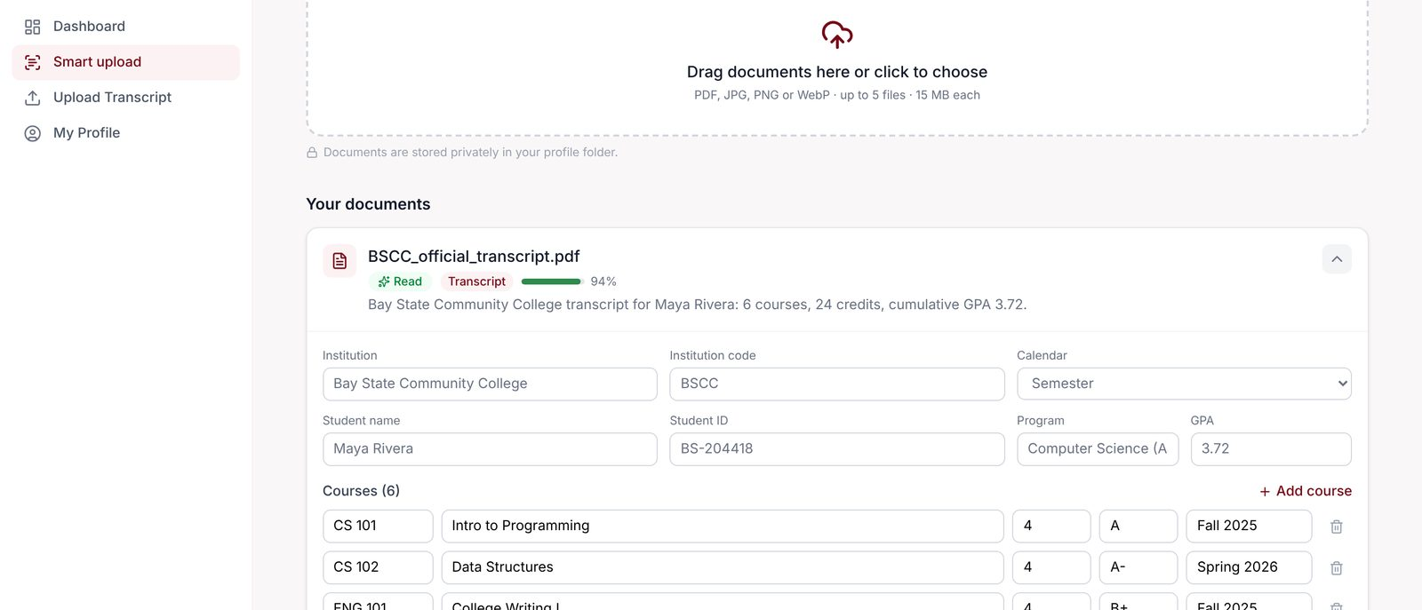
Auto-capture into the transfer request
c
Student
Transcript read
Courses extracted
"Use these courses"
Request pre-filled
Smart Upload, confirmed by the student
Code, title, credits, grade, term
One click on Submit Transcript
Source college + every course row
Then the student only chooses
University to transfer to (from the profile target)
Program to join, with its credits and course count
Optional syllabus or catalogue link per course
Notes:
On Submit Transcript the student picks "Use these courses" from a transcript Smart Upload already read. Nothing is retyped. Target university and program are pre-selected from the profile; each program shows its credits.

Slide 6
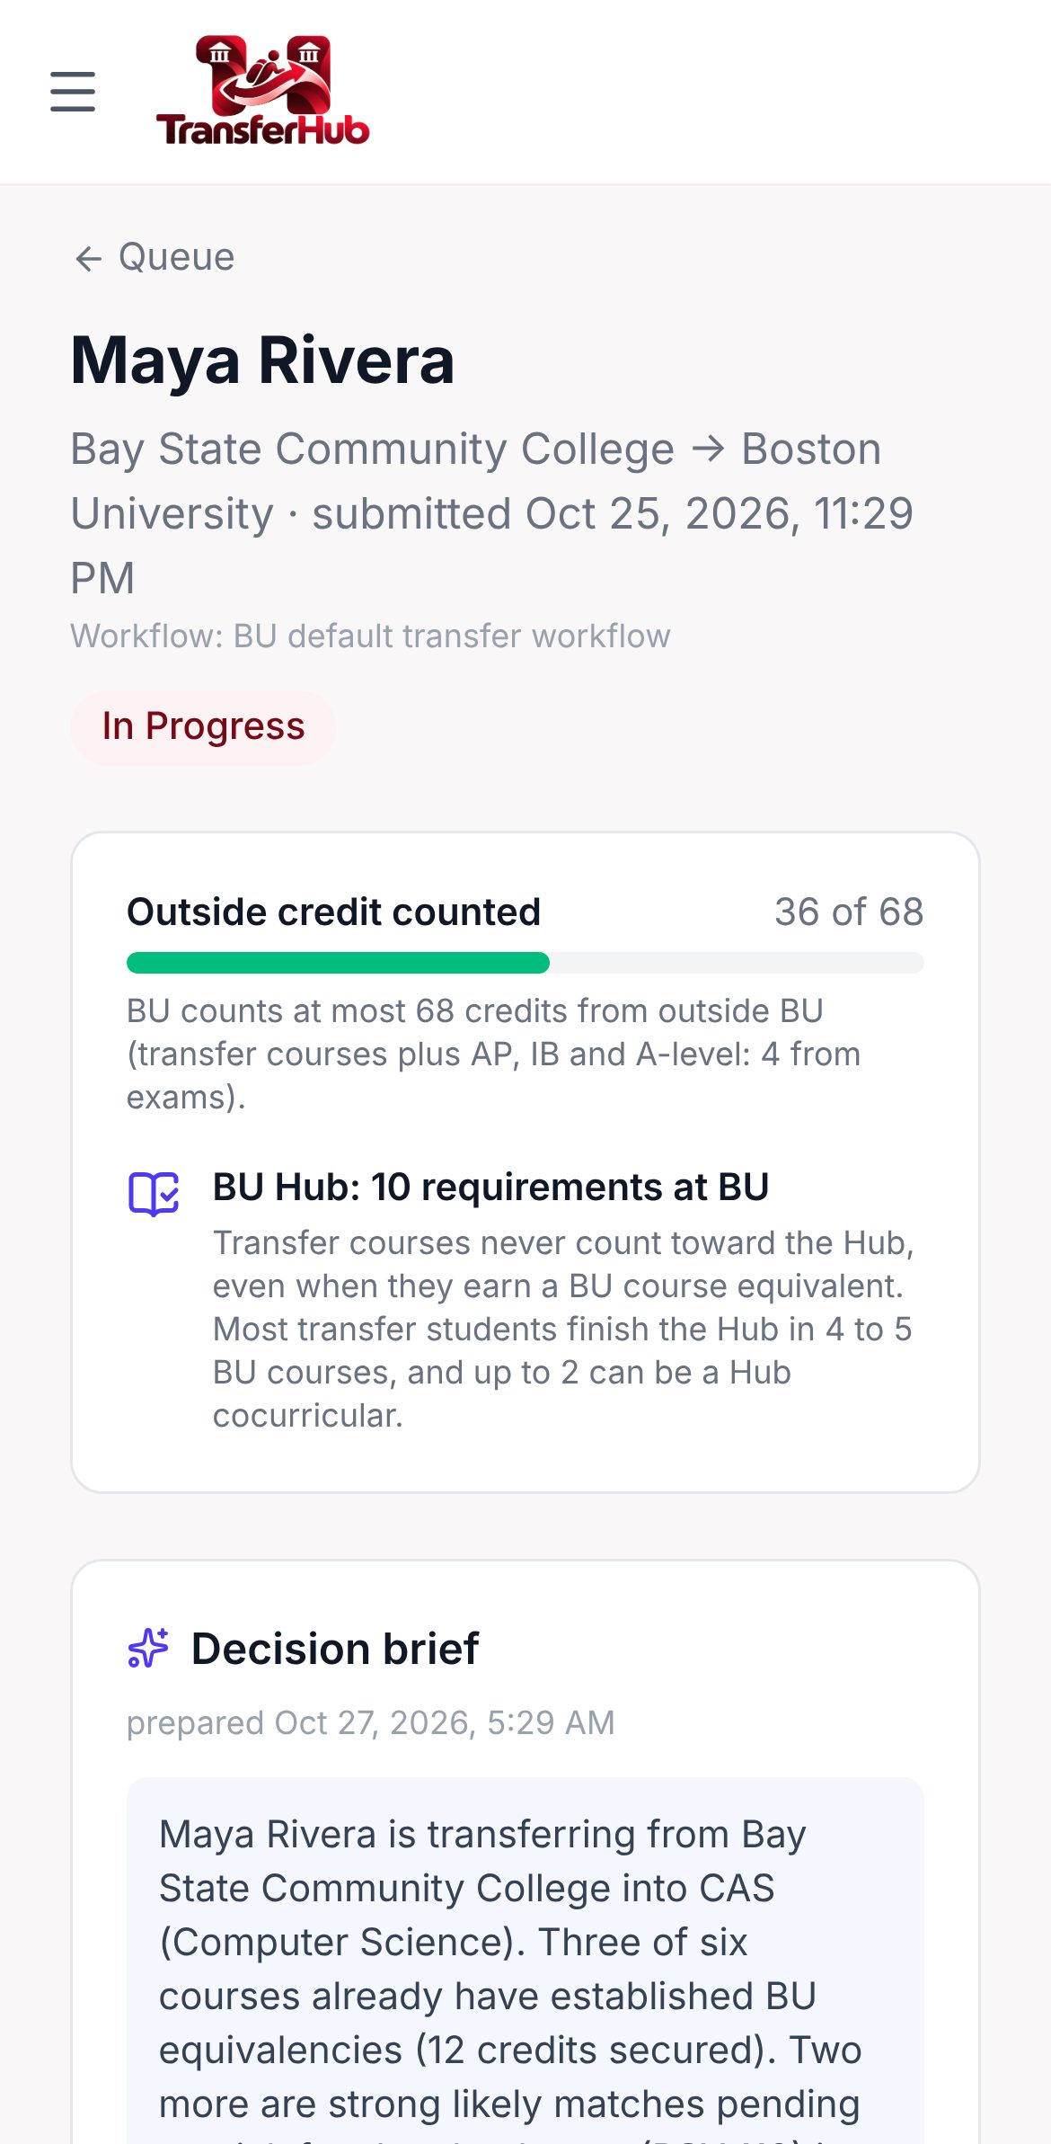
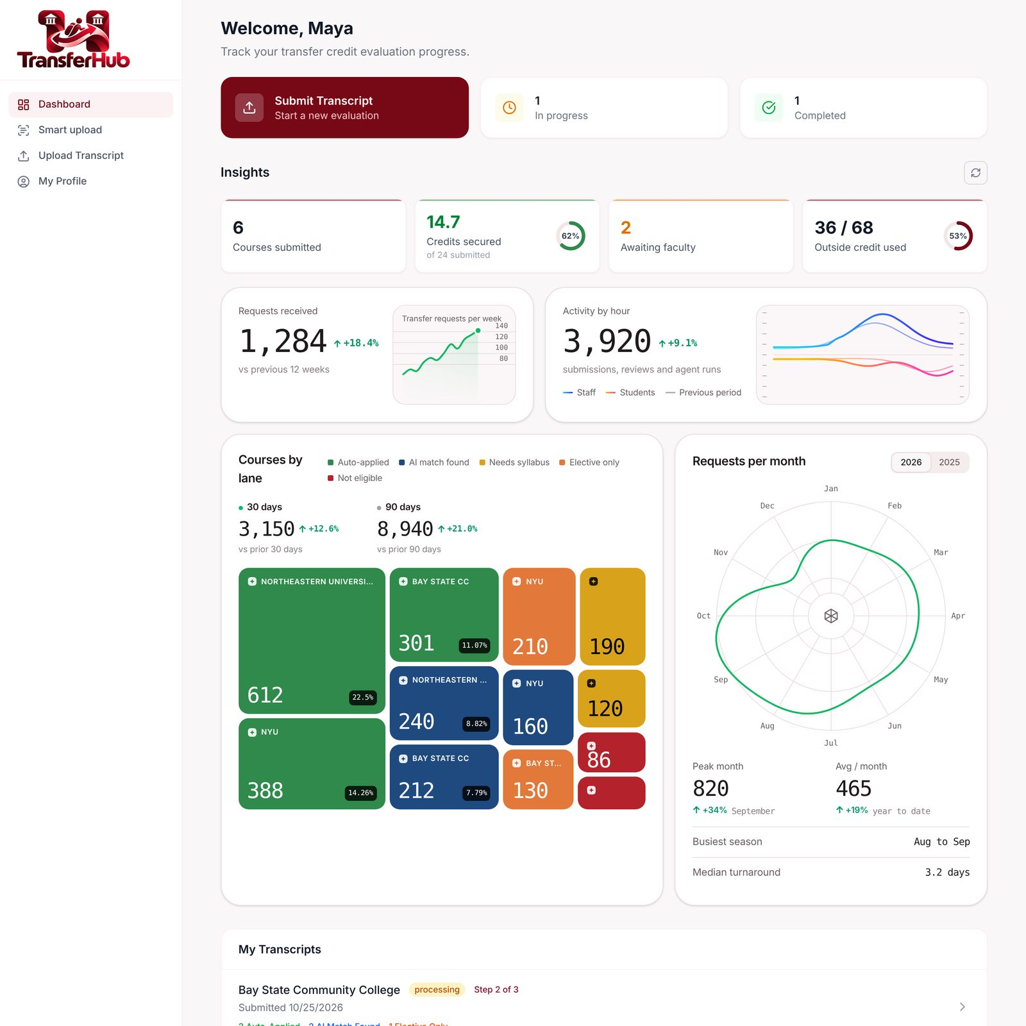
Ready to submit for transfer
d
Student
Triage lanes at upload
Applied, likely, needs syllabus, not eligible: per course, not "0 units".
Top-3 suggestions
Each pending course shows the ranked BU candidates with a reason.
Live tracker
Which stage, who owns it, notes beside it. Updates without reload.
From → To credits
Degree progress: secure, likely, pending, not counted against the cap.
Notes:
On submit every course is triaged at once (sp_TriageCourse + the BU policy engine). The student watches a live tracker (server-sent events) with notes beside each step.

Slide 7
What triage does with Maya's six courses
d
Student
External course
Lane
What the student sees
CSC 110 Intro to Programming
Applied
BU CAS CS 111 · 4 cr
MAT 210 Calculus I
Applied
BU CAS MA 123 · 4 cr
ECO 101 Microeconomics
Applied
BU CAS EC 101 · 3 cr as taken
CSC 220 Data Structures
Likely match
CS 112 ranked first · CS dept decides
CSC 240 Discrete Math
Needs syllabus
CS 131 or MA 293 · evaluator picks
CIS 150 Linear Algebra (quarter)
4 qtr → 2.66 cr
vs MA 242 (4) · evaluator decides
11 credits secure the moment she submits (4 + 4 + 3); every pending course has a named next step.
Notes:
Three known equivalencies apply instantly. Two go to the CS department with ranked suggestions. The quarter course is converted 4 x 2/3 = 2.66.

Slide 8
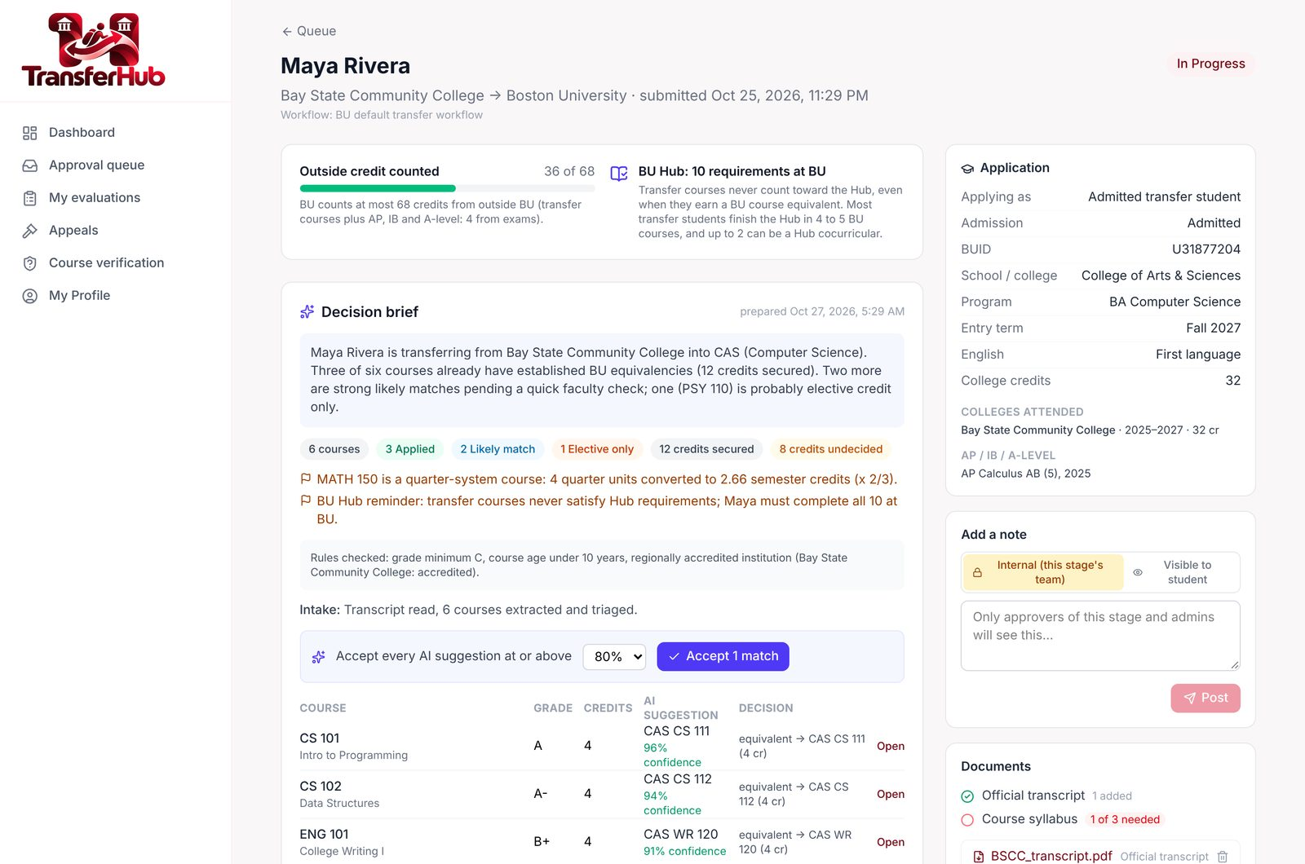
Approval: the evaluator workbench
e
Faculty / Admin
Side-by-side compare
Syllabus topics next to the BU course, shared terms highlighted, overlap % and credit math.
Decide in one click
Equivalent, elective, no credit or "must take at BU". Accept every suggestion ≥ X% at once.
Department decides
AI and rules never reject. Admins see only their university; outgoing requests are read-only.
Notes:
Sign in as faculty (one-click demo login), open the Approval queue, the Bay State request, Faculty review stage. Compare CSC 220 with CAS CS 112 and decide.

Slide 9



Each decision makes the next one faster
e
Faculty / Admin
Where the system learns
Equivalencies table: every approved decision, with start and end dates
Cross-student match cache: the same external course is never matched twice
Learned skills: mined from faculty overrides and repeated elective / no-credit choices
Playbook skills: editable instructions sent to whichever AI provider is active
Nothing is automatic: a person adds each learned rule
1 Faculty decides
2 Equivalency saved
CSC 220 = CAS CS 112, 4 cr
Reusable, with effective dates
4 Skills learn
3 Next student: instant
Overrides become suggested playbook rules (AI Controls → Learning)
Noah Chen's CSC 220 is applied, no review
Notes:
Press "Add second student" on the Demo scenario page: Noah Chen, also CSC 220 from Bay State, is applied automatically with no review. AI Controls > Learning turns repeated faculty corrections into suggested playbook rules; an admin adds them with a click.

Slide 10
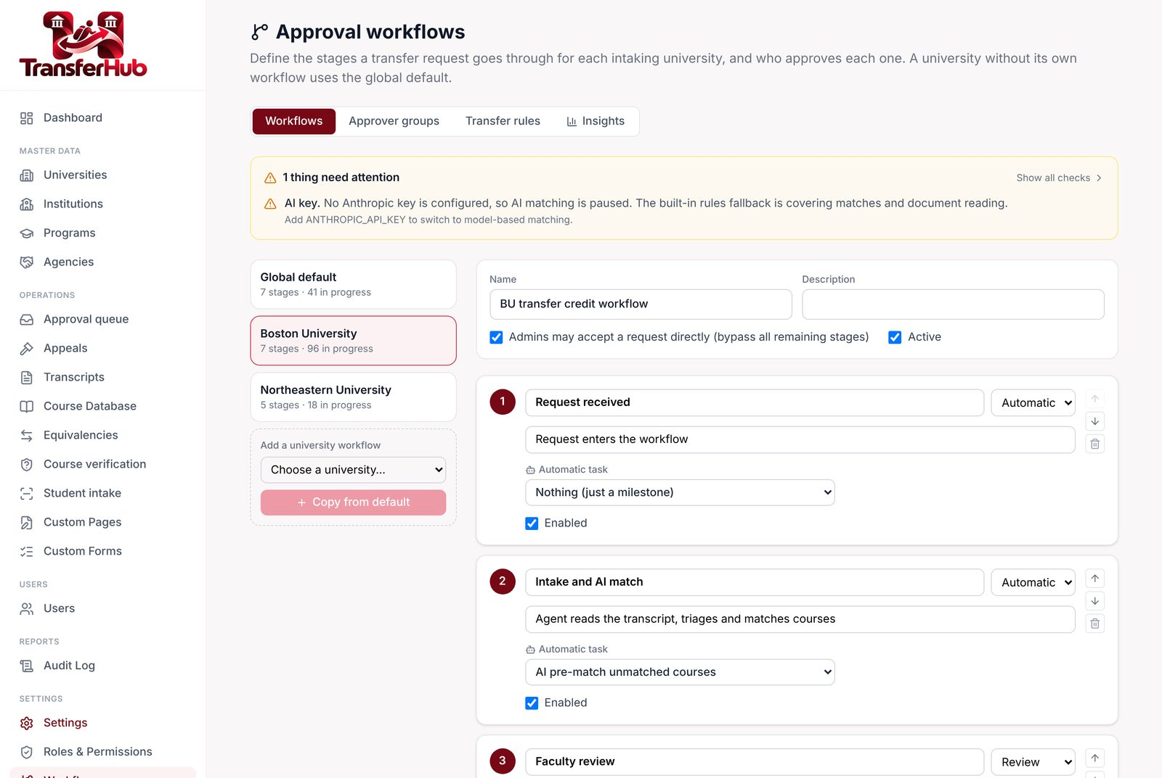





Workflow stages you can configure
f
Admin
Stages
System, review or approval; agent task per stage
Approver groups
Role, group or person; per university
SLAs
Overdue stages escalate once, by email
Auto-approve
Accept suggestions ≥ a threshold; never rejects
Bypass
Skip one stage, or accept the whole request
Notes:
Workflows (super admin settings, or /admin/workflows). The default: request received → intake and AI match → faculty review → finance → first approver → final approver → completed. Each university can copy it and change it.

Slide 11
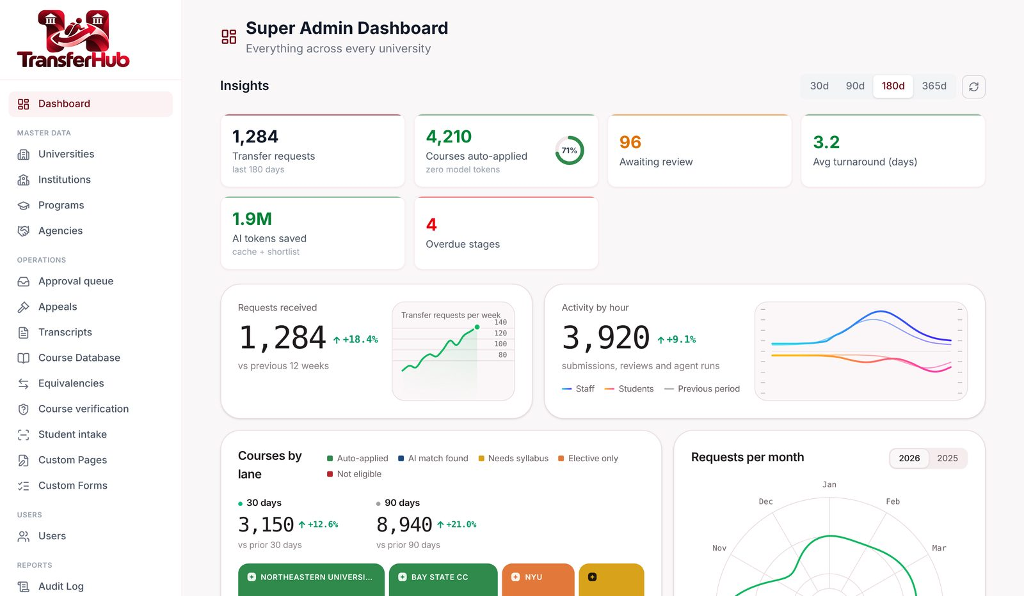
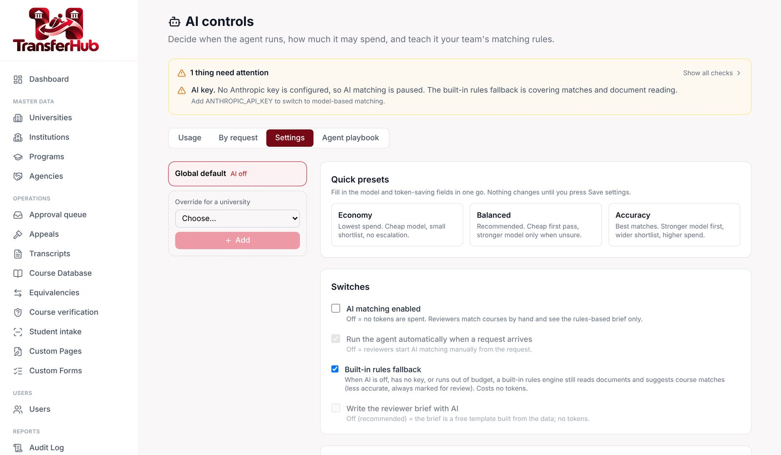
AI stats for the Super Admin
g
Super admin
Dashboard: operations and AI agents, kept apart
AI Controls: usage, $ by request, settings, playbook
Spent this month
$ spent by request
Efficiency
Speed
against a monthly budget meter
matching · documents · briefs
tokens avoided, cache hits, calls skipped
average and slowest response
Notes:
Super admin dashboard: an "AI agents" block sits under Transfer operations, separate from the regular counts. AI Controls shows the same numbers in detail: spent this month, $ spent by request (matching / documents / briefs), tokens avoided, cache hits, response times. No AI key yet, so live AI spend is zero; the rules engine is logged at no cost.

Slide 12






The team behind TransferHub
Raghuram Raichooti
Sankara Varaprasad
Swetha Katkkoori
Harshil Shah Parimal
Shravani Bollu
Microsoft practice
UI practice
Microsoft practice
UI practice
UI practice
Emp. ID 3869
Emp. ID 801
Emp. ID 4126
Emp. ID 2458
Emp. ID 2473
rraichooti
@evoketechnologies.com
skvenkobarao
@evoketechnologies.com
skatkkoori
@evoketechnologies.com
hparimal
@evoketechnologies.com
sbollu
@evoketechnologies.com
Clopay CodeCrafters · Evoke FDE AI Hackathon 5.0 · Problem 1
Notes:
Clopay CodeCrafters: two Microsoft-practice and three UI-practice engineers from Evoke Technologies.

Slide 13


Faster for evaluators. Clearer for students. The department still decides.
Source code
https://github.com/Evoke-Hackathon-2026/Clopay-CodeCrafters
Live site
https://transferhub.wcubeprojects.in/
Clopay CodeCrafters
Notes:
Invite questions. Repo and live site on screen.

