Slide 1


Smarter Transfer Credit Evaluation
From "0 units" and weeks of waiting to a clear status for every course, on the day a student submits.
Clopay CodeCrafters · Evoke FDE AI Hackathon 5.0 · Problem 1 · Boston University
https://transferhub.wcubeprojects.in/
Notes:
One-line promise: faster for evaluators, clearer for students, and the department still decides.

Slide 2
Every course, every student, one syllabus at a time
800+
0 units
1 by 1
1 year
transfer students a year at BU
shown for every pending course
manual syllabus comparisons
to settle all transfer credit
Root causes
The "maybe" path is manual
Evaluator time goes into lookups and side-by-side reading.
Status is binary and late
Students cannot plan registration or graduation.
Evidence falls on the student
Old syllabi are chased even when they would not change the outcome.
Decisions are not reused
The same external course is compared again for every student.
Notes:
BU takes 800+ transfers a year. Courses without an equivalency show 0 units, students chase syllabi, evaluators compare by hand. All credit must be settled within one year of starting.

Slide 3





Five kinds of user, one source of truth
Maya
Dan
Dr. Lee
Partner
Owner
Transfer student
Credit evaluation staff
Department evaluator
Agency or college
Platform owner
student
admin
faculty
agency
super_admin
Know which credits are secure, what to do, and by when.
Clean queue, fast lookups, little chasing. Scoped to his university.
All evidence in one place; consistent with past decisions.
Submit students and catalogues in bulk; see outcomes.
Configure universities, workflows, AI, roles; see cost and throughput.
Hard constraint. Academic departments make the final decision. The system ranks, pre-fills, explains and routes; it never rejects on its own.
Notes:
Personas from DISCOVERY.md. Custom roles are built on one of the base roles with their own permission grants.

Slide 4




What they asked for, and what we built
Faster
Every course triaged into a lane at upload. Known equivalencies apply instantly. The rest arrive pre-ranked with reasons. Decisions feed back so the next student is instant.
More transparent
Per-course status, a live tracker with notes beside each step, From → To credits and degree progress replace "0 units".
Less stressful
Syllabi asked for only where they matter. Documents are read for the student. Applicants get a preview before admission.
Department decides
Configurable approval stages. AI and rules never reject; rules confidence is capped at 70%; auto-approve is opt-in per stage.
Notes:
Four tests in the brief. Each has a concrete feature you can click.

Slide 5
How it works
One pipeline from a student's documents to posted credit
Notes:
Section: solution and architecture.

Slide 6






One pipeline from upload to posting
Upload
Rules
Equivalency
Match
People
Posted
Documents read, courses captured
Grade, credits, age, caps, Hub
Known match applies at once
AI or built-in rules rank top 3
Faculty to final approver
Student and source notified
Every course lands in a lane the student can see
Applied
Likely match
Needs syllabus
Elective only
Not eligible
International
The learning loop. Every approved decision is saved as a reusable equivalency with effective dates, and match results are cached across students.
Notes:
Rules first, then known equivalencies, then AI or built-in rules, then the people.

Slide 7




Architecture: one Node app on Azure
Browser and phone
Azure App Service (Linux, Node 20)
Azure SQL
React 19 SPA Vite, Tailwind, TanStack Query
sp_TriageCourse, sp_RecordDecision, 33 migrations
Student
Faculty
Azure Blob Storage
NestJS API JWT, permission matrix, Swagger
Private documents, public logos
Admin
Workflow engine
Policy engine
Agency
Resend
AI service
Document reader
Branded, editable emails
Super admin
Live events (SSE)
Partner API
Partner API (key)
AI providers
Exchange
Rules fallback
Claude · Azure OpenAI · custom · Azure DI
GitHub Actions builds and deploys on every push to main
Notes:
Single Azure App Service serves the React SPA and the NestJS API. Azure SQL holds data and the two core stored procedures; Blob holds documents; Resend sends email; AI providers are pluggable with a zero-token fallback.

Slide 8
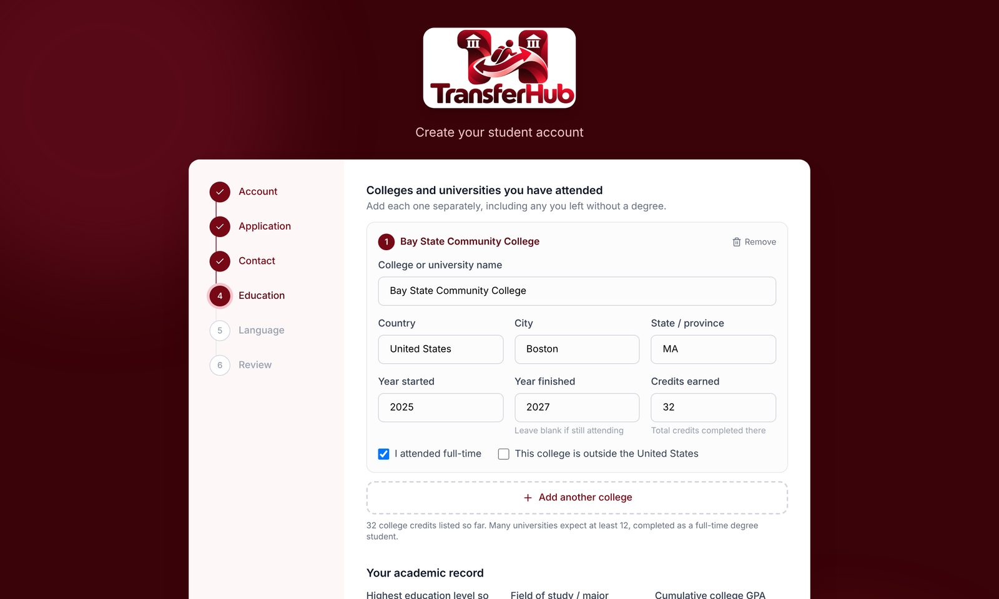
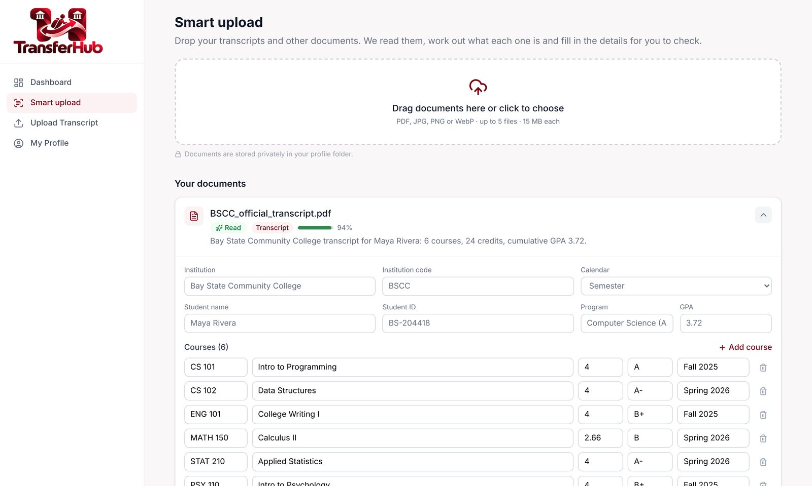
Students: register, then let the documents do the typing
Six-step registration
Account, application, contact, every college + AP / IB / A-level, language, review.
Smart Upload
Classify and extract from PDFs and photos; phone camera capture; scan view highlights each value.
Five ways in
Self-register, claim link, QR code, registrar profile, agency bulk API.
Notes:
Six-step registration aligned with BU policy, plus admin-defined Custom Form steps. Smart Upload reads transcripts, IDs, English tests and syllabi, fills profile blanks and flags a college that does not match.

Slide 9

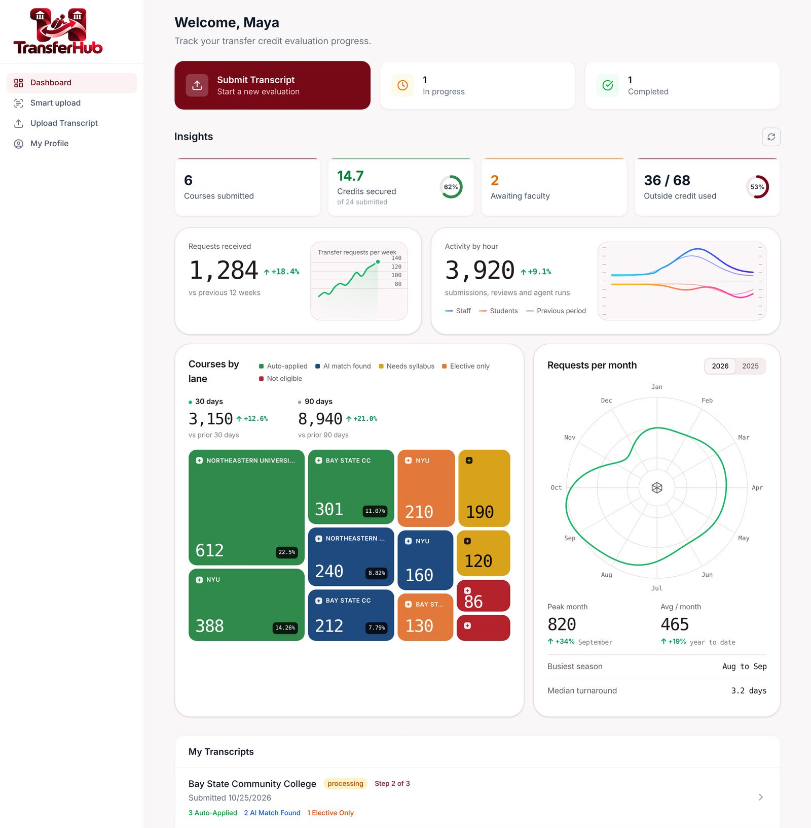
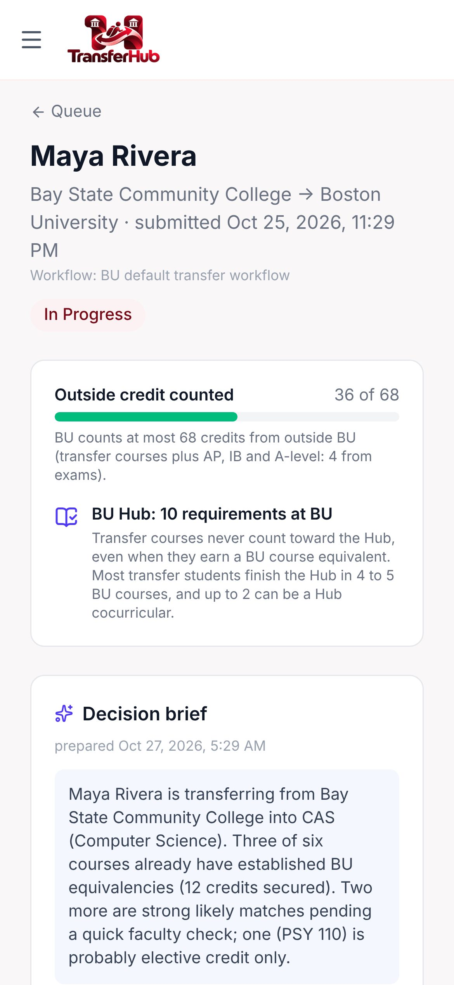




Students: submit once, then watch it move
No retyping
Courses from the read transcript; target university + program.
Live tracker
Stage, owner, notes beside each step; no reload.
Degree progress
Secure, likely, pending, not counted vs the cap.
Explore
Compare up to 3 universities, then apply.
Stay in control
Edit pending courses, appeal, cancel.
Notes:
Courses captured from Smart Upload, target university and program chosen with their credits, live tracker by server-sent events, degree progress, Explore and compare up to three universities.

Slide 10
The six-course story, upload to posting
External course
Lane
What the student sees
CSC 110 Intro to Programming
Applied
BU CAS CS 111 · 4 cr
MAT 210 Calculus I
Applied
BU CAS MA 123 · 4 cr
ECO 101 Microeconomics
Applied
BU CAS EC 101 · 3 cr as taken
CSC 220 Data Structures
Likely match
CS 112 ranked first · CS dept decides
CSC 240 Discrete Math
Needs syllabus
CS 131 or MA 293 · evaluator picks
CIS 150 Linear Algebra (quarter)
4 qtr → 2.66 cr
vs MA 242 (4) · evaluator decides
11 credits secure at upload (4 + 4 + 3); three pending courses, each with a named next step.
Notes:
Maya Rivera, Bay State Community College (semester) and Pioneer Valley Technical College (quarter). Three known, two maybe, one quarter course converted 4 x 2/3 = 2.66.

Slide 11
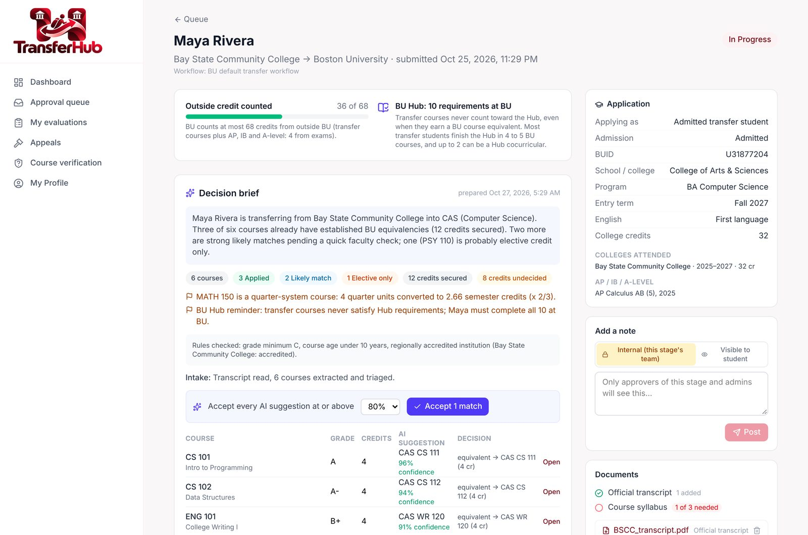
Evaluators: everything in one place
Decision brief
Policy flags, credit math and the Hub rule, for every stage a reviewer can see.
Side-by-side compare
Shared topics highlighted, overlap %, credit math, candidates 1 to 3.
One click or bulk
Accept all suggestions ≥ X%; approve clean requests from the queue.
Scoped and safe
Staff see their university; outgoing requests are read-only.
Notes:
Request review: decision brief, timeline, ranked suggestions with reasons, side-by-side compare with credit math, accept all above a threshold, bulk approve in the queue.

Slide 12


Each decision makes the next one faster
Beyond one university
Cross-student match cache: one external course, one model call
Equivalency network: anonymised history from other universities, optional confidence boost (off by default)
Learning tab: weekly agreement, top-3 rate and recurring mistakes
A person adds every learned rule; nothing changes on its own
1 Faculty decides
2 Equivalency saved
Equivalent, elective, no credit or BU-only
With effective dates; one-to-many supported
4 Skills learn
3 Next student: instant
Overrides become suggested playbook rules
Known match applies at triage, no review
Notes:
Decide CSC 220 for Maya; the second Bay State student with CSC 220 is applied automatically. Learned skills are suggestions only.

Slide 13

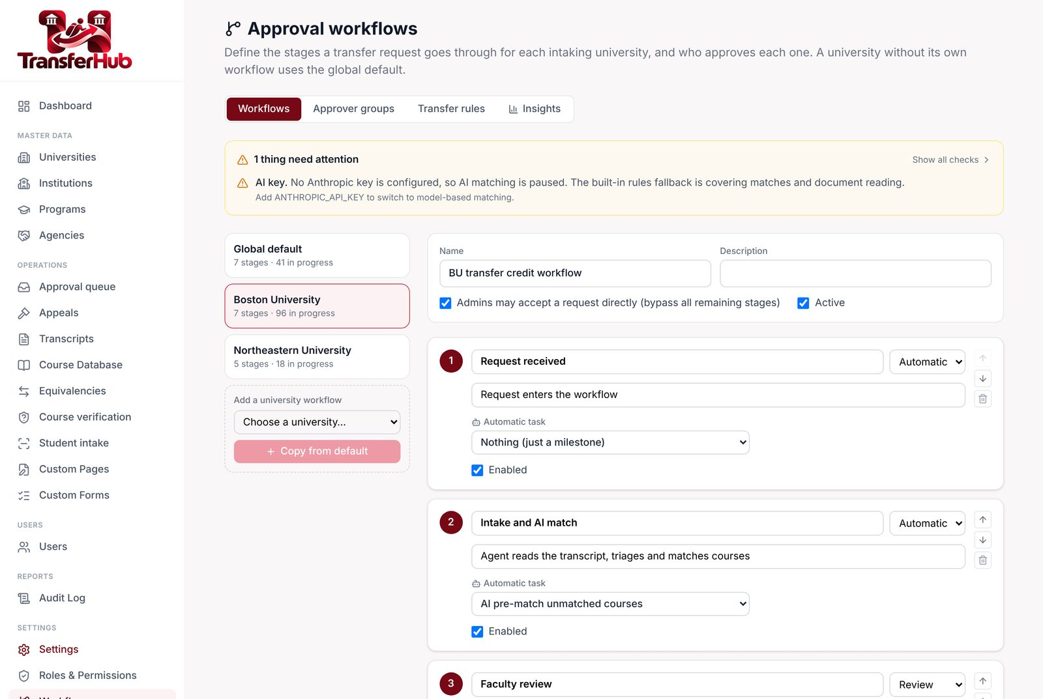


A workflow per university, designed not coded
Stages
System, review or approval; agent task per stage.
Approver groups
Role, group or person, per university.
SLAs
Overdue stages escalate once by email.
Auto-approve
Accept suggestions ≥ a threshold; never rejects.
Bypass and notes
Skip a stage; internal vs student notes.
Notes:
Default: received → intake and AI match → faculty → finance → first approver → final approver → completed. Copy per university; approver groups are cloned with the university code.

Slide 14







BU's published rules, enforced and explained
Credit cap
Per applicant type (68 for transfers), including AP, IB and A-level
Grades
C or better; P/F and S/U go to review, with the Spring 2020 exception
Age and accreditation
Old or unaccredited coursework goes to review
Not eligible
Internships, research, military and life experience
International
Outside-US coursework routed to International Admissions
Quarter credits
× 2/3, truncated: 4 quarter = 2.66 semester
Programme rules
12 BU rules, e.g. Econ at most 4 courses at 200+
One-year deadline
Reminders at 90 / 30 / 7 days, then review
Notes:
TransferPolicyService runs after sp_TriageCourse and only tightens lanes. Flags are shown to both the student and the reviewer. Thresholds are per university.

Slide 15
AI, on a leash
It ranks and reads. People decide. It keeps working when it is off.
Notes:
Section: AI approach and controls.

Slide 16
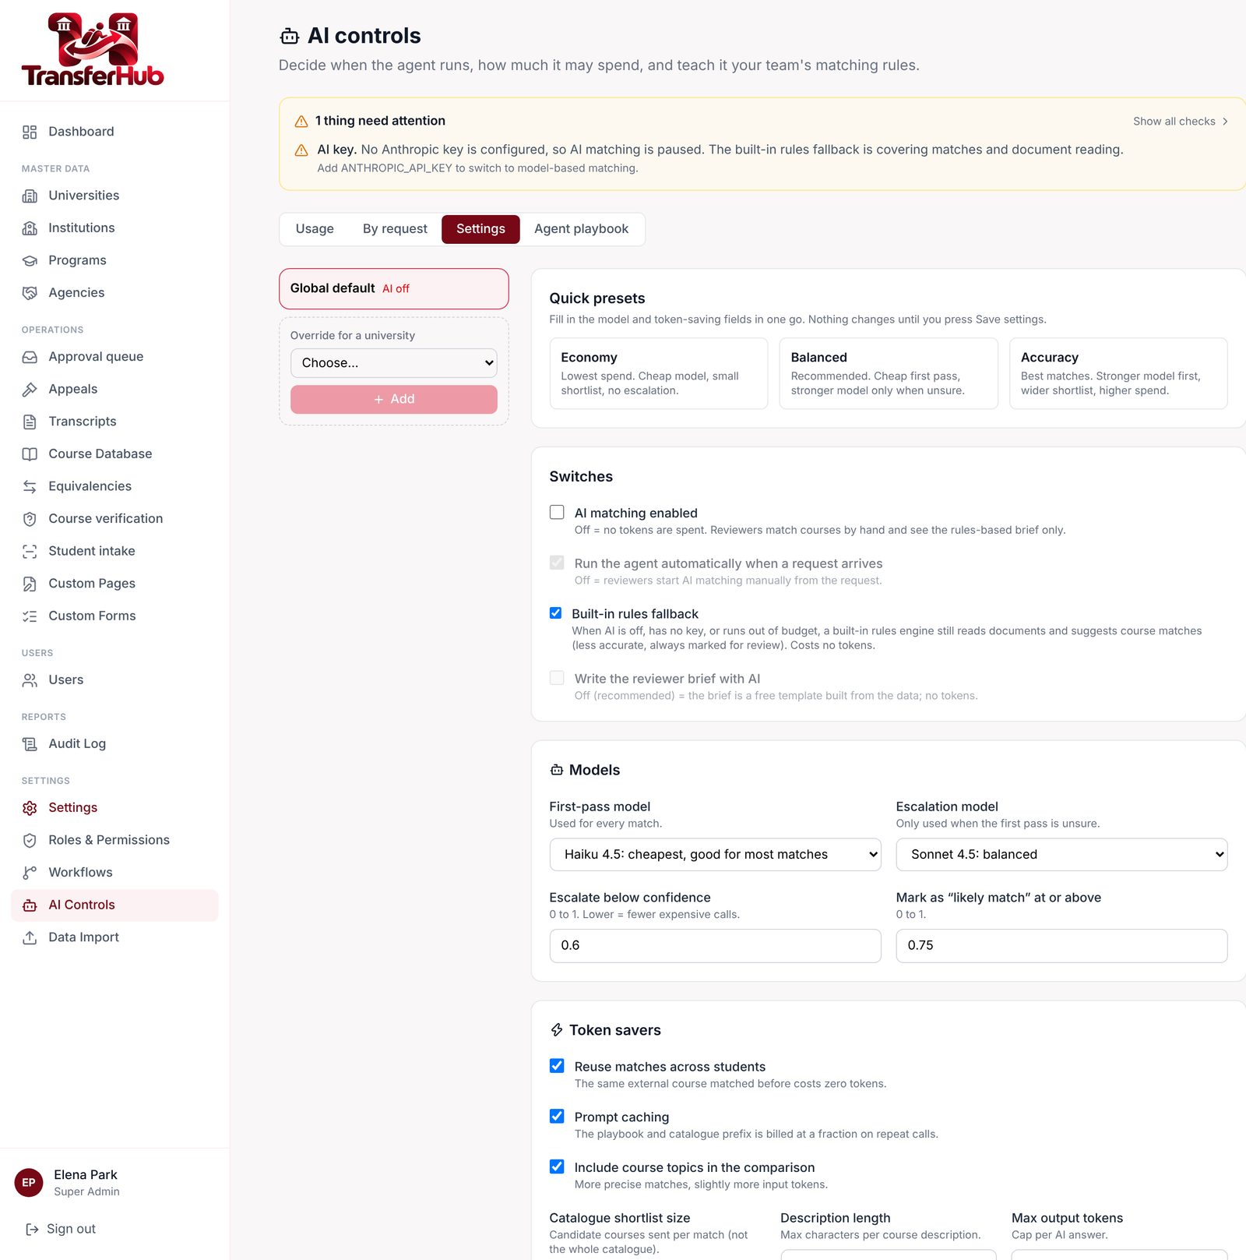
AI that keeps working when AI is off
1
AI provider
Claude (direct API), Azure OpenAI or any OpenAI-compatible service for matching; Azure Document Intelligence for reading. Cheap model first, escalates only when unsure.
2
Built-in rules
Zero tokens. Reads text PDFs, classifies, extracts fields; ranks courses by title, topics, code and credits. Confidence capped at 70%, so it never auto-approves at default thresholds.
3
Human
Faculty and students can edit or override every result. Nothing is ever auto-rejected.
Honest status: no Anthropic key yet, so the AI paths are built but not verified live. The rules engine runs every AI step today.
Notes:
Order: AI if a provider is set up, switched on and within budget; else the built-in rules if the fallback is on; else paused. A person can always override.

Slide 17
Cheap to run, and every dollar is visible
1
Lexical shortlist
Catalogue ranked locally; only top N sent
What the super admin sees
Dashboard "AI agents" block, separate from transfer operations
AI Controls → Usage: tokens, cost, tokens avoided, cache hits, response times, by model
"$ Spent by request": matching, documents and briefs split
Spent this month against a budget meter
Providers: switch Claude, Azure OpenAI or a custom service; test the connection
Benchmark: dry-run every ready engine on real students; Learning: agreement trend
Playbook skills: editable instructions per agent
2
Cross-student cache
Same course, one model call
3
Cheap model first
Escalate only when unsure
4
Prompt caching
Playbook reused across calls
5
Budgets
Monthly and per-request caps, then rules
Notes:
Shortlist is lexical and free; cache means one call per external course; budgets fall back to rules. Super admin sees AI spend separately from operations.

Slide 18
Measured, not claimed
96.8%
88.9%
63
right BU course in the top 3
right BU course ranked first
held-out past decisions
Matcher Built-in rules matcher (zero tokens). No AI accuracy is claimed: the AI matcher has not run live yet.
Live smoke test 39 of 40 HTTP checks pass on the deployed app, 1 write check skipped, 0 failed.
Database checks 243 SQL smoke checks and all 11 triage contract cases pass, including the 2.66 quarter rule.
Notes:
Backtest: for each of 63 past decisions, hide it from the matcher and ask whether the right BU course is in its top 1 or top 3. Built-in rules only, no AI key. The same harness will score the AI matcher once a key exists.

Slide 19
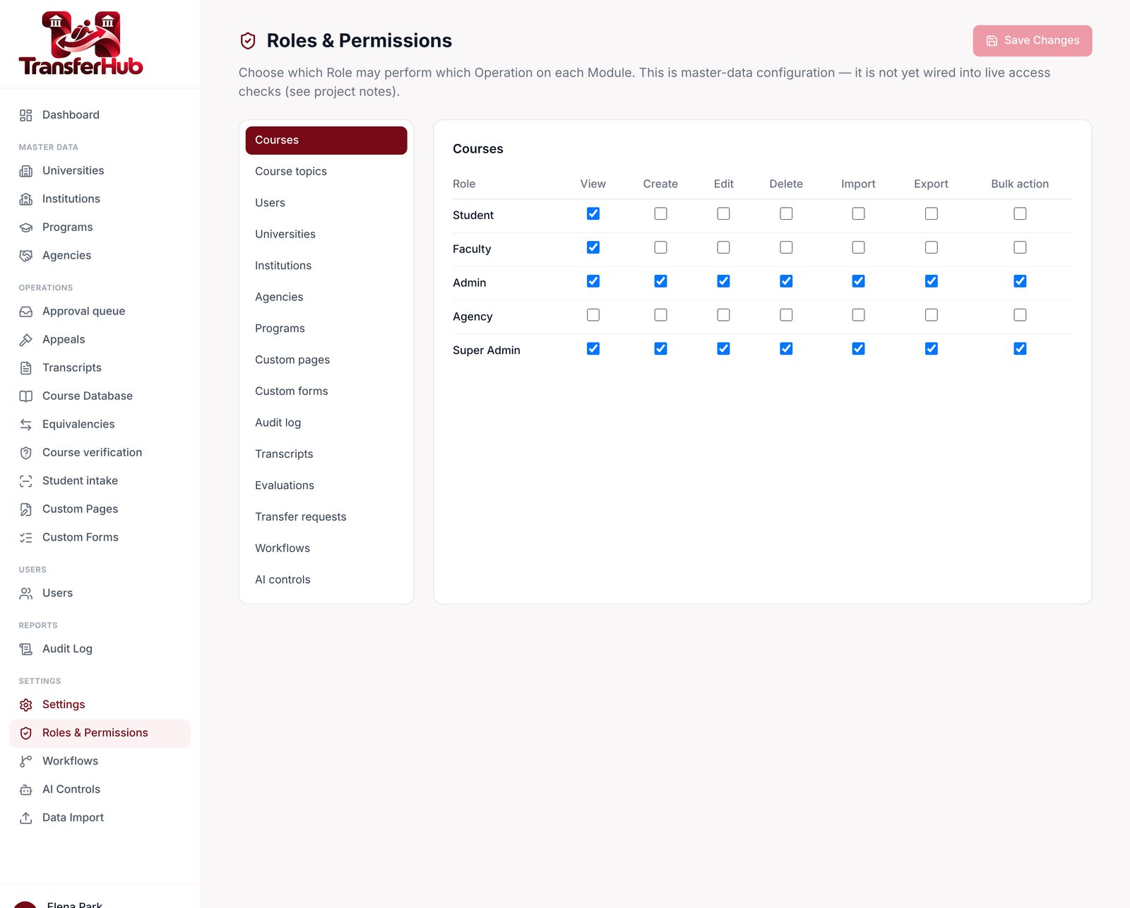
Roles and permissions, changed without a deploy
Registers, uploads, submits, tracks, appeals
student
Department evaluator; decides at review stages
faculty
Credit evaluation staff, scoped to a university
admin
Partner agency; submits for its students
agency
Platform owner: data, workflows, AI, roles
super_admin
Built on a base role, with its own grants
custom
Notes:
Role × module × operation matrix, enforced on every change endpoint with a 30-second cache. Custom roles sit on a base role with their own grants. Staff are scoped to their universities; super admins are invisible to admins.

Slide 20
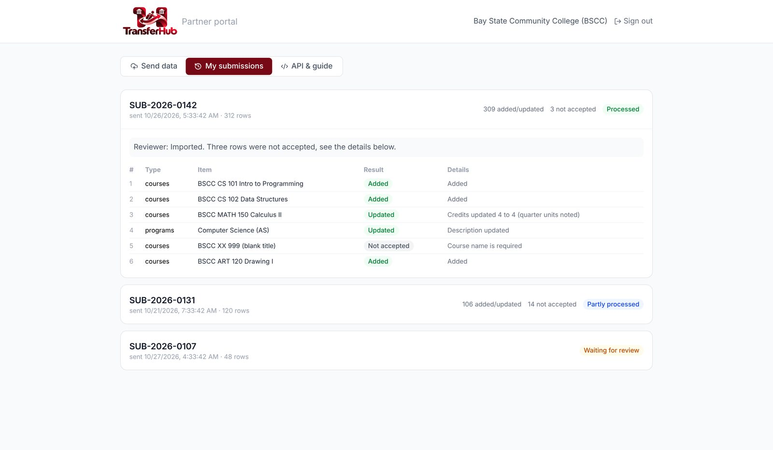
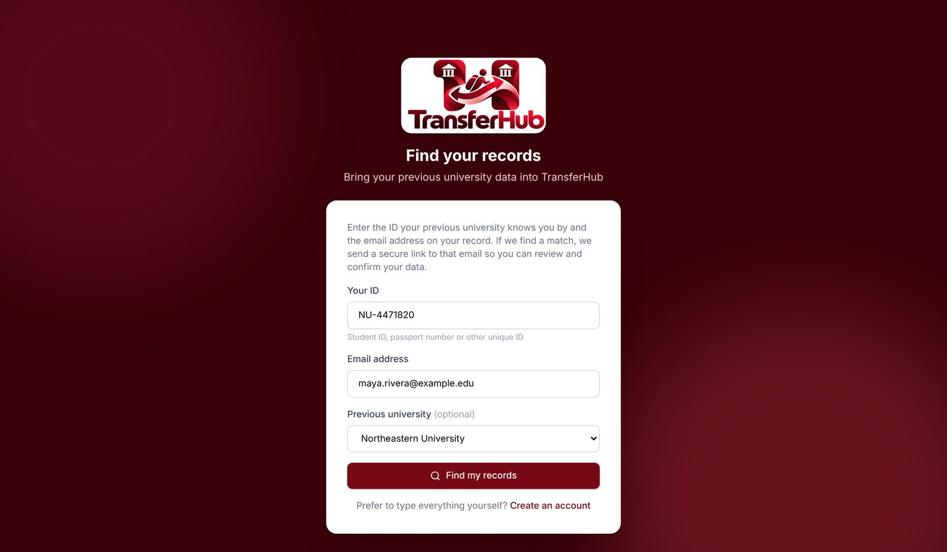



Data in from everywhere, checked before it lands
Partner portal: universities, programs, courses, topics, students
Intake: ID or passport + email, then a claim link
Self-register
Claim link
QR code
Registrar profile
Agency bulk API
Notes:
Partner API with hashed keys and a review queue; partner portal with Excel templates; student intake by claim link where the account exists only after the student confirms.

Slide 21


Built as a platform, not a prototype
Multi-university
University exchange
Dashboards
Universities → programs → courses → topics, shared many-to-many with per-university switches.
Source and target both see a transfer, request documents and remind each other.
Analytics for every role; live updates; mobile-ready with a PWA manifest.
Branded emails
Private documents
Repeatable demo
Every template editable by the super admin; custom templates too.
Azure Blob, one folder per student; images compressed on upload.
Reset Maya, add a second student, generate demo documents.
Notes:
Multi-university master data, exchange between universities, dashboards, emails, storage, demo tooling.

Slide 22



Tech stack
UI
React 19 · Vite · Tailwind v4 · TanStack Query · framer-motion · recharts · zustand
API
NestJS 10 · TypeScript · JWT (passport) · argon2 · Swagger · helmet · throttler
Database
Azure SQL / SQL Server via mssql + tedious · sp_TriageCourse · sp_RecordDecision · 33 idempotent migrations
Storage and email
Azure Blob Storage · Resend
AI
Anthropic Claude (direct API) · Azure OpenAI · custom OpenAI-compatible · Azure Document Intelligence · zero-token rules fallback
Hosting and CI/CD
Azure App Service (single Node app serving API + SPA) · GitHub Actions
Notes:
Everything runs as one Node app on Azure App Service; database changes are 33 idempotent numbered SQL scripts.

Slide 23
Scorecard: the brief and its rules vs. the code
Open
No requirement is left open
Partial
Faculty screen for one external course → several BU courses (API ready) · 5-credit lab rule (BU to answer)
Built
Lanes, quarter 2/3, grades, caps, Hub, appeals, workflow, learning loop, degree progress, side-by-side, programme and exam rules, one-year deadline, backtest, repeatable demo
Notes:
From GAP_ANALYSIS.md: 22 brief tests and business rules. 20 built, 2 partial (faculty screen to pick several BU courses for one external course; the 5-credit lab rule awaiting BU), 0 open.

Slide 24






The team behind TransferHub
Raghuram Raichooti
Sankara Varaprasad
Swetha Katkkoori
Harshil Shah Parimal
Shravani Bollu
Microsoft practice
UI practice
Microsoft practice
UI practice
UI practice
Emp. ID 3869
Emp. ID 801
Emp. ID 4126
Emp. ID 2458
Emp. ID 2473
rraichooti
@evoketechnologies.com
skvenkobarao
@evoketechnologies.com
skatkkoori
@evoketechnologies.com
hparimal
@evoketechnologies.com
sbollu
@evoketechnologies.com
Clopay CodeCrafters · Evoke FDE AI Hackathon 5.0 · Problem 1
Notes:
Clopay CodeCrafters: two Microsoft-practice and three UI-practice engineers from Evoke Technologies.

Slide 25
What we have not proven yet, and what comes next
Not proven yet
Next
No Anthropic key yet: AI matching and reading are built but unverified live; the rules fallback carries the demo
No BU baseline for evaluator minutes or turnaround, so time saved is not yet quantified
No API integration tests; coverage is unit scripts, an HTTP smoke suite and SQL contract tests
Exam thresholds and quarter rounding follow defaults; BU to confirm
1
Get the Anthropic key; re-run the same backtest
2
BU answers: 5-credit lab rule, exam thresholds
3
Faculty screen for one-to-many mappings
4
Measure evaluator minutes against a BU baseline
5
SIS connector; turn demo login off for launch
Notes:
No live AI key, no BU baseline numbers. Plan to close the gaps.

Slide 26


Faster for evaluators. Clearer for students. The department still decides.
Source code
https://github.com/Evoke-Hackathon-2026/Clopay-CodeCrafters
Live site
https://transferhub.wcubeprojects.in/
Clopay CodeCrafters
Notes:
Close on the promise and move to the live demo.

