Slide 1
Customer Operations — Q3 2026 Review
Quarterly business review · Thu 8 Oct 2026 · Hollin Street Energy

Slide 2
Agenda
Volume
Quality
Complaints
People
Outlook

Slide 3
Ticket Volume
Tickets received per month, all channels.

Slide 4
First-contact resolution reached 71%, above the 68% target
Metric | Q2 2026 | Q3 2026 | Target
First-contact resolution | 69% | 71% | 68%

Slide 5
Billing migration drove the September complaint spike
Complaints logged by category.
Notes:
We think the billing migration on 7 Sep is to blame, but root cause isn't confirmed yet — Ops analytics are still pulling the case codes.

Slide 6
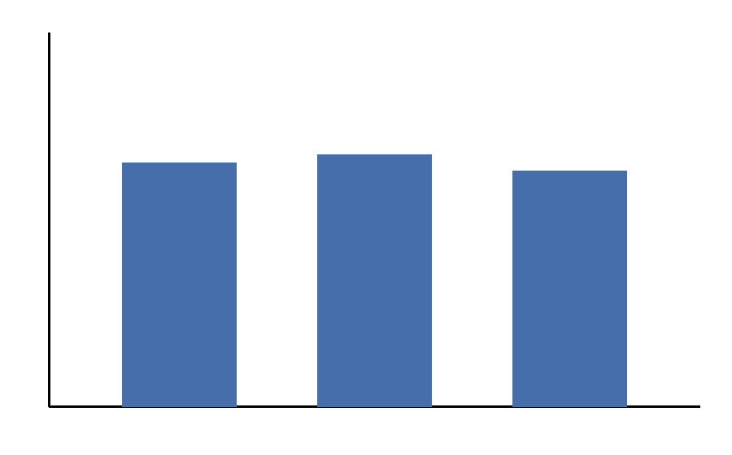
Agent Headcount
Source: WFM system export.

Slide 7
Customer Satisfaction and Cost
Metric | Q2 2026 | Q3 2026
CSAT (post-contact survey) | 82% | 79%
Cost per contact | £4.10 | £3.65

Slide 8
Strong quarter for self-service
Metric | Q2 2026 | Q3 2026
Self-service containment | 21% | 22%

Slide 9
Backlog Update
Open backlog: 4,300 tickets at end of September, against 1,900 at end of June.
Target: 2,000 open tickets by end of November — currently at risk.
Recovery plan with overtime and a temporary billing queue goes to the steering group on 15 Oct.

Slide 10
Q4 Outlook
 | Q3 2026 (actual) | Q4 2026 (forecast)
Tickets received | 61,200 | 65,000
Forecast assumes billing complaints return to August levels by mid-November.

Slide 11
Team Structure
Priya Anand
Head of Customer Ops
Tom Reyes
Billing Queue Lead
Ines Varga
Metering Queue Lead
Sam Okoro
Quality & Training
Notes:
New structure went live 1 Aug. Say that handoffs are down about 30% — numbers to follow from Sam.

Slide 12
Appendix

Slide 13
A1 · Ticket volume by channel
Channel | Jul 2026 | Aug 2026 | Sep 2026
Phone | 9,600 | 9,800 | 11,900
Chat | 5,700 | 6,100 | 8,300
Email | 3,100 | 3,200 | 3,500

Slide 14
Questions

