Slide 1
Monthly Revenue Pack
August 2026 · all figures £000s

Slide 2
Revenue by segment and region — August
Segment | Region | Value (£000s)
Enterprise | UK | 612.0
Enterprise | DACH | 301.5
Enterprise | France | 180.0
Enterprise | North | 95.0
Enterprise | Ireland | 142.8
SMB | UK | 210.4
SMB | Benelux | 88.4
SMB | DACH | 76.9
SMB | Iberia | 18.4
SMB | Malta | 1.2
Public Sector | UK | 115.6
Total |  | 1,842.2
* Malta figures exclude intercompany recharges.

Slide 3
Revenue by segment — August

Slide 4
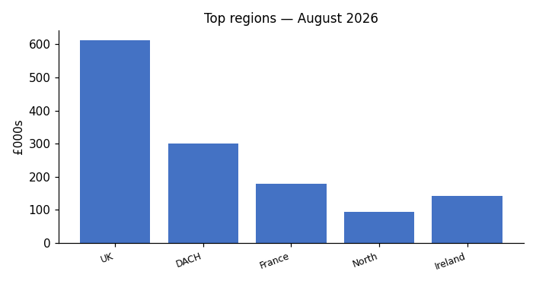
Top regions — August
Source: regional MI extract (chart supplied by Finance)

Slide 5
Commentary — August
Enterprise UK renewals weighted to the second half of the month.
SMB Benelux rate card renegotiation agreed, effective 1 September.
Iberia under review following the partner transition.

