Slide 1
Monthly Revenue Pack
September 2026 · all figures £000s

Slide 2
Revenue — top 5 lines, September
Segment | Region | Value (£000s)
Enterprise | UK | 548.1
Enterprise | DACH | 318.0
SMB | UK | 208.1
Enterprise | France | 180.0
Enterprise | Ireland | 141.9
Total (all lines) |  | 1,785.8
Top 5 lines shown; full detail in the source workbook.

Slide 3
Revenue by segment — September

Slide 4
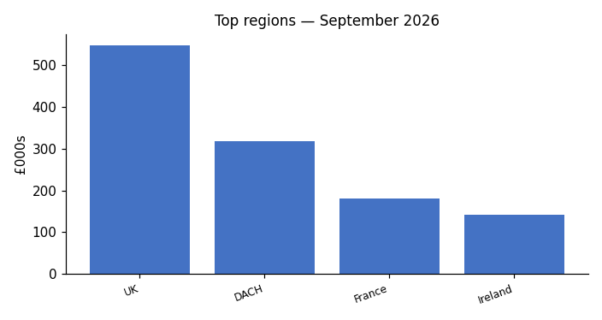
Top regions — September
Source: regional MI extract (chart supplied by Finance)

Slide 5
Commentary — September
Enterprise UK volumes down 13 units month on month; pricing held.
SMB Benelux reflects the renegotiated rate card effective 1 September.
Nordics opened as a new territory in September.

