Slide 1
Larkfield Home Services — Q3 2026 Operating Review
Board pack · Tue 13 Oct 2026

Slide 2
Agenda
Customers
Finance
Operations
Service

Slide 3
Monthly Active Users
Customers who logged in to the app at least once in the month.

Slide 4
On-time dispatch stayed above 90% every month

Slide 5
Revenue and Gross Margin

Slide 6
Open Cases by Region

Slide 7
Channels Customers Use
Customer survey, September 2026 (n = 1,240).
Q: Which of these channels have you used in the last three months? Select all that apply.

Slide 8
Churn fell through Q3

Slide 9
Marketing Spend by Region
Notes:
All figures £m, from the finance ledger.

Slide 10
Installations by Product Line, Q3 2026

Slide 11
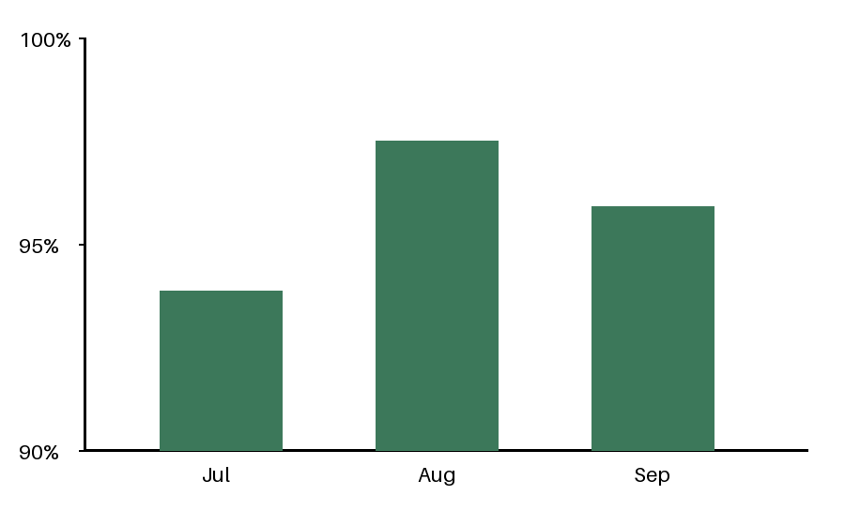
Service Availability
Chart exported from the monitoring dashboard.

Slide 12
Average Job Value

Slide 13
Chat handled the most tickets in September

Slide 14
Questions

