Slide 1




AWS AI workshop
Ranjani Nataraja Sharma

Slide 2
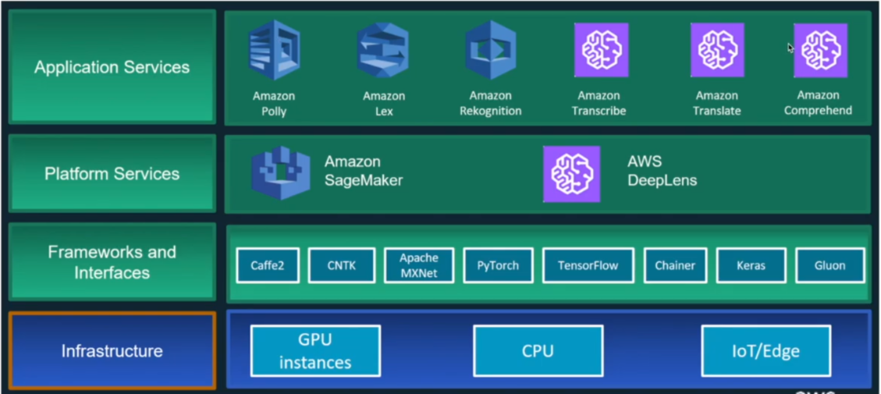

Slide 3
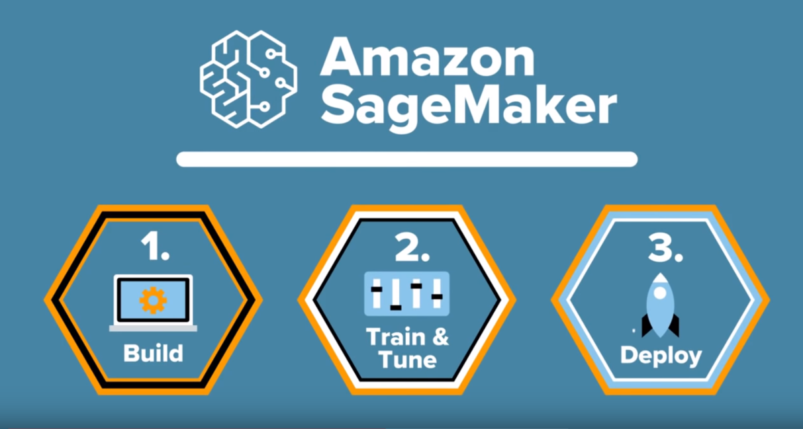

Slide 4
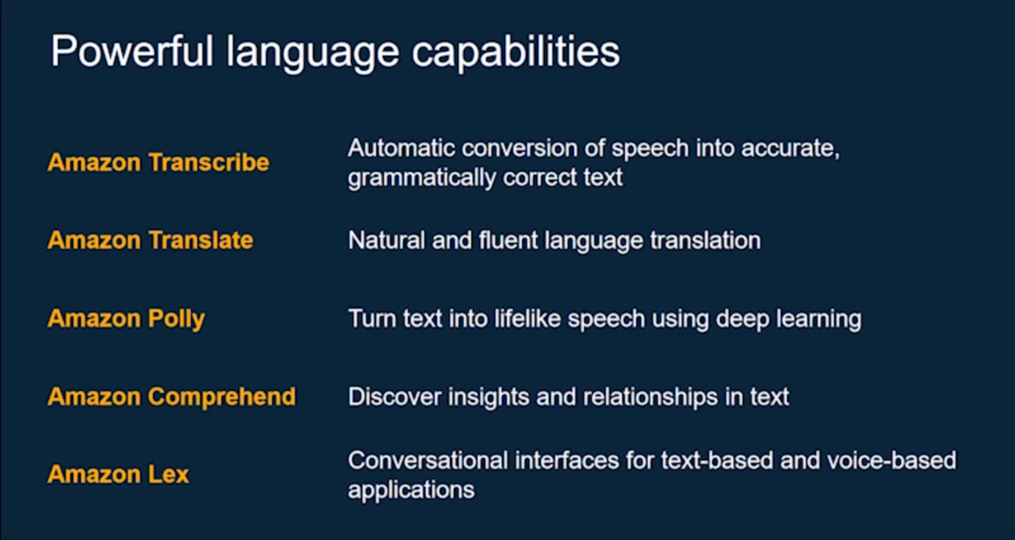
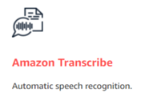
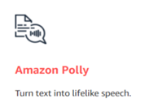
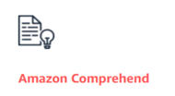
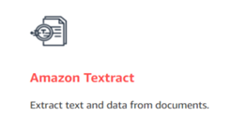


Slide 5

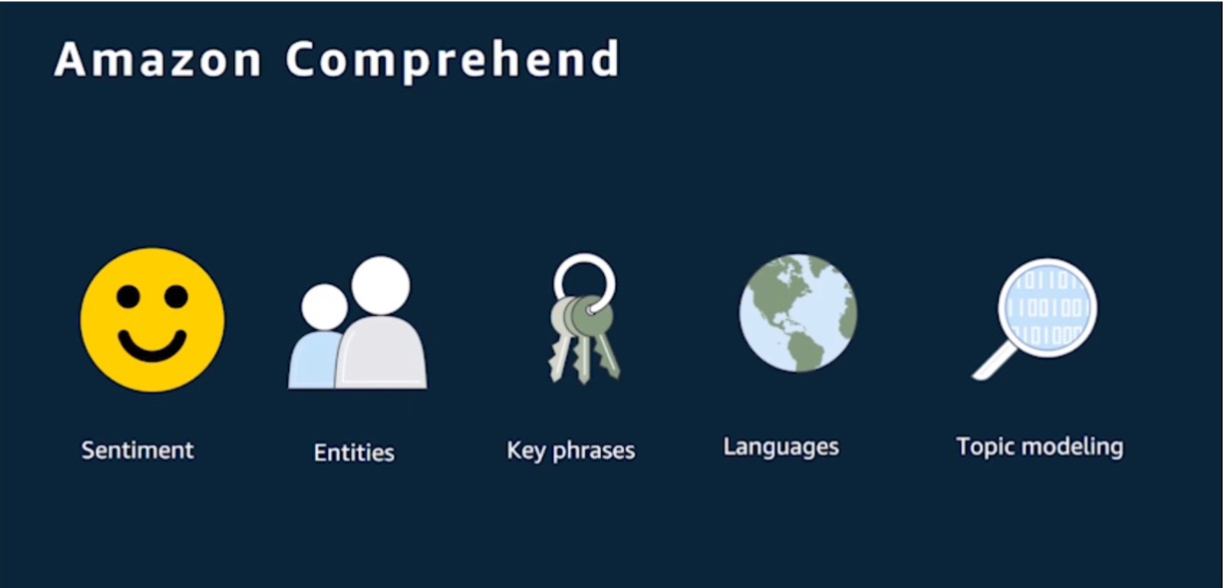

Slide 6
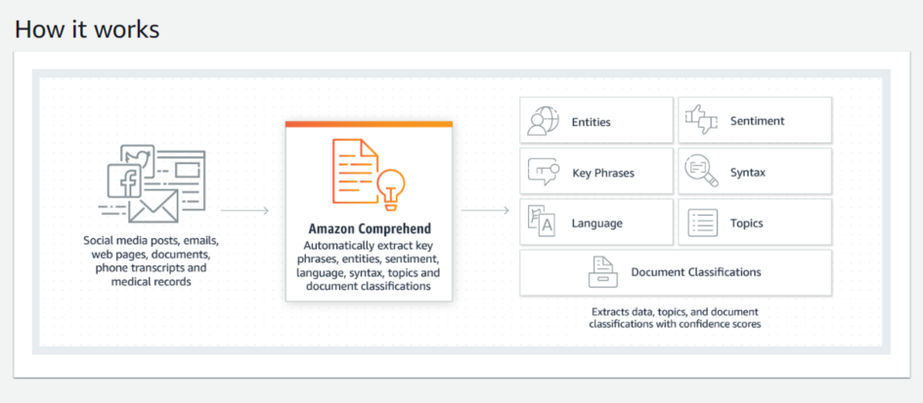

Slide 7
Sample Text for analysis
While best known in Australia as a leading index manager, Vanguard is a leader in active management with over $1.5 trillion of funds under management in active products, representing around a quarter of our assets globally. We are the second largest provider of actively managed portfolios in the U.S. and the fifth largest provider of active management globally. Vanguard has successfully lowered the cost of investing across the globe within both index and active investment solutions. The expansion of our active product line-up in Australia will continue to deliver on this fundamental commitment, removing a significant hurdle to active funds' outperformance and increasing the chance of success for investors.

Slide 8
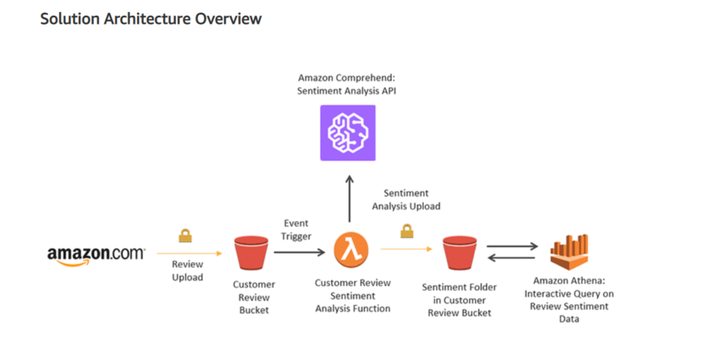
Sentiment analysis workshop
https://aws.amazon.com/blogs/machine-learning/detect-sentiment-from-customer-reviews-using-amazon-comprehend/

Slide 9
AthenA querying
DROP TABLE `reviewsentimentanalysis`;
CREATE EXTERNAL TABLE `reviewsentimentanalysis`(
`imagelocation` string,
`timestamp` string,
`sentiment` string,
`positive` string,
`negative` string,
`neutral` string,
`mixed` string)
ROW FORMAT DELIMITED
FIELDS TERMINATED BY ','
STORED AS INPUTFORMAT
'org.apache.hadoop.mapred.TextInputFormat'
OUTPUTFORMAT
'org.apache.hadoop.hive.ql.io.HiveIgnoreKeyTextOutputFormat'
LOCATION
's3://review-sentiment-s3-17avflvj8736/sentiment'
TBLPROPERTIES (
'transient_lastDdlTime'='1562239159')

Slide 10
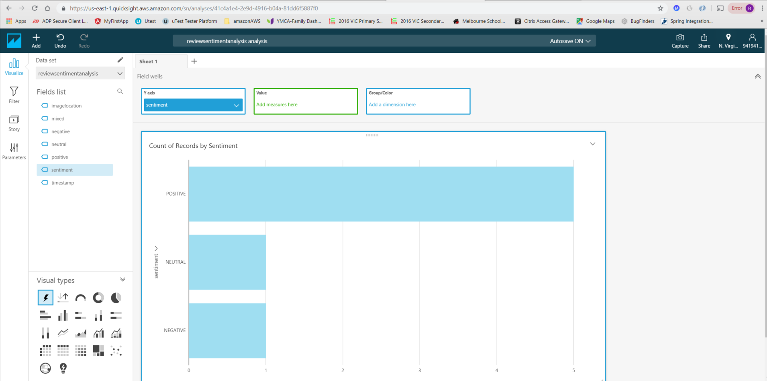
Quick sight analysis of sentiments

Slide 11
THANK YOU!
http://localhost:4200/ - Talking App and Sentiment Analysis Angular app.

