Slide 1
Topic POINTERS

Slide 2
What is POINTERS[*] ?
Okay, imagine your computer's memory is like a big grid of mailboxes, each with a unique address.
When you declare a variable in C, like an integer or a character, it gets stored in one of these mailboxes. You can access the value stored in that mailbox directly using the variable's name.
Now, a pointer is like a special type of variable that doesn't store the actual value, but instead stores the address of another variable. So, it's like a note that says "the value you're looking for is in this particular mailbox".
A pointer is defined as a derived data type that can store the address of other C variables or a memory location.
We can access and manipulate the data stored in that memory location using pointers.

Slide 3
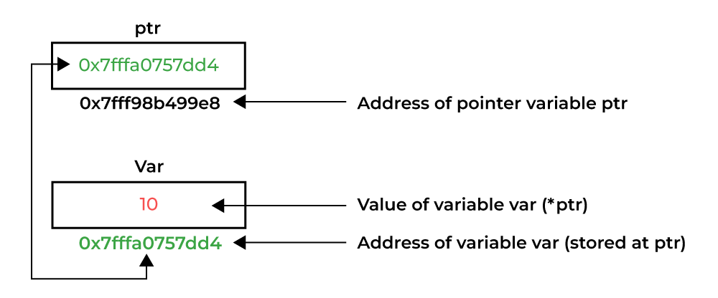

Slide 4
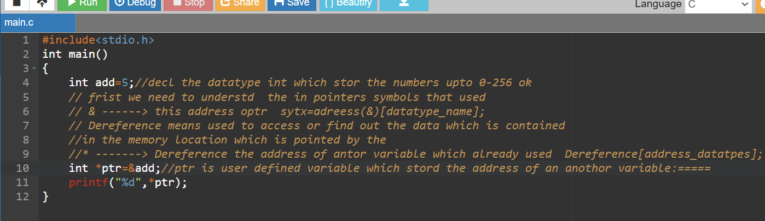
Small c programm on pointers..

Slide 5
Types of POINTERS ?
Integer Pointer
Void Pointer
Array Pointer
Structure pointer
Function Pointer
Pointer to Pointer
Void Pointer
Constant Pointer
Null Pointer
Dangling Pointer

