Slide 1

Presentation on Testing Online Shopping Portal (Demo.Opencart.com)
(Browsing products & Add to cart)

Slide 2
Team Members
Divyangna Gupta
Akshay Gupta
Abir Coomar
Akshay Dhongadi
Subhasish Bhattacharjee
Raghu Sai Praveen

Slide 3
Overview of the PLP Project!
Our project is to test the features of online shopping portal (https://demo.opencart.com/). We are testing two features of this online shopping website that are “Browsing all products & Cart related features“.
Our aim is to create all possible Test Cases, Defect Report & Automation Scenarios.
This presentation contain knowledge about Software Testing Concepts, Test Cases, Defect Reports, Automation Scenarios & TestNG.

Slide 4
What is Software Testing?
Software testing is an investigation conducted to provide stakeholders with information about the quality of the software product or service under test.
Software testing can also provide an objective, independent view of the software to allow the business to appreciate and understand the risks of software implementation.
Test techniques include the process of executing a program or application with the intent of finding software bugs (errors or other defects), and verifying that the software product is fit for use.

Slide 5
Test Cases
We have written all possible test case for product browsing and cart related scenarios.
In precondition, we assume that user is already logged in.
Here is the link to the test cases :-
CLICK HERE FOR TEST CASES

Slide 6
DFDR
After uncovering a defect (bug), testers generate a formal defect report.
The purpose of a defect report is to state the problem as clearly as possible so that developers can replicate the defect easily and fix it.
We prepared Defect Reporting according to all negative test cases.
Here is the link to the test cases :-
CLICK HERE FOR DFDR

Slide 7
Automation Testing
Use of special software to control the execution of tests.
Comparison of actual outcomes with predicted outcomes.
Test automation can automate some repetitive but necessary tasks in a formalized testing process already in place.
To perform additional testing that would be difficult to do manually.
Test automation is critical for continuous delivery & continuous checking.

Slide 8
TestNG
We have used TestNG as the Testing Framework for our project.
In TestNG we are having 4 different Testing scenarios.
We can also see the status of Test scenarios in the TestNG report.

Slide 9
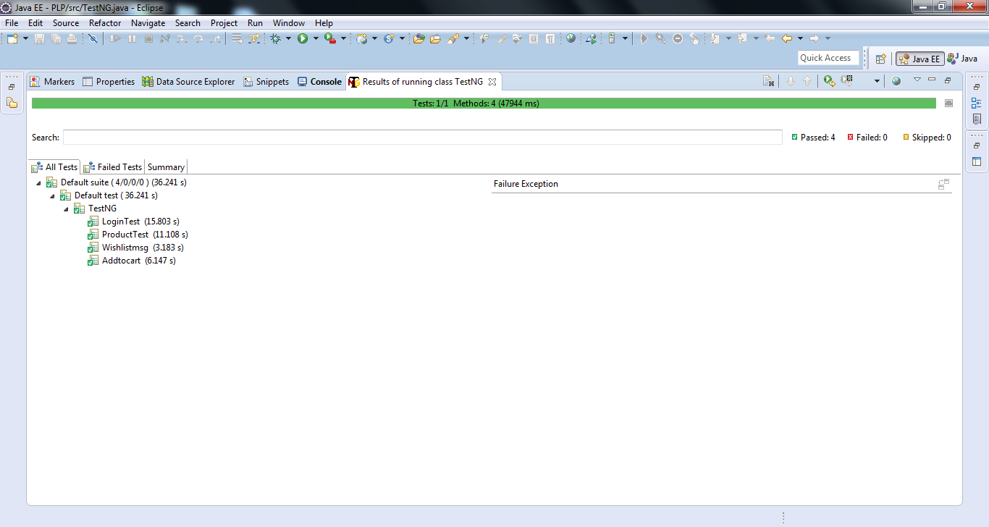
TestNG

Slide 10
Thank You!!
Have a Nice Day Ahead

