Slide 1
POC
Jira → GitLab Sync Service
Automated replication of Jira Stories, Bugs & Tasks to GitLab milestones
using a .NET 8 Windows Service — Proof of Concept
.NET 8
Jira REST API v3
GitLab REST API v4
Windows Service
Raghubir Singh · June 2026

Slide 2
Problem Statement
Three challenges driving the need for this sync service
Limited Jira Access
01
Entire team cannot see work items
Stories and Bugs are created in Jira, but only a few members have licences. Developers and QA who work in GitLab daily have zero visibility into sprint scope, ticket details, or planned work — creating a blind spot across the team.
Disconnected Tools
02
Code in GitLab, work tracking in Jira
All code repositories live in GitLab which the whole team can access, but sprint planning and stories remain siloed in Jira. Context-switching between two systems makes it hard to link commits to requirements or track sprint progress.
Manual Excel Tracking
03
Team managing tasks and status in spreadsheets
Without a shared system, members maintain tasks, assignments and work status in Excel files. This causes version conflicts, stale data, no sprint-wise tracking, and zero traceability between work items and the code being delivered.
Jira → GitLab Sync Service · POC · Confidential

Slide 3
Solution Benefits
What the team gains by syncing Jira to GitLab
👥
Whole Team Visibility
🗂️
Single Source of Truth
📅
Sprint-wise Tracking
Every member — dev, QA, designer — views sprint tickets in GitLab with no Jira licence needed.
Replaces fragmented Excel sheets. Work status, assignees and story points always up to date.
Tickets map to GitLab milestones. Track velocity, completion rate and sprint health.
🔗
Code ↔ Work Traceability
⚡
Zero Manual Effort
📊
Better Retrospectives
Developers reference ticket IDs in commits — linking code changes to business requirements.
Runs automatically on schedule. No copy-pasting, no spreadsheet updates — fully hands-free.
GitLab burndown charts and milestone reports give accurate sprint data for stakeholder updates.
✓ No Jira licence needed ✓ Replaces Excel tracking ✓ Sprint progress in GitLab ✓ Fully automated
Jira → GitLab Sync Service · POC · Confidential

Slide 4
Solution Overview
A .NET 8 Windows Service that automatically replicates Jira tickets to GitLab on a configurable schedule
Jira Cloud
Sync Service
GitLab
→
→
Stories · Bugs · Tasks
.NET 8 Windows Service
Issues · Milestones
⏱ Scheduled Sync
🎯 Smart Routing
🔁 Create & Update
Runs at configured times (e.g. 09:00 IST). Auto-retry on failure.
Active milestone today → sprint. No milestone → Backlog.
New tickets created; existing issues updated and moved to correct milestone.
🏷 Field Mapping
🛡 Error Handling
⚙️ Config-Driven
ID, Description, Assignee, Sprint Dates, Story Points all synced.
Global exception handler with per-ticket isolation — one failure won't stop others.
All settings in appsettings.json — schedule, tokens, project key.
Jira → GitLab Sync Service · POC · Confidential

Slide 5
Architecture
Layered .NET 8 service with clean separation of concerns
Worker Layer
Timer loop · Retry logic · Schedule mode · Graceful shutdown
SyncWorker (BackgroundService)
↓
Orchestration Layer
Milestone routing · Create vs Update decision · Error isolation per ticket
SyncOrchestrator
↓
Service Layer
REST API clients · Basic Auth & Private Token · Pagination · Milestone cache
JiraService + GitLabService
↓
Model Layer
Typed DTOs · ADF → plain-text · Field resolution · SyncResult tracking
JiraModels · GitLabModels · SyncTicket
Jira → GitLab Sync Service · POC · Confidential

Slide 6
Field Mapping
How Jira ticket data maps to GitLab issue fields
Jira Field
GitLab Field
Notes
Story / Bug / Task Key
Issue title prefix [PROJ-42]
Enables duplicate detection on re-sync
Summary
Issue title (after key prefix)
Full summary preserved
Description (ADF format)
Issue description (Markdown)
Atlassian ADF flattened to plain text
Assignee name / email
Assignee (matched by name/email)
Skipped on free-tier GitLab (403 on /users)
Sprint start → end date
Shown in description: From → To
Also drives milestone date matching
Story Points (customfield)
Issue weight field
Tries customfield_10016, 10028, story_points
Issue type (Story/Bug/Task)
GitLab label (story/bug/task)
Configurable via LabelMappings in config
Jira → GitLab Sync Service · POC · Confidential

Slide 7
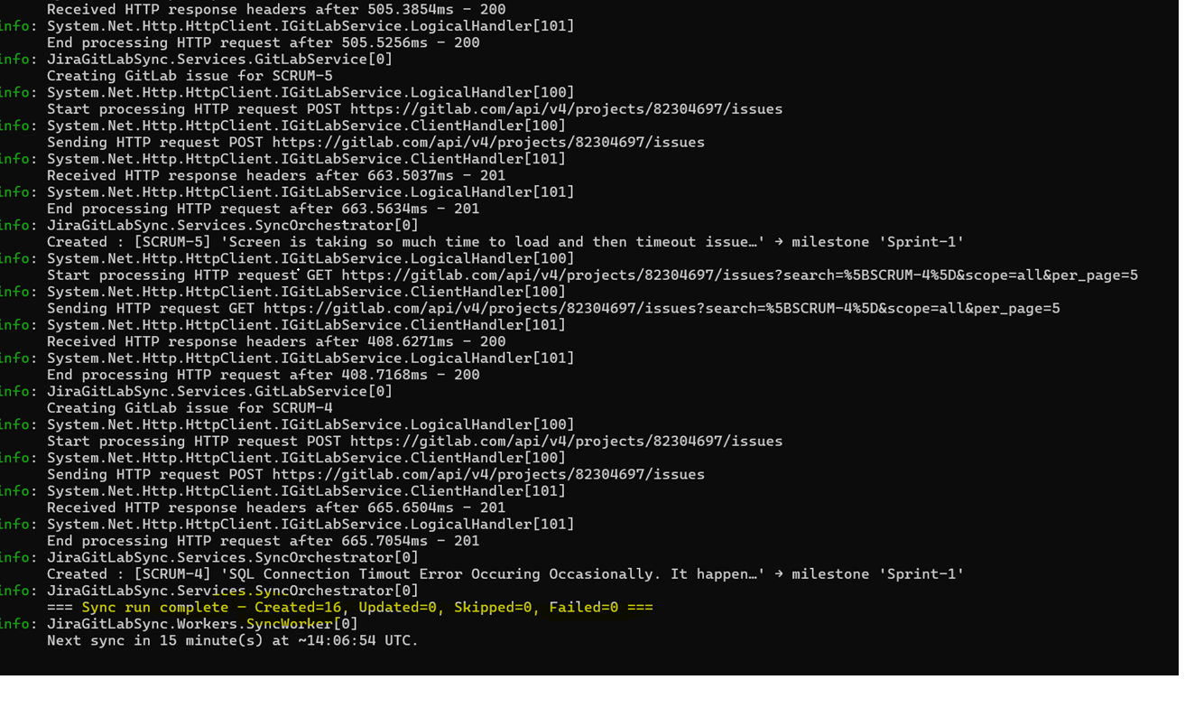
Service Execution Log
Sync run showing 16 tickets created in GitLab Sprint-1 milestone
✓ Sync run complete — Created=16, Updated=0, Skipped=0, Failed=0
Jira → GitLab Sync Service · POC · Confidential

Slide 8
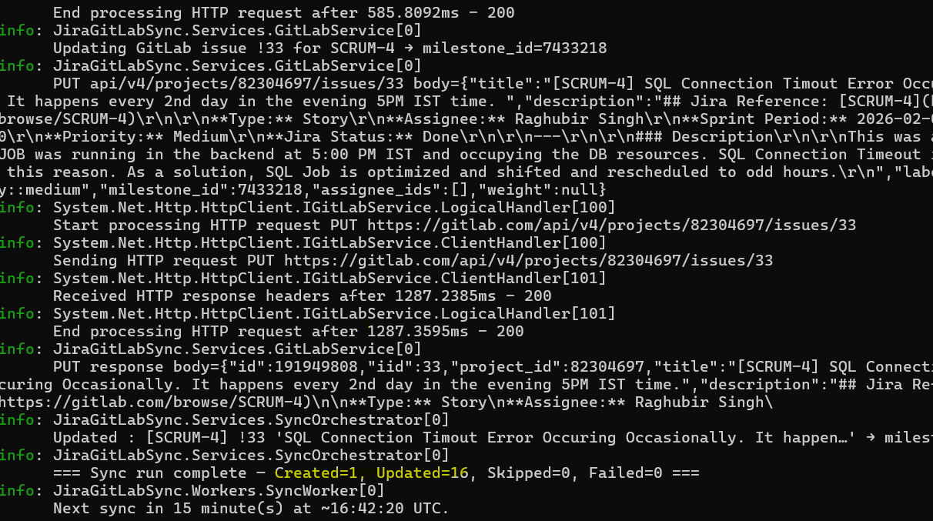
Service Execution Log
Subsequent run showing update sync — 1 created, 16 updated with no failures
✓ Sync run complete — Created=1, Updated=16, Skipped=0, Failed=0
Jira → GitLab Sync Service · POC · Confidential

Slide 9
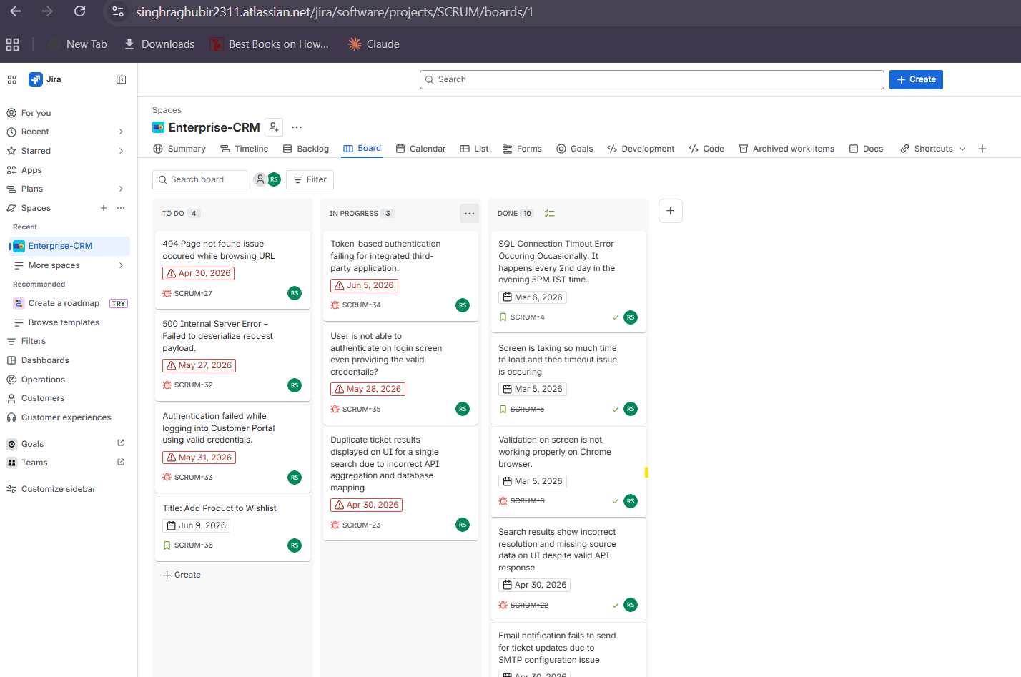
Source: Jira Board
4
To Do
3
In Progress
10
Done
Jira → GitLab Sync Service · POC · Confidential

Slide 10
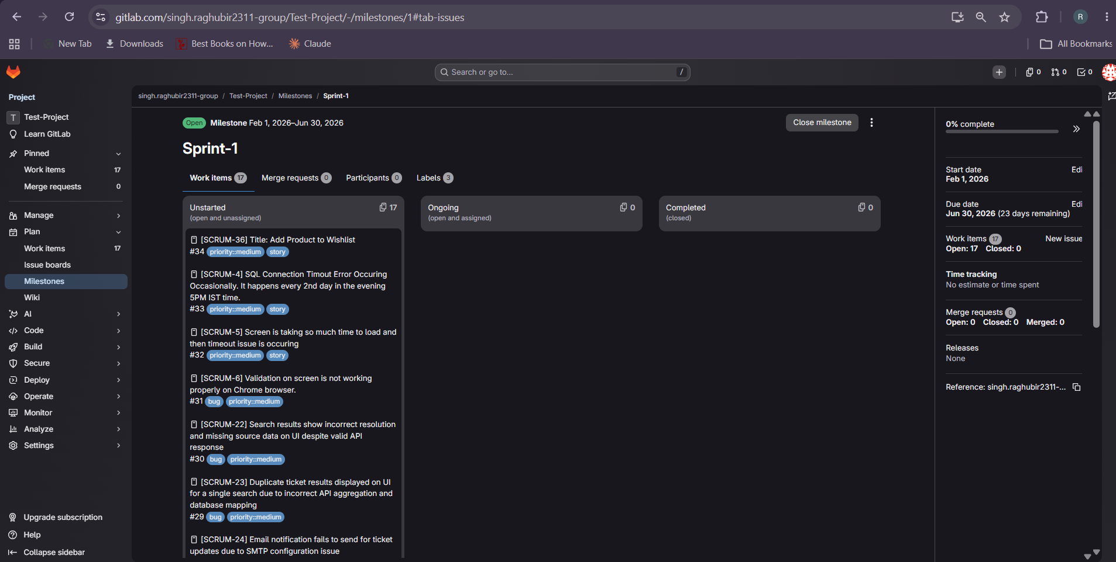
Result: Tickets Replicated to GitLab Sprint-1
17
Work Items
3
Labels
0
Failed
Jira → GitLab Sync Service · POC · Confidential

Slide 11
Authentication Setup
How the service authenticates with Jira and GitLab
🔑 Jira — API Token (Basic Auth)
🔒 GitLab — Personal Access Token
01
Go to id.atlassian.com → Security → API tokens
01
Go to gitlab.com/-/user_settings/personal_access_tokens
02
Click Create API token — give it a name
02
Click Add new token — name it JiraGitLabSync
03
Copy the token (shown only once)
03
Select scope: api (full read/write access)
04
Set Username + ApiToken in appsettings.json
04
Copy the generated token (starts with glpat-)
05
Auth header: Basic base64(email:token)
05
Set PrivateToken in appsettings.json
Jira → GitLab Sync Service · POC · Confidential

Slide 12
POC Complete
Jira → GitLab Sync
Service
16+
100%
3-Level
0
Tickets Synced
Automated
Milestone Fallback
Manual Steps
Thank You · Questions Welcome

